Slide 1
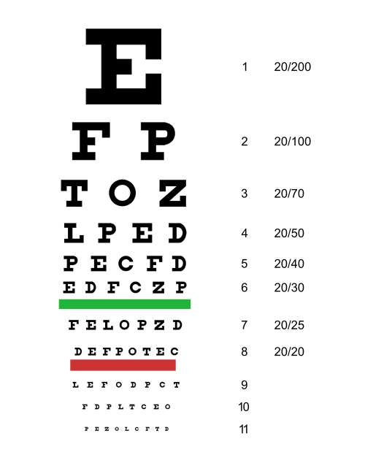
Visual Pathway and Visual Pathologies (Human Visual System: Visual Periphery, Visual Pathway, Normal Function and Impairment)
Petr Maršálek
First presented in 2020, version 24+
Notes:
1

Slide 2
Outline 8 – Retina and Subcortical Visual Pathway
Retina, Point Spread Function
Adaptation, Accommodation
Visual Acuity, Optical Eye Media, Lens, Illumination,
Rods, Cones, Black and White /and Color Vision
Ten Neural Layers in Retina, Functional Aspects
Binocular Vision and Its Disorders, Vergence, Strabism
Saccades, Visual Following, Nystagmus
Visuo-motor Eye Movement Control, Basic Concepts
Optical nerve, Perimeter, Objective Perimeter
Color Opponent System in the Visual Pathway

Slide 3
Snellen (N/36)
Optotypes have (N/32)
letters with defined (N/28)
letter size, (or number of points) (N/26)
seen from a calibrated distance. (N/24)
This is written as fraction. (N/22)
The best vision is: 6/6 (N/20)
Numerator: From distance six meters/ (N/18)
denominator: we see six points (B/16)
(one arch minute each). (B/14)
Hermann Snellen, 1834 -1908

Slide 4
Functional Classification of Vision Impairment
A fraction, written as numerator/ denominator denotes:
given a 6 m viewing distance, /or 20 feet/, how many
points are seen as one point? (hence best is 6/6 or 20/20)
(Geometry of 2D angle is simplified to a square patch
angular_degº (*= times) angular_degº.)
1 normal vision 6/6
2 low vision worse than (<) 6/18
(on the best eye with corrective lenses)
3 (practical) blindness (EU) < 3/60
or narrowing of visual angle less than < 10º*10º
other more strict norm (US) < 6/60, < 20º*20º
4 amblyopia also known as „lazy eye“
(= lower acuity due to central causes)

Slide 5
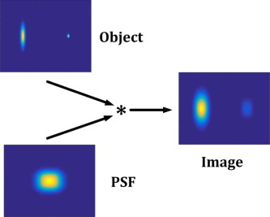
Visual Acuity: 1’ (angular minute)
Retinal
image results from convolution of object and point spread function
The sharp image results when the object plane is focused and spherical aberration is minimal

Slide 6
Far and Near Point/ or How Eye Focuses
Myopia = Near-sightedness
The opposite is Hypermetropia = Far-sightedness

Slide 7
Accommodation = Focusing to Get a Sharp Image

Slide 8
Accommodation = Focusing to Get a Sharp Image
In individual development and ageing, far and near point positions change. A common effect of this presbyopia is a hyper-metropia.
Around the age of 50, the elasticity of the lens drops to the point that the near point is distant enough that practically merges with the far point.
(As the next stage, with the use of current eye treatment, patients with cataract have implanted artificial lenses…)

Slide 9
Visual Acuity, Day and Night Acuity
Blind Spot and Yellow Spot in Retina <stop>, test yourself…

Slide 10
Adaptation to Day and Night Illumination Conditions
Adaptation to lighter conditions is instant. Adaptation to the dark takes tens of minutes.

Slide 11
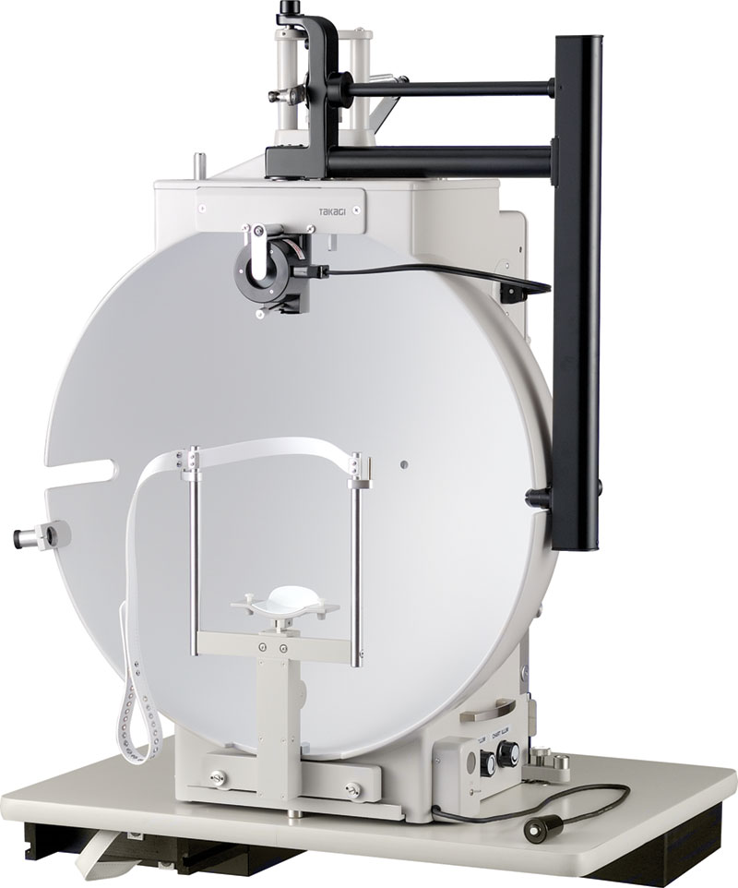
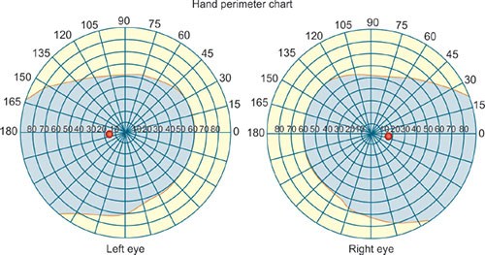
Perimeter investigation
Blind Spots and Yellow Spots in L and R Retina
The perimeter can be measured objectively
A normal visual field is a combination of left and right eye views

Slide 12
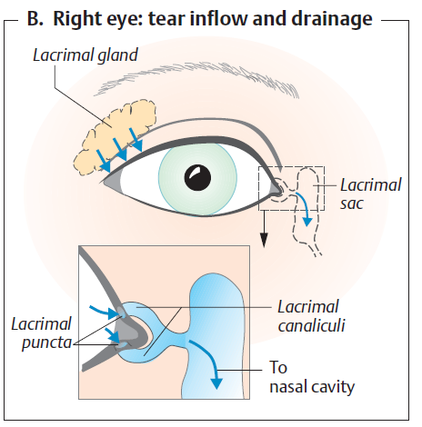
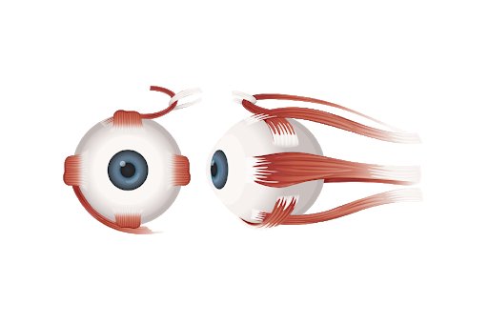
Lacrimal Gland and Duct, Eye Muscles
Left-right symmetry, eye movements
Oculo-motor muscles

Slide 13
Nystagmus

Slide 14
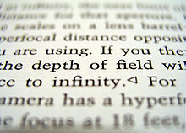
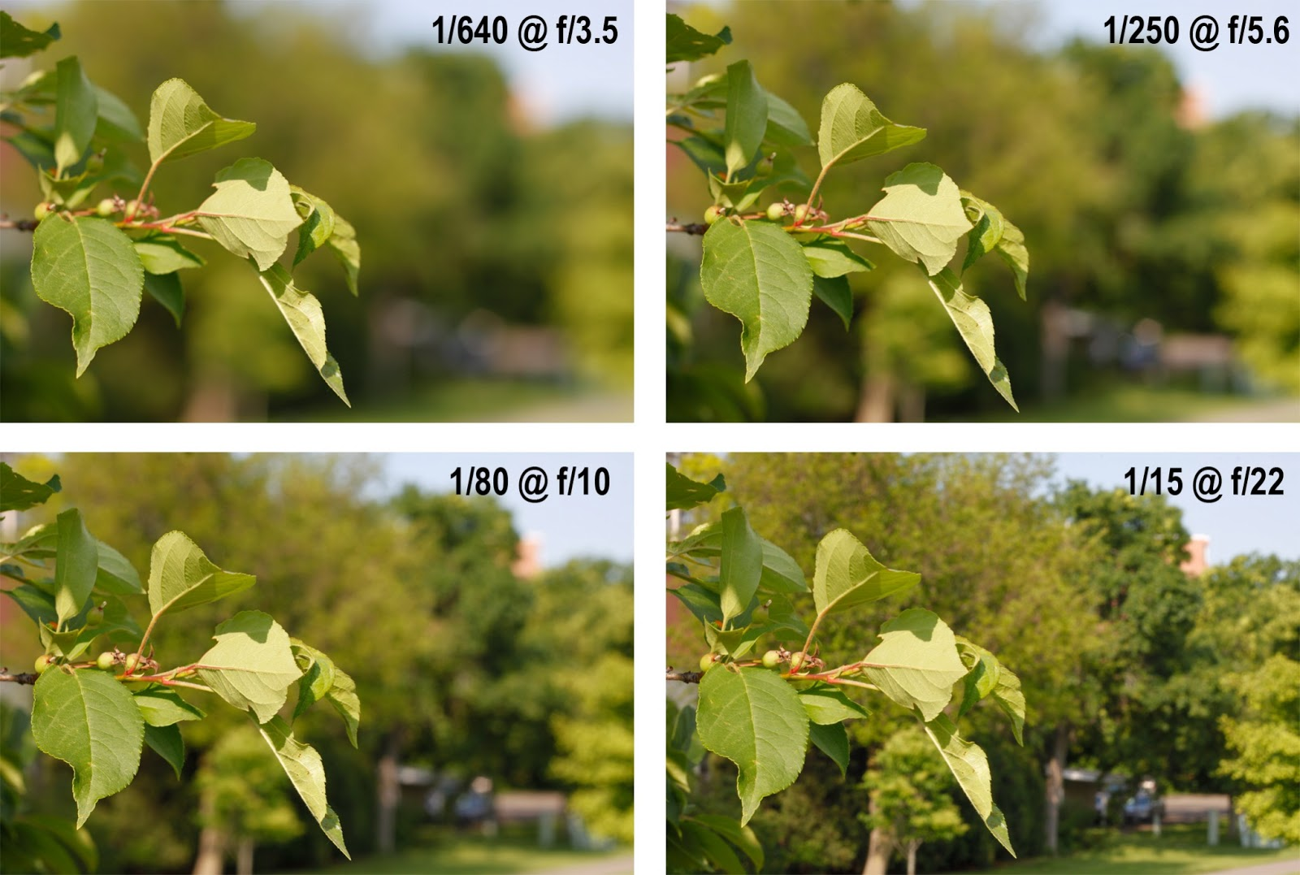
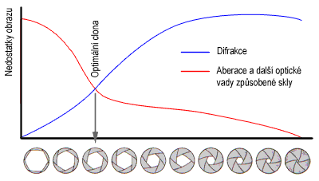
Aperture Versus Depth of Field (světelnost/ clona, hloubka ostrosti) Apply to Human Eye Functioning as Well
In Photography, these are Shutter Speeds and Apertures…

Slide 15
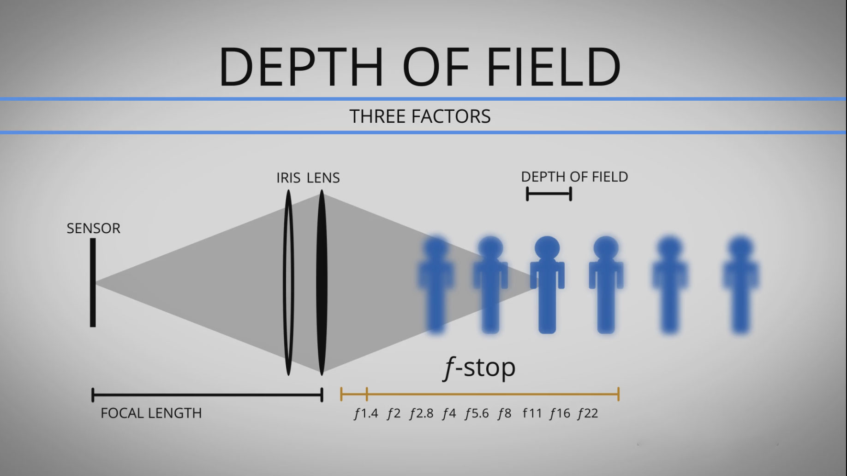

Aperture Versus Depth of Field
$$D_{\text{DOF}}≈{2u_{}^{2}Nc/f^{2}}_{}$$
Depth of field D is approximately proportional to this formula, entered by
an acceptable circle of confusion diameter (c), aperture diameter (A),
and distance to the subject (u), divided by the square of the focal length (f),
all in length units. The dimensionless f-number is N = f/A.

Slide 16
Aperture Versus Depth of Field Apply to Human Eye Functioning as Well
These are ‘digital’ processes, encoded by action potentials

Slide 17
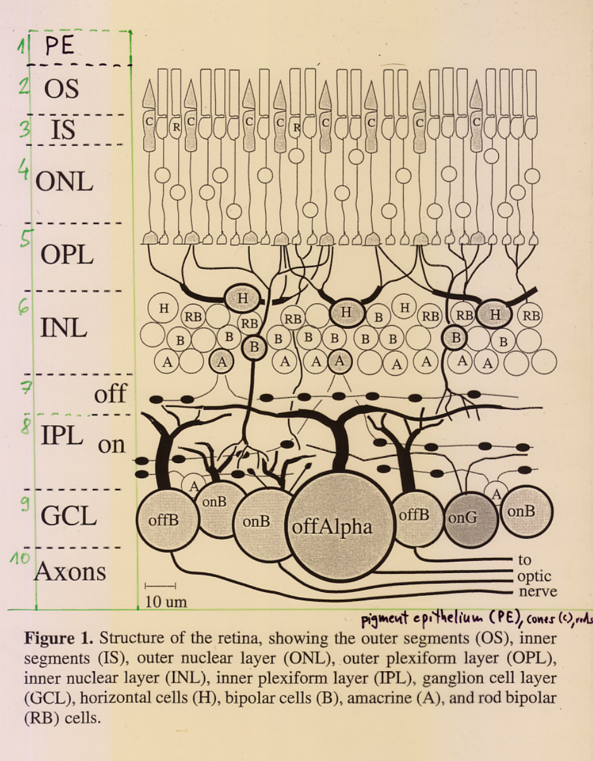
Ten Layers of Retina
The optic nerve is the output of the retina.
The retina is a unique neural network of the immense size of one million output lines, a patch of = 10^3*10^3 pixels. Its functions are poorly understood…

Slide 18
Od světla přes receptorový potenciál k akčním potenciálům a kódování ve zrakovém nervu
From Light Through Receptor Potential to Action Potentials and Coding in Optical Nerve

Slide 19
From Light Through Receptor Potential to Action Potentials and Coding in Optical Nerve
Retinal ‘On’ and ‘Off’ ganglion cells

Slide 20
From Light Through Receptor Potential to Action Potentials and Coding in Optical Nerve
Origin of visual illusions...
Peripheral (=Retinal) and Central (=Cortical) Mechanisms…

Slide 21
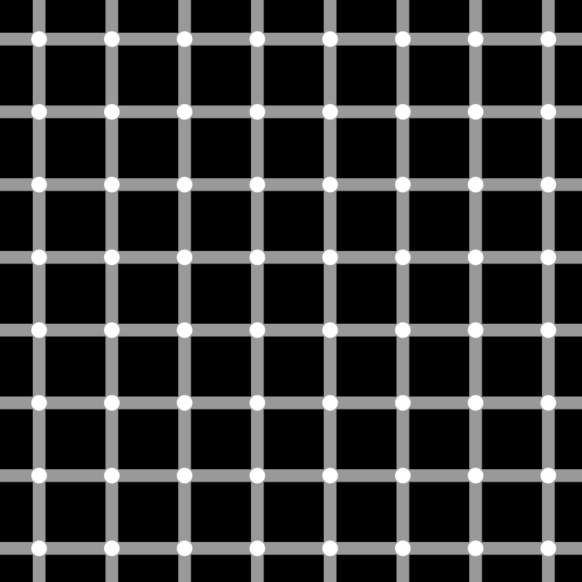
The (Ludimar) Hermann Grid Illusion, 1870
Note the white ‘lightning’ and ‘darkening’ of the grid nodes.

Slide 22
The (Ludimar) Hermann Grid Illusion, 1870
Comment:
The right side does not show illusory darkened centers compared to the left side. The illusion producing the mechanism acts probably only on perpendicular neighbourhoods. This locates the illusion to the central (cortical) part of the visual pathway.
[M. Bach and C. M. Poloschek, Visual Neuroscience 2006]

Slide 23
Electric Potentials of Retina
Electro-Retino-Gram in analogy to the EEG can record retinal activity and eye movements.

Slide 24
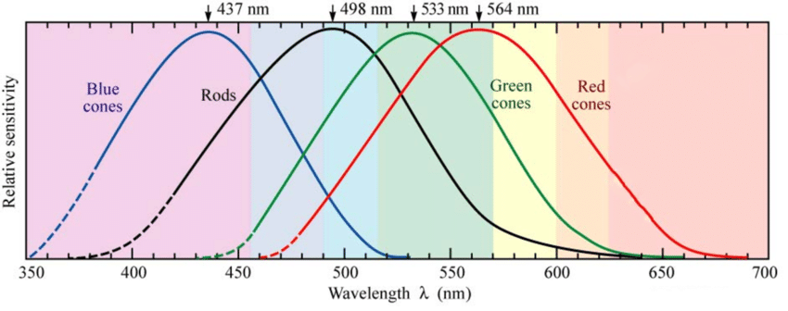
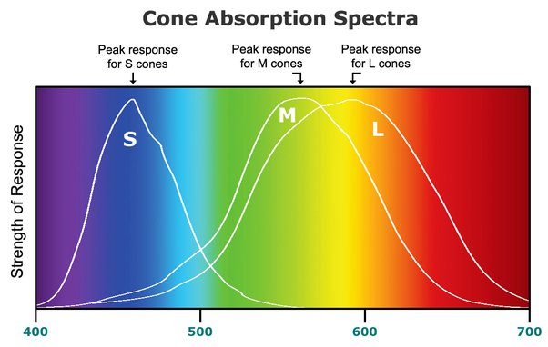
Spectral sensitivities of cones and rods

Slide 25
Day and Night Vision, with Rods and Three Cone Types
Color Blindness is manifested in men (XY) only, as it is located on the X chromosome. Women have the X in duplicate (XX). It also includes visual acuity impairment due to different than normal densities of cones.

Slide 26
Day and Night Vision, with Rods and Three Cone Types
Color Blindness is manifested in men (XY) only, as it is located on the X chromosome. Women have the X in duplicate (XX). It also includes visual acuity impairment due to different than normal densities of cones.

Slide 27
Protanopia (no red cones) and Deuteranopia (no green cones) and How They (May) See Colors
Normal, protan-opia (2%), deutan- (6% of males).

Slide 28
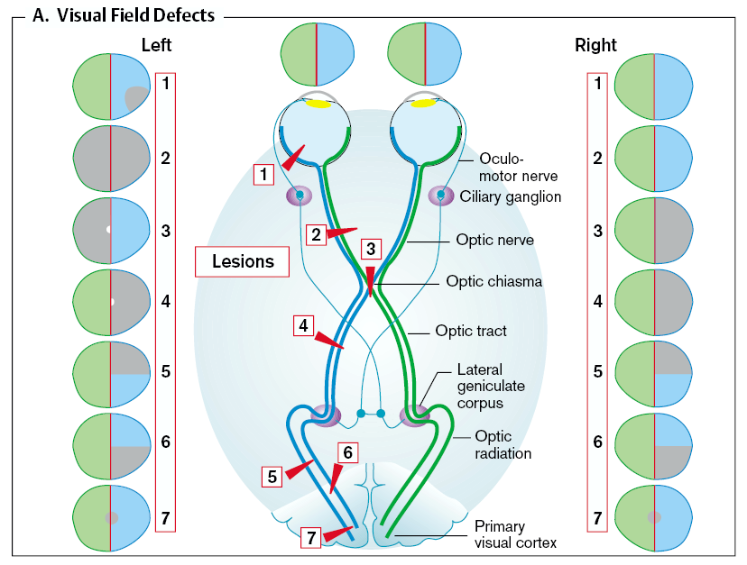
Visual Fields in Optic Nerve and their Defects

Slide 29
Binocular/ Stereoscopic Vision

Slide 30
Binocular/ Stereoscopic Vision
Geometry of disparities using the Cyclopean Eye
[Julesz, Bela. "Foundations of cyclopean perception." 1971]

Slide 31
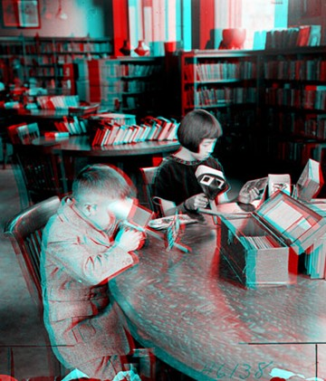
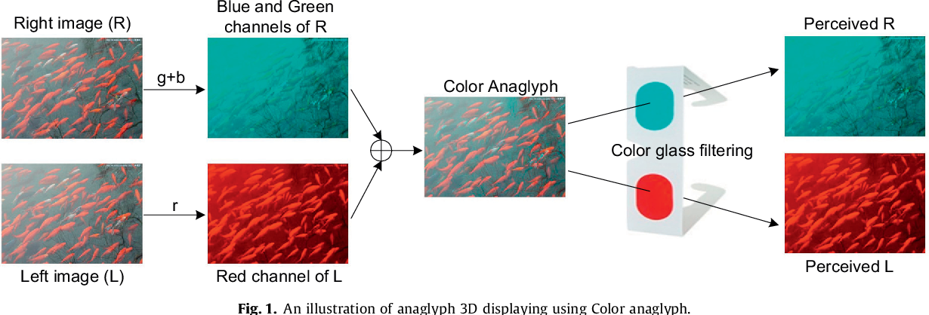
Red and Cyan Anaglyphs for
Stereoscopic
Images

Slide 32
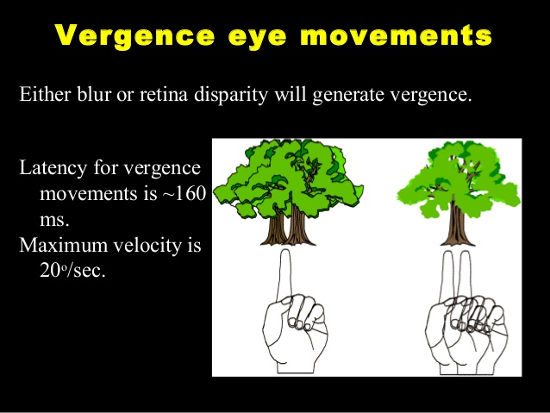
There is More to Depth of Field:
Binocular Focusing is Realized by Eye Con- and Di-Vergence
(Con)vergence disorder is called strabism.

Slide 33
Stereoscopic Vision
Binocular: Stereo Disparity, in Near Field Scene Only
Monocular: - By Perspective
- By Known Object Sizes
- By Parallax (in Disparity and Relative Motion)

Slide 34
Literary references
[Despopoulos, A; Silbernagl, S,
Color Atlas of Physiology, 1991],
[Marsalek, P.; Hajny, M.; Vokurka, M. (2017). Pathological Physiology of the Visual Pathway. In Homonymous Visual Field Defects, edited by K. Skorkovska (pp. 17-29). Springer, Cham]
[Julesz, Bela. "Foundations of cyclopean perception." 1971]
[Julesz Bela. Stereoscopic vision. Vision Research. 26 (9): 1601-12, 1986]

Slide 35
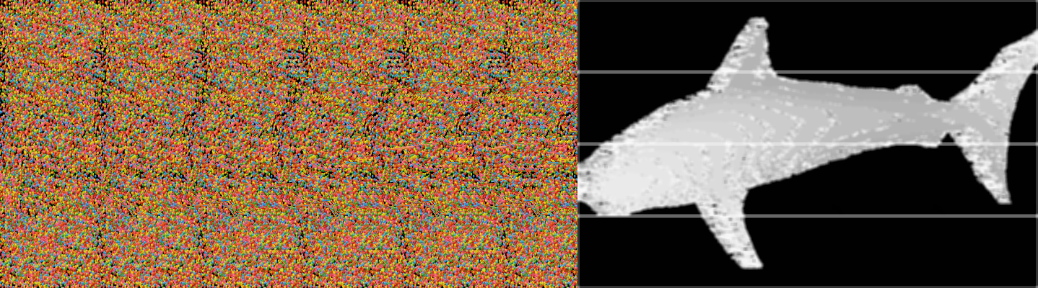
Random dot stereogram (autostereogram)

Slide 36
Random dot stereogram (autostereogram)

Slide 37
Another stereoscopic perception mode can be obtained using red and blue anaglyphs.
This is also a subject in the following two lectures:
- Visual cortex
- Vision/ hearing cross, also about space perception
END
OF THE LECTURE

Slide 38
České vysoké učení technické v Praze, Fakulta elektrotechnická Právní doložka (licence) k tomuto Dílu (elektronický materiál) České vysoké učení technické v Praze (dále jen ČVUT) je ve smyslu autorského zákona vykonavatelem majetkových práv k Dílu či držitelem licence k užití Díla. Užívat Dílo smí pouze student nebo zaměstnanec ČVUT (dále jen Uživatel), a to za podmínek dále uvedených.
ČVUT poskytuje podle autorského zákona, v platném znění, oprávnění k užití tohoto Díla pouze Uživateli a pouze ke studijním nebo pedagogickým účelům na ČVUT. Toto Dílo ani jeho část nesmí být dále šířena (elektronicky, tiskově, vizuálně, audiem a jiným způsobem), rozmnožována (elektronicky, tiskově, vizuálně, audiem a jiným způsobem), využívána na školení, a to ani jako doplňkový materiál. Dílo nebo jeho část nesmí být bez souhlasu ČVUT využívána ke komerčním účelům. Uživateli je povoleno ponechat si Dílo i po skončení studia či pedagogické činnosti na ČVUT, výhradně pro vlastní osobní potřebu. Tím není dotčeno právo zákazu výše zmíněného užití Díla bez souhlasu ČVUT. Současně není dovoleno jakýmkoliv způsobem manipulovat s obsahem materiálu, zejména měnit jeho obsah včetně elektronických popisných dat, odstraňovat nebo měnit zabezpečení včetně vodoznaku a odstraňovat nebo měnit tyto licenční podmínky.
V případě, že Uživatel nebo jiná osoba, která drží toto Dílo (Držitel díla), nesouhlasí s touto licencí, nebo je touto licencí vyloučena z užití Díla, je jeho povinností zdržet se užívání Díla a je povinen toto Dílo trvale odstranit včetně veškerých kopií (elektronické, tiskové, vizuální, audio a zhotovených jiným způsobem) z elektronického zařízení a všech záznamových zařízení, na které jej Držitel díla umístil.

