Slide 1
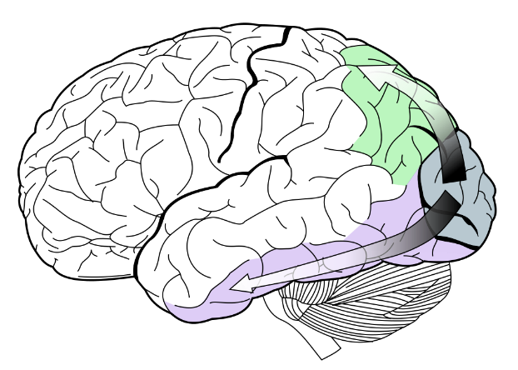
FAV, Talk no. 9, Visual Cortex,
Petr Maršálek
Years 2020/ 2021/ 2022
Notes:
1

Slide 2
Outline 9 – Visual Cortex
Primary and Secondary Visual Areas
Synthetic Overview: Image Processing, Receptive Fields, Physiological ‘Laws’
Not All Visual Areas Contain Consciously Accessible Representation – Eye Rivalry
Magnocellular and Parvocellular Pathways
V1, V2, V3, V4, MT (=V5) and Other Areas
Modalities of Vision Based on Cortical Processing
Features not Residing in Unique Areas: Stereo Disparity, Color
Features Located To Areas: Dorsal (Location and Motion) versus Ventral (Object) Streams
Controversies
Processing Hierarchy of the Visual Cortex

Slide 3

Ventral and Dorsal Stream

Slide 4
Warning, this is the Same Slide as in the Hearing talk
THIS PANEL IS A SPECULATIVE ATTEMPT TO CLASSIFY BRODMANN AREAS DIFFERENTLY
“Binary Trees of Brodmann Areas” and Beyond Brodmann Areas
Bit 1: (Left) vs. (Right) Hemisphere
Bit 2 and 3: (Motor/ Frontal Lobe) (Somatosensory/ Parietal L.)
Bit 2 and 3: (Auditory/ Temporal L.) (Visual/ Occipital L.)
Bit 4: (Primary) vs. (Secondary) Sensory projection areas
Bits 5, 6, 7: subdivisions of visual/ sensory areas
Sensory Domains: Bits 1 and 7: (Left/ Right) vs. (Bottom/ Top) Extensions, Retinotopy, Spatial Maps
Bit 8: Temporal encodings: subcortical
Bit 9: Other modality encodings – Hippocampus (Archi-cortex)/ space navigation, and so on.
Olfactory cortex and Hippocampus (Archi-cortex), Olfacory Bulb (Paleo-cortex), Vestibular Cortex (Part of Temporal lobe), Cortical Projections, Remaining senses: Olfaction, Taste and Touch
This is NOT an official anatomical classification.

Slide 5

Warning, this is almost the Same Slide as in the Hearing talk
auditory
CORTICAL MICROCIRCUIT
Neocortex and Other Cortices
(Paleocortex, Olfact. Only: 3 Layers, Archicortex, Olfact. and Hippocampus,
3 or 4 Layers)
visual

Slide 6
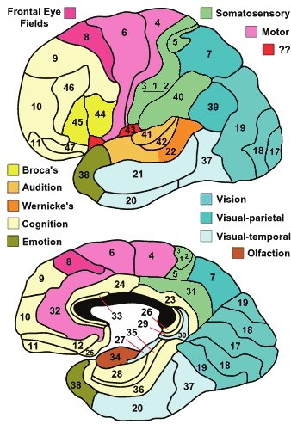
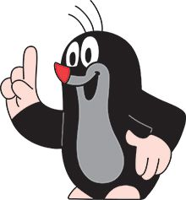
Warning, this is almost the Same Slide as in the Hearing talk
Can you find differences between Auditory and Visual Areas?
Brodmann Areas
(Outer and Inner Hemisphere Parts)
X
X
X
Next slides will be in search of the function of individual visual areas, V1, V2, V3, V4, et cetera…

Slide 7
Visual Pathway Inner Workings
Both Peripheral (=Retinal) and Central (=Cortical) Mechanisms Contribute to Contrast Perception

Slide 8

The Kanisza Triangle
= An illusory triangle pointing to the bottom of the figure.
Gaetano Kanizsa (1913-1993), Italian artist and psychologist.
Experimental Construction of Receptive Fields:
Simple and Complex Cells in Primary Visual Cortex, Area V1,
Illusory Contours by von der Heydt, Area V2, and Higher Areas

Slide 9
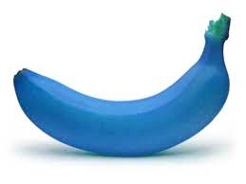
What We See Results from Expectations
Comment/ question:
when do we see and when don’t see yellow banana?

Slide 10
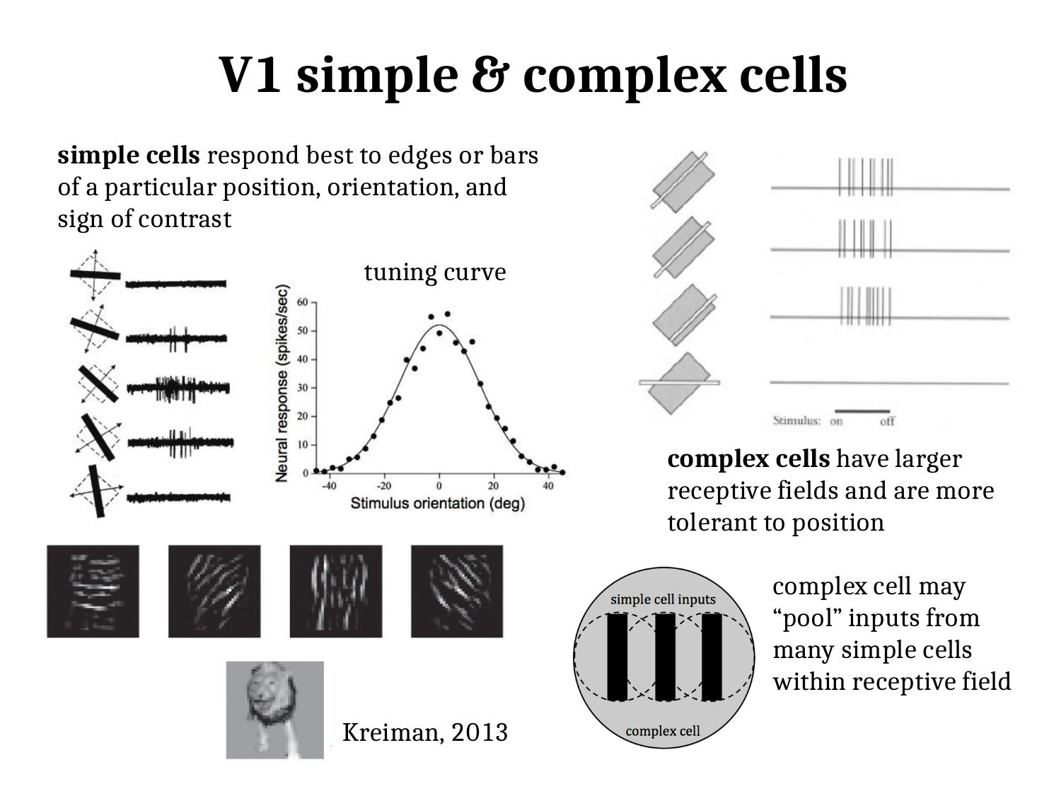

Slide 11
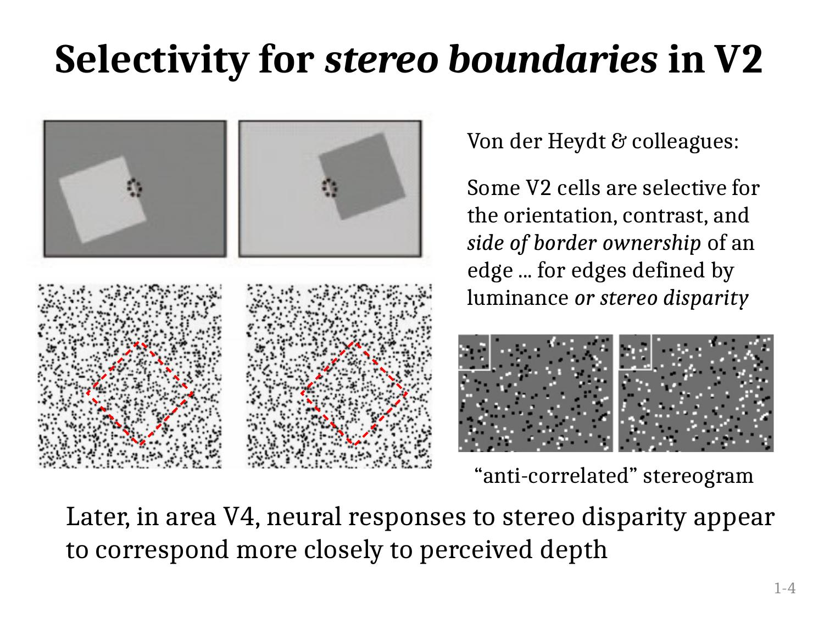

Slide 12
Visual/Illusions
Examples of visual illusions
Hyperacuity (llll////)
Group of illusions based on perceptual figure-ground alternation
Kanisza and Bregman-Kanisza illusory occluded objects
Cortical “inertial mechanisms“ creating after-effects
Impossible 3-dimensional object designs (e.g. drawings by M. C. Escher)
Binary (Necker cube like) illusory percepts: they are important mechanisms how to register two variants of the binocular outer world that cannot be distinguished by creating only one probable input.
The rivalry between the two eyes is another mechanism for how to arrive at a plausible outer world scene. Intricate displays addressing these mechanisms demonstrate that part of what we see cannot be accessed consciously [Koch and others.]
(This is not a complete list, these are rather random examples.)

Slide 13

Faces/ Vase (Gestalt Illusion)
Definitions:
What are
1/ illusions (following slides)
2/ pseudo-hallucinations
(example: migraine perceptions)
3/ hallucinations (seeing unreal scenes)
Comment:
figure and ground alternate, based on to what we attend.

Slide 14
Mechanisms in visual cortex are powerful in constructing, what we see, and sometimes in constructing illusions
Comment:
first fix the center of the left image, after circa 10 second move your eyes to fixate the center of the right image.

Slide 15
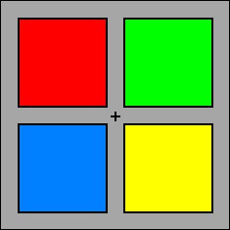
Alignment
Comment:
fixate cross 10 secs. Then move to next slide

Slide 16
Alignment
Comment:
fixate cross 10 secs. When colors fade go to the previous slide

Slide 17
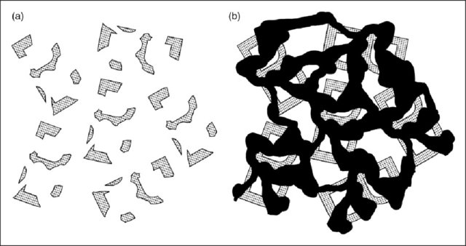
Bregman - Kanisza Illusion
Comment:
the Bs on the right panel are more legible than those on the left.

Slide 18
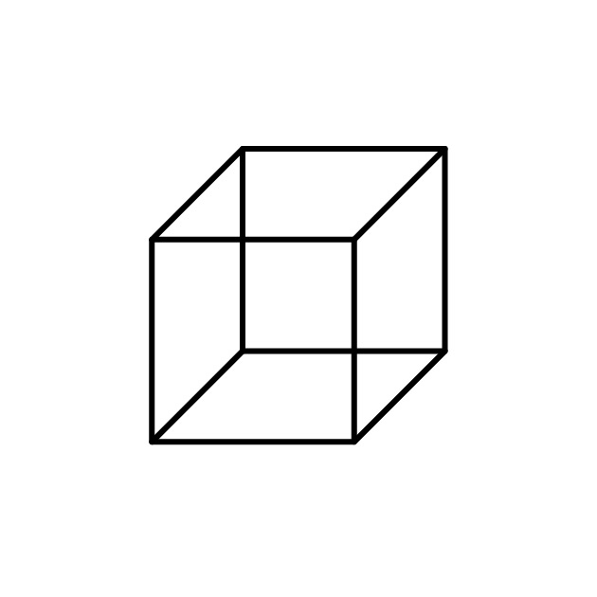
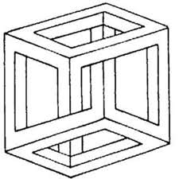
Necker Cube/ Impossible Necker Cube
Comment:
attend to the top and the bottom inner vertex of the cube.

Slide 19
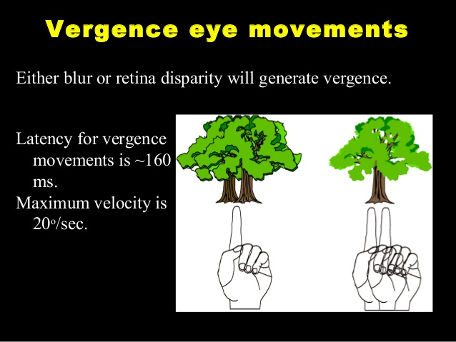
Binocular Focusing is Realized by Eye Con- and Di-Vergence
Mostly involuntary and rarely voluntary subcortical vergence control is needed for proper stereo vision and disambiguating binocular perceptions.
(Con)vergence disorder is called strabism.

Slide 20
Binocular Rivalry in Conflicting Images To Left and Right Eye
What Functional Purpose This May Have?
Not All Visual Areas Contain Consciously Accessible Representation –> Eye Rivalry
[Koch and others.]

Slide 21
Binocular Fusion

Slide 22
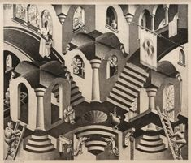
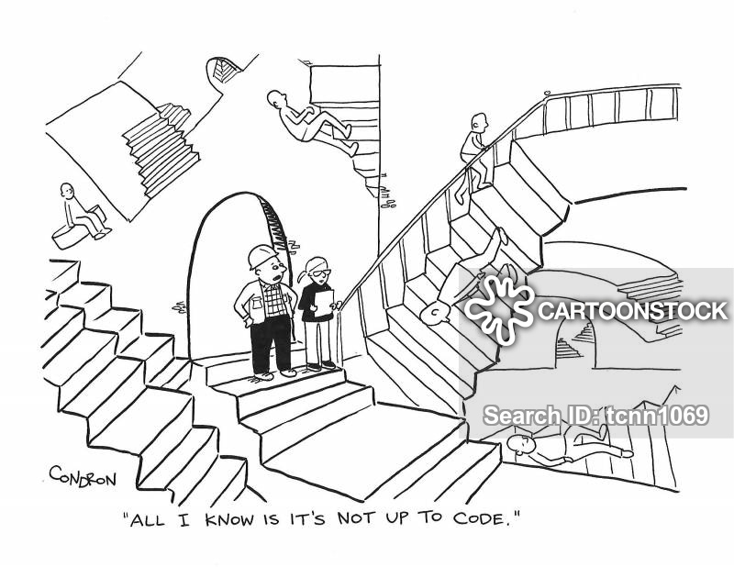
Paintings by Maurits Cornelis Escher (1898-1972)
CODE“

Slide 23
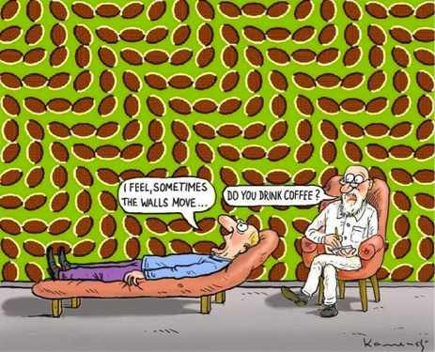
Sometimes the walls move…
Cartoon: Drinking coffee and illusions

Slide 24
Auditory Illusions
Examples of auditory illusions/ Some of these are binaural
- Binaural beats (comment: this is rather a regular sound perception)
- The constant spectrum melody
- Scale illusion by (Diana Deutsch in1973), this is a binaural melody presentation potentially usable as a diagnostic for some neocortical defects
- Illusory continuity and illusory discontinuity of tones
Hearing a missing fundamental frequency, given other parts of the harmonic series
Illusory „circular pitch scale (octave)“
- Various effects using lossy audio compression (some based on the aliasing effects/ Octave illusion/ Deutsch's high–low illusion)
- Auditory pareidolia: hearing indistinct voices in random noise (comment: Recall babble noise).
- perceptually ambiguous stimuli (analogy to Necker cube)

Slide 25
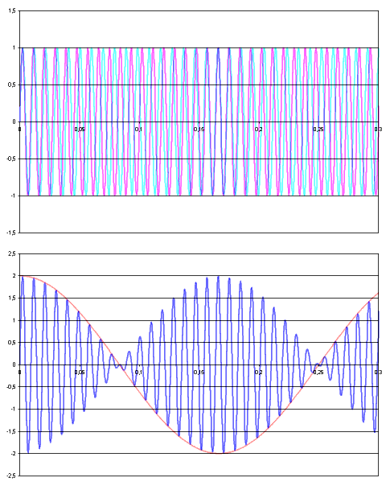
Binaural Beats
Comment:
top: left and right ear channels,
bottom: resulting beating sound.

Slide 26
Circular pitch
This continuum is known as pitch height. However pitch also varies in a circular fashion, known as pitch class: as one plays up a keyboard in semitone steps, C, C♯, D, D♯, E, F, F♯, G, G♯, A, A♯ and B sound in succession, followed by C again, but one octave higher. Because the octave is the most consonant interval after the unison, tones that stand in octave relation, and are so of the same pitch class, have a certain perceptual equivalence—all Cs sound more alike to other Cs than to any other pitch class, as do all D♯s, and so on;

Slide 27
Combined Visual and Auditory Stimuli
Visual and auditory objects are localized in the same quadrant/ location of outer space
Ventriloquism effects are based on „binding“ visual and auditory disparate parts of „speech“
Other perceived objects can be „multisensory“ /examples include visual and touch objects/ and „synesthetic“ /examples include smell, taste, and cold touch sensation of menthol on a skin
Augmented /Sound /Image /Video /Reality
Unity of outer space is disturbed in a rare cognitive disorder condition: hemineglect

Slide 28
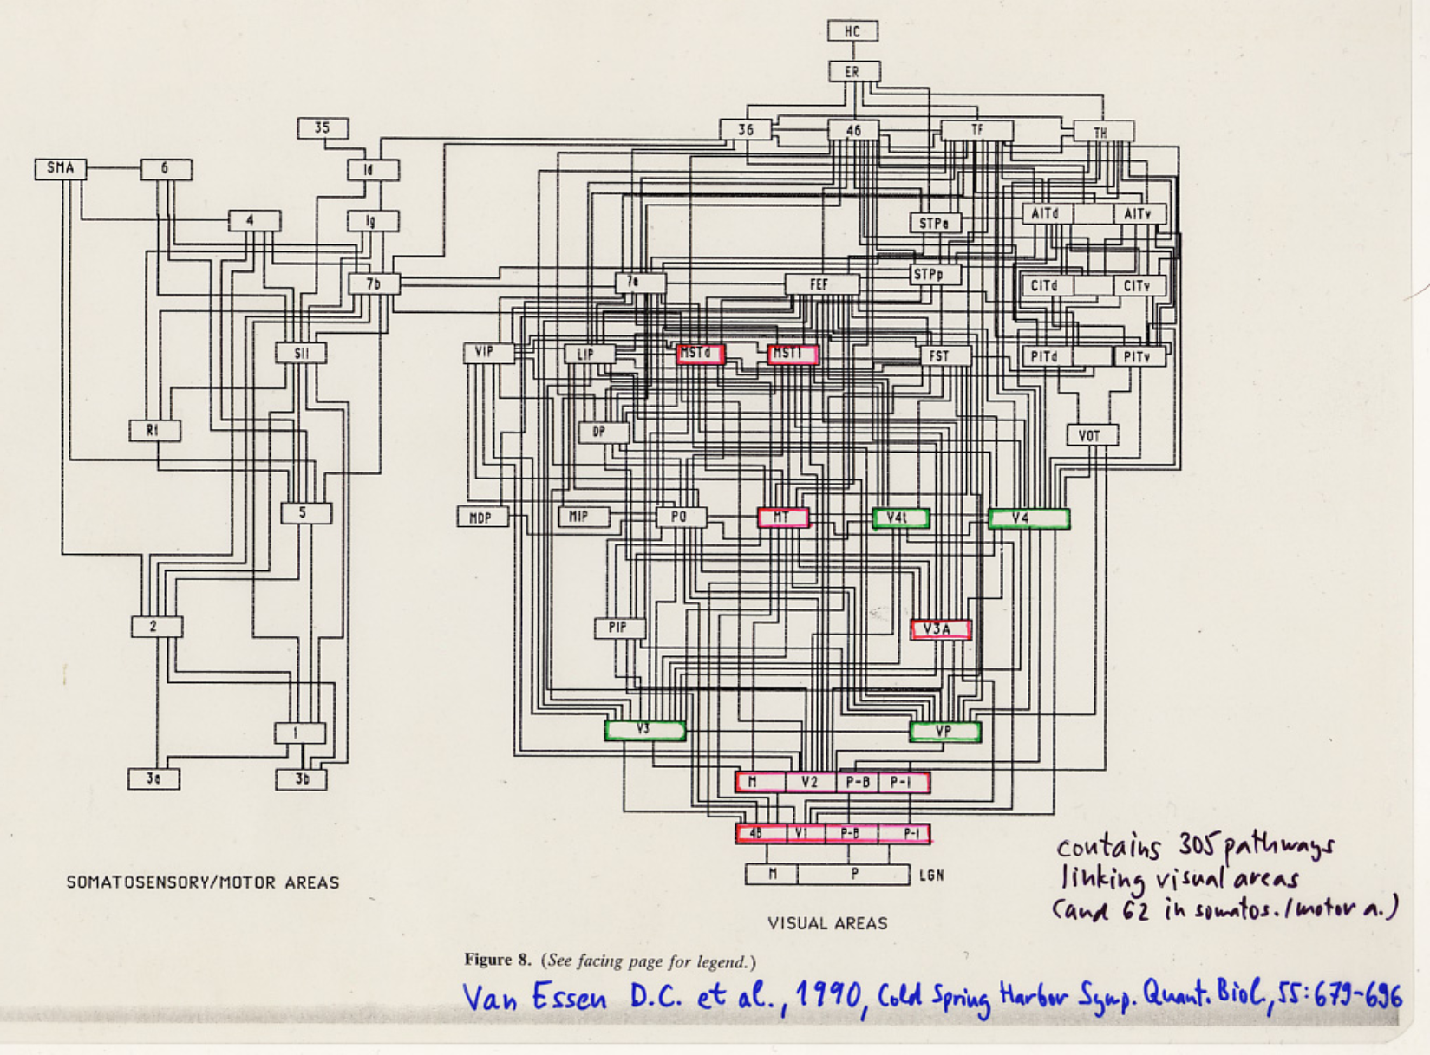
What? and Where? In Visual Cortex
Connectivity and Function
Visual Pathways
red:
magnocellular pathway (motion, black and white)
green:
parvocellular
pathway (color)
]

Slide 29
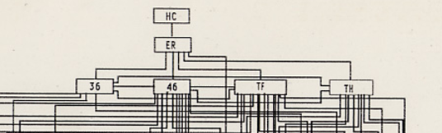
What is HC? Is it a (H)igher (C)enter, (H)ippo(c)ampus, (H)ommun(c)ulus, Is there Anything At All On the Top of Cortical Hierarchy?
Visual Cortices are Primary and Secondary (Any Sensory Are Like This)
What? is in (ventral=) facing cortical projection areas Where? is in (dorsal=) rear cortical projection areas

Slide 30
Too Complicated Way to Explain Visual Cortex
Connectivity and Function
Visual Pathways
red:
magnocellular pathway (motion, black and white)
green:
parvocellular
pathway (color)

Slide 31
Alternative Way to Explain Vision…
Overview of higher functions of visual cortex
Early
vs. Late
vision

Slide 33
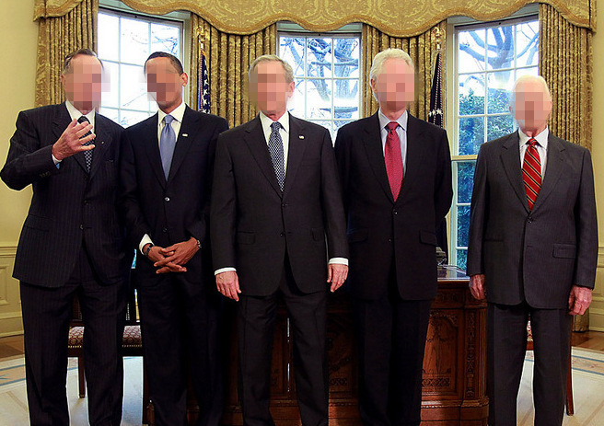
Face recognition – to recognize these blurred faces, some degree of visual acuity is needed

Slide 34
Blurred faces, however these famous people are recogizable from the context
2 G. Bush Sr.[+] – 5 B. Obama – 4 G.W. Bush – 3 B. Clinton – 1 J. Carter

Slide 35
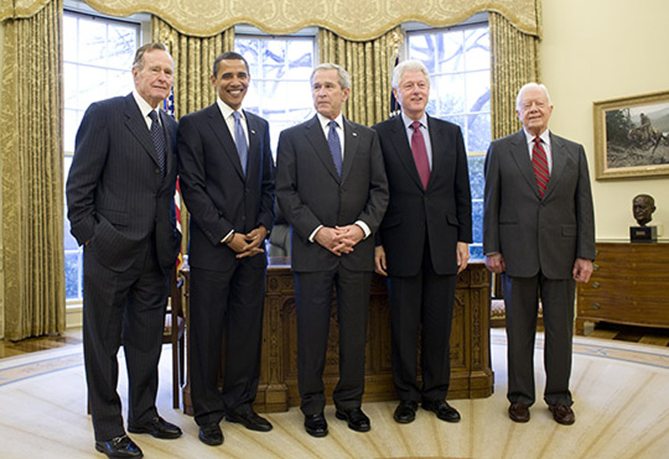
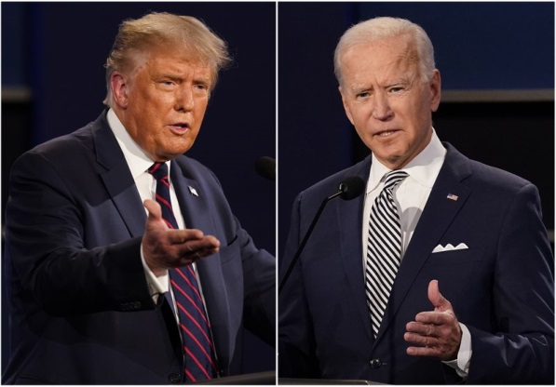
-…
2 G. Bush Sr.[+] – 5 B. Obama – 4 G.W. Bush – 3 B. Clinton – 1 J. Carter

Slide 36
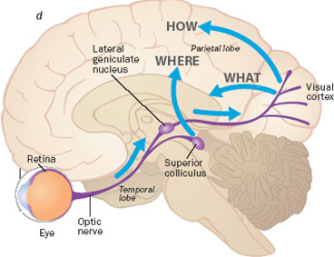
Blindsight (= slepo-zrakost…)
This is another example of visual-motor brain action not accessible to consciousness.

Slide 37
Retreating to Sensory Diagnostic Methods Magnetic Resonance Imaging (MRI) (Spatial Domain) Functional MRI, fMRI (Spatial and Time Domain) Evoked Responses, ER, EP, EEG (Time Domain)

Slide 38
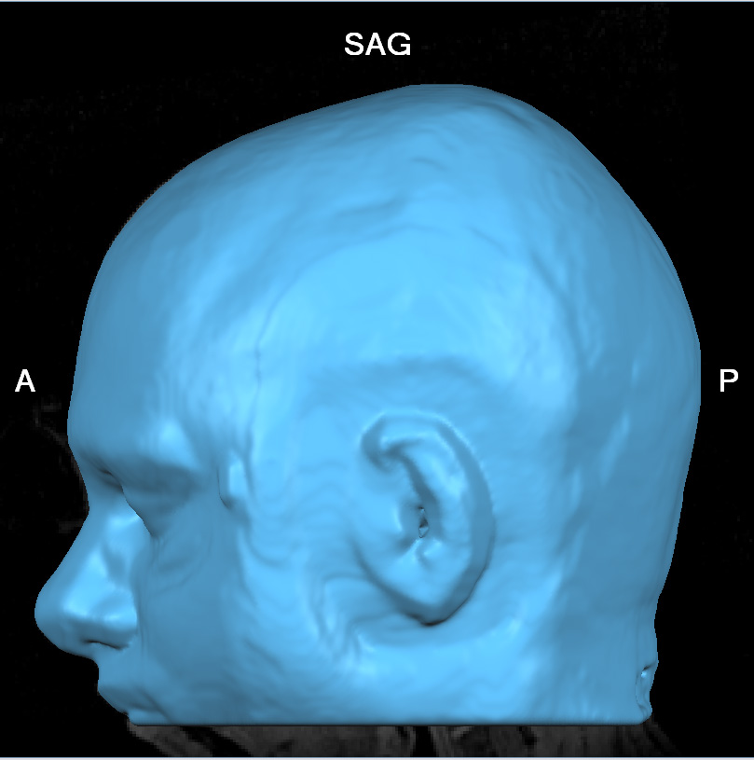
Around year 2000:
Caltech’s 3.0 T Trio Siemens magnetic
scanner

Slide 39
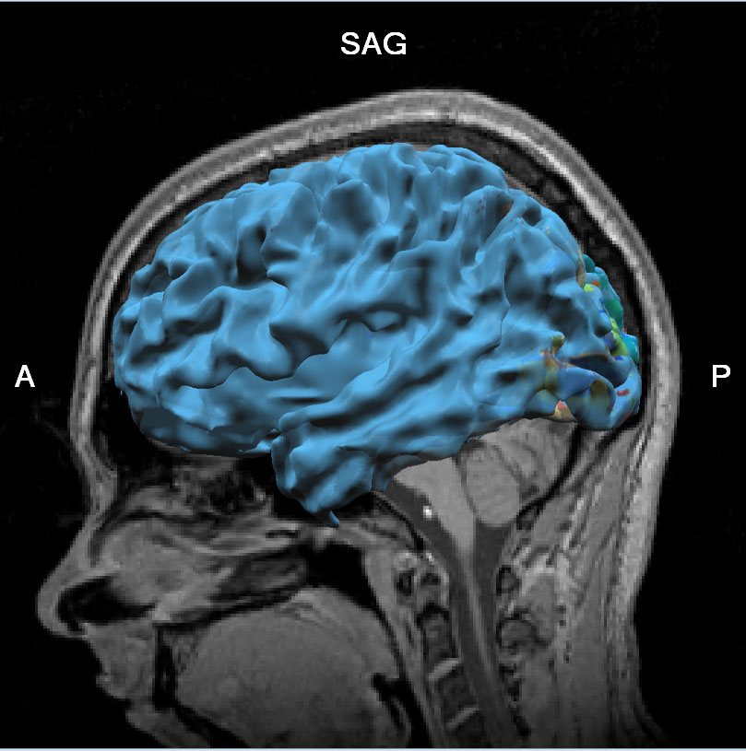

Slide 40
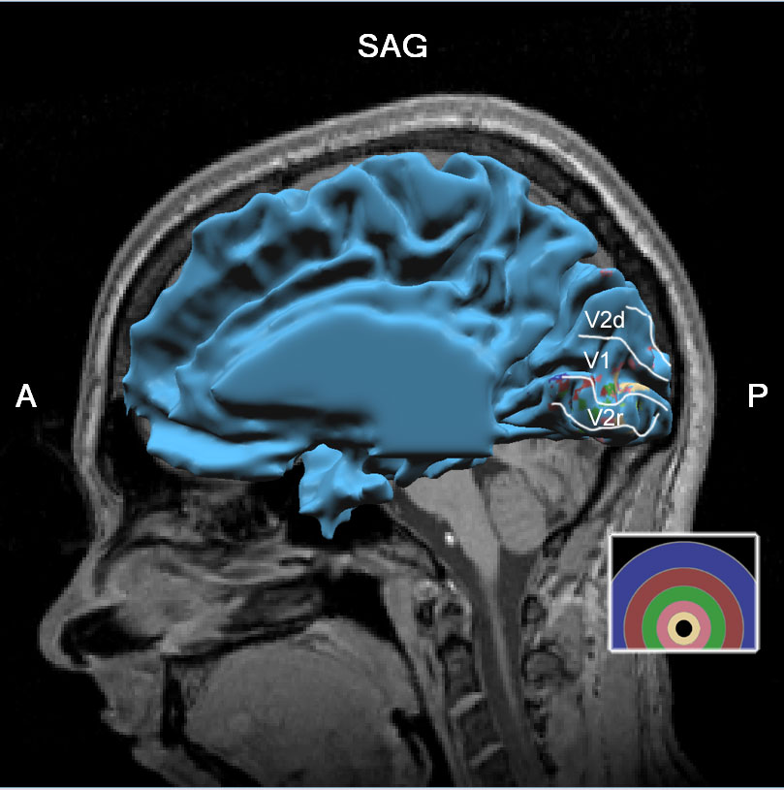

Slide 41
Talk no. 4 – Hearing Loss, Diagnostic Methods in Audiology

Slide 42
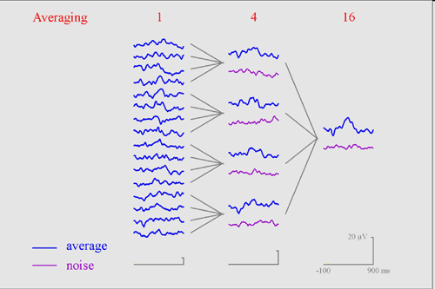
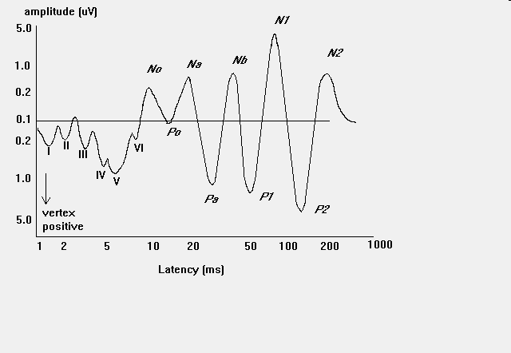
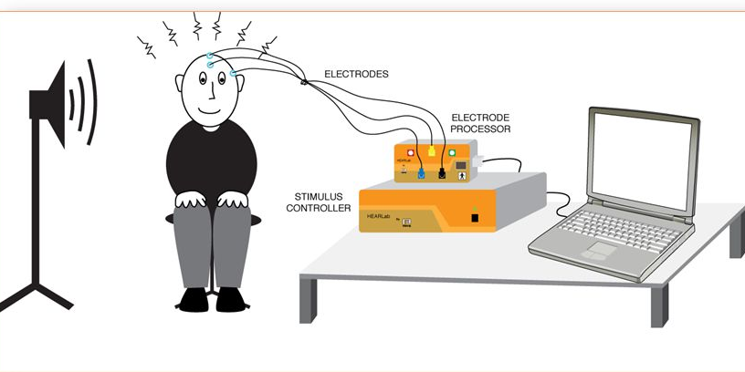
Auditory and Visual Cortical Evoked (Response) Potentials
AEP – Auditory EP VEP – Visual EP
Repetition rate in
brainstem ER audiometry
Can be of low freq. sound
(40 Hz).CZ:BERA,EN:ABR
[R. Hari et al., Exp. Brain Res., 1980]

Slide 43
Alignment
What are the cortical origins of these after-images?

Slide 44

Color Opponent Processes
Color Opponent Processes

Slide 45
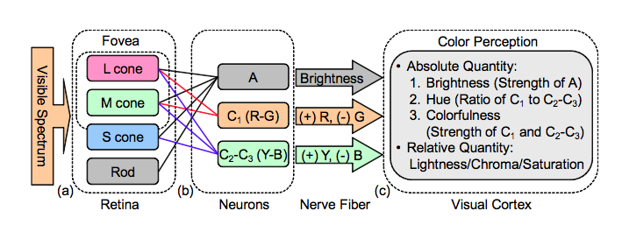
Color Opponent Processes
Color Opponent Processes

Slide 46
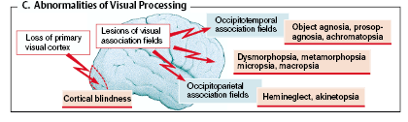
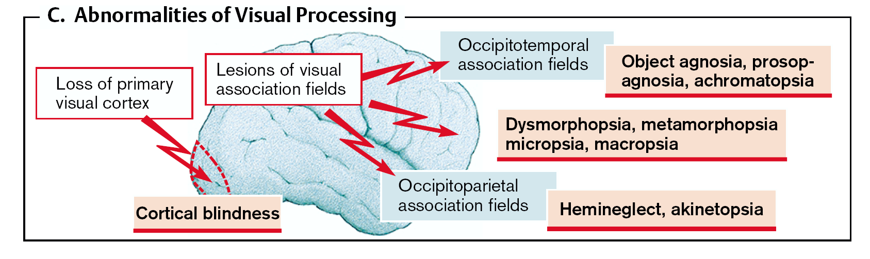
Disorders of Visual Association Cortices Atlas of Patophysiology, 1st English edition, 2000, p. 327

Slide 47
Literature
There are Many More Numerous Understanding and Interpretation Difficulties, How To Explain Visual Perception as... Physiological, Neural, Psychological Process…
(3) SCOVILLE William Beecher and MILNER Brenda, Loss of recent memory after bilateral hippocampal lesions. Journal of Neurology, Neurosurgery and Psychiatry 20, (1): 11–21, 1957.
(2) TURING A. M., Computing Machinery and Intelligence. Mind 49: 433-460, 1950.
(1) FECHNER G.T., Foundations of psychophysics, Elemente der Psychophysik, 1860.
(4) WERNER G., MOUNTCASTLE V.B., Neural activity in mechano-receptive cutaneous afferents: stimulus-response relations, Weber functions, and information transmission, J. Neurophysiology, 28(2), 359-397, 1965.
(5) KANDEL E., SCHWARTZ JH, JESSELL TH, Principles of Neural Science, 2000.
(6) KOCH C., The Quest for Consciousness, 2004.
(7) MARR, D. Vision: a Computational Investigation into the Human Representation and Processing of Visual Information, 1982.
(8) LODGE D., Thinks..., 2002

Slide 48
Literature
(1) KURISCAK E., MARSALEK P., STROFFEK J. and TOTH P.G., Biological context of Hebb learning in artificial neural networks, a review. Neurocomputing, 152, 27-35, 2015.
(2) GRUNDA T., MARSALEK P. and SYKOROVA P., Homonymous hemianopia and related visual defects: Restoration of vision after a stroke. Acta Neurobiol. Exp. (Wars.), 73(2), 237-249, 2013.
(3) HRUBY T. and MARSALEK P. Event-related potentials - the P3 wave. Acta Neurobiol. Exp. (Wars.), 63(1), 55-63, 2003.
(4) MARSALEK P., SANTAMARIA F. Investigating spike backpropagation induced Ca2+ influx in models of hippocampal and cortical pyramidal neurons. Biosystems, 48, 147-156, 1998.
(5) MARSALEK P., KOCH C. and MAUNSELL J. On the relationship between synaptic input and spike output jitter in individual neurons. Proc. Natl. Acad. Sci. USA, 94, 735-740, 1997.

Slide 49

Thanks for your attention
Thanks for your attention
CTU FEE
Warning: neither the PDF, nor the PPT, PPTX, etc.
Versions of this presentation are official study materials.
For internal use only. Do not distribute.
Contacts:
Petr.Marsalek@FEL.CVUT.CZ
Petr.Marsalek@LF1.CUNI.CZ
http://onyx.lf1.cuni.cz/mlab/ftp/PPT-CVUT/FAV/2022
END
OF THE LECTURE

Slide 50
České vysoké učení technické v Praze, Fakulta elektrotechnická Právní doložka (licence) k tomuto Dílu (elektronický materiál) České vysoké učení technické v Praze (dále jen ČVUT) je ve smyslu autorského zákona vykonavatelem majetkových práv k Dílu či držitelem licence k užití Díla. Užívat Dílo smí pouze student nebo zaměstnanec ČVUT (dále jen Uživatel), a to za podmínek dále uvedených.
ČVUT poskytuje podle autorského zákona, v platném znění, oprávnění k užití tohoto Díla pouze Uživateli a pouze ke studijním nebo pedagogickým účelům na ČVUT. Toto Dílo ani jeho část nesmí být dále šířena (elektronicky, tiskově, vizuálně, audiem a jiným způsobem), rozmnožována (elektronicky, tiskově, vizuálně, audiem a jiným způsobem), využívána na školení, a to ani jako doplňkový materiál. Dílo nebo jeho část nesmí být bez souhlasu ČVUT využívána ke komerčním účelům. Uživateli je povoleno ponechat si Dílo i po skončení studia či pedagogické činnosti na ČVUT, výhradně pro vlastní osobní potřebu. Tím není dotčeno právo zákazu výše zmíněného užití Díla bez souhlasu ČVUT. Současně není dovoleno jakýmkoliv způsobem manipulovat s obsahem materiálu, zejména měnit jeho obsah včetně elektronických popisných dat, odstraňovat nebo měnit zabezpečení včetně vodoznaku a odstraňovat nebo měnit tyto licenční podmínky.
V případě, že Uživatel nebo jiná osoba, která drží toto Dílo (Držitel díla), nesouhlasí s touto licencí, nebo je touto licencí vyloučena z užití Díla, je jeho povinností zdržet se užívání Díla a je povinen toto Dílo trvale odstranit včetně veškerých kopií (elektronické, tiskové, vizuální, audio a zhotovených jiným způsobem) z elektronického zařízení a všech záznamových zařízení, na které jej Držitel díla umístil.

