Slide 1
FAV, Talk: Auditory Cortex, Spatial Hearing, Speech Perception
Petr Maršálek
https://dec52.lf1.cuni.cz/~pmar/ftp/REST/PPT-FEL-older/
September/ October 2025
Notes:
1

Slide 2
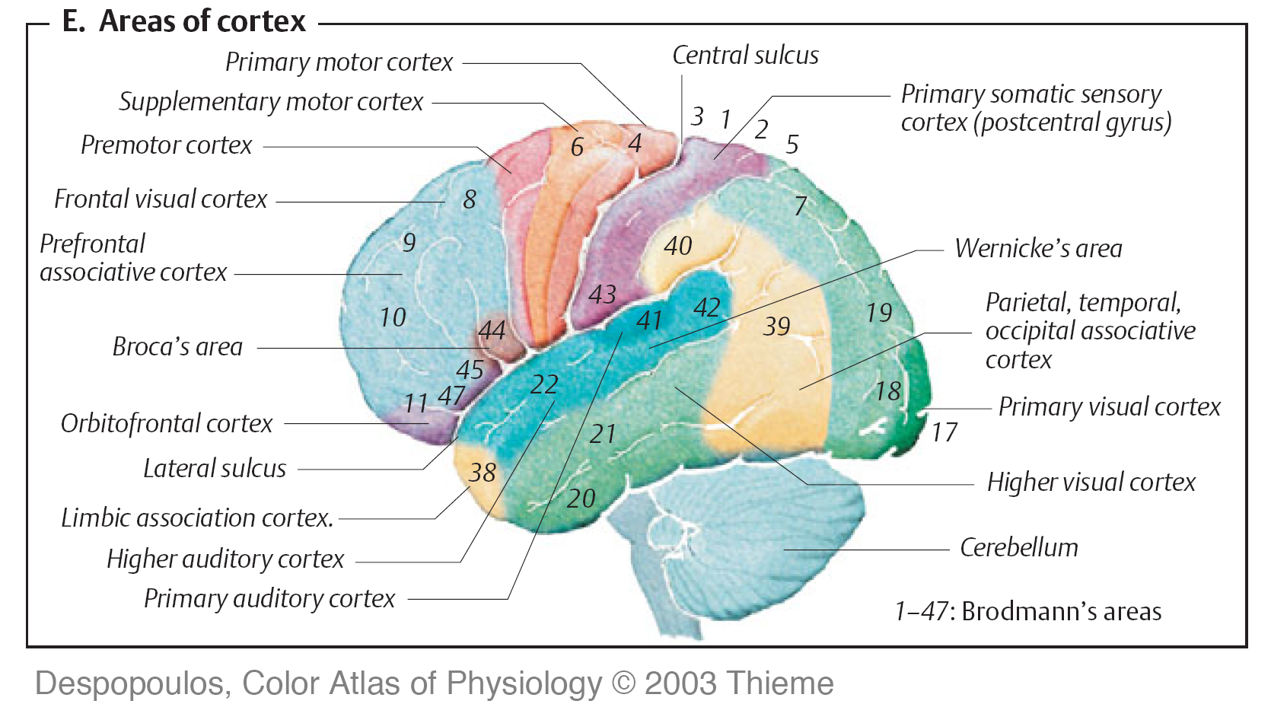
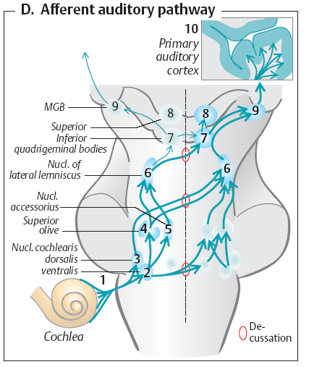
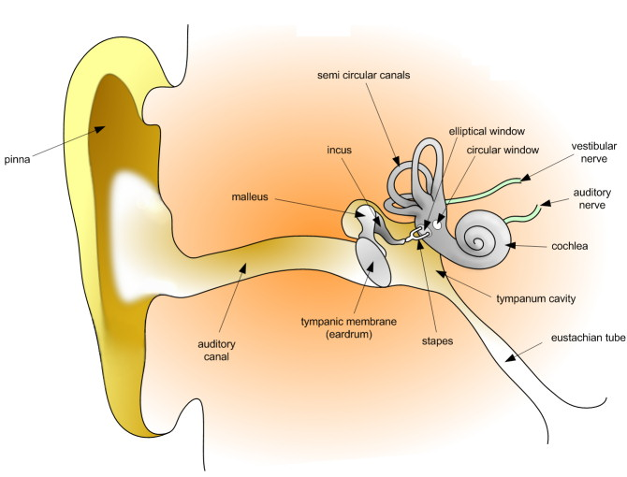
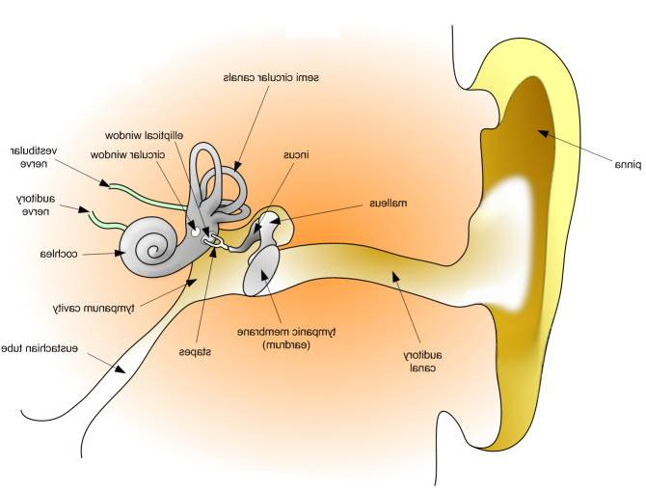
Overview of the Auditory Pathway
Auditory pathway
from the two ears
crosses several times
at different height
(= distance from ‘rostrum’)
Crossings:
1) back up object hearing
2) serve spatial hearing
Auditory pathway
from cochlea to
brainstem
and subcortical
centers
to thalamus and
cortex

Slide 3
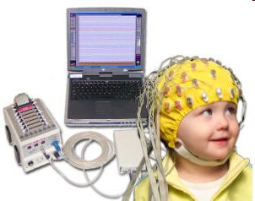
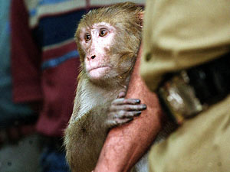
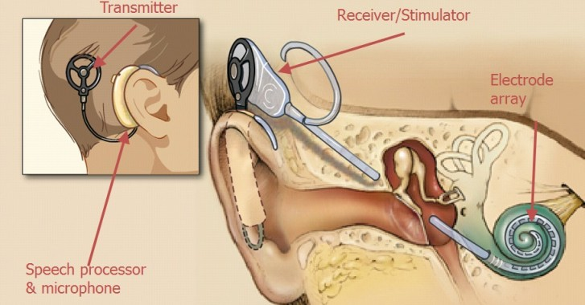
How Do We Collect Information About Cortex? We Use Behavior/ Or Electrophysiology,
Non-invasive and Invasive.

Slide 4
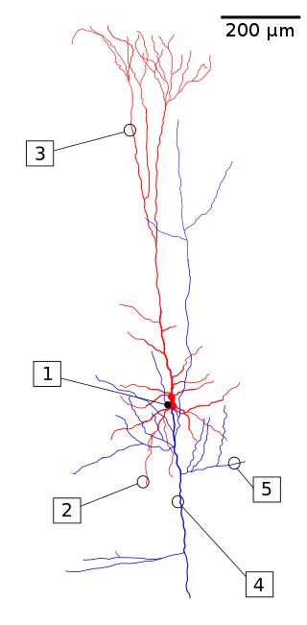
Pyramidal Neuron
As most neurons, this cell consists of:
[1] cell body
[2] basal dendrites
[3] apical dendrites
[4] principal axon
[5] axon collaterals
Synapses use excitatory neuro-
transmitter: glutamate.

Slide 5
CORTICAL MICROCIRCUIT
Neocortex and Other Cortices (Paleocortex, Olfactory Only: 3 Layers, Archicortex, Olfactory and Hippocampus, 3 or 4 Layers)

Slide 6
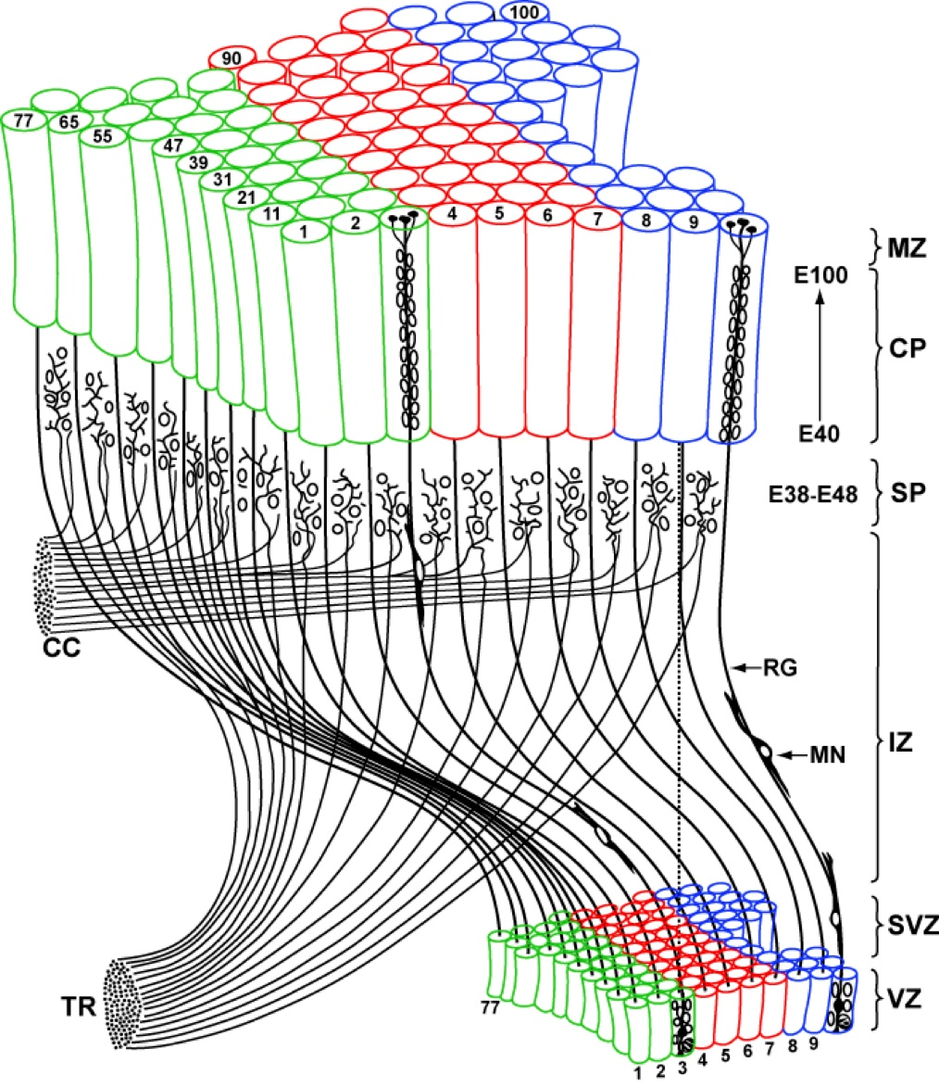
Cortex Consists of Columns as Functional Units
Area of Cerebral Cortex Correlates with the Size and Surface Area of the Mammal
CC = Cortico-Cortical Connections,
TR = Thalamic Radiation

Slide 7
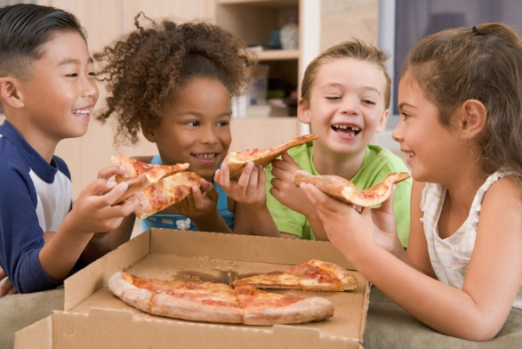
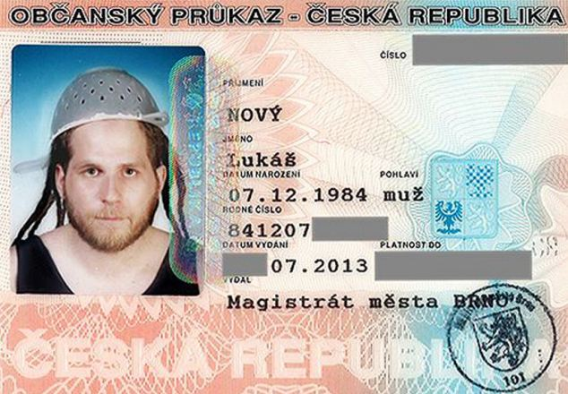
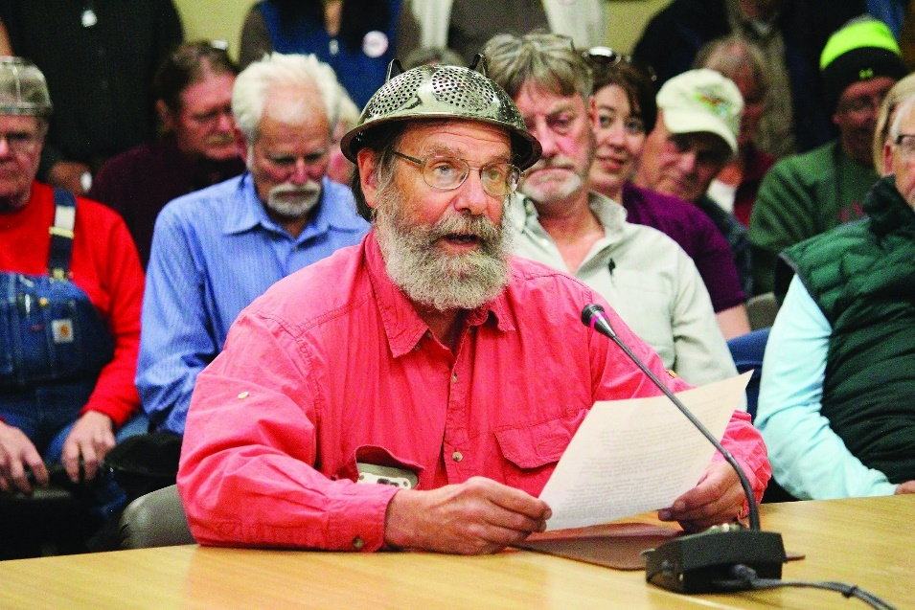
Skid Time
Unfolded Human Cerebral Cortex Has Surface Area As Medium Size Pizza
Says Our Proud
Pastafarian Mission

Slide 8
Cerebral Cortex and Other Connected Nuclei
- Reticular Formation
Sensory Projections
Motor Projections
Thalamus
… Other Sub-Cortical Projections...

Slide 9
Reticular Formation

Slide 10
Two Main Speech Centers Within the (Brodmann’s) Areas

Slide 11
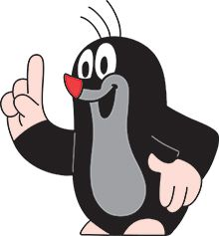
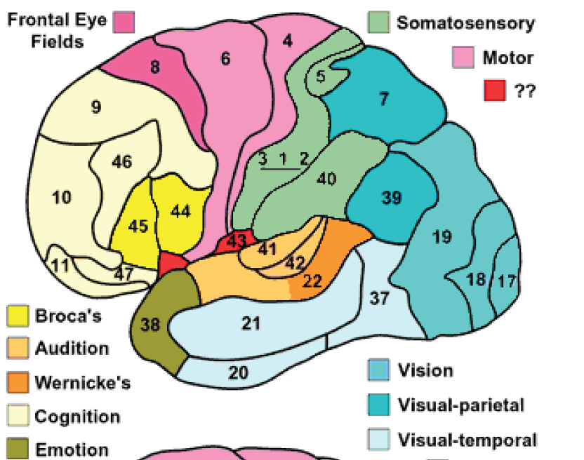
Brodmann Areas
(Outer Hemisphere Part)
X
X
X
X
X
The Least Structured Mammalian Brain is Found in Rodents and Insectivora
e.g. in Mole/or Hedgehog

Slide 12
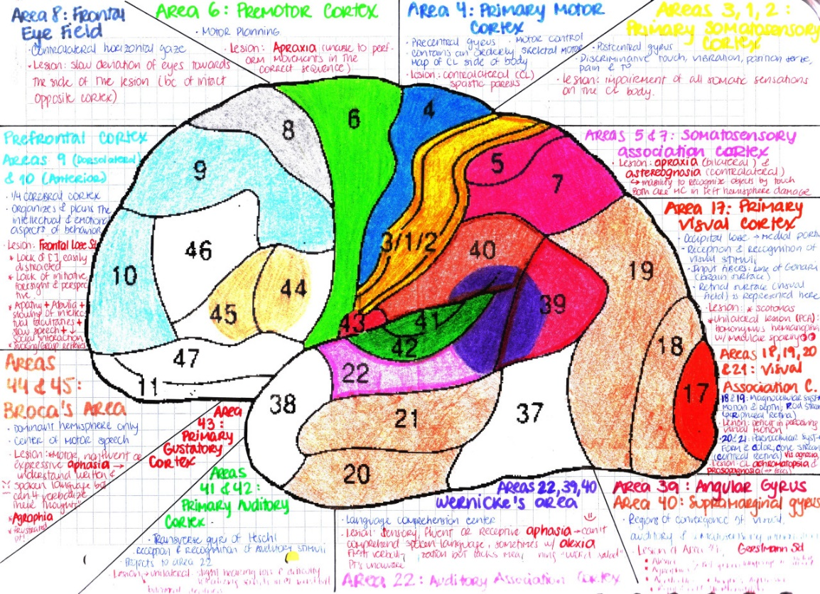
Brodmann Areas (Inner and Outer) http://www.fmriconsulting.com/brodmannconn/

Slide 13
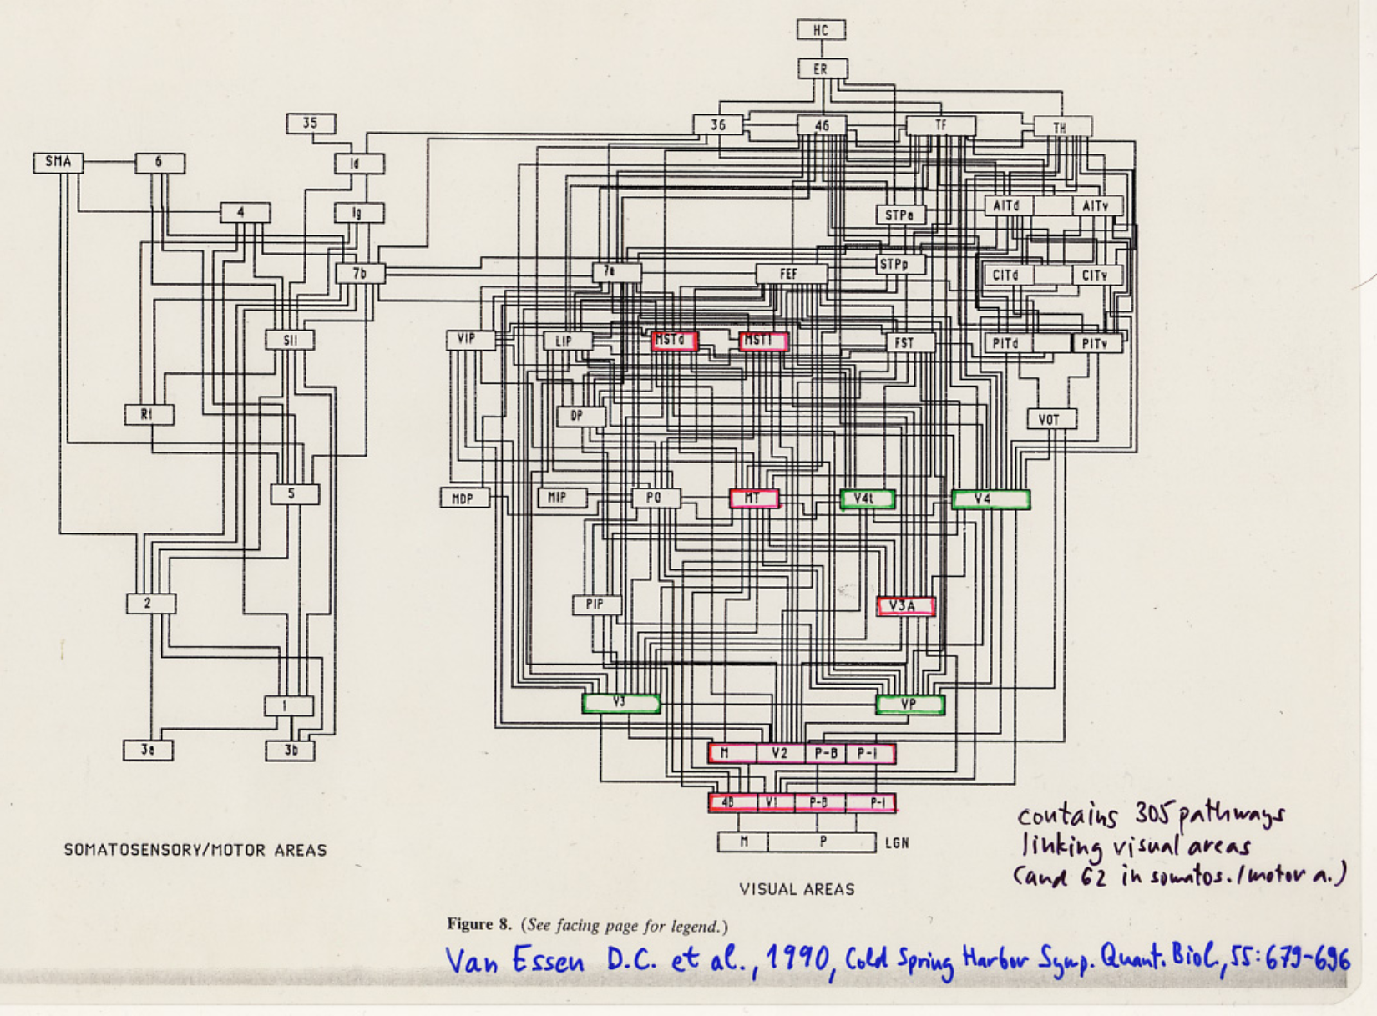
Inappropriate Way to Explain (Visual)Cortical Connectivity
Visual Pathways
red:
magnocellular pathway (motion, black and white)
green:
parvocellular
pathway (color)

Slide 14
Alternative Way to Explain Vision…
Overview of higher functions of visual cortex
Early
vs. Late
vision

Slide 15
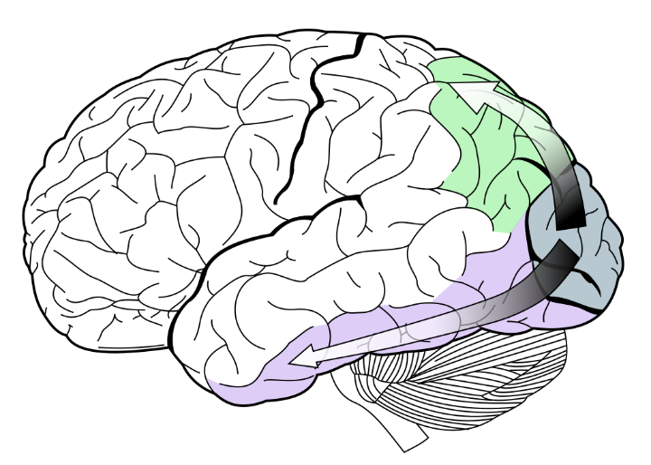
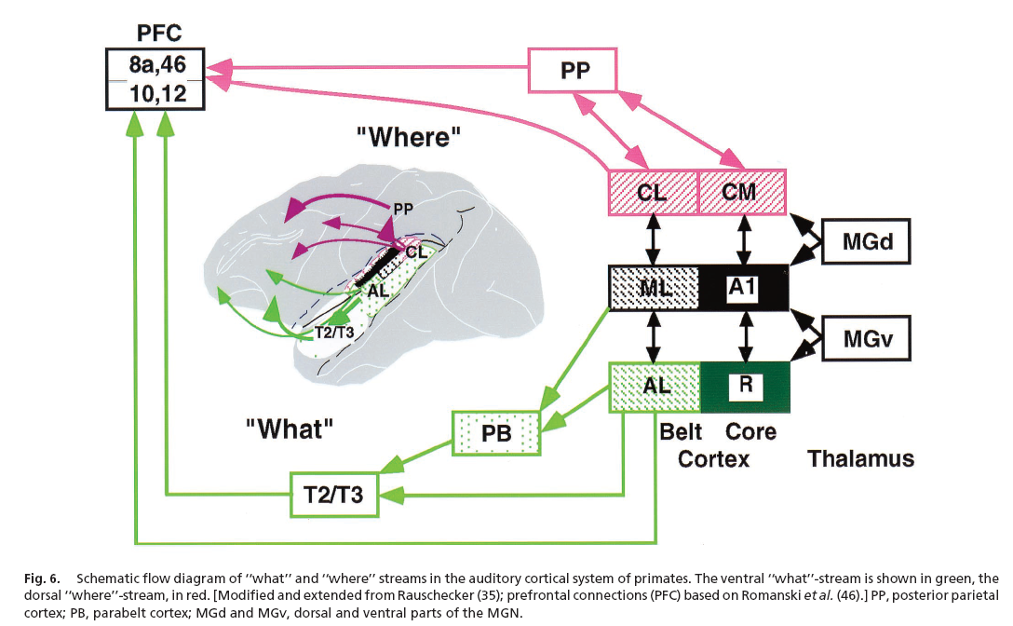
What and Where in auditory cortex?
Visual
Areas
Auditory
Areas

Slide 16
THIS PANEL IS A SPECULATIVE ATTEMPT TO CLASSIFY BRODMANN AREAS DIFFERENTLY
“Binary Trees of Brodmann Areas” and Beyond Brodmann Areas
Bit 1: (Left) vs. (Right) Hemisphere
Bit 2 and 3: (Motor/ Frontal Lobe) (Somatosensory/ Parietal L.)
Bit 2 and 3: (Auditory/ Temporal L.) (Visual/ Occipital L.)
Bit 4: (Primary) vs. (Secondary) Sensory projection areas
Bits 5, 6, 7: subdivisions of visual/ sensory areas
Sensory Domains: Bits 1 and 7: (Left/ Right) vs. (Bottom/ Top) Extensions, Retinotopy, Spatial Maps
Bit 8: Temporal encodings: subcortical
Bit 9: Other modality encodings – Hippocampus (Archi-cortex)/ space navigation, and so on.
Olfactory cortex and Hippocampus (Archi-cortex), Olfacory Bulb (Paleo-cortex), Vestibular Cortex (Part of Temporal lobe), Cortical Projections, Remaining senses: Olfaction, Taste and Touch

Slide 17
Speech
Processing in Cerebral Cortex

Slide 18
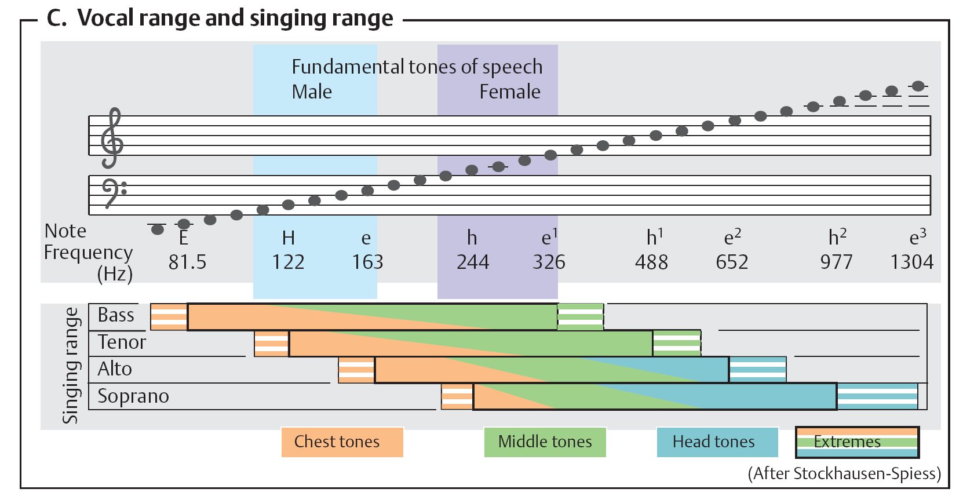
Vocal range and singing range + modalities...

Slide 19
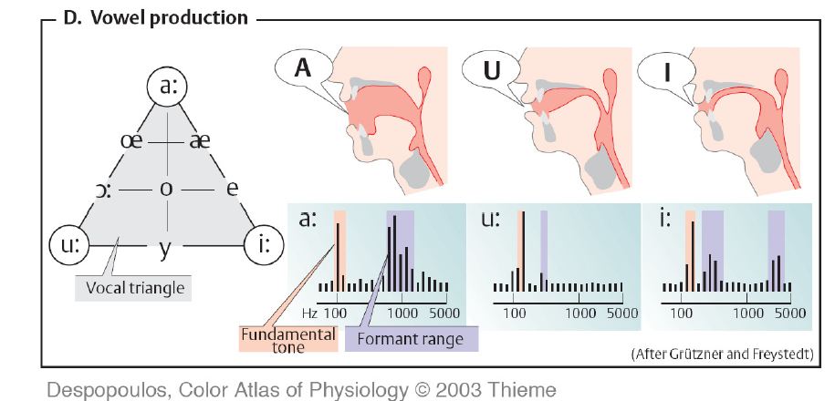
Formants of Vowels in Different Languages

Slide 20
Vývojová stadia rozvoje řeči
6 měsíců Počátky žvatlání.
1 rok Počátky rozumění řeči, jednoslovná produkce.
1.5 roku Slovník s 30 až 50 slovy.
2 roky Slovník s 50 až několika sty slovy. Holé věty (telegramy/ SMSky).
2.5 roky Věty se třemi a více slovy. Mnoho gramatických chyb, neologismy, idiosynkratické výrazy. Dobré porozumění řeči.
3 roky Slovník s 1000 slovy.
4 roky Produkce řeči blízká schopnostem dospělého, slovník s 2000 slovy.
Podle: [Kandel, Schwartz, Jessel, Principles of Neural Science, 1991]
(Jak je to v jiných jazycích?
CZ: žvatlat, SK: džavotať, EN: babble, GE: plappern, FR: babiller,
LAT: balbuties, RU: lepetať. a.t.d…)

Slide 21
Stages of Speech and Language Acquisition
6 mo Beginning of distinct babbling.
1 y Beginning of language understanding, one word utterances.
1.5 y Dictionary of 30 to 50 words.
2 y Dictionary of 50 to several hundred words. Two word (telegraphic/ short message) speaker.
2.5 y Three or more word sentences. Many grammatical errors and idiosyncratic expressions. Good understanding of language.
3 y Dictionary of 1000 words.
4 y Dictionary of 2000 words. Speech competence close to adults.
[Kandel, Schwartz, Jessel, Principles of Neural Science, 1991]
EN: babble, CZ: žvatlat, SK: džavotať, GE: plappern,
LAT: balbuties, et cetera…

Slide 22
Comments On Speech Centers
(1) On rare cases of ‘split brain’ patients, it has been demonstrated
that lateralization of is a purposeful physiological feature
(2) Sensory speech center deficit (= aphasia) is more devastating than
motor aphasia. This is because one does not have a way how to
communicate with a patient affected by sensory aphasia.
(3) There are critical developmental periods in native (and foreign)
language and speech acquisition.

Slide 23
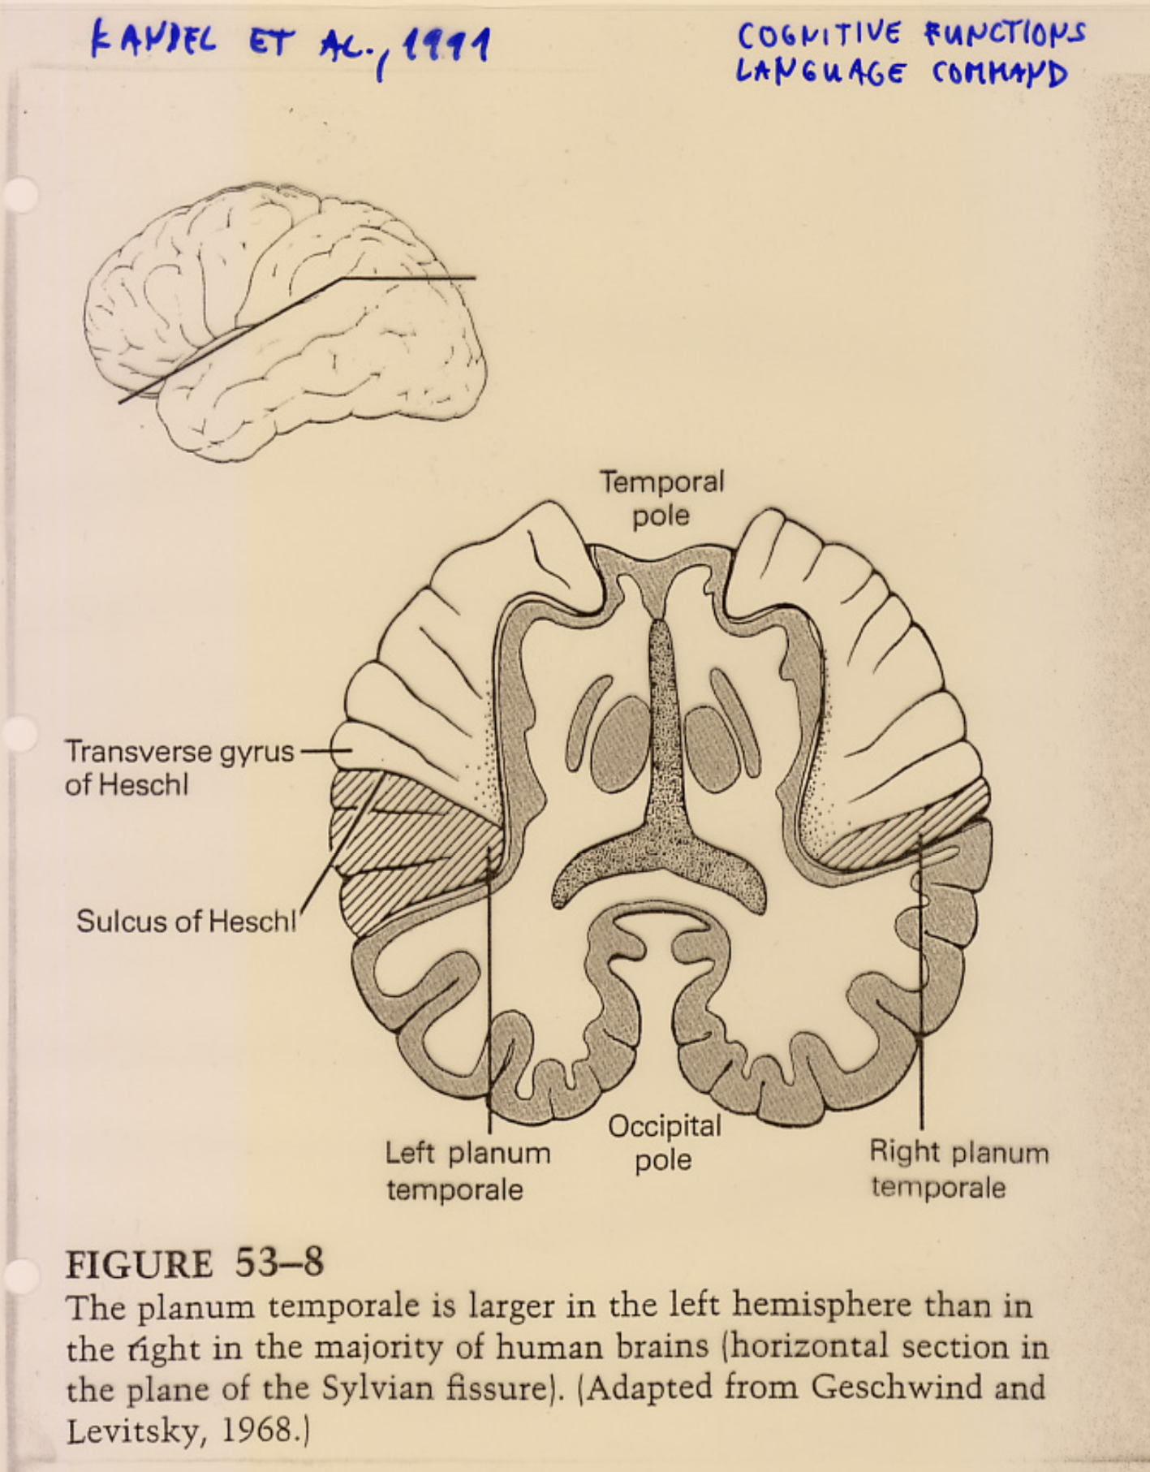
Asymmetries
Seen
In Specific Sections of Cerebral Cortex

Slide 24
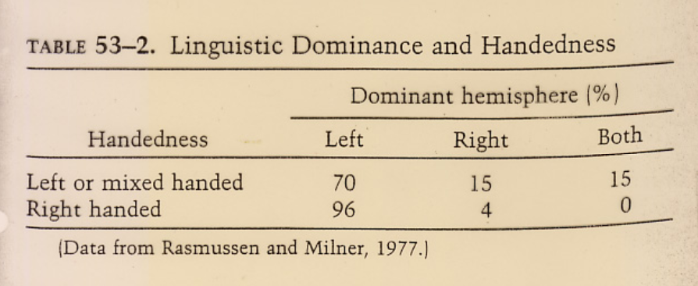
Statistics of Left Versus Right
Asymmetries
Is Not Symmetric (?)

Slide 25
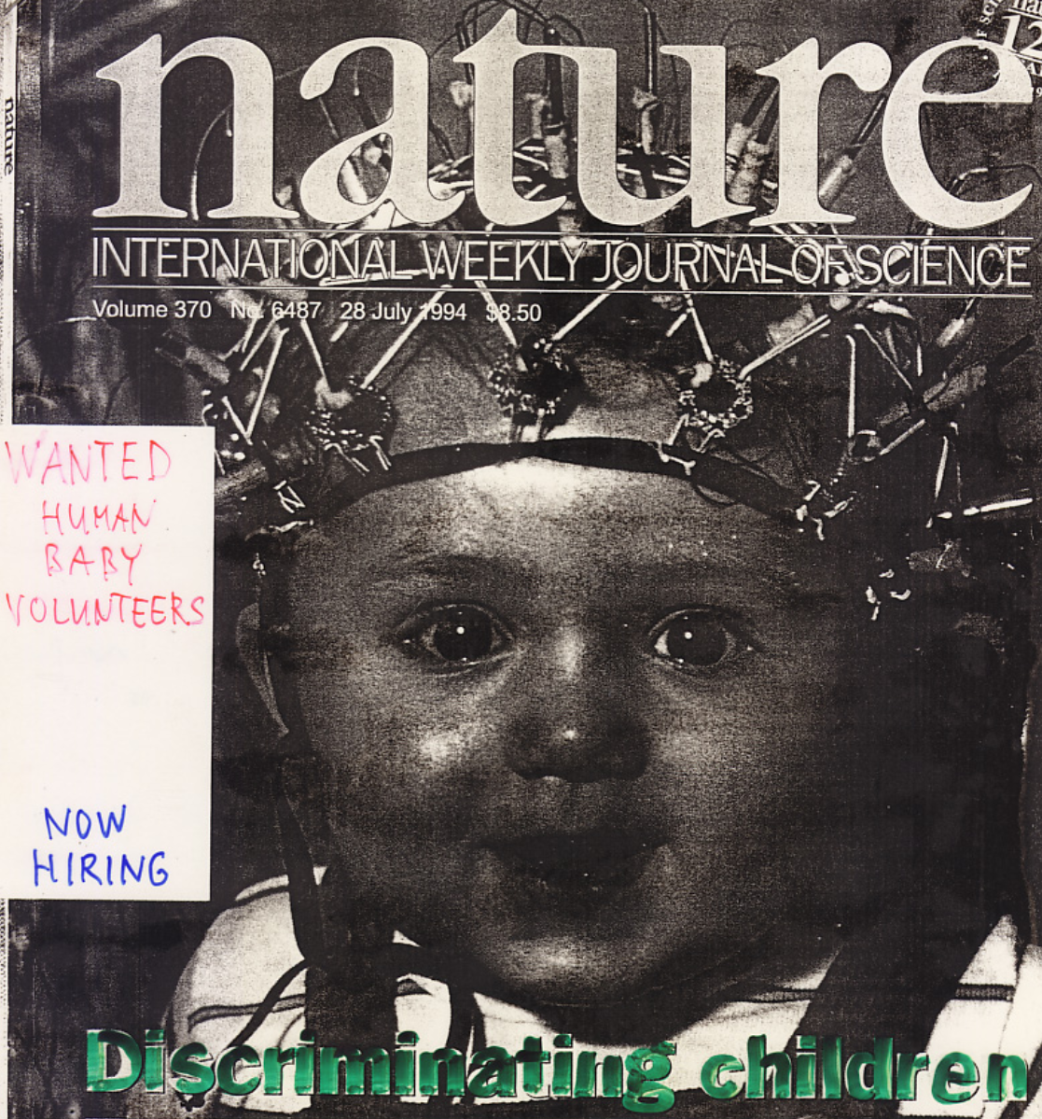
All Conscious Mental Processes
Reside in Cerebral Cortex
Psycho-Physical
and Electro- Encephalo-Graphic
Responses
of Infants and
Small Children

Slide 26
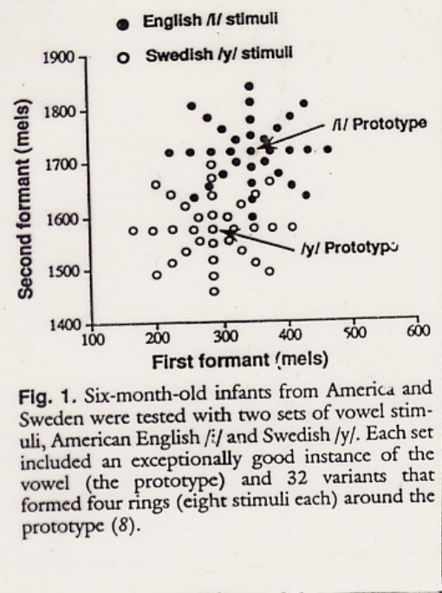
Prototypes of vowels
and synthetic vowels
in formant space
[P. Kuhl et al, 1992]

Slide 27
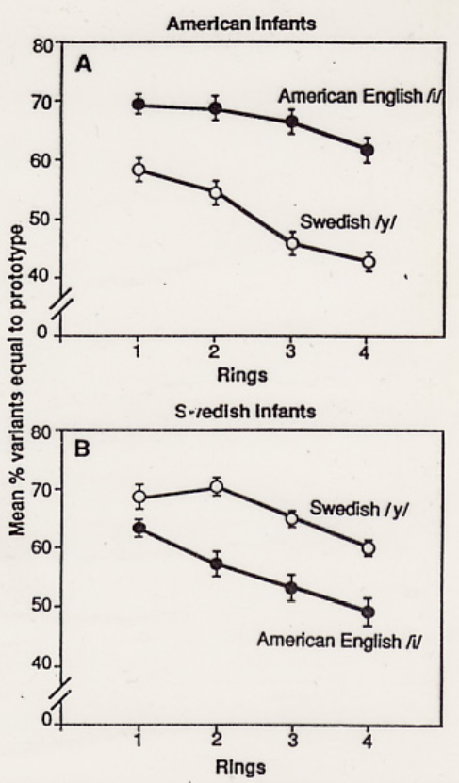
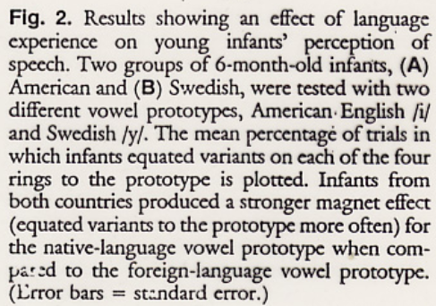
Psycho-physical
responses of 6 month old infants to vowels of native and foreign language
[P. Kuhl et al, 1992]

Slide 28
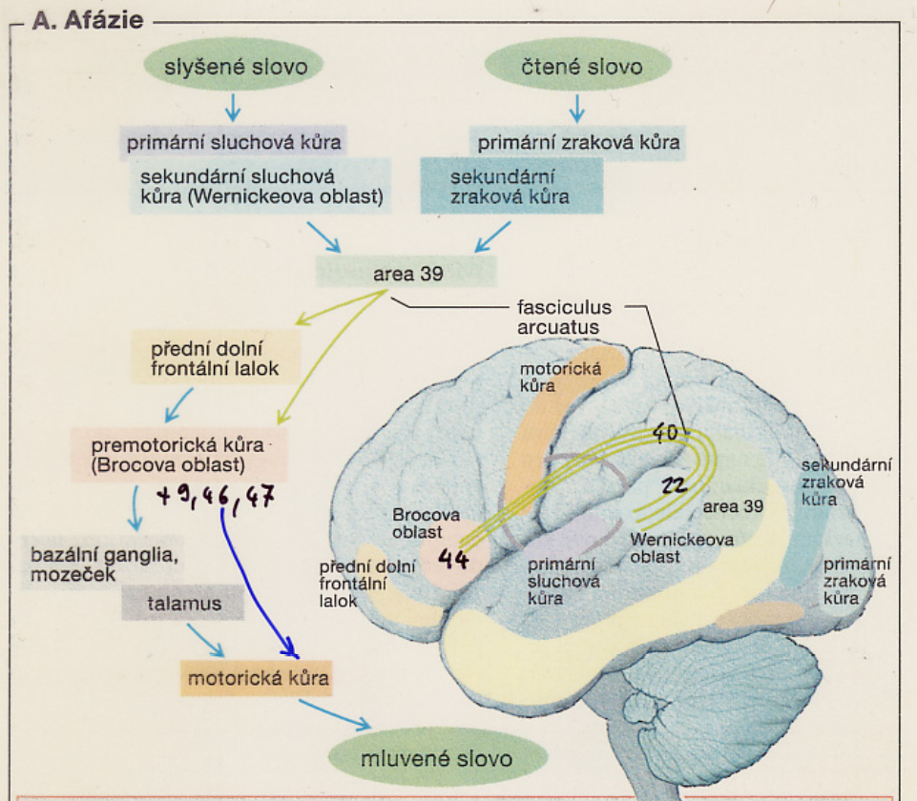

Slide 29
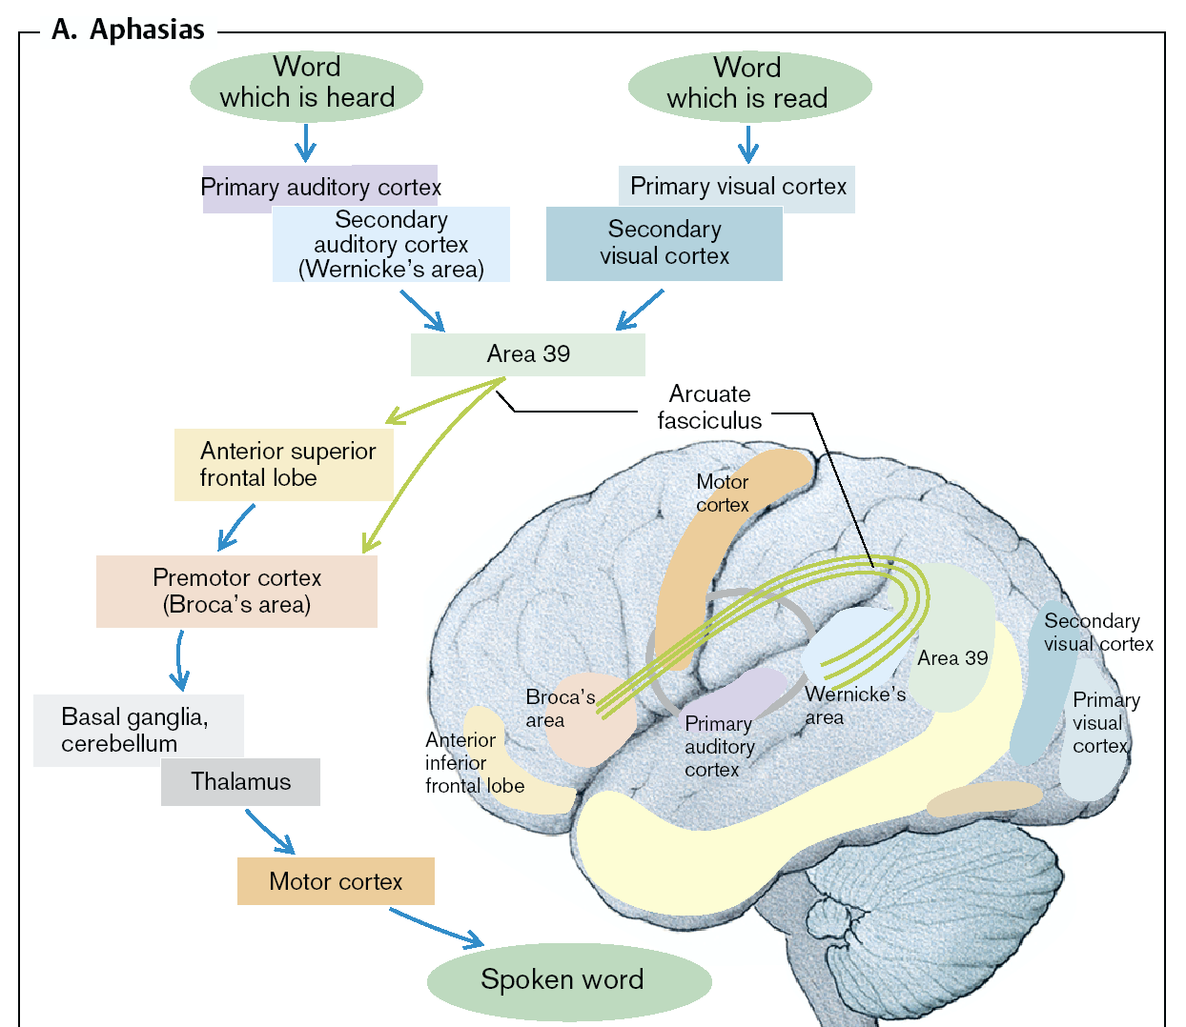

Slide 30
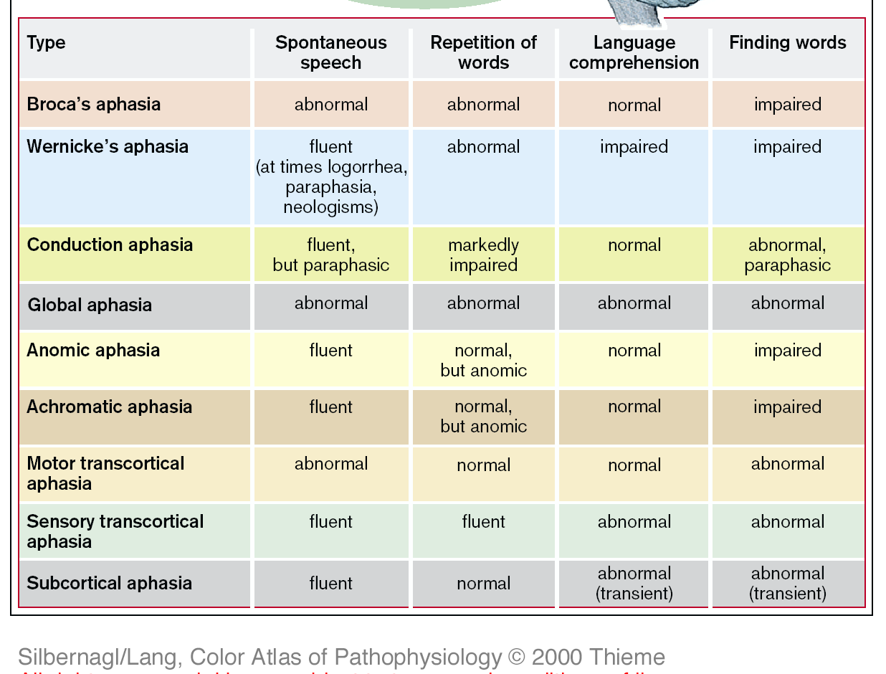

Slide 31
Literature – Computational Brain
(3) SCOVILLE William Beecher and MILNER Brenda, Loss of recent memory after bilateral hippocampal lesions. Journal of Neurology, Neurosurgery and Psychiatry 20, (1): 11–21, 1957.
(2) TURING A. M., Computing Machinery and Intelligence. Mind 49: 433-460, 1950.
(1) FECHNER G.T., Foundations of psychophysics, Elemente der Psychophysik, 1860.
(4) WERNER G., MOUNTCASTLE V.B., Neural activity in mechano-receptive cutaneous afferents: stimulus-response relations, Weber functions, and information transmission, J. Neurophysiology, 28(2), 359-397, 1965.
(5) KANDEL E., SCHWARTZ JH, JESSELL TH, Principles of Neural Science, 2000.
(6) KOCH C., The Quest for Consciousness, 2004.
(7) LODGE D., Thinks..., 2002

Slide 32
Outline –
Binaural Hearing
Introduction: coincidence detectors are part of the circuit
Hypothetically it is possible that coincidence detectors are at different processing stages
Several models are discussed: with and without synaptic mechanisms, with and without cochlear mechanics, and other variants
Outputs of all models are evaluated by the ideal observer
Questions addressed/ open questions
Example: Can modeling phase information improve our description/ understanding of ‘medial superior olive’/ ‘interaural time difference’ mechanisms?
Discussion

Slide 33
Tonotopic organization in cochlea, function of D.D. Greenwood, 1961

Slide 34
auditory nerve phase coding interval histogram
spikes are in rectified half-wave probabilities/ synchronizations
x-axis: time, ms;
y-axis: N - Number of spikes
(A) stimulation frequency 412 Hz;
(B) stimulation frequency 1 kHz.
[Rose JE, 1962]

Slide 35
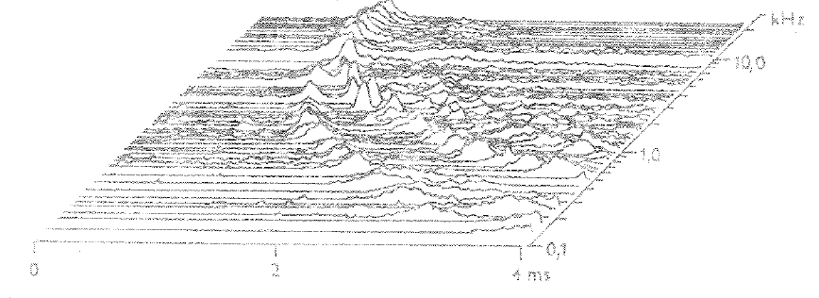
auditory nerve
time and frequency coding
time histogram
x-axis: time; y-axis: neuronal characteristic frequency;
z-axis: spike time histogram
[Kiang, 1965]

Slide 36
Signal discrimination by ideal observer
x-axis: firing rates;
y-axis: response probabilities;
- different signals are detected based on variable responses and different mean values
JND (just noticeable difference), in dB
encoded by spikes
[(computational) neuroscience reviews/ textbooks]

Slide 37
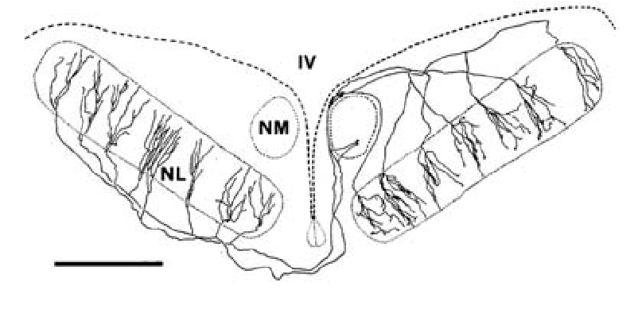
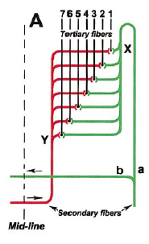
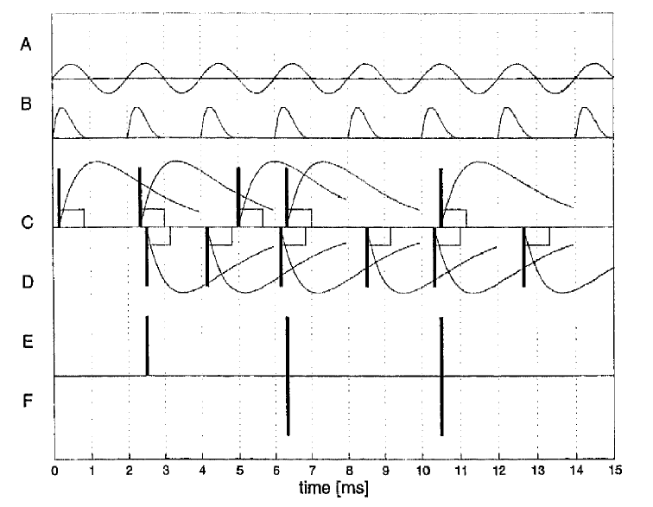
Coincidence detectors
Jeffress delay line is the use of coincidence detectors in birds.
Mammals use other circuitry with coincidence detectors

Slide 38
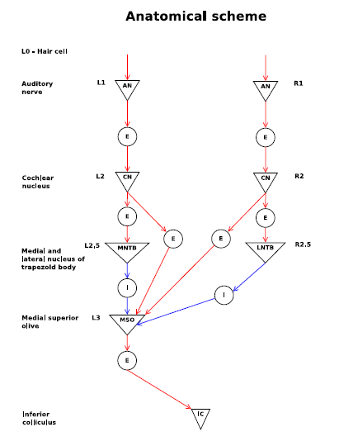
Sanda and Marsalek, Stochastic interpolation model…of MSO…, Brain Research, 2012.
(= model without detailed cochlear mechanics)
Later Compared to the Meddis model
Raymond Meddis (23 July 1944 – 25 November 2018)
/aged 74/ was a British auditory psychologist.

Slide 39
Model output - examples
Sound frequencies 50, 71, 100, 141, 200, 283 Hz.
[Sanda and Marsalek, 2012]

Slide 40
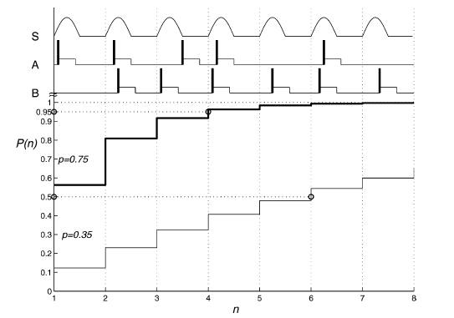
low frequency localization with several different parameter settings/ ideal observer readouts:
left: single neuron, unlimited time
right: reaction time of azimuth TA, spike timing jitter TJ, window of coincidence detection wCD
[bw: Lansky and Marsalek, 2008]
[colored: Sanda and Marsalek, 2012]

Slide 41
Coincidence detection - examples
left from top: candidate mechanisms of sound azimuth in LSO, in high frequencies.
JND, just noticeable difference in ILD, inter-aural level difference can be equivalently expressed in dB, or in spikes/ s.
right: shows parameter variation.
bottom: inhibition/ post- inhibitory rebound
[Bures and Marsalek, ‘On Lateral Superior Olive, LSO’, 2013]

Slide 42
Coincidence detectors are ‘implemented’ by combination of few EPSPs and an IPSP.
These are candidate mechanisms of calculating sound azimuth in low frequencies with the use of adding excitatory and inhibitory postsynaptic
potentials.
[Toth and Marsalek, 2015]

Slide 43
[Toth and Marsalek, 2015]
Solution to some questions as to the construction of the ‘tuning curve’ can be simple:
to calculate a “read-out” curve, it just needs to take inversion function of a spike time histogram, pick a proper branch and a proper function normalization.

Slide 44
Cochlear phase in response to sine input
Simplified cochlear model by Duke, Julicher, Vilfan, and others

Slide 45
Applications of auditory nerve spike train studies: cochlear implants (CI) .
Some cochlear implantees have implants on both sides (mostly in German speaking countries). How is it with binaural hearing and horizontal localization?
In tonal languages (Asian, like Chinese) pitch by CI is the processing bottleneck. How can be pitch impression improved in CI? Key observation: tradeoff localization vs. pitch.
Ambisonics/ holophonics/ augmented/ etc/ digital sound engineering …
open problems,
interdisciplinary questions,
technology questions

Slide 46
Literature – Binaural Hearing
BURES Z. and MARSALEK P., Models and manuscripts in preparation.
TOTH P.G. and MARSALEK P., Analytical description of coincidence detection synaptic mechanisms in the auditory pathway. Biosystems, 136, 90-98, 2015.
BURES Z. and MARSALEK P., On the precision of neural computation with inter-aural level differences in the lateral superior olive. Brain Res., 1536, 16-26, 2013.
SANDA P. and MARSALEK, P., Stochastic interpolation model of the medial superior olive neural circuit, Brain Res., 1434, 257-265, 2012.
MARSALEK P., DRAPAL M., Mechanisms of Coincidence Detection…
Chapter in Book: Mathematical Modeling of Biological Systems, 2008.
BURES Z., PhD thesis, 2007.
MARSALEK P., Habilitation thesis, 2005.

Slide 47
Literature – Brain networks
(1) KURISCAK E., MARSALEK P., STROFFEK J. and TOTH P.G., Biological context of Hebb learning in artificial neural networks, a review. Neurocomputing, 152, 27-35, 2015.
(2) GRUNDA T., MARSALEK P. and SYKOROVA P., Homonymous hemianopia and related visual defects: Restoration of vision after a stroke. Acta Neurobiol. Exp. (Wars.), 73(2), 237-249, 2013.
(3) HRUBY T. and MARSALEK P. Event-related potentials - the P3 wave. Acta Neurobiol. Exp. (Wars.), 63(1), 55-63, 2003.
(4) MARSALEK P., SANTAMARIA F. Investigating spike backpropagation induced Ca2+ influx in models of hippocampal and cortical pyramidal neurons. Biosystems, 48, 147-156, 1998.
(5) MARSALEK P., KOCH C. and MAUNSELL J. On the relationship between synaptic input and spike output jitter in individual neurons. Proc. Natl. Acad. Sci. USA, 94, 735-740, 1997.

Slide 48
Thanks for your attention
Thanks for your attention
CTU FEE
Warning: neither the PDF, nor the PPT, PPTX, etc.
versions of this presentation are official study materials.
For internal use only. Do not distribute.
Contacts:
Petr.Marsalek@LF1.CUNI.CZ
END
OF THE LECTURE

Slide 49
(Outline) Conclusions – Binaural hearing
Introduction: coincidence detectors are part of the circuit
Hypothetically it is possible that coincidence detectors are at different processing stages
Several models are discussed: with and without synaptic mechanisms, with and without cochlear mechanics, and other variants
Outputs of all models are evaluated by the ideal observer
Questions addressed/ open questions
Example: Can modeling phase information improve our description/ understanding of MSO (= low frequency encoding) mechanisms?

Slide 50
Outline FAV 5
Cortex
Thalamus is a gateway through which sensory stimulation gains cortical attention and processing. We can be woken up by strong auditory or visual stimuli.
Neocortical brain areas have common features (six layers) and distinctions (sensory versus motor, and others).
Sensory areas are typically divided into ‘primary’ and ‘secondary’, but the functional features of processing order between these remain unclear.
There are 47 distinct Brodmann areas (by Korbinian Brodmann, 1909).
Speech
Distinct areas enable vocalization: 2 major speech centers, sensory and motor.
Inter-hemispheric division of labor: when we sing a song, left (dominant) hemisphere maintains lyrics and the other (non-dominant) hemisphere contains the melody.
Speech sounds (vowels, consonants) have distinct spectral and temporal features (formants).
There are critical developmental periods for speech acquisition – language understanding starts before speech production. Developmental period partly closes in puberty.
(Families of Indo-European languages, tonal languages, language origin, structure and putative universal grammar et cetera. This is fascinating, but it is mostly beyond scope of these lectures…)
Hearing loss in ageing progresses across modalities and higher loudness in hearing aid often does not help – is there a need for augmented media? Yes…
Binaural hearing
Medial Superior Olive computes sound azimuth in horizontal plane in low frequencies from interaural time difference
Lateral Superior Olive computes sound azimuth in horizontal plane in high frequencies from interaural intensity difference

Slide 51
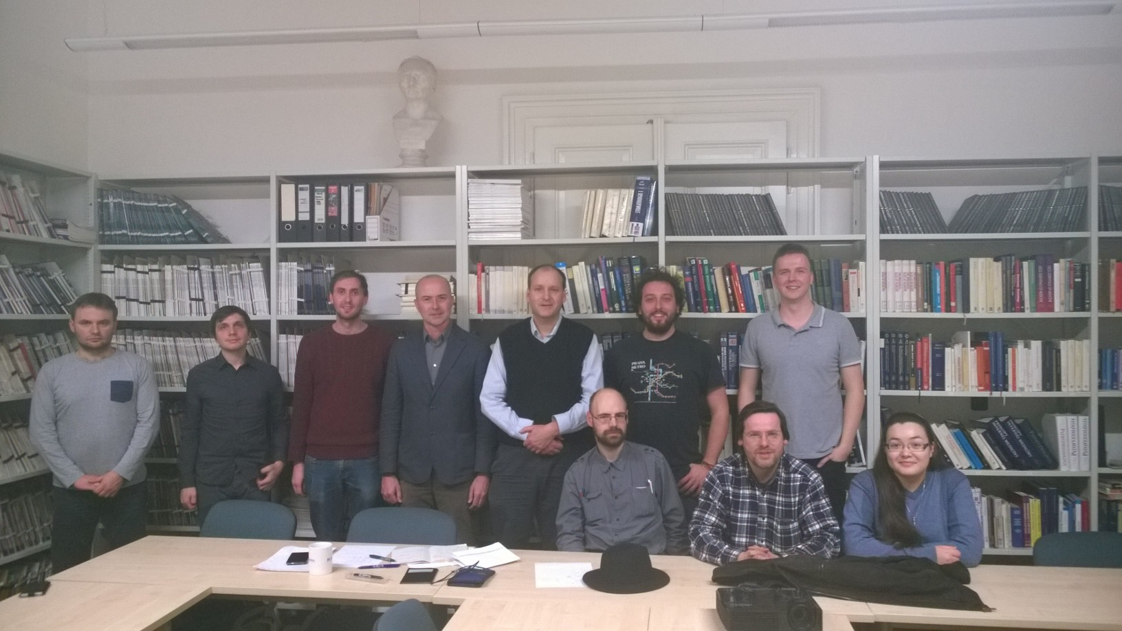
Group: Audiology, Acoustics and Computational
Neuroscience, CTU and 1stMF CUni (year 2015)

Slide 52
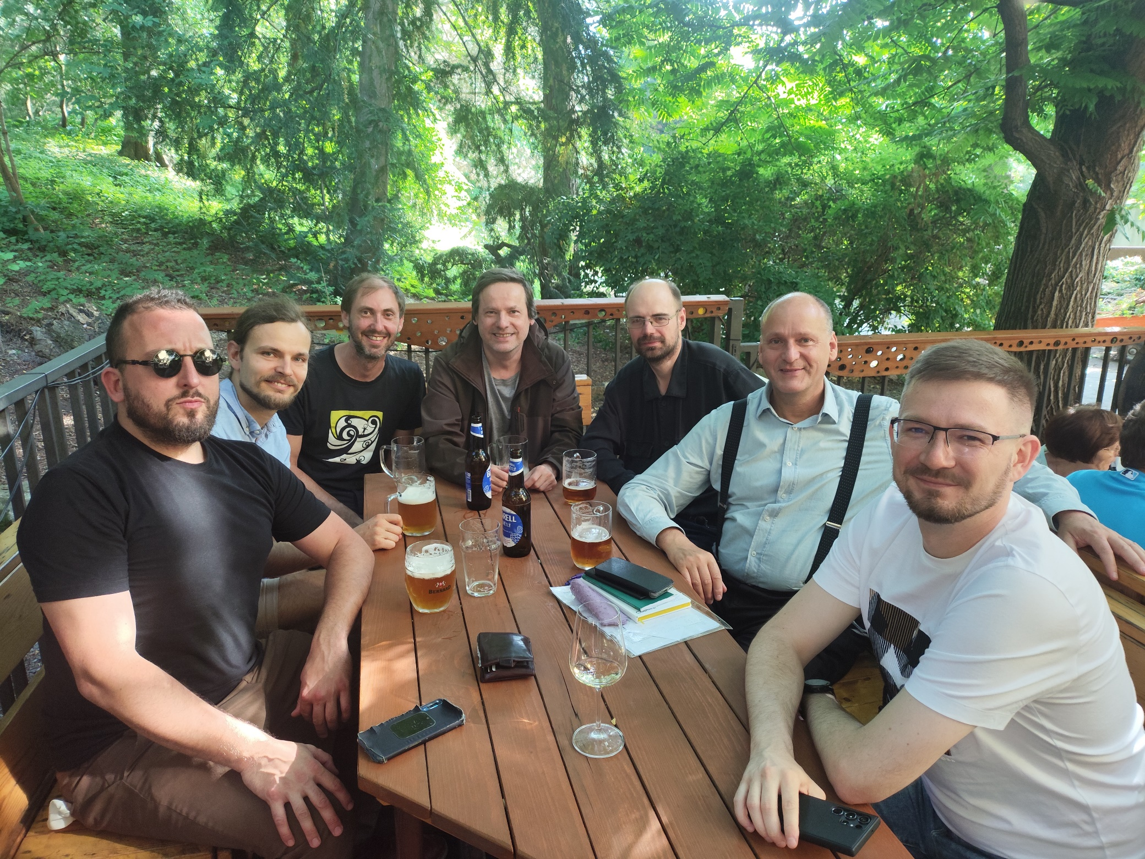
Group: Audiology, Acoustics and Ad hoc people
(year 2025)

