Slide 1
VYŠETŘENÍ GIT, JATER A ŽLUČOVÝCH CEST
AKK
Petr Maršálek, Jan Živný, a další
Ústav patologické fyziologie
1. LF UK
Petr.Marsalek@LF1.cuni.cz

Slide 2
Průchod
tráveniny
trávicím
systémem

Slide 3
Žvýkání a polykání sousta,
Pití, pasáž soust a nápojů jícnem

Slide 4
Defekace
analogicky jako u močení
dva svěrače:
jeden inervován kosterními,
a jeden vegetativními nervy

Slide 5
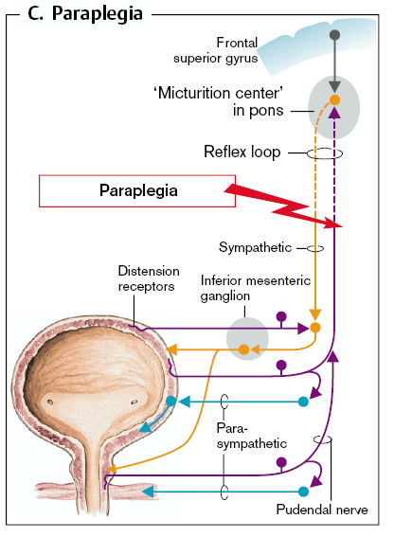
(Připomenutí) Vyprazdňování močového měchýře: normální (a automatické u paraplegie)
Močení
Dva svěrače:
jeden inervován kosterními,
a jeden vegetativními nervy

Slide 6
Funkce GIT
štěpení a vstřebávání živin
obranná bariera (toxiny, mikroorganismy)
mechanická
mechanismy nespecifické imunity
mechanismy specifické imunity

Slide 7
Jícen

Slide 8
GASTROESOFAGEÁLNÍ REFLUX
Tonus dolního esofageálního svěrače (LES)
Klinické příznaky:
Pyróza (pálení žáhy)
Důsledky:
Esofagitida
Barrettův jícen
Adenokarcinom jícnu

Slide 9
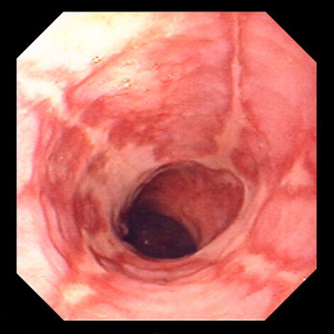
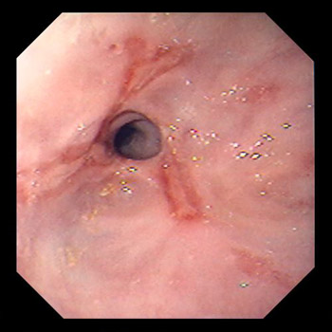
Refluxní esofagitida
Zúžení esofagu vzniklé na
základě refluxní esofagitidy
Refluxní esophagitis
Notes:
A detailed history points to the diagnosis. X-rays, esophagoscopy, esophageal manometry, pH monitoring, the Bernstein acid perfusion test, and esophageal biopsy help to confirm the diagnosis and demonstrate possible complications (eg, Barrett's esophagus). X-rays taken with the patient in Trendelenburg's position may show reflux of barium from the stomach into the esophagus. Abdominal compression may be used, but x-ray maneuvers usually are not sensitive indicators of GERD. X-rays after a barium swallow readily show esophageal ulcers and peptic strictures but are only rarely diagnostic in patients with hemorrhage caused by esophagitis. Esophagoscopy provides accurate diagnosis of esophagitis with or without hemorrhage. Esophagoscopy with cytologic washings and direct vision biopsy is essential to distinguish benign peptic stricture (see Plate 20-5) from esophageal cancer. Esophageal manometry determines pressure at the lower esophageal sphincter. Esophageal pH monitoring provides direct evidence of GERD. In the Bernstein test, symptoms are promptly reproduced by acid perfusion in the esophagus and relieved by saline perfusion. Esophageal biopsy may show thinning of the squamous mucosal layer and basilar cell hyperplasia, even without evidence of gross esophagitis by endoscopy.
A positive biopsy or a positive Bernstein test correlates best with esophageal symptoms of reflux regardless of endoscopic or x-ray findings. Endoscopic biopsy is also the only test that consistently detects the columnar mucosal changes of Barrett's metaplasia (see Plate 20-6).

Slide 10
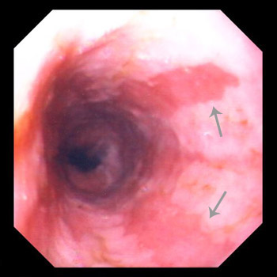
Barrettův jícen
Metaplazii epitelu jícnu je potřeba histologicky potvrdit
Reddish, columnar epithelium extends more than 3 cm above the gastroesophageal junction.
Notes:
A detailed history points to the diagnosis. X-rays, esophagoscopy, esophageal manometry, pH monitoring, the Bernstein acid perfusion test, and esophageal biopsy help to confirm the diagnosis and demonstrate possible complications (eg, Barrett's esophagus). X-rays taken with the patient in Trendelenburg's position may show reflux of barium from the stomach into the esophagus. Abdominal compression may be used, but x-ray maneuvers usually are not sensitive indicators of GERD. X-rays after a barium swallow readily show esophageal ulcers and peptic strictures but are only rarely diagnostic in patients with hemorrhage caused by esophagitis. Esophagoscopy provides accurate diagnosis of esophagitis with or without hemorrhage. Esophagoscopy with cytologic washings and direct vision biopsy is essential to distinguish benign peptic stricture (see Plate 20-5) from esophageal cancer. Esophageal manometry determines pressure at the lower esophageal sphincter. Esophageal pH monitoring provides direct evidence of GERD. In the Bernstein test, symptoms are promptly reproduced by acid perfusion in the esophagus and relieved by saline perfusion. Esophageal biopsy may show thinning of the squamous mucosal layer and basilar cell hyperplasia, even without evidence of gross esophagitis by endoscopy. A positive biopsy or a positive Bernstein test correlates best with esophageal symptoms of reflux regardless of endoscopic or x-ray findings. Endoscopic biopsy is also the only test that consistently detects the columnar mucosal changes of Barrett's metaplasia (see Plate 20-6).
Endoscopic Photograph Showing Traditional, or Long-Segment, Barrett’s Esophagus

Slide 11
POTVRZENÍ GASTROESOFAGEÁLNÍHO REFLUXU
Monitorování pH (24h):
refluxní esofagitida
Perfuzní (Bernsteinův) test
objektivizace příčiny bolesti na hrudi (GE reflux)
perfuze distálního esofagu 0.1M roztokem HCl 6-8 mL/min střídavě s fyziologickým roztokem

Slide 12
ENDOSKOPICKÉ VYŠETŘENÍ JÍCNU
Diagnostika – vizuální
léze
akutní krvácení
polknutí cizích těles
tumory
Diagnostika – biopsie
tumory
Terapie
krvácení
léze

Slide 13
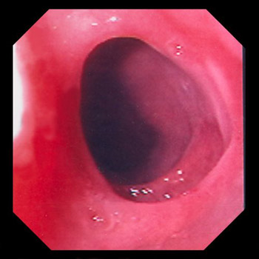
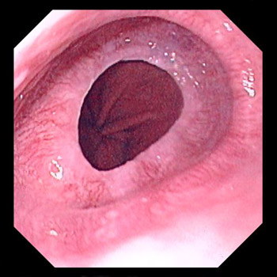
Jícnové řasy/ překážky v jícnu
Esophageal web.
Esophageal ring.
A thin mucosal membrane that grows across the lumen of the esophagus
A 2- to 4-mm mucosal structure, probably congenital, causing a ringlike narrowing of the distal esophagus at the squamocolumnar junction
Notes:
Webs develop rarely in patients with untreated severe iron-deficiency anemia or, even more rarely, without an overt anemia. They usually occur in the upper esophagus, producing dysphagia for solids. They are usually missed on ordinary barium swallow and can be shown best on cinefilms. The webs disappear with therapy for the anemia, but they may be easily ruptured during esophagoscopy.
Lower esophageal rings are the most common cause of intermittent dysphagia. Intermittent dysphagia for solids may occur, usually when the esophageal lumen is < 12 mm in diameter.

Slide 14
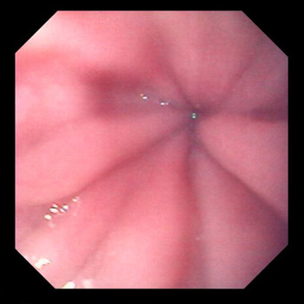
Fibroskopie – porucha motoriky jícnu
Achalasie jícnu
A neurogenic esophageal disorder of unknown origin characterized by impaired esophageal peristalsis and a lack of lower esophageal sphincter relaxation.
Notes:
Barium x-ray of the esophagus demonstrates the absence of progressive peristaltic contractions during swallowing. The esophagus is dilated, frequently enormously, but is narrowed and beaklike at the lower esophageal sphincter. Esophageal manometry shows aperistalsis, increased lower esophageal sphincter pressure, and incomplete sphincteric relaxation with swallowing. Esophagoscopy reveals dilation but no obstructing lesion. The esophagoscope usually passes readily into the stomach; difficulty doing so should raise the possibility of malignancy or stricture. An increased sensitivity of the denervated structures to pharmacologic stimuli (eg, methacholine) can usually be shown on manometry, but may be associated with adverse effects and is rarely necessary for diagnosis.
Achalasia must be differentiated from a distal stenosing carcinoma and a peptic stricture, particularly in the patient with scleroderma in whom esophageal manometry may also show aperistalsis. Scleroderma is usually accompanied by a history of Raynaud's phenomenon and symptoms of GERD. A retroflexed view of the gastric cardia, biopsies, and brushings for cytology should be obtained in all patients to exclude malignancy.

Slide 15
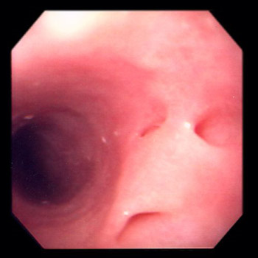
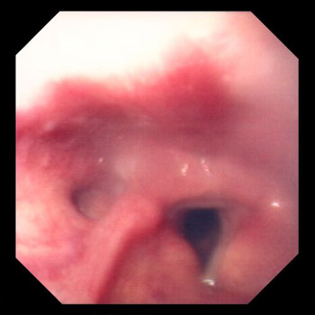
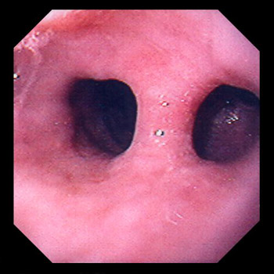
Diverticula jícnu: fibroskopie
Esophageal diverticula.
Zenker's diverticulum
Traction diverticulum
Notes:
There are several types of esophageal diverticula (see Plate 20-7), each of different origin. A Zenker's (pharyngeal) diverticulum is a posterior outpouching of the mucosa and submucosa through the cricopharyngeal muscle (see Plate 20-8). It probably results from incoordination between pharyngeal propulsion and cricopharyngeal relaxation. Midesophageal (traditionally called traction) diverticula (see Plate 20-9) are either caused by traction from mediastinal inflammatory lesions or secondary to motor disorders. An epiphrenic diverticulum, also probably of propulsive origin, occurs just above the diaphragm and usually accompanies an esophageal motor disturbance (achalasia, diffuse esophageal spasm).
Symptoms and Signs
A Zenker's diverticulum fills with food that may be regurgitated when the patient bends or lies down. Aspiration pneumonitis may result if regurgitation is nocturnal. Rarely, the pouch becomes large and causes dysphagia. Traction and epiphrenic diverticula are rarely symptomatic in themselves.

Slide 16
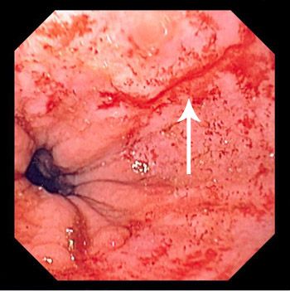
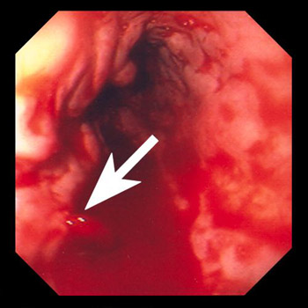
Jícnové krvácení: fibroskopie
Mallory Weiss tear
Acute variceal hemorrhage
Laceration of the distal esophagus and proximal stomach during vomiting, retching, or hiccuping
Notes:
MALLORY-WEISS SYNDROME
Laceration of the distal esophagus and proximal stomach during vomiting, retching, or hiccuping (see Plate 20-10).
GI hemorrhage from an arterial site is the usual clinical presentation. Initially described in alcoholics, Mallory-Weiss syndrome is recognized in all types of patients. It is the cause of upper GI hemorrhage in about 5% of patients. Diagnosis is made during endoscopy or arteriography. The lesion is not seen on routine upper GI x-rays. Most episodes of bleeding stop spontaneously, but some patients require ligation of the laceration. Intra-arterial infusion of pitressin or therapeutic embolization into the left gastric artery during angiography may also be used to control bleeding.

Slide 17
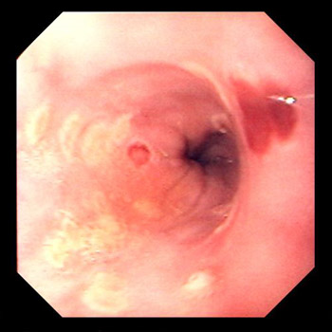
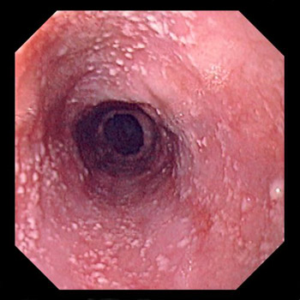
Infekční onemocnění esofagu: fibroskopie
Herpes simplex virus esophagitis
Candidal esophagitis
Notes:
MALLORY-WEISS SYNDROME
Laceration of the distal esophagus and proximal stomach during vomiting, retching, or hiccuping (see Plate 20-10).
GI hemorrhage from an arterial site is the usual clinical presentation. Initially described in alcoholics, Mallory-Weiss syndrome is recognized in all types of patients. It is the cause of upper GI hemorrhage in about 5% of patients. Diagnosis is made during endoscopy or arteriography. The lesion is not seen on routine upper GI x-rays. Most episodes of bleeding stop spontaneously, but some patients require ligation of the laceration. Intra-arterial infusion of pitressin or therapeutic embolization into the left gastric artery during angiography may also be used to control bleeding.

Slide 18
RENTGENOLOGICKÉ VYŠETŘENÍ
Nativní: cizí těleso, achálazie jícnu
Kontrastní: poruchy motility, léze , tumor, struktura, hernie, spasmus.
kinematografické (v krátkých časových intervalech)
videoskopický záznam polykacího aktu – dysfagie, porušení motility

Slide 19
Esophagogram Showing a Malignant Esophageal Stricture

Slide 20
Positron-emission tomography (eg. Fluorodeoxyglucose ¹⁸F; ¹⁸F-FDG)
Cancer
Metastasis
Cancer
Metastasis
CT scan
Cancer of the distal esophagus with metastasis to a
paraesophageal lymph node
Notes:
Cancer of the Distal Esophagus (Panels A and B) with Metastasis to a Paraesophageal Lymph Node (Panels A and C).
Panel A shows a coronal section of a positron-emission tomographic (PET) study with fludeoxyglucose F 18. A cancer of the distal esophagus
is present (black arrow) with metastasis to a paraesophageal lymph node (white arrow). Panels B and C show corresponding axial
sections of the PET scan (top two images) and a CT scan (bottom two images); the cancer in the distal esophagus is indicated by the
black arrows in Panel B, and the metastatic paraesophageal lymph node by the white arrows in Panel C. Courtesty of Annick D. Van den
Abbeele, M.D.

Slide 21
ŽALUDEK A DUODENUM

Slide 22
Peptická vředová choroba (PUD)
5-10% populace (50% opakovaně do 5 let)
Patofyziologie peptického vředu:
vřed – slizniční defekt pronikající pod muscularis mucosae
výskyt: jícen, žaludek, duodenum, tenké střevo (při gastroenteroanastomóze ektopické sliznice u Meckelova divertiklu)
rozlišení dle lokalizace:
a) žaludeční (cca z 5% maligní)
b) duodenální (nebývají zpravidla maligní)

Slide 23
Peptická vředová choroba (PUD): Patogeneze
Poškození bariérové funkce sliznice
Helicobacter Pylori
Poléková
kortikoidy, nesteroidní protizánětlivé léky (NSAID)
Endokrinní
Zollinger-Ellison sy, hyperparathyreóza
Stresová
Hepatogenní
vlivy poruch metabolismu a krevního oběhu
Kouření?

Slide 24
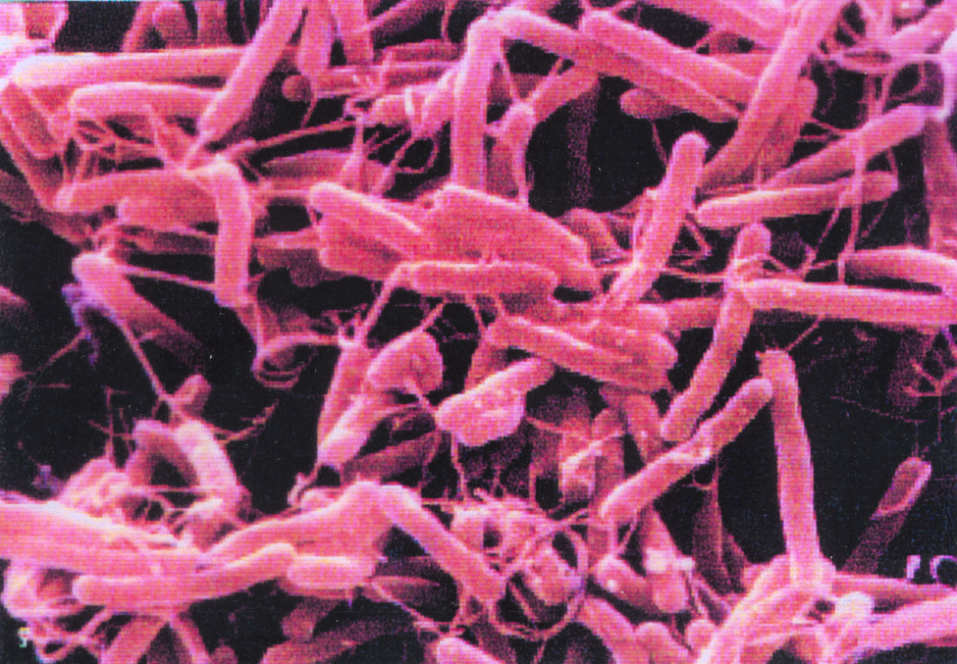
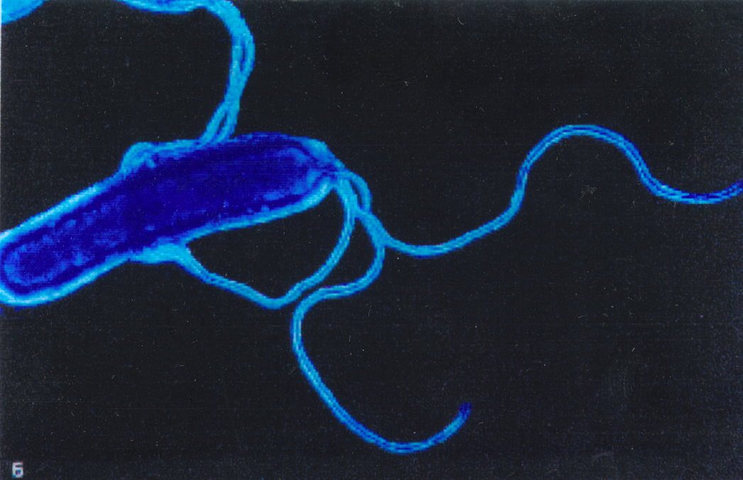
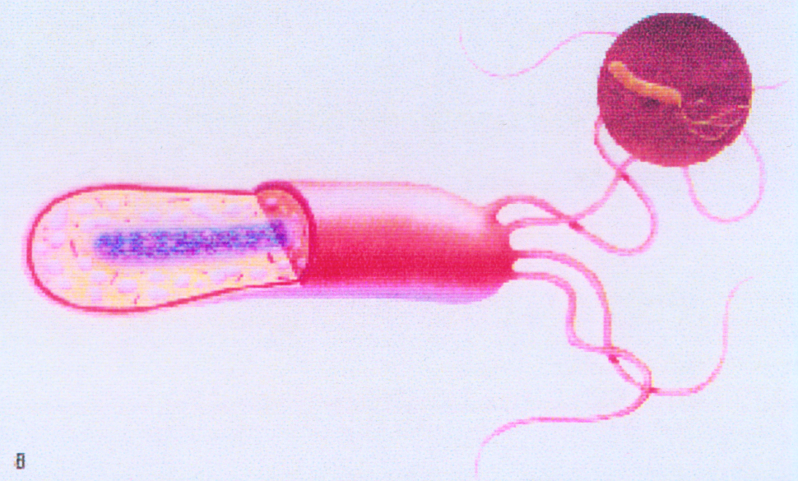
Helicobacter Pylori

Slide 25
Helicobacter Pylori (Gr- bacillus)
Robin Warren a Barry Marshall
v r.1983 popsali vztah HP a gastritidy
Nobelova cena 2005
15-20% infikovaných onemocní peptickým vředem
Genotypicky rozlišitelné kmeny HP
vac A gen = vacuolising cytotoxin gene
cag A gen = cytotoxin associated gene
Přežívá při pH ~ 1,0
umožňuje enzym ureáza vytvářející amoniak - alkalický obláček chrání bakterii před vlivem HCl

Slide 26
Vyšetření H. pylori infekce
Neinvazivní:
serologické vyšetření na IgG proti antigenům H. pylori (ELISA)
dechová zkouška s radioaktivním uhlíkem-značenou ureou
Invazivní:
Endoskopie + biopsie +
+ histologická analýza bioptického materiálu
+ potvrzení ureázové aktivity ve vzorku - ureázový test (Clotest)
+ kultivační průkaz H. pylori
+ PCR průkaz H. pylori DNA ve vzorku

Slide 27
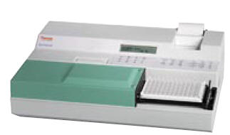
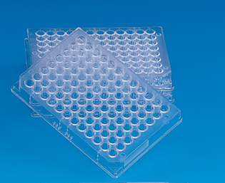
Serologické vyšetření na protilátky proti antigenům H. pylori (ELISA)
96-ti jamkové destičky
Antigen H. pyplori
Pacientovo serum/plazma
Y
Y
Y
Y
Y
Anti-IgG (Ig) –HRP (AP)
Y
Y
Y
Y

Slide 28
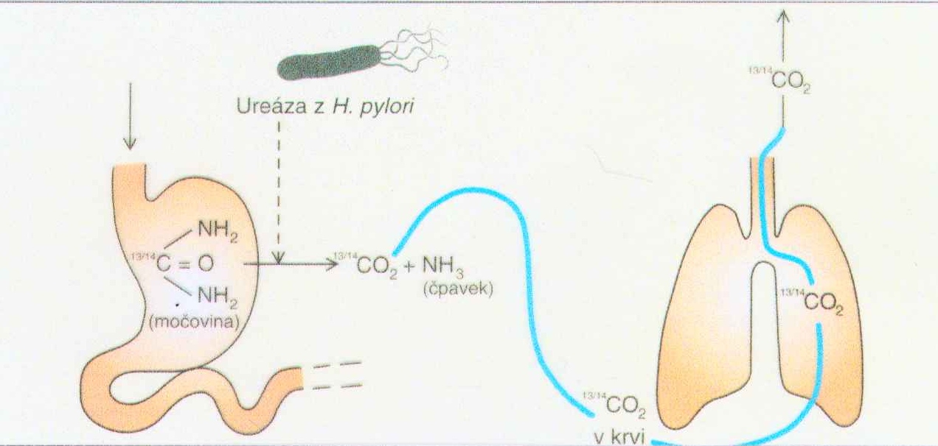
Dechový test s izotopem uhlíku značenou ureou
14C = radioaktivní izotop uhlíku nebo 13C neradioaktivní izotop uhlíku
Notes:
Patients swallow urea labelled with an uncommon isotope, either radioactive carbon-14 or non-radioactive carbon-13. In the subsequent 10-30 minutes, the detection of isotope-labelled carbon dioxide in exhaled breath indicates that the urea was split; this indicates that urease (the enzyme that H. pylori uses to metabolize urea) is present in the stomach, and hence that H. pylori bacteria are present.
For the two different forms of urea, different instrumentation is required; carbon-14 is normally measured by scintilation, carbon-13 by isotope ratio mass spectrometry (IRMS). For carbon 13 a baseline sample before taking urea is required for comparison with the post urea sample.
The difference between the pre and post urea measurements is used to determine infection. This value is compared to a cut-off value. Results below the value are assumed to be negative, those above positive. The cut-off value itself is determined by comparing the results of patients with two or more different detection methods. The value is chosen that gives the best combination of sensitivity and specificity.
The test measures active H. pylori infection. If antibiotics are depressing the amount of H. pylori present or the stomach conditions are less acidic than normal the amount of urease present will be lessened.
Accordingly the test should only be performed 14 days after stopping acid reducing medication (proton pump inhibitors ('PPI')) or 28 days after stopping antibiotic treatment. Some clinicians believe that a reservoir of H pylori in dental plaque can affect the result.

Slide 29
Rentgenologické vyšetření
Kontrastní:
tvar žaludku
změny slizničního reliéfu
postup peristaltické vlny
evakuační schopnost

Slide 30
Endoskopické vyšetření žaludku a duodena (gastroskopie) Esofagogastroduodenoskopie = EGD
Riziko vážných komplikací 1: 800
Riziko smrti pacienta 1: 5000
Informace o povrchových změnách sliznice + odběr vzorků + terapie
dg. erozí, vředů, krvácení

Slide 31
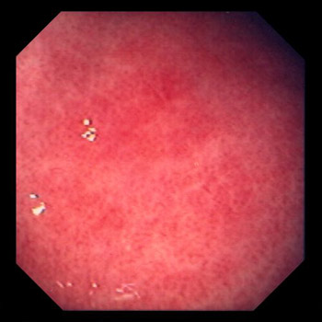
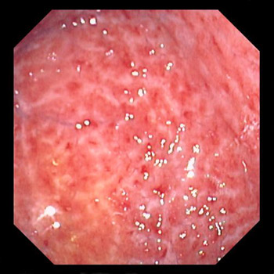
Gastritida/ záněty žaludeční sliznice
Acute gastritis
Chronic gastritis
Patient tested positive for H. pylori
Chronic erosive gastritis may be idiopathic or caused by drugs, Crohn's disease or viral infections.
Helicobacter pylori does not appear to have a major role in the pathogenesis of this condition.

Slide 32
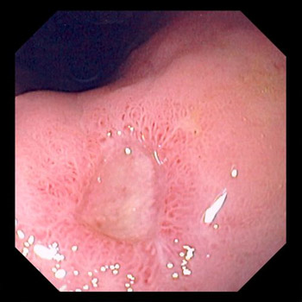
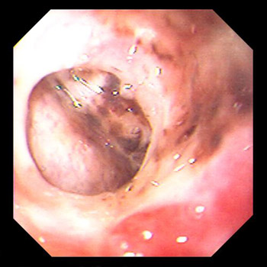
Peptický vřed/ vředová choroba
An excoriated segment of the GI mucosa, typically in the stomach (gastric ulcer) or first few centimeters of the duodenum (duodenal ulcer), which penetrates through the muscularis mucosae
Gastric ulcer
Gastric ulcer (confined perforation).

Slide 33
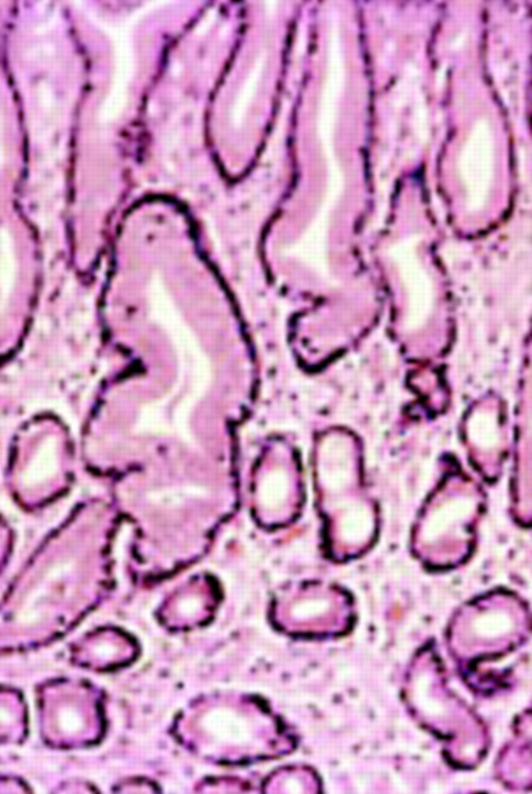
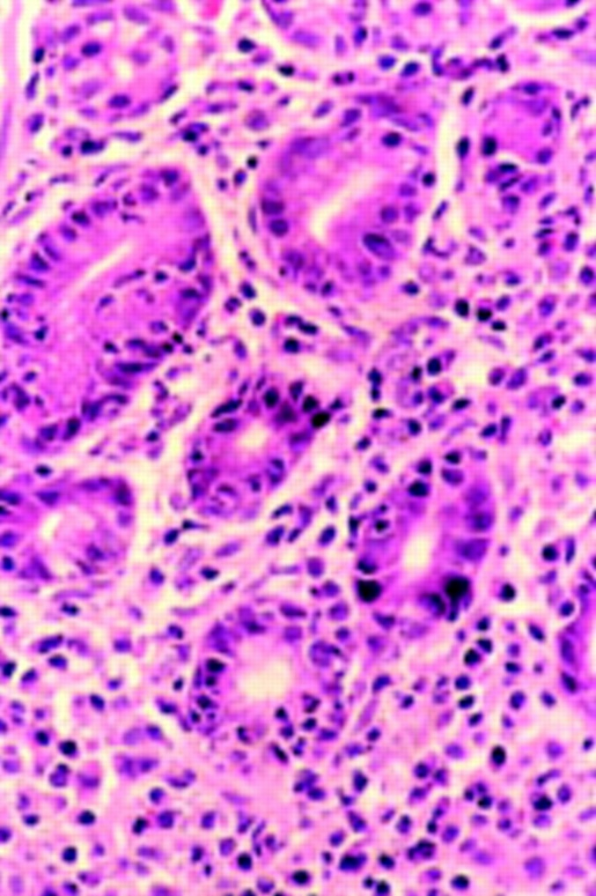
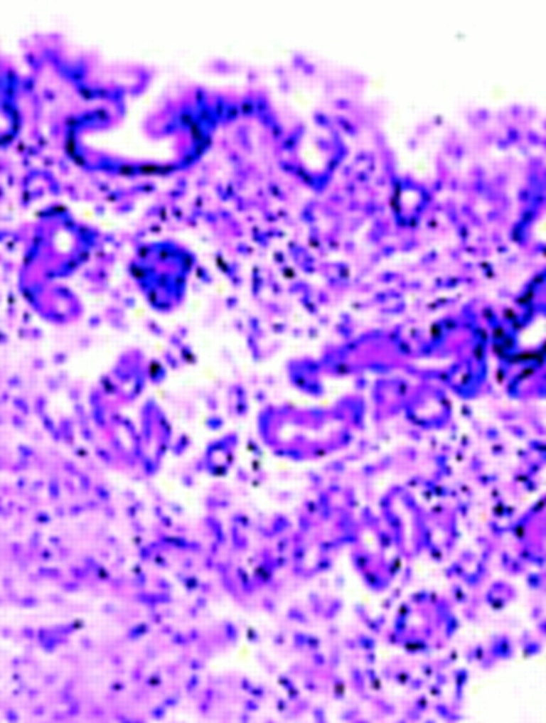
Histology of gastric mucosa
normal antral mucosa
active gastritis
atrophy of antral mucosa
Notes:
Histology of gastric mucosa. Top left: normal antral mucosa, with sparse infiltrate of lymphocytes in lamina propria. Top right: active gastritis with neutrophils infiltrating epithelium and marked infiltrate of lymphocytes in lamina propria. Bottom: atrophy of antral mucosa with loss of specialised glands near muscularis mucosa

Slide 34
Ostatní vyšetření žaludku a duodena
Vyšetření žaludečního chemismu:
omezený význam při dg. Zollinger-Ellisonova sy
Basal acid output (BAO): Po zavedení sondy se v 15 minutových intervalech odeberou 4 vzorky žaludeční štávy
Maximal (peak) acid output (MAO nebo PAO): po s.c. aplikaci pentagastrinu se se v 15 minutových intervalech odeberou 4 vzorky žaludeční štávy.
Stanovení gastrinu v séru :
dg. Zollinger-Ellisonova sy.

Slide 35
TENKÉ STŘEVO

Slide 36
Rentgenologické vyšetření
změny funkční (motilita) a morfologické (nádory, divertikly)
Nativní snímek
ve stoje, vleže (hladinky – střevní neprůchodnost - ileus)
Kontrastní
Enteroklýza - pasáž tenkým střevem (tumory, enteritídy)
Angiografie – dg. embolizace větví a.mezenterica

Slide 37
Resorpční testy
posouzení charakteru patologických změn
přímé metody
vyšetření určité látky ve stolici (tuk>6g/den ~ malabsorpce)
podmínka: neresorpovaný zbytek prochází tlustým střevem
nepřímé metody
měření p.o. podané látky v moči nebo v pravidelných intervalech v krvi

Slide 38
Resorpční testy: nepřímé metody
Xylózový test
sledování xylózy v moči po jejím p.o. podání
patologické hodnoty u poruch resorpce z prox. části tenkého střeva (typicky u chorob postihujících jejunum)
Schillingův test
sledování značeného B12 v moči po p.o. podání

Slide 39
Biopsie tenkého střeva
patient swallows lubricated tube with a Carey capsule
the tube is manipulated with fluoroscopic guidance through the pylorus to the third or fourth portion of the duodenum
biopsy specimen is obtained by producing negative pressure with a syringe while the aspiration port is open

Slide 40
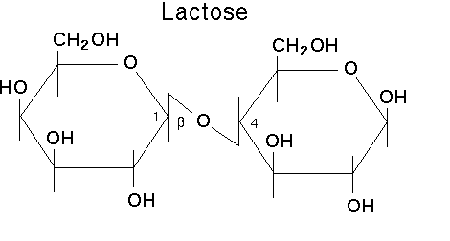
Laktózová Intolerance
The diagnosis may be suspected when chronic or intermittent diarrhea is acidic (pH < 6)
The lactose tolerance test:
Lactose 50 g p.o.
Diarrhea with abdominal bloating and discomfort within 20 to 30 min
Blood glucose flat curve with no significant peak (peak 1-2 hours)
The hydrogen breath test
Interval measurement of breath hydrogen by mass spectrometry
Small-bowel biopsy
lactase activity in a jejunal biopsy specimen confirms the diagnosis
Notes:
In a hydrogen breath test, after an overnight fast, 50 grams of lactose (in a solution with water) is swallowed. If the lactose cannot be digested, enteric bacteria metabolize it and produce hydrogen. This, along with methane, can be detected in the patient's breath by a clinical gas chromatograph or a compact solid state detector. The test takes about 2 to 3 hours. A medical condition with similar symptoms is fructose malabsorption.
In conjunction, measuring the blood glucose level every 10 - 15 minutes after ingestion will show a "flat curve" in individuals with lactose malabsorption, while the lactase persistent will have a significant "top", with an elevation of typically 50 to 100% within 1 - 2 hours. However, given the need for frequent blood drawns, this approach has been largely supplanted by breath testing.
β-D-galactose & β-D-glucose

Slide 41
TLUSTÉ STŘEVO A REKTUM

Slide 42
Zobrazovací metody
Nativní
diagnostika subileosních stavů - ileus
Kontrastní – irigoskopie
dg. susp. tumory, divertikly, tbc tl.střeva, ulcerozní kolitída, Crohnova choroba

Slide 43
Kolonoskopie, rektoskopie
hodnocení sliznice
zánět difúzní X lokalizovaný
příměs hlenu / krve
hemorhoidy
prekancerózy - polypy
Tumory
odběr vzorku na histol. vyšetření

Slide 44
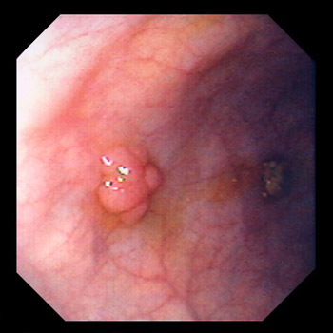
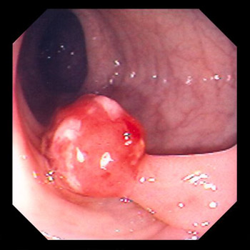
POLYPS OF THE COLON AND RECTUM
Colonic polyp (sessile)
Colonic polyp (pedunculated)
Histology demonstrated benign tubular adenoma

Slide 45
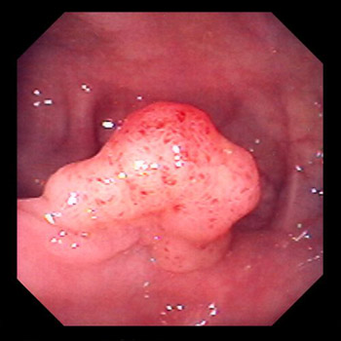
POLYPS OF THE COLON AND RECTUM
Villous adenoma.

Slide 46
Vyšetření stolice
bakteriologicky
parazitologicky
chemicky – zkouška na okultní krvácení
stanovení množství tuku

Slide 47
JÁTRA A ŽLUČOVÉ CESTY

Slide 48
Příčiny patologických výsledků jaterních testů
Snížení objemu fungující tkáně
snížení tvorby albuminu, protrombinu
Poškození hepatocytů
zvýšení transamináz v krvi, hyperbilirubinémie
Cholestáza
zvýšení bilirubinu, alkalické fosfatázy, cholesterolu v krvi
Portosystémové zkraty
snížené vychytávání látek z krve, zvýšení amoniaku v krvi

Slide 49
Základní sada jaterních testů: indikace
Příznaky jaterního onemocnění
žloutenka, tmavá moč, zvracení a/nebo průjem, světlá stolice, krvácení do gastrointestinálního traktu
zvracení krve, krev ve stolici, otoky, bolesti břicha .....
Jaterní onemocnění a poškození
Detekce
Vyhodnocení
Monitorování

Slide 50
Základní sada jaterních testů
Aspartát aminotransferáza (AST)
Alanin aminotransferáza (ALT)
Alkalická fosfatáza (ALP)
Bilirubin
Albumin
Celkové proteiny

Slide 51
ASpartát-amino-transferáza (AST)
0,5-0,65 μkat/l
srdce, kost. svalstvo, mozek, ledviny a játra
zvýšení – IM, srdečním selhání, sval. poranění, chorobách CNS a jiných mimojater. chorobách, poškození jater. buněk
vysoké hodnoty – při akutní virové nebo toxické hepatitídě
spolehlivý ukazatel poskytující dobrou monitoraci jaterních chorob (pokles k normálu svědčí o regeneraci mimo stavů spojených s jaterní nekrózou)

Slide 52
Alanin-amino-transferáza (ALT)
0,55-0,65 μkat/l
primárně v jaterních buňkách
relativně specifická pro jaterní choroby
poměr AST/ALT < 1
alkoholické postižení jater AST/ALT >2
způsobeno deficitem vit. B6 u alkoholiků (kofaktor pro ALT)

Slide 53
ALkalická fosfatáza (ALP)
2,3-2,7 μkat/l
zdroj játra, kost, placenta
Poškození jater – abnormální bilirubin, AST, nebo ALT
Kostní onemocnění – abnormální Ca2+ a fosfáty
výrazně zvýšená hladina
cholestáza
intrahepatálních příčin (prim. biliární cirhóza, poléková)
extrahepatálních příčin (obstrukce žlučovodu)
mírně zvýšená
při hepatocelulárních lézích (hepatitídy, cirhózy)
izolovaná elevace
granulomatózních nebo fokálních jaterních lézích (absces, tumor. infiltrace, částečná biliární obstrukce)
nehepatální tumory (bronchogenní Ca, Hodgkinův lymfom)

Slide 54
Bilirubin v séru
celkový bilirubin (2-14 μmol/l)
konjugovaný (přímý) bilirubin (<4 μmol/L)
Hyperbilirubinémie příčiny:
nadprodukce bilirubinu (hemolýza) ~ nekonjugovaný = volný bilirubin v séru
snížené jaterní vychytávání a konjugace ~ nekonjugovaný = volný bilirubin v séru
snížená biliární sekrece (cholestaza) ~ konjugovaný bilirubin v séru a v moči

Slide 55
celková bílkovina
60-80 g/l
snížení:
hyperhydratace
malnutrice
únik do třetího prostoru
zvýšení: dehydratace

Slide 56
albumin
30-50 g/l
biologický poločas cca 20 dnů
při akutní jater. lézi sérové hladiny nekorespondují s hepatocelurární funkcí
snížení:
chronické jaterní postiženích (cirhóza, ascites) za současného zvýšení distribučního prostoru
alkoholismus a malnutrice
ztráty ledvinami
nefrotický sy
ztráty střevem
gastroenteropatie
ztráty kůží
popáleniny

Slide 57
Ostatní jaterní testy
Gamma-glutamyl transferáza (GGT, GGTP, GMT)
0,6-1,1 μkat/l)
zvýšení – obturukce žlučovodů,
po užívání léků a požívání alkoholu (indukuje mikrozomové enzymy)
Laktát dehydrogenáza (LDH)
do 7,5 μkat/l)
ukazatel hemolýzy , infarktu myokardu, jaterní malignity
Plasmatická cholinesteráza (80-190 μkat/l)
snížená – u poškození jaterního parenchymu
zvýšená – u alkoholismu
5’ Nukleotidasa
více specifická než ALP
Notes:
cholinesterase is a term which refers to one of the two enzymes:
* Acetylcholinesterase (EC 3.1.1.7) (AChE), also known as RBC cholinesterase, erythrocyte cholinesterase, or (most formally) acetylcholine acetylhydrolase, found primarily in the blood and neural synapses
* Pseudocholinesterase (EC 3.1.1.8) (BChE or BuChE), also known as plasma cholinesterase, butyrylcholinesterase, or (most formally) acylcholine acylhydrolase, found primarily in the liver
Both of these compounds catalyze the hydrolysis of the neurotransmitter acetylcholine into choline and acetic acid, a reaction necessary to allow a cholinergic neuron to return to its resting state after activation.
The difference between the two types of cholinesterase has to do with their respective preferences for substrates: the former hydrolyses acetylcholine more quickly; the latter hydrolyses butyrylcholine more quickly. In 1968, Walo Leuzinger et al successfully purified and crystallized the enzyme from electric eels at Columbia University, NY. The 3D structure of acetylcholinesterase was first determined in 1991 by Sussman et al using protein from the Pacific electric ray.
An absence or mutation of the pseudocholinesterase enzyme leads to a medical condition known simply as pseudocholinesterase deficiency. This is a silent condition that only manifests itself when people who have the deficiency receive the muscle relaxants succinylcholine or mivacurium during a surgery.

Slide 58
Ostatní jaterní testy
Bilirubin v moči
zvýšené hladiny souvisí se zvýšením sérové koncentrace konjugovaného = přímého bilirubinu
časná známka akutní virové hepatitídy
falešně negativní – oxidace bilirubinu, askorbová kyselina, nitráty v moči
Urobilinogen v moči (střevní metabolit bilirubinu)
při nadprodukci bilirubinu (hemolýza)
při sníženém jater. vychytávání a exkreci (enterohepatální oběh přesáhne jaterní kapacitu)
snížená až negativní hodnota – při poklesu exkrece bilirubinu do střeva

Slide 59
Ostatní testy
Sérové imunoglobuliny
zvýšení: u chron. jater. chorob
pravděpodobně zvýšená antigenní stimulace extrahepatálních lymfoidních tkání GIT antigeny při poruše portálního oběhu jaterních funkcí
mírný vzestup –při akutní hepatitídě
výrazný vzestup – u chron. aktivní hepatitídy
IgM – zvýšen výrazněji u primární biliární cirhózy
IgA – zvýšen u alkoholického postižení jater
IgG – zvýšen u chron. aktivní hepatitídy

Slide 60
Ostatní jaterní testy
Protrombinový čas = Quickův čas = PT
význam PT: prognostická hodnota při akutním jater. postižení
biol. poločasy koagulačních faktorů jsou několik hod. max. několik dní

Slide 61
Onemocnění jater: Specifické testy
Virové antigeny = Ag
HBsAg –
povrchový antigen hepatitis B viru
pozitivní 1-7týdnů před, v průběhu a 1-6 týdnů po klinicky manifestní chorobě, a u chronické formy)
HBeAg – marker infektivity Hepatitidy typu B
Virové protilátky = Ab
anti-HBs – proti povrch. antigenu, po průběhu Hepatitidy typu B
anti-HBc - v průběhu akutní fáze Hepatitidy typu B
Anti HAV –
protilátky IgM (akutní) a IgG proti hepatitida A picornaviru

Slide 62
Onemocnění jater: Nádorové markery
AFP = alfa-fetoprotein syntetizován fetál. játry
u primárního hepatocelulárního karcinomu
mírné zvýšení: u akutní a chronické hepatitídy (projev jaterní regenerace)

Slide 63
Zobrazovací vyšetřovací metody: játra a žlučové cesty
nativní rtg snímek
ultrazvukové vyšetření = USG
ultrazvukové Dopplerovské průtokové vyšetření
počítačová tomografie = CT
magnetická rezonance = MRI
radionuklidové zobrazovací metody
perorální cholecystografie
endoskopická retrográdní cholangiopankreatografie = ERCP, perkutánní transhepatální cholangiografie = PTC
transvenózní jaterní biopsie
angiografické metody

Slide 64
PANKREAS vyšetření exokrinních funkcí

Slide 65
Invazivní metody
po zavedení sondy do duodena a stimulaci (secretin/cholecystokinin nebo testovací dieta)
Odběr po dobu 45 – 120 minut
Měření objemu tekutiny (>2mL/kg/h)
Měření sekrece HCO3- (>80 mmol/L and 10 mmol/h
Měření aktivity enzymů (když podán secretin/cholecystokinin nebo testovací dieta)
amyláza, lipáza, chymotrypsin, trypsin
Notes:
should be considered in the differential diagnosis of every acute abdomen. The differential diagnosis of acute pancreatitis includes a perforated gastric or duodenal ulcer, mesenteric infarction, strangulating intestinal obstruction, ectopic pregnancy, dissecting aneurysm, biliary colic, appendicitis, diverticulitis, inferior wall MI, and hematoma of abdominal muscles or spleen.
Laboratory tests cannot confirm a diagnosis of acute pancreatitis but can support the clinical impression. Serum amylase and lipase concentrations increase on the first day of acute pancreatitis and return to normal in 3 to 7 days. Both may remain normal if destruction of acinar tissue during previous episodes precludes release of sufficient amounts of enzymes to raise serum levels. Serum amylase may remain normal if there is coexisting hypertriglyceridemia (which may contain a circulating inhibitor that must be diluted before an elevation in serum amylase can be detected). Both serum amylase and lipase may be increased in other disorders, such as renal failure and abdominal conditions requiring urgent surgical therapy (eg, perforated ulcer, mesenteric vascular occlusion, intestinal obstruction associated with ischemia). Other causes of increased serum amylase include salivary gland dysfunction, macroamylasemia, and tumors that secrete amylase.
The amylase:creatinine clearance ratio does not appear to have sufficient sensitivity or specificity to confirm a diagnosis of pancreatitis. It is generally used to diagnose macroamylasemia when no pancreatitis truly exists. In macroamylasemia, amylase bound to serum immunoglobulin falsely elevates the serum amylase level. Fractionation of total serum amylase into pancreatic type (p-type) and salivary-type (s-type) isoamylase is now possible in most commercial laboratories. p-Type increases on the first day of pancreatitis and, along with serum lipase, remains elevated longer than total serum amylase. However, p-type also increases in renal failure and in other severe abdominal conditions in which amylase clearance is altered.
The WBC count usually increases to 12,000 to 20,000/µL. Third space fluid losses may increase the Hct to as high as 50 to 55%, indicating severe inflammation. Hyperglycemia may occur. Serum Ca concentration falls as early as the first day because of the formation of Ca "soaps" secondary to excess generation of free fatty acids, especially by pancreatic lipase. Serum bilirubin increases in 15 to 25% of patients because pancreatic edema compresses the common bile duct.

Slide 66
Nepřímé neinvazivní testy
Měření tuků ve stolici (72 h)
pacient na dietě se standardním množství tuku
fyziologicky < 7% požitého tuku
pankreatická insuficience > 20% požitého tuku
Měření trypsinu a chymotrypsinu ve stolici
Notes:
Ranson’s criteria for evaluation of Acute Pancreatitis
Five signs can be documented at admission: age > 55 yr, serum glucose > 200 mg/dL (> 11.1 mmol/L), serum LDH > 350 IU/L, AST > 250 U, and WBC count > 16,000/µL. The rest are determined within 48 h after admission: Hct decrease > 10%, BUN rise > 5 mg/dL (> 1.8 mmol Urea/L), serum Ca < 8 mg/dL (< 2 mmol/L), PaO2 < 60 mm Hg, base deficit > 4 mEq/L, and estimated fluid sequestration > 6 L. Mortality increases with the number of positive signs: If fewer than three signs are positive, the mortality rate is < 5%; if three or four are positive, it is 15 to 20%.
Pancreatitis associated with necrosis and hemorrhage has a mortality rate >= 10 to 50%. This diagnosis is suggested by a progressive decrease in Hct, presence of hemorrhagic fluid within ascites, reduction in serum Ca, and Grey Turner's or Cullen's sign (indicating extravasation of hemorrhagic exudate to the flanks or umbilical region, respectively).

Slide 67
Fuknční testy: bentiromidový test
Syntetický peptid bentiromide navázaná na para-aminobenzoic acid (PABA) je hydrolyzovaná chymotrypsinem v duodenu
PABA je absorbována v proximální části tenkého střeva, konjugována v játrech a její metabolity vylučované močí
Množství vyloučené PABA odpovídá aktivitě chymotrypsinu
withdrawn in the US in October 1996
Notes:
Falešně abnormální výsledky při poškození stření sliznice, jaterních onemocněních a onemocněních ledvin

Slide 68
Vyšetření krve
Trypsinogen
zvýšený u akutní pancreatitidy a renálního selhání
snížený u těžké pancreatické insuficience, cystické fibrosy a DM-I
Lipáza – zvýšená při akutní pancreatitidě
Pancreatická amyláza
představuje asi 33% serových amyláz
může být odlišena od ostatních isoenzymů elektroforeticky
akutní pankreatitida
zvýšení amylázy v séru
zvyšuje se renální clearence amylázy (amylase/creatinin ratio)

Slide 69
PANKREAS
Při pankreatickém selhání (při poškození ~90%) se může vyskytovat typická klinická trias:
pankreatické katcifikace
steatorhea
diabetes mellitus

Slide 70
Souhrn/ Dotazy/ komentáře ?
Děkuji
Vám za pozornost
-Toto je v jakékoliv formě
(PDF, PPT, PPTX atd.)
neoficiální výukový materiál
pro interní potřebu
nešířit
pro dotazy kontaktujte:
Petr.Marsalek@LF1.CUNI.CZ

