Slide 1
Part 2: Psychophysics
Charles University of Prague, First Medical Faculty

Slide 2
Outline of part 2
- Introduction: what is psychophysics
- Laws of psychophysics
- Logarithms and other functions – quantitative relations between stimulus and response
- Weber - Fechner logarithmic law
- Stevens’s law enables comparison between modalities

Slide 3
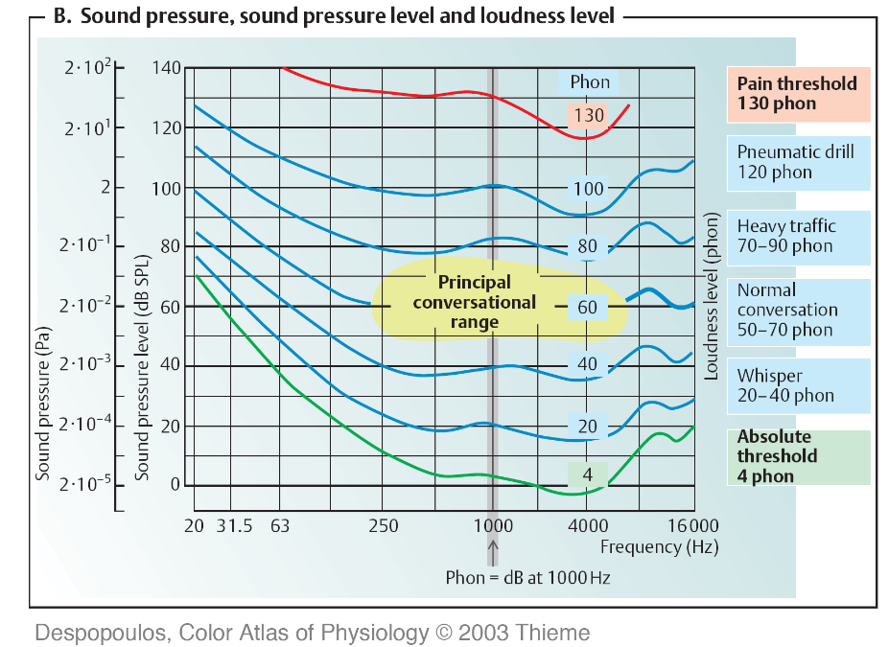
Nadpis
Let us remind the hearing range again

Slide 4
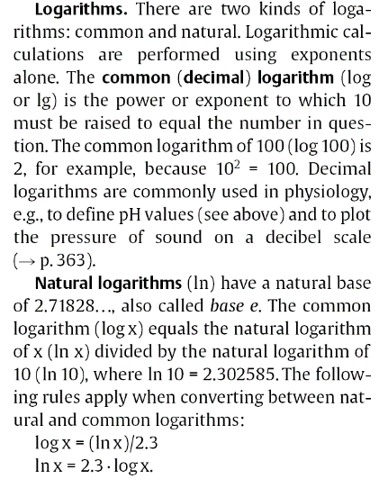
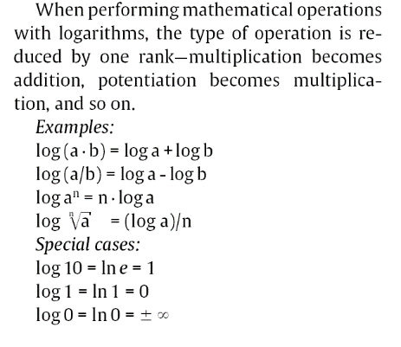
Decibel is defined as ten times decimal
logarithm of the ration of intensities.

Slide 5
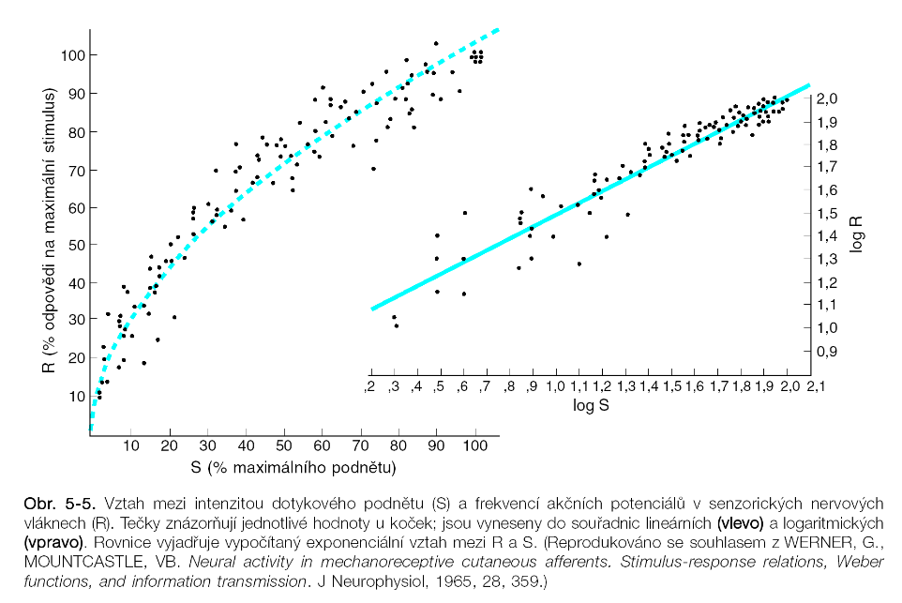

Slide 6
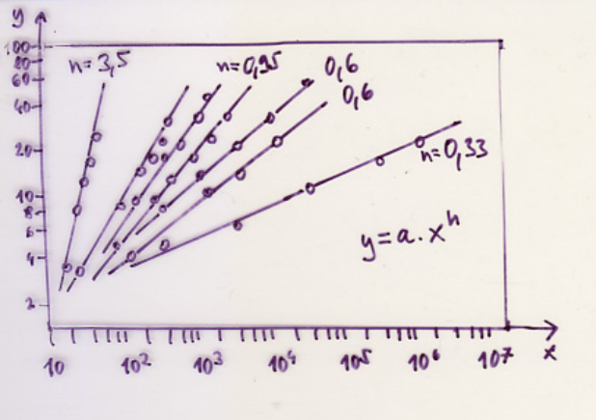
R - (response) subjective intensity
S - (stimulus) physical intensity
S₀ - threshold stimulus intensity
A - constant of proportion
N - exponent
Stevens (power) law

Slide 7
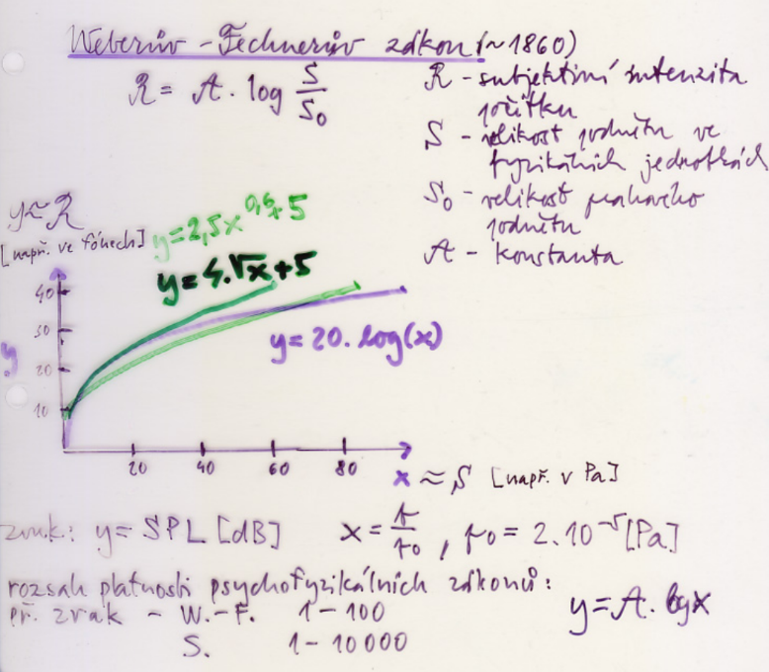
Weber – Fechner (logarithmic) law
R - (response) subjective intensity
S - (stimulus) physical intensity
S₀ - threshold stimulus intensity
A – constant of proportion

Slide 8
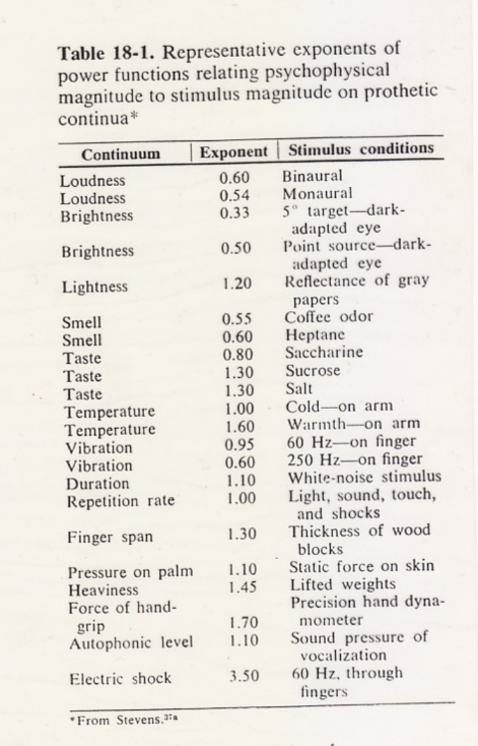
Exponents in the
Stevens (power)
law

