Slide 1
General patho-physiology: stress, neural and other control, autonomous nervous system, hormonal control, system approach…
Petr Maršálek
https://dec52.lf1.cuni.cz/~pmar/ftp/PPT-PATF/
Seminar circa 50 slides,
Topic code SY

Slide 2
Stress

Slide 3
Stress
  Stress, stress syndrome
= neurohumoral defense reaction
= universal response to different external or internal changes and stimuli – stressors
Definition:
The state of threatened homeostasis or disharmony that is counteracted by a complex of physiologic and behavioral responses that reestablish homeostasis

Slide 4
Stress
  Stressor
= factor, any adverse change of outer or inner conditions
physical
chemical
biological
psychosocial
  (trauma, surgery, infection, intoxication, pain, working overload, intensive emotion ...)

Slide 5
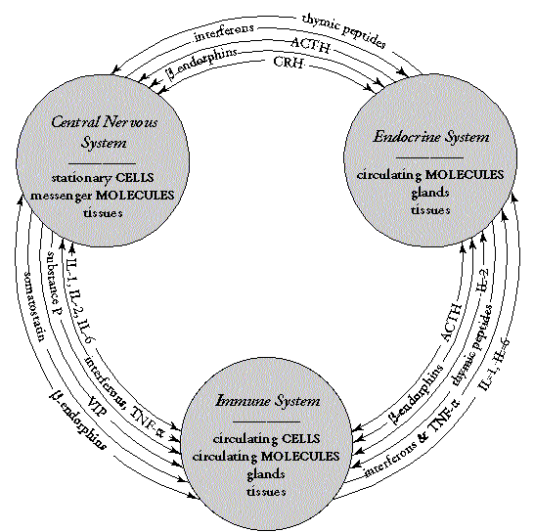
Stress
  ”Common adaptive syndrome”
  = Neurohumoral reaction, response to stressor
  mechanisms of stress activation
Stress and Inflammation
Stress with cortisol acts against
immune reaction, it is immuno=suppressive

Slide 6
Stress and Inflammation
    Stress reaction
Generalized reaction
Activation and coordination from CNS (hypothalamus)
Universal (non-specific) character
    Inflammation
Primarily local reaction (→ generalization)
Reaction of vascularized tissues
Specific response – targeting against initial stimulus

Slide 7
Stress reaction - phases
  (Hans (Janos) Selye, 1907 - 1982)
Phase Mediators Dominant changes
Alarm catecholamines CNS activation
  gluco-corticoids (=gcc),
  growth hormone,
  melano-cortin (=gcc+acth) hypothalamus
  cardiovascular effects
  glycogenosysis
proteocatabolism
Resistance gcc gluconeogenesis
  proteocatabolism
  anti-inflammat. effects
  ↓ Lymphocytes
Na + water retention
Exhaustion gcc energetic depletion
↓Glc
  metabolic acidosis

Slide 8
Stress axes
hormonal
regulation
neural
regulation
PVN
(periventricular nucleus)
CRH
Locus coeruleus
NE
Pituitary
ACTH
Sympathetic
nervous system
epinephrine
cortisol
Preganglional cholinergic fibers
stimulation
inhibition

Slide 9
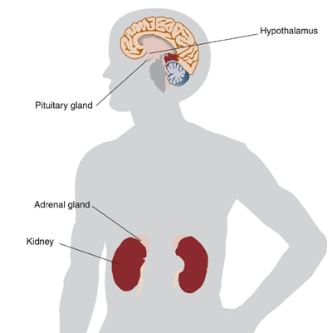
Stress system
  Mechanisms of stress activation:
  1. Activation of cerebral cortex
  2. Activation of hypothalamus
  3. Neuro-humoral response
  (sympatho - adrenal axis, pituitary - adrenal axis)
  4. Peripheral actions
  (metabolic, cardiovascular, immune system...)

Slide 10
Hypothalamus
  ↑ epinephrine
  ↓ norepinephrine
  (↑ ratio E / NE)
  ↑ CRH production in mediobasal centers
  ↑ ADH production in preoptical part of hypothalamus
  ↓ inhibition of TRH release
  activation of sympathetic - adrenal axis

Slide 11
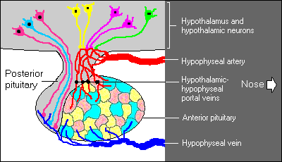
Pituitary gland
Hypothalamo - hypophyseal axis

Slide 12
Pituitary gland
  ↑ CRH + ↑ ADH → ↑ POMC
  ↑ GH
  ↓ TRH → ↓ TSH → ↓T4, T3
  ↓ GnRH → ↓ LH
  ↑ACTH

Slide 13
Pituitary - adrenal axis
  ↑CRH → stimulator of POMC in adenohypophysis
  ↑ACTH → activation of adrenal cortex
  (↑cortisol, ↑ aldost.)
  ↓ role of negative feedback of corticoids

Slide 14
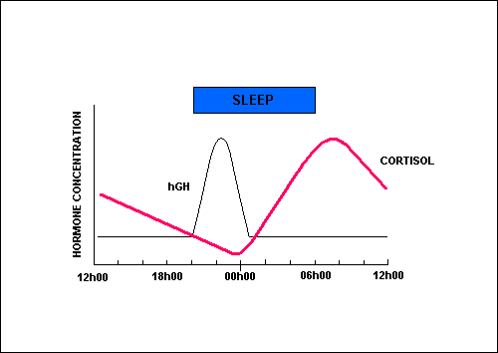
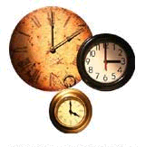
Pituitary - adrenal axis
  Secretion
Ultradian rhythm (short periods, episodic, pulsatile)
Circadian rhythm (24 h periods)
  maximal secretion at 8-10 a.m.
  minimal secretion at 11 p.m.

Slide 15
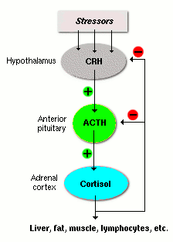
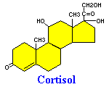
Pituitary - adrenal axis

Slide 16
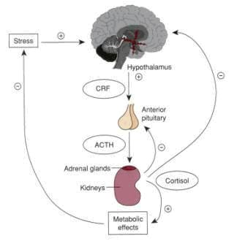
Cortisol secretion control
Negative feedback regulation

Slide 17
General control concepts, control theory
In contrast to description of cellular and molecular
response stands a systemic description
of homeostasis and its disturbances as interplay
of control (sub)systems.

Slide 18
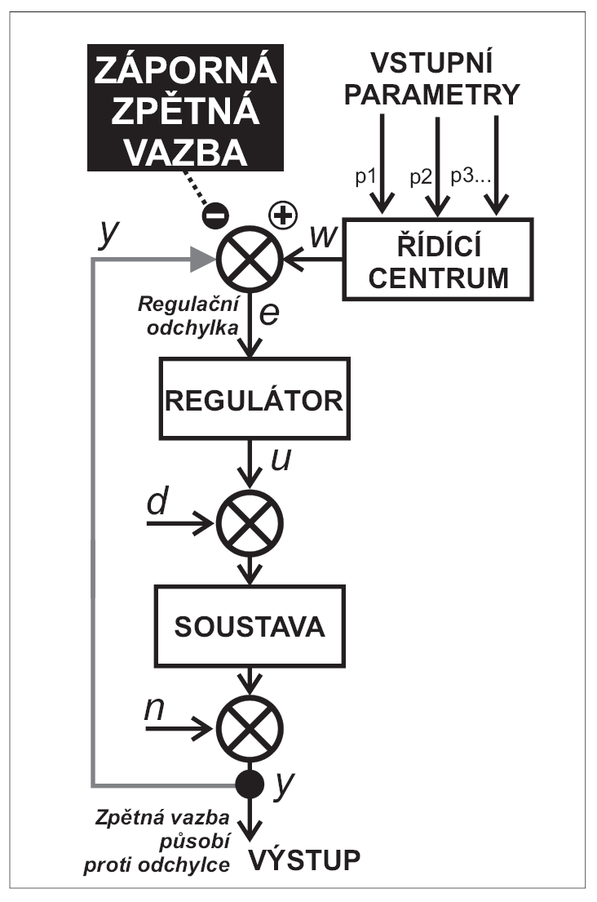
Control system: Negative feed-back
y…controlled variable, I/O
w…pre-set value
e…error signal
u…actuating variable
d,n…disturbance variables
In negative feed-back, error signal e used for control is obtained by subtraction of the controlled variable (-y) from the pre-set value (+w), e = w - y.

Slide 19
Control system: Positive feed-back
y…controlled variable, i/o
w…pre-set value
e…error signal
u…actuating variable
d,n…disturbance variables
In positive feed-back, error signal e used for control results from addition of the controlled variable (+y) to the pre-set value (+w),
e = w + y.
Outer factor is needed to disconnect feedback cycle at the point from output back

Slide 20
Examples – negative and positive feed-back
Negative feed-back – easy, almost everything is controlled this way:
blood pressure, temperature, glycemia, …
in general – homeostasis…
positive feedback – fewer examples, more difficult:
in physiology/ pato-physiology:
Fever onset, ovulation, production of sex hormones in large,
„avalanche-like“ trigger reactions:
hemocoagulation, division of lymfocytes
during the immune reaction (e.g the pneumonia crisis)
2) Pathology (pathologic values of variables, vicious circles, failures).
Building up of a new, pathologic equilibrium, example: adaptation to the lower PO2
failure of blood pressure control -> shock, hypo-perfusion, hypoxia…

Slide 21
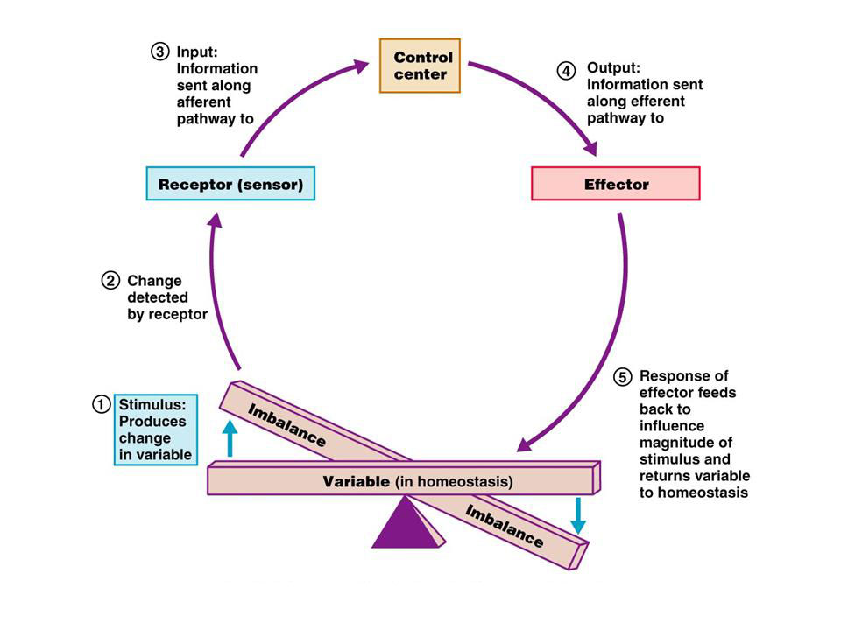
Homeostasis, control circuit simplified

Slide 22
Adrenal glands
  Glucocorticoids
  - essential for an adequate course of stress reaction
  - permissive effect on catecholamine action
  - domination in 2nd phase of stress response (st. of resistance)
  Effects:
  glycids ... gluconeogenesis
  proteins ... proteocatabolism (neg. N balance)
  lipids
  hematopoiesis (↑Neu, ↓Eos, ↓Ly, ↑Plt)
  anti-inflammatory effects ... cytokines, APP
  circulatory changes (↑BP, Na and water retention)

Slide 23
Adrenal glands
  Glucocorticoids
Glucose
1. Gluconeogenesis stimulation in liver (6-10x)
2. Activity of enzymes for AA conversion to Glc
3. Mobilization of AA from tissues (x liver)
4. Elevation of hepatic glycogen
5. Decrease of Glc utilization in cells

Slide 24
Adrenal glands
  Glucocorticoids
Proteins
1. Proteocatabolic effect in all tisues excepting liver
2. Low protein synthesis
3. Low AA transport into cells (muscles, lymphoid t.)
4. Proteoanabolic effect in liver (APP)

Slide 25
Adrenal glands
  Glucocorticoids
Lipids
1. Mobilization of fatty acids from adipose t.
2. High oxidation of fatty acids (low utilization of Glc
- energy from fatty acids)

Slide 26
Adrenal glands
  Glucocorticoids
Anti / inflammatory effects
1. The release of proteolytic enzymes, histamin, bradykinin
  x cortisol - stabilisation lysosomal membrane
2. Vasodilation in inflammatory tissue
  x cortisol - vasoconstrictory effect
3. High permeability
  x cortisol - decreased capillary permeability
4. Leucocyte infiltration
  x cortisol - inhibition of Leu migration
5. Cortisol - immunosuppresive effect (decrease of T Ly)
6. APP synthesis

Slide 27
Sympathetic - adrenal axis
  Hypothalamus
  → Medulla oblongata
  → Medulla spinalis
  → Adrenal medulla + sympathetic ganglia
  Metabolic and cardiovascular responses

Slide 28
Adrenal medulla
Catecholamine synthesis
Norepinephrine 20% 1.2 - 3.4 nmol/l
5-6 x elevation ... biological effects
Epinephrine 80% 0.1 - 0.8 nmol/l
2 x elevation ... biological effects

Slide 29
Adrenal medulla
  Catecholamines (adrenomedular system)
  rapid activation (sec...min.), rapid degradation
  crucial in an initial (alarm) phase of stress response
  Effects
  cardiovascular (chrono, ino, bathmo, dromo-tropic)
  heart (=rate, =contractility, =excitability/ depolarization to threshold, =conduction)
  ↑Cardiac Output, ↑Blood Pressure
  metabolic ... hepatic glycogenolysis
  ↑ intestinal resorption of glc.
  ↓ insulin production
  lipolysis, ↑FFA

Slide 30
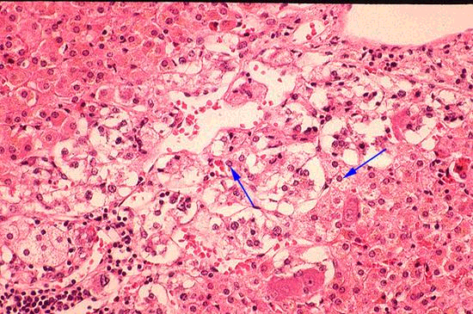
Adrenal medulla
Chromaffine cells = pheochromocytes
Axons of preganglionic sympathetic nerves
Catecholamines:
Norepinephrine … adrenal medulla + CNS + PNS
Epinephrine … adrenal medulla
Dopamine … precursor of NE, adrenal medulla + noradrenergic neurons
Receptors:
α … vasoconstriction, sweating, GIT
β … vasodilatation, GIT, catabolism, bronchodilation

Slide 31
Psycho - social stress
  = Emotional activation of stress response
  The role of paleocortical region (limbic cortex, neocortical region)
  Activating (stressogenic) pathway
  nc. amygdalae → mediobasal hypothalamus
  Inhibiting (anti-stressogenic) pathway
  fornix, gyrus hippocampi → corpora mamillaria of posterior hypothalamus
  ... protracted activation of sympathoadrenal + adrenocortical axis
  without psychiological benefit
  ... risk factor of psycho-somatic disorders

Slide 32
Stress and somatic disorders
Alterations of the ability to respond to stressors, as for example inadequate, excessive and/ or prolonged reactions, may lead to disease.
Moreover, excessive and/ or chronically imposed stressors may have adverse impact on a variety of physiologic functions, such as growth, reproduction, metabolism and the immunity, as well as on development and behavior.
Prenatal life, infancy, childhood and adolescence are critical periods characterized by increased vulnerability to stressors.

Slide 33
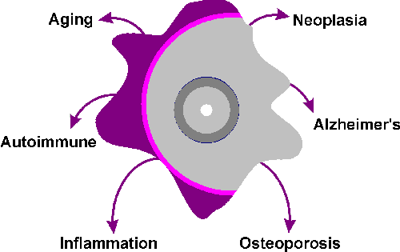
Stress and somatic disorders

Slide 34
Stress and somatic disorders
  Atherosclerosis
  Hemoconcentration
  Heart ischemic dis.
  Myocardial infarction
  Stroke
  Metabolic (Reaven) syndrome (insulinoresistance, hyperinsulinaemia, hypertension, hyperlipidaemia, hyperurikaemia...)
  ↑ sensitivity to infection
  Malignancies ?
  Gastric ulcer (Cushing syndrome ulcer)
  Graves-Basedow disease
  Psoriasis
  ... Psychosomatic medicine

Slide 35
Autonomous nervous system
This is a major control system. Often, in pathological
physiology studies of nervous system it is forgotten.
Because of: central nervous system,
humoral control (hormones), immune system, etc.

Slide 36
Neurotransmitter examples
Autonomic/ Vegetative nervous system
- sympathetic and parasympathetic,
receptors (alpha- and beta- adrenergic, nicotinic and muscarinic cholinergic)
mediators (adrenaline, noradrenaline (norepinephrine), acetylcholine)
mediator synthesis (= biogenic amines)
cleavage (choline-esterase, mono-amino-oxidase, and
re-uptake)
anatomic connections (segmental, versus head a torso, pre- and post- ganglionic fibers), urination, defecation, erection, ejaculation,
eye focusing = accomodation, pupil sphincter = adaptation,
balancing sympathetic and parasympathetic effects
36

Slide 37
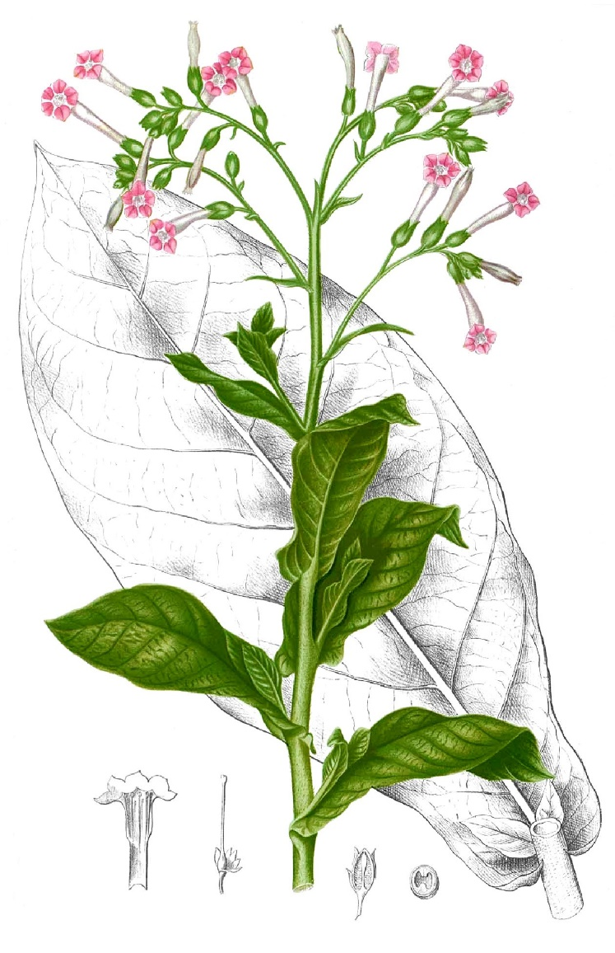
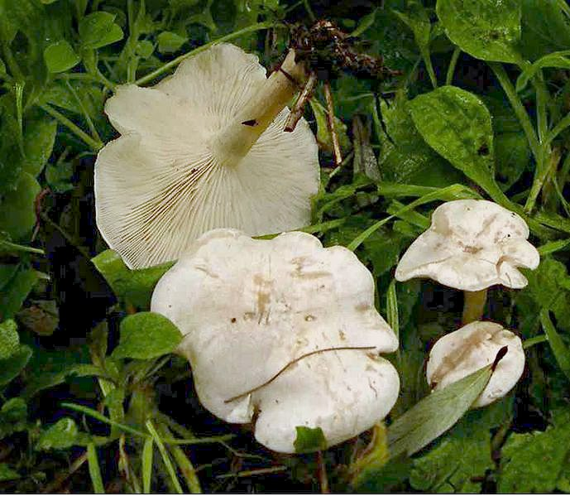
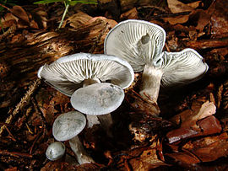
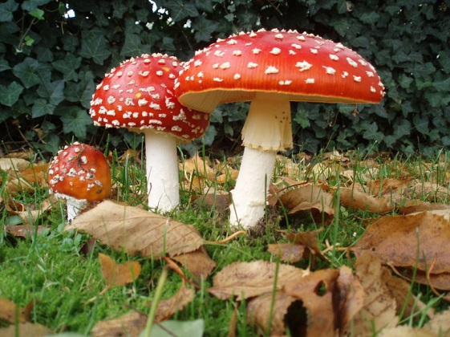
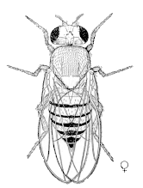
nicotinic and muscarinic cholinergic receptors
Plants and mushrooms with effect on the cholinergic synapse
Clitocybe dealbata,
or sweating mushroom
Deadly poisonous mushroom,
poison: muscarine,
antidotum: atropine
Clitocybe odora,
Edible mushroom
Nicotiana tabacum,
Tobacco plant,
Deadly poisonous plant
Amanita muscaria,
or fly agaric
Mildly poisonous
mushroom, poison:
muscimol

Slide 38
Neural pathways/ neural control
Aim and purpose and „utility“ in (patho-)physiological response.
Immuno-supressive therapies
sometimes show that a pathogenesis in disease and physiological response
Do not have these „utilitary“ features.
Neural signals/ firing rates have only a positive sign(+).
This is implemented with dual system of excitatory and inhibitory neurons.
V případě vegetativního NS this is a „duality“ of
sympathetic and parasympathetic responses
Thermoregulation:
skin vasoconstriction/ vasodilation
Sweat glands - sympathetic
Exception in mediator: cholinergic
Baroreflex: balancing
sympathetic and parasympathetic
effects
changing blood pressure:
(-) pressure=> -symp.+parasymp.
see e.g.: orthostatic reflex
(+) pressure=> +symp.-parasymp.

Slide 39
Circulation and vaso-motor control
Failure of circulatory control
is manifested as shock
(defined as) such a drop of the systemic
blood pressure, which cannot sustain
oxygenation reserve in functioning of organs
with vital importance
(heart, brain, respiratory muscles)

Slide 41
Baroreflex
Baroreflex: balancing
sympathetic and parasympathetic
effects
changing blood pressure:
(-) pressure=> -symp.+parasymp.
see e.g.: orthostatic reflex
(+) pressure=> +symp.-parasymp.

Slide 42
Baroreflex

Slide 43
Baroreflex

Slide 44
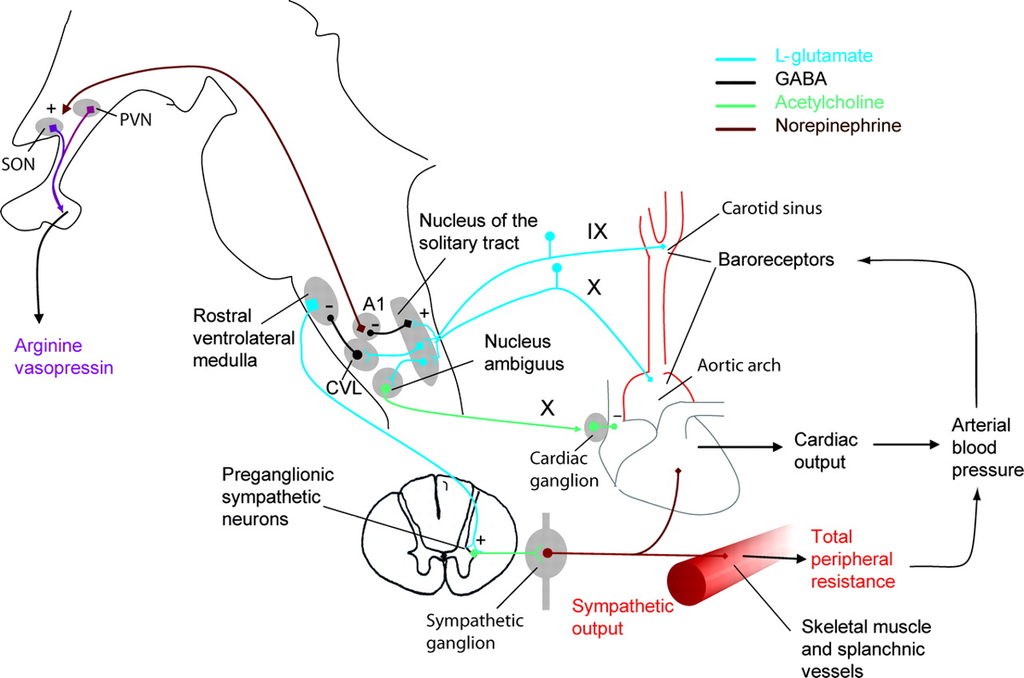
Baroreflex
SON = supra-optic nucleus
(ADH, or vasopressin)
PVN = para-ventricular nucleus
(oxytocin)
CVL= caudal ventrolateral n.
(-) press.=> also orthostatic
reflex
(+) press.=> symp./ parasymp. balance

Slide 45
Autonomous nervous system,
And its polarity, (or duality):
Parasympathetic versus sympathetic.
Fight and/ or flight versus relaxation/ regeneration
Sometimes more than 2 alternatives: vasomotor control can be:
1 alpha and 2 beta adrenergic and 3 cholinergic

Slide 46
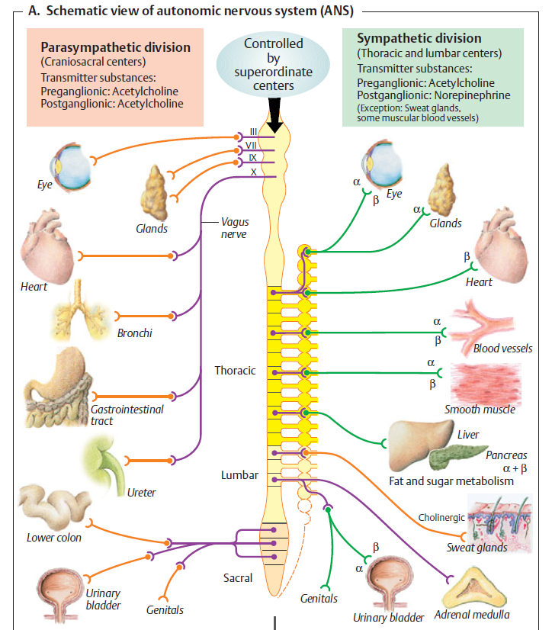
CZ
Eye and autonomous system
uvnitř jsou jen hladké svaly,
mióza – paras., cholinergní,
mydriáza – symp., alfa1 adren;
akomodace, m. ciliaris,
do dálky – symp. beta2,
na blízko – paras.;
slzné žlázy - paras.;

Slide 47
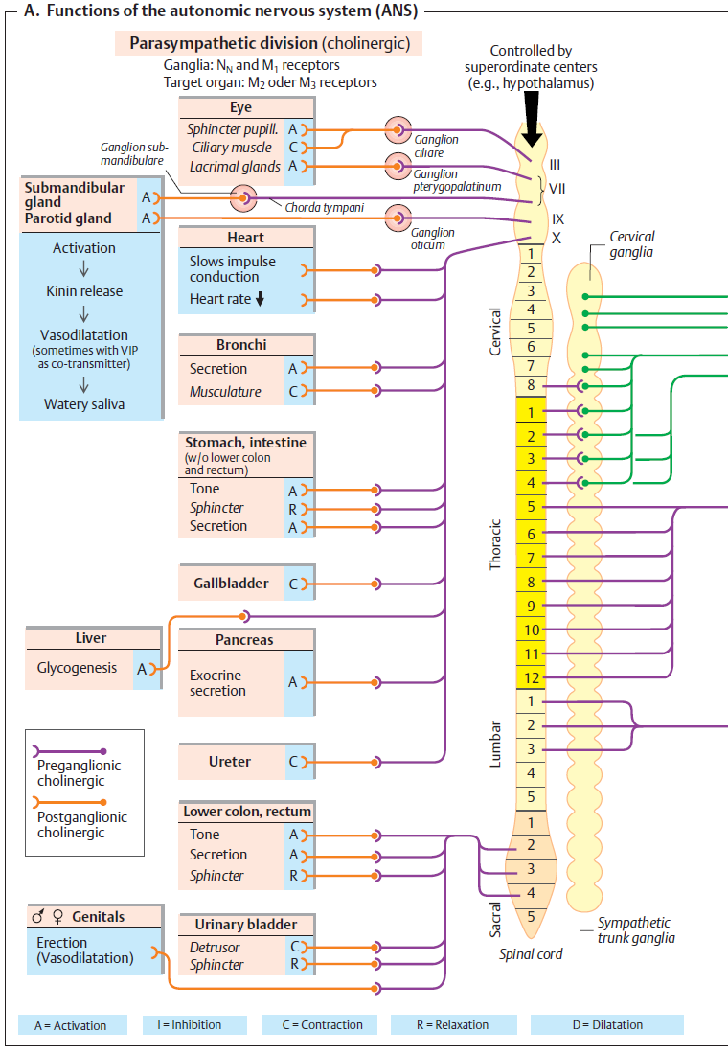

Slide 48
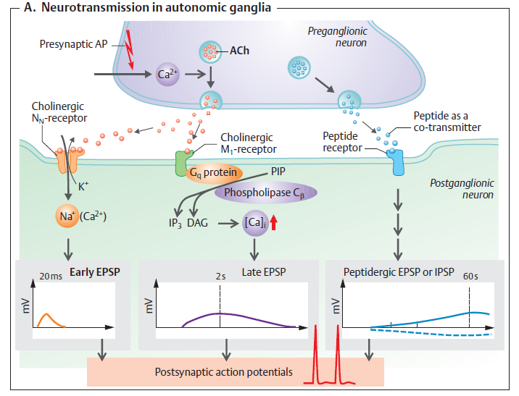
Cholinergic receptors

Slide 49
Cholinergic receptors

Slide 50
Adrenergic receptors

Slide 51
Adrenergic
receptors

Slide 52
Další N.S.:
Enterický nervový
systém, myenterický a submukósní plexus,
atd, atd
Je modulován hormony
i vegetativním NS, ale peristaltika může probíhat i nezávisle na obou vlivech. Po laparotomii,
či jiném inzultu nastává většinou přechodná paralýza, potom se opět restartuje.
CZ

Slide 53
Sympathetic
Autonomous nervous system disorders
Influenced
by various
drugs

Slide 54
Parasympathetic
Influenced
by various
drugs

Slide 55
Temperature control, fever, hypothermia
homeostasis
processes to save heat
processes to eliminate heat
1 radiation, 2 conduction, 3 convection, 4 evaporation

Slide 56
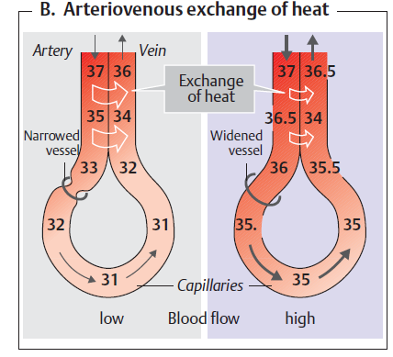
core and shell
countercurrent systém

Slide 57
Heat transfer:
1
(radiation)
2
(conduction)
3
(convection)
4
(evaporation)

Slide 58
Přehřátí, úpal/ úžeh…
Vicious circles

Slide 59
Fever, temperature control
homo-io-termic organisms

Slide 60
Fever
Old defence reaction, well conserved in evolution
Correlation with better prognosis and duration of acute infection
Defense reaction → adverse environment for microbes, for their metabolism and proliferation.

Slide 61
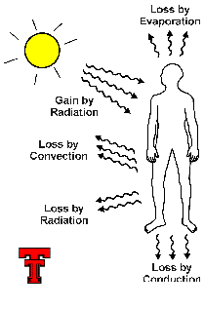
Fever
Regulation of temperature
heat production
(intensity of metabolism – catecholamines, T_{3,4})
x
heat output

Slide 62
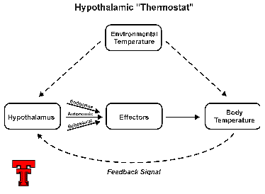
Fever
Hypothalamic thermoregulatory center
- „thermostat“

Slide 63
Fever
TNF, IL-1, IL-6 + microbial toxins + PG
↓
stimulation / reset of hypothalamic center
    direct effect of mediators in hypothalamus
    indirect / afferent stimulation via n. vagus from periphery to hypothalamus
    ↓
    peripheral vasoconstriction (cold skin, hypoperfusion)
    heat production (thermogenesis)
↓
Restoration of initial status
    vasodilatation
    perspiration

Slide 65
Hypothermia

Slide 66
Inflammation

Slide 67
Inflammation
= The complex system of defense reactions of vascularized tissues against pathogenic stimulus (insult) of different character
The aim of inflammation is:
elimination of a cause,
removal of an irreversibly damaged tissue,
consecutive tissue regeneration or reparation, restoration of impaired both metabolism and function of organs, the return to dynamic balance status
Including other defense actions: coagulation, regeneration, vs. (connective) tissue reparation, wound healing, neuro-humoral responses

Slide 68
Acid base balance

Slide 69
Fyziologické regulace se uplatňují u patologických stavů, hranice mezi fyziologickým a patologickým je neostrá
CZ
- Patologické procesy a mechanismy se podílejí v patogenezi více onemocnění
Fyziologické mechanismy zúčastňující se tzv. patogeneze: obranné a adaptivní mechanismy, zánět, horečka, hyper-termie, hypo-termie, šok, stres, edém,
poruchy regulačních mechanismů (!, co to je?...),
poruchy metabolismu, poškození genetické informace, atd. ….

Slide 70
CZ
Další témata obecné patofyziologie:
aktivní transport, klidový (Nernstův) potenciál na membráně, akční potenciál, membránové jevy obecně
nutrice
růst a vývoj
stres a jeho mechanismy

Slide 71
Acute phase proteins
Stimulatory effects of proinflamm. cytokines + corticoids ( + insulin) on hepatic proteosynthesis
An increase of expression of a group of important defense proteins + concurrent depression of both structural and transport protein synthesis
Acute phase proteins = plasma proteins formed in liver; its synthesis is regulated both by proinflamm. cytokines and corticoids
Due to dynamics of changes:
- positive APP (elevation of synthesis)
- negative APP (depression of synthesis).

Slide 72
Acute phase proteins
Importance
1. mediators and modulators of inflamm. response - members of cytokine cascade (CRP, …)
2. inhibitors of leukocyte proteases – limitation of a range of proteolytic tissue destruction (a₁-antitrypsin, a₂-macroglobulin)
3. scavengers – binding of both circulating or tissue fragments of damaged cells, hemoglobin fragments (haptoglobin, hemopexin) or free oxygen radicals (ceruloplasmin)
4. some coagulation factors (e.g. fibrinogen)
5. reparatory proteins – a stimulation of connective tissue proliferation (a₁-acid glycoprotein) and angiogenesis (ceruloplasmin)
6. transport proteins - (x Cpl); a moiety of other transport proteins (albumin, transferrin) represent negative APP ... their plasma concentration decline during inflammation.

Slide 73
Disturbances of the growth
• genetic factors
action of the endocrine system
function of the CNS
nutrition
• genotype determines scheme of the growth, development, habit, prenatal period (development of CNS and endocrine glands)
outstanding influence of thyroid hormones, GH, insulin
T3, T4 - necessary for release of GH, for development of teeth germs, development of habit, ossification of the cartilages
• growth after birth continues two steps of accelerated growth:
till 3rd month
puberty control and stop by influence of the sex hormones

Slide 74
Insufficient growth 1
• influence of heredity
chondrodystrophy – disturbance of growth of long bones, skull base, vertebrae,
low production of the GH, thyroid hormones etc.
disturbance of the hypothalamus –
disturbed production GnRHs Fröhlich´s syndrome,
pubertas praecox
• neural influence, hypothalamic region
Fröhlich´s syndrome
pubertas praecox
diabetes insipidus
disturbed control of body temperature

Slide 75
Insufficient growth 2
• influence of the endocrine systeme
acquired diseases are manifestated at hypophysis disturbance before
puberty:
separate low production of GH
low production of further hormones
(e.g. hypothyroidism, insuphiciency of the adrenal cortex, gonads etc)
• influence of the nutrition
lack of full-value proteins retarded growth, decreased synthesis
of proteohormones

Slide 76
Excessive growth
• influence of heredity
primordial gigantism
• endocrine system
a) insufficient production of sex hormones
primary hypogonadism (late closing of growth cartilages)
b) overproduction of the GH
before closing – gigantism
after acromegaly

Slide 77
Causes of the ageing
• influence of heredity
• defective protein synthesis – accumulation of the defects, accumulation
of the mutations
• mutations in the immune system – lasting accumulation of the mutations
of immune-competent cells (lymphocytes, macrophages) higher frequency
of the autoimmune disturbances in old age
role of the cytokines in development of diseases – IL-1, IL-6, TNF, EGF,
IGF-1, fFGF, PDGF
decreased amount of heat-shock proteins (HSPs prevent protein from
aggregation, from increase of the Ca2+ in ICF; they lower the amount of the
free radicals, prevent from DNA breaks and accelerate DNA repair
• pre-programmed life-span in cell populations – interference by:
a) accumulation of free radicals
b) accumulation of the substances in ECF (Ca, lipofuscin, cholesterol)
c) cross-linkage of the macromolecules in ICS including DNA, RNA

Slide 78
Hypothermia in surgery
decline of core temperature lowering of metabolism and oxygen uptake in
tissues
controlled hypothermia is used prevalently in cardiosurgery and neurosurgery
programmed cooling of blood in extracorporal circulation
temperatures 32ºC - 27ºC are commonly used
in long-term surgery – body temperature can be lowered less then 25ºC
after surgery – programmed relatively rapid blood rewarming

Slide 79
Bazální metabolismus
CZ
Bazální metabolismus = klidový metabolický obrat
hrubý odhad: asi 100 kJ na 1 kg za 1 den
Mechanická energie: činnost srdce, plic, střevní peristaltika,…
Transportní a osmotická práce: udržení rovnováhy na membránách
Chemická energie: biosyntézy
Tepelná energie: udržení tělesné teploty

Slide 80
The END
Thanks for your attention
Warning: neither the PDF, nor the PPT, PPTX, etc.
versions of this presentation are official study materials.
For internal use only. Do not distribute.
Contact: Petr.Marsalek@LF1.CUNI.CZ
First Medical Faculty, Institute of Pathological Physiology

