Slide 1
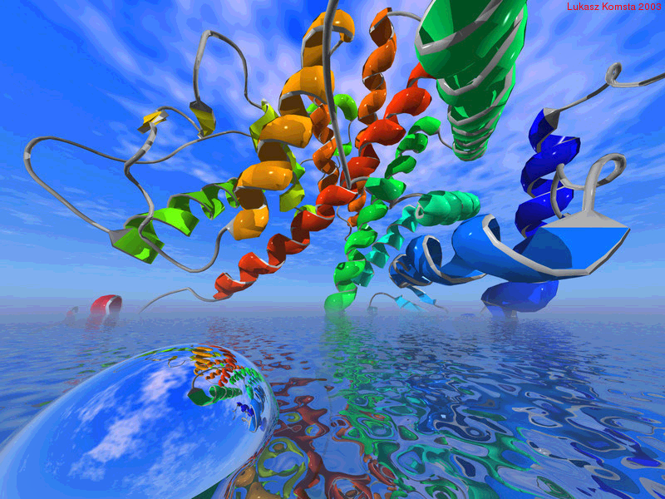
EXAMINATION OF ENDOCRINE DISORDERS (2)
Case reports
Prof. Dr. Pavel Maruna

Slide 2
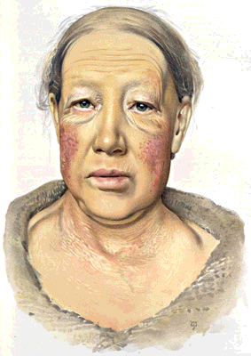
Case report No. 1
Hypothyroidism

Slide 3
Female, 46 yr.
Patient treated with arterial hypertension for last 3 years;
Palpitations for many years, established diagnosis of neuro-circulatory asthenia, higher frequency of palpitations in last months, reported as paroxysmal heart pulsation, accompanied with a pant and shortness of breath, independent on her physical activity;
Impaired glucose tolerance, last 3 yr. on a diet;
As a new problem, paresthesia in fingers, swelling of hands developed several weeks ago.

Slide 4
Allergy: negative
Chronic medication: ramipril (angiotensin-converting enzyme inhibitor) as an anti-hypertensive treatment
Abuse: alcohol and smoking - negative
Gynecological history: menses from 12 to 44 yr. (e.g., menopause 2 yr. ago), 2 deliveries, 1 abortion.
Social situation: married, 2 kids, working as a shop assistant.
Family history: twin sister treated with thyroid dysfunction;
without other serious diseases in her family.

Slide 5
Actual problems:
Progressive difficulties last year:
Patient is slow, non effective, sleepy.
Tiredness, worsening of memory.
Poorer pronunciation, rhonchus (=low pitch chest wheezing).
Constipation.
Weight increase about 5 kg last 12 months.

Slide 6
Physical examination:
Blood pressure 130 / 85 mmHg, heart rate 50 / min., regular, temperature 36,0 °C
Height 165 cm, weight 74 kg, BMI 27,2
Differences from a normal status:
Moderated/ slowed down psycho-motor tempo,
limited mimics in face,
rhonchus,
dry skin with a yellow tone,
spare hair,
symmetrically edematous (upper) eyelids,
symmetric soft painless goiter,
hand and finger swelling,
peri-maleolar ankle edemas.

Slide 7
Laboratory findings
Na+ 138 mmol/l (137 - 146)
K+ 4,1 mmol/l (3,8 - 5,0)
Cl- 101 mmol/l (97 - 108)
glycaemia 5,5 mmol/l (3,9 - 5,6)
urea 6,9 mmol/l (2,8 - 8,0)
creatinine 112 μmol/l (44 - 110)
cholesterol 7,8 mmol/l (3,8 - 5,8)
triacyl-glycerols 1,1 mmol/l (0,68 - 1,69)
total bilirubin 17 mmol/l (2,0 - 17,0)
ALT 0,46 ukat/l (0,10 - 0,78)
AST 0,72 ukat/l (0,10 - 0,72)

Slide 8
Blood count
Leukocytes 8,6 x 10³/mm³ (4,1 - 10,2)
Erythrocytes 3,12 x 10⁶/mm³ (4,19 - 5,75)
Hemoglobin 101 g/l (135 - 174)
HCT 32,8 (0,39 - 0,51)
MCV 105 fl (82 - 98)
MCH 0,32 pg (28,0 - 34,6)
Platelets 295 x 10³/mm³ (142 - 327)

Slide 9
Thyroid gland examinations
free T4 4,2 pmol/l (11,0 - 21,0)
free T3 0,7 nmol/l (1,5 - 3,0)
TSH 33,3 mIU/l (0,5 - 5,0)
anti-TSHR Ab negative
anti-TPO Ab +++
anti-thyroglobulin Ab ++
USG imaging
Volume of thyroid gland 25 ml (normal limits to 20 ml), lobes are symmetric, bilaterally numerous foci with low echo-genicity. Thyroid gland delimited (without invasion to surrounding structures). Lymph nodes of normal shape.

Slide 10
Achilles tendon reflex: markedly protracted
ECG
Sinus rhythm, ventricular activity 50 / min., horizontal axis, PR segment 220 ms, QRS duration 90 ms, QT-c interval 420 ms, low voltage of QRS complex, ST segment in iso-electric line, normal shape of T wave.

Slide 11
Recommendation:
To start a treatment with levothyroxine (Euthyrox tbl.) in a dose
25 ug per day (1 tbl. in the morning).
After 4 weeks, Euthyrox may be increased to 50 ug per day.
After 2 months, laboratory control of TSH, free T3 and free T4 levels.

Slide 12
Question No. 1
Diagnosis of hypothyroidism in this patient can be established with a knowledge of history and physical examination, still before laboratory examination.
Nevertheless, which laboratory parameters confirm hypothyroidism in this patient? What is their relation to thyroid dysfunction ?

Slide 13
Question No. 2
Mild anemia was found in this patients.
Based on morphological classification, which type of anemia is it?
What is a pathogenesis of anemia in hypothyroidism ?

Slide 14
Question No. 3
Discuss following findings and their possible links to hypothyroidism:
hypercholesterolemia
ECG curve changes

Slide 15
Question No. 4
The diagnosis of thyroid disorder is based on knowledge of:
1. Thyroid function (hypothyrodism, hyperthyroidism, euthyroid status);
2. Local signs (goiter, local expansion - trachea, esophagus, vessels);
3. Etiological classification.
What is a cause (etiology) of hypothyroidism in this patient?

Slide 17
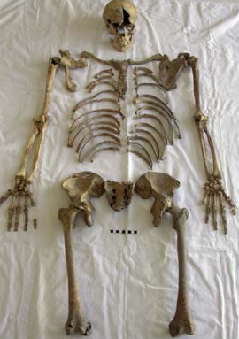
Case report No. 2
Osteomalacia

Slide 18
History
Recorded in 2008
Female, 60 yr. old
Past history: without severe diseases in anamnesis
Chronic treatment: irregularly analgetic drugs for dorsalgia (back pain)
Allergy: negative
Abuse: negative
Family history: without important diseases in parents and siblings
Gyn. history: delivery 1, abortion 0.
Social status: lives in solitude, old-age pensioner

Slide 19
History
Patient was admitted to internal department of regional hospital in Moravia
for progressive dyspnoe stage II.-III. (according to NYHA classification)
In physical examination
  cachexia,
  heavy kypho-scoliosis,
  short stature (136 cm),
  pectus excavatum
  tachypnoe, dyspnoe in minimal activities (walking).
In laboratory – markedly elevated D- dimers (>6000),
(norm is less than 500 nanograms per milliliter, ng/mL)
high activity of ALP 16 μkat / l (norm is less than 2.2 μkat / l ).

Slide 20
History
The examination in hospital excluded following diseases:
acute coronary syndrome,
pulmonary embolism,
dissection of aortal aneurysma,
pneumotorax
…

Slide 21
X-ray imaging
Chest native X-ray: Heavy kyphoscoliosis of thoracic backbone.
Backbone skiagram: Diffuse osteoporosis with de-differentiation and destruction of vertebrae.
Skull skiagram: Without destructive changes of bones.

Slide 22
With these findings, the patient was send to hospitalization to Osteological department of the 3rd Internal clinic,
1st Faculty of Medicine in Prague
...to examine bone metabolism and to start a therapy.

Slide 23
With these findings, the patient was send to hospitalization to Osteological department of the 3rd Internal clinic,
1st Faculty of Medicine in Prague
...to examine bone metabolism and to start a therapy.
Newly patient reports a progressive lowering in body height in last 2 years.
As a main problem, patient complains about dorsal pain.

Slide 24
Physical examination
Height 136 cm, weight 29 kg, BMI 16.1
BP 130/90 mmHg, heart rate 115/min.,
O₂ saturation 95%
Kypho-scoliosis, pectus excavatum.

Slide 25
Physical examination
Height 136 cm, weight 29 kg, BMI 16.1
BP 130/90 mmHg, heart rate 115/min.,
O₂ saturation 95%
Kyphoscoliosis, pectus excavatum.
ECG
Sinus tachycardia 105 / min., AV blockade of the 1st degree

Slide 26
Laboratory examination
Na ⁺ 141 mmol/l (137 - 146)
K ⁺ 5,0 mmol/l (3,8 - 5,0)
Cl ⁻ 107 mmol/l (7 - 108)
Ca ²⁺ 2,66 mmol/l (2,00 - 2,65)
Ca ²⁺ 1,45 mmol/l (1,0 - 1,4)
H₂PO₄⁻ 0,93 mmol/l (0,6 - 1,6)
Mg 0,79 mmol/l (0,66 - 1,08)
LDH 2,63 ukat/l (2,20 - 3,75)
Urea 6,0 mmol/l (2,8 - 8,0)
Creatinine 61,0 μmol/l (44,0 - 110,0)
Uric acid 411 mmol/l (220 - 420)

Slide 27
Laboratory examination
ALT 0,26 μkat/l (0,10 - 0,78)
AST 0,28 μkat/l (0,10 - 0,72)
GGT 0,66 μkat/l (0,14 - 0,84)
Bilirubin 8 mmol/l (2,0 - 17,0)
ALP 13,53 μkat/l (0,6 - 2,2)
Cholesterol 5,4 mmol/l (3,8 - 5,8)
Triacylglycerols 1,8 mmol/l (0,68 - 1,69)
Total protein 78 g/l (65,0 - 85,0)
Albumin 40 g/l (35,0 - 53,0)
TSH 6,821 mIU/l (0,5 - 5,0)
Free T4 15.2 pmol/l (11,0 - 21,0)
PTH 257,2 pmol/l (1,6 - 6,9)

Slide 28
USG of thyroid and parathyroid glands
Enlargement of a parathyroid body bellow left lobe of thyroid gland.
Thyroid gland of a normal size and shape.
^{99m}Tc-MIBI
Higher accumulation of ^{99m}Tc-MIBI near a lower edge of a left thyroid lobe

Slide 29
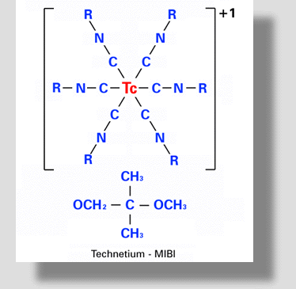
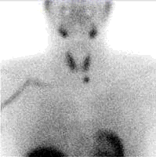
^{99m}Tc-MIBI
= methoxy isobuthyl isonitril
The molecule passes cells membranes passively, once intracellular it further accumulates in the mitrochondrias.
Detection of ^{99m}Tc gamma emission
Adenoma of a parathyroid gland

Slide 30
Abdominal USG imaging
Without pathological changes.
Echocardiography
Normal ventricular function, normal valvular morphology and function.
Spirometry
Severe restrictive respiratory disease.
Severe reduction of a vital lung capacity to 25% of normal values.

Slide 31
Diagnostic consideration (1)
Findings of ↑ PTH, ↑ Ca, and HPO₄ near a lower limit support a diagnosis of primary hyperparathyroidism. A severe bone syndrome in a clinical and laboratory examination.
Suspect adenoma of a left lower parathyroid gland.
There is an indication to surgical removal of parathyroid adenoma.
...And following surgical treatment of deforming kyphoscoliosis with markedly decreased lung capacity.

Slide 32
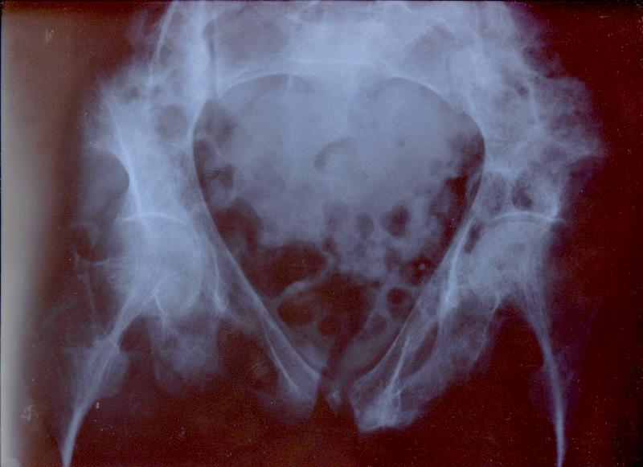
X-ray examination of pelvis and femoral bones
Marked deformation of pelvic skeleton, „heart-shaped“ pelvis, deflection of both femoral bones, low density of all displayed bones

Slide 33
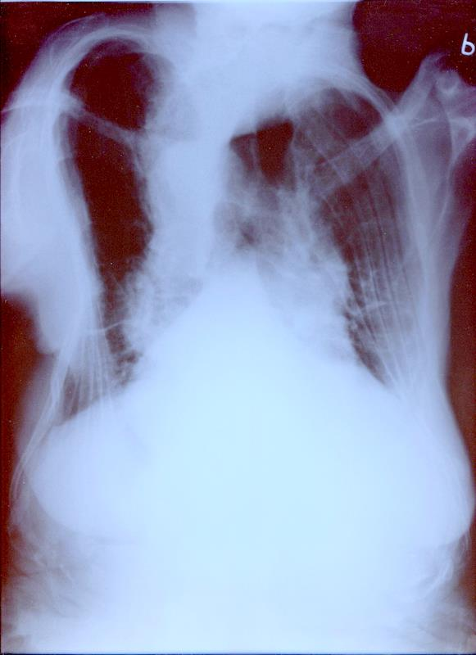
Chest X-ray image
Bell-shaped chest with gibbus,
Total resorption of humerus head on the left side.

Slide 34
Chest X-ray image
Bell-shaped chest with gibbus,
Total resorption of humerus head on the left side.
Conclusion
Skeletal deformities are typical for osteomalacia

Slide 35
„Bone“ laboratory parameters
Osteocalcin 201,8 μg/l (15 - 46)
25(OH)-D₃ vitamin 5 ng/ml (15 - 42)
1,25(OH)-D₃ vitamin 48,4 ng/l (19 - 67)
U - Ca 2,5 mmol/24 h (3,5 - 6,5)
U - HPO₄ 19,1 mmol/24 h (13 - 42)

Slide 36
Diagnostic consideration (2)
Skeletal deformities are characteristic for osteomalacia, not for primary hyperparathyroidism.
Extremely low levels of kalcidiol (25-OH-D₃ vitamin), as a marker of vitamin D storage in organism.

Slide 37
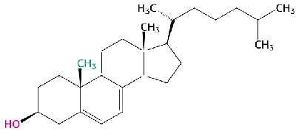
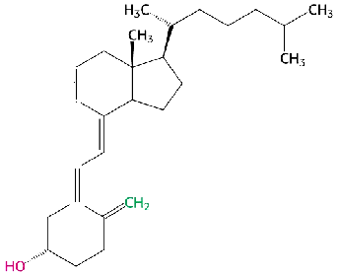
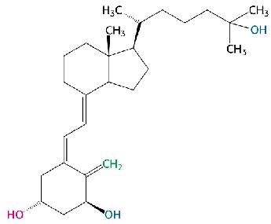
7-Dehydrocholesterol (liver)
Vitamin D₃ metabolism
Photoreaction
(skin)
Calcitriol
(1α,25-dihydroxycalciol)
Calciol
(cholekalciferol, D₃)
25-hydroxylation (liver)
1α-hydroxylation (kidneys)

Slide 38
Diagnostic consideration (2)
Skeletal deformities are characteristic for osteomalacia, not for primary hyperparathyroidism.
Extremely low levels of kalcidiol (25-OH-D₃ vitamin), as a marker of vitamin D storage in organism.
Marked skeletal decalcification – low calciuria, high ALP (marker of increased osteoblastic activity).

Slide 39
Diagnostic consideration (2)
Findings give evidence against primary hyperparathyroidism
Long-term hypo-calcemia leads to hyperplasia of parathyroid glands with following autonomous over-function of one of them.
This course suggests for tertiary hyperparathyroidism.

Slide 40
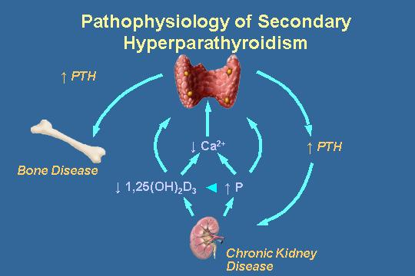
Tertiary hyperparathyroidism
Due to prolonged hypocalcemia, one hyperplastic parathyroid body developed functionally autonomous adenoma. Hypocalcemia has changed to hypercalcemia.

Slide 41
Recommendation
Surgical revision of parathyroid glands, displacement of autonomous body (v. s. adenoma) as well as other 3 (likely hyperplastic) parathyroid bodies, the maintenance of ½ of one of them - what is sufficient for normal PTH production.
Post-surgery massive re-calcification due to expected „hungry bone“ syndrome.

Slide 42
Surgery
February 20 – 29, 2008, hospitalization at the 3rd Dept. of surgery, Faculty hospital in Motol.
February 22, 2008 – Extirpation of adenoma of the left lower parathyroid gland, currently total extirpation of upper and lower parathyroid body on the right side, subtotal ablation of the left upper body.
Post-surgical course:
Laboratory: Ca 1,71….1,75 mmol / l
Post-surgery creepiness of hands and face ... as expected manifestation of transitory hypocalcemia

Slide 43
2nd hospitalization
February 29 – March 02, 2008, 3rd Internal Department
Subjectively: Intermittently depressive.
Objectively: Rest scar above sternum, without other variations.
Laboratory: Ca 1,85 mmol/l (2,0 - 2,65)
HPO₄ 0,67 mmol/l (0,6 - 1,6)
ALP 25,45 ukat/l (0,6 - 2,2)
PTH 18,01 pmol/l (1,6 - 6,9).

Slide 44
Diagnostic consideration (3)
1. Tertiary hyperparathyroidism – extirpation of parathyroid adenoma which developed in long-term secondary hyperparathyroidism.
2. Post-surgery „hungry bone“ bone syndrome with hypocalcemia.
3. Osteomalacia of an unclear origin as a primary disease

Slide 45


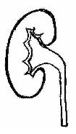
Ca balance in organism
Mineral deposits
25 mol Ca
Daily intake
approx. 25 - 30 mmol
(rapidly replaceable
only 100 mmol)
Bone remodelation
7,5 mmol / d
(phosphates, oxalates...)
Quick replacement
500 mmol / d
Absorption
upto 15 mmol / d
ECT
2,5 mmol / l
totally only 35 mmol
ICT
signal function
0,1 μmol / l
Secretion
to 7 mmol / d
Filtration
240 mmol/d
Tubular resorption
230 mmol / d
17 – 25 mmol /d
5 – 6 mmol /d

Slide 46
What now?
1. To establish etiology of osteomalacia – suspicion of malabsorption.
2. Repeated controls of calcemia during therapy:
Calcium 1,5 g / den, Alpha-D3 1 ug/day.
(Alpha-D3 is vitamin D3 hydroxylated in position 1)

Slide 47
Hospitalization on the 4th Internal Clinic, 1st Faculty of Medicine in Prague
Diagnostic hospitalization for suspicion of intestinal malabsorption syndrome

Slide 48
Auto-Ab, coeliac disease
Auto-antibodies negative
Gastroscopy
Normal macroscopic finding
Biopsy with normal histological image
Colonoscopy
Diverticolis of sigmoideum, other parts without pathological changes.
Histological examination from biopsies with normal findings.

Slide 49
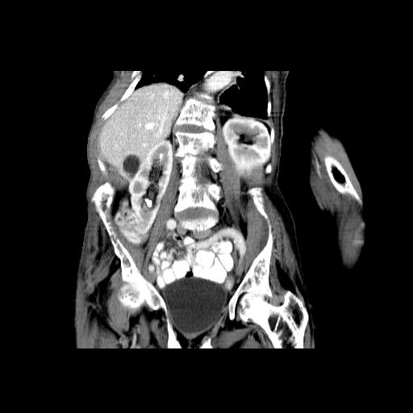
Abdominal CT imaging
Without important changes. As an incidental finding, a cyst of right hepatic lobe and a renal stone of a right kidney (10x7 mm) were revealed.

Slide 50
Intestinal resorption of Ca²⁺
Fc₂₄₀ = 9 % (normal limits 20 - 22 %)

Slide 51
Intestinal resorption of Ca²⁺
Fc₂₄₀ = 9 % (normal limits 20 - 22 %)
Principles of examination
Resorption of Ca²⁺ is derived from Sr²⁺ resorption.
After p.o. administration of 2,5 mmol SrCl₂, serum levels of Sr²⁺ are measured immediately (c₀) and after 240 min (c₂₄₀). Fc₂₄₀ is calculated.

Slide 52
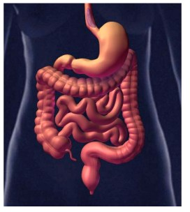
Causes of impaired gut resorption of Ca
Low intake of Ca in a food
Low biol. availability of Ca in a food
„Negative balance“ – secretion of Ca
Impaired absorption of Ca

Slide 53
Physiology of Ca absorption
D-vitamin independent paracelullular absorption
D-vitamin dependent absorption

Slide 54
Ca²⁺ resorption is independent on a specific transport protein
Calcitriol changes conformation of calmodulin. More effective linkage of Ca²⁺ to calmodulin facilitates a passing of Ca²⁺ through intestinal wall
Calcitriol induces a synthesis of cytosolic calbindin (CaBP, calcium-binding protein). CaBP has high affinity to Ca²⁺ in cytosol. Therefore an increase of intracellular Ca²⁺ is limited and Ca is released from enterocytes.
Calcitriol induces a synthesis of Ca²⁺-ATPase, from Ca²⁺ transport from enterocyte do extracellular fluid.

Slide 55
Conclusion
Idiopathic impaired calcium intestinal resorption
Recommended nutritional support by „sipping“.
Therapy: Ca 1,5 g / day, Alpha-D3 1 ug / day.
Follow up in out-patient department of osteology

Slide 57
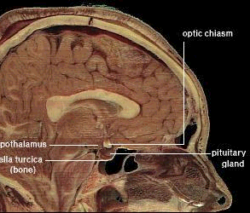
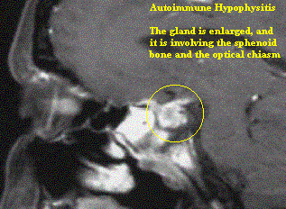
Case report No. 3
Hypopituitarism

Slide 58
Female, 38 yr.
at age 20 umbilical herniotomy
at age 28 cholecystectomy for gallbladder stones
at age 34 sectio cesarea
Without regular medication
Abuse - negative
Allergy - negative
Social status: teacher, 3 children
Gynecology: 3 deliveries, 3 aborts

Slide 59
June 26, 2009, sectio cesarea as a 3rd delivery
One week after delivery, severe weakness, headache and impaired lateral vision revealed.

Slide 60

June 26, 2009, sectio cesarea as a 3rd delivery
One week after delivery, severe weakness, headache and impaired lateral vision revealed.
Perimeter
Bitemporal hemianopsia
MRI of pituitary (September 14, 2009)
Macroadenoma of pituitary gland with suprasellar propagation,
in a near contact with chiasma n. optici.

Slide 61
Laboratory
Prolactin 117 mIU/l (<630)
LH 0,62 IU/l (0,7-5,0)
FSH 2,22 IU/l (0,5-8,0)
Estradiol 11,0 pg/ml (25-75)
free T4 6,2 pmol/l (11,0-21,0)
TSH 0,6 mIU/l (0,5-5,0)
Cortisol 81,0 nmol/l (200-750)
All described hormones are borderline or bellow normal limits.
Laboratory findings respond to combined pituitary insufficiency:
- hypogonadism,
- hypothyroidism,
- hypocortisolism

Slide 62
Hospitalization at internal department
Substitution therapy of hypopituitarism
High doses of corticoids → hypokalemia
October 04, 2009 – paroxysm of ventricular fibrillation

Slide 63
Hospitalization at internal department
Substitution therapy of hypopituitarism
High doses of corticoids → hypokalemia
October 04, 2009 – paroxysm of ventricular fibrillation
Transport to ICU of the 3rd Internal clinic, General Faculty Hospital in Prague
Stabilization, correction of hypokalemia and hypophosphatemia
Indicated to neurosurgical treatment of pituitary adenoma

Slide 64
Hospitalization at internal department
Substitution therapy of hypopituitarism
High doses of corticoids → hypokalemia
October 04, 2009 – paroxysm of ventricular fibrillation
Transport to ICU of the 3rd Internal clinic, General Faculty Hospital in Prague
Stabilization, correction of hypokalemia and hypophosphatemia
Indicated to neurosurgical treatment of pituitary adenoma
Hydrocortison 25-15-5 mg / d.
Euthyrox 125 μg / d.
Omeprazol (Helicid) 20 mg / d.

Slide 65
January 25, 2010 – admission to Neurosurgical dept.
Perimeter
Normal finding !!
MRI of pituitary (January 26, 2010, Prague)
Hypophysis 12x6 mm, without signs of adenoma !!
Infundibulum without dislocation.
No signs of bleeding.
Normal size of ventricular system.

Slide 66
Conclusion:
Actual finding is not an indication to surgery.
Pituitary apoplexy ?
Persisting panhypopituitarism, requiring substitution.

Slide 67
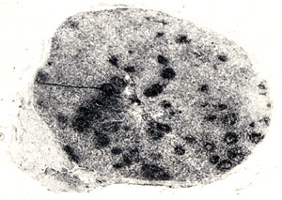
Following revision of previous MRI images
The finding, regarded to be a pituitary macroadenoma, is a typical image of lymphocyte (autoimmune) hypophysitis.
Development of MRI image as well as clinical course confirm this diagnosis.
Prof. J. Marek, 3rd Internal Dept., 1st Faculty of Medicine

Slide 68
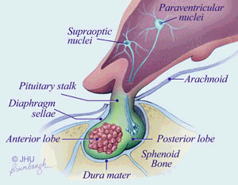
Differential diagnostics of pituitary expansions
Tumors
Other
90 %
10 %

Slide 69
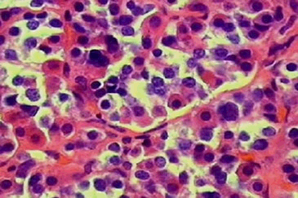
Differential diagnostics of pituitary expansions
Tumors
Other
Adenome
35 % hormonally afunctional
30 % PRL ... prolactinoma
25 % STH ... acromegaly
10 % ACTH ... Cushing sy
< 1 % other (TSH, LH, FSH)

Slide 70





Differential diagnostics of pituitary expansions
Tumors
Other
Craniopharyngeoma
Glioma
Chordoma
Meningeoma
Metastasis
Hamartoma
Dysgerminoma

Slide 71
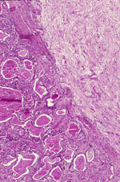
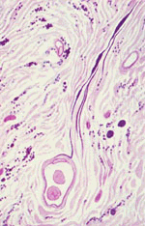
Differential diagnostics of pituitary expansions
Tumors
Other
Hereditary disorders
Cysts
Aneurysm
Hypophysitis

Slide 72
Autoimmune hypophysitis
The most frequent type of chronic pituitary inflammation
Prevalence: females – mainly during pregnancy + shortly after delivery
Frequent mismatch with macroadenoma
Good prognosis with tendency to spontaneous regression.

Slide 73
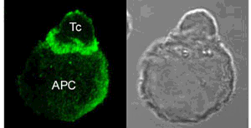
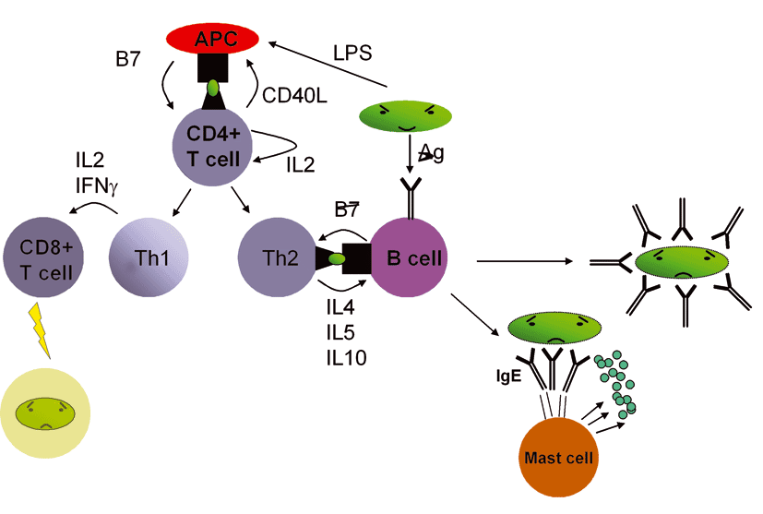
Patogenesis of hypophysitis
Hormonal dysbalance (gravidity, post-delivery)
„Dysbalance“ of T_{H1} / T_{H2} responses
Expression of MHC II
+
CD 4+ T Ly
CD 8+ T Ly
Autoimmune reaction
type 4

Slide 74
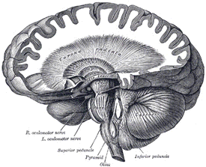
Clinical findings
Local changes
47 % headache
33 % vision alteration
Hypopituitarism
33 % ↓ ACTH
13 % ↓ TSH
Hypothalamic - pituitary
dysfunction
27 % diabetes insipidus
23 % ↑ PRL

Slide 75
Dif. dg. between hypophysitis and pituitary adenoma
Young females
Onset usually before or early after delivery
Early symptoms - headache, vision alteration
Spontaneous regression

Slide 76
Dif. dg. between hypophysitis and pituitary adenoma
MRI image ... elongated, pyriform shape of pituitary in hypophysitis

Slide 77
Dif. dg. between hypophysitis and pituitary adenoma
„Selective“ hypopituitarism:
Pituitary destruction caused by tumor leads usually to subsequent dysfunction in following order:
LH, FSH
STH, TSH
ACTH
In a case of lymphocyte hypophysitis, the decrease of ACTH is usually the first sign.

