Slide 1
Talks and seminars on NS at the (internal) web server of Medical Faculty 1: dec52.lf1.cuni.cz
This seminar „Examination in Neurology“:
https://dec52.lf1.cuni.cz/~pmar/ftp/PPT-PATF/PPT-sem-EN/
pptx and pdf files
All Talks on NS:
https://dec52.lf1.cuni.cz/~pmar/ftp/PPT-PATF/...
Seminar on Diagnostic Methods:
SE-Nerv-Syst-Diag-EN-2025-etc.pptx

Slide 2
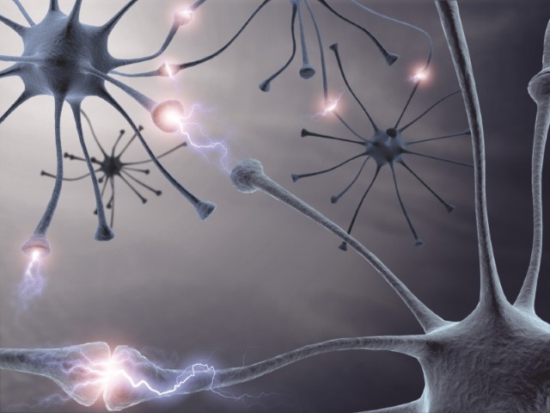
Examination in neurology
Institute of Pathological Physiology
1st Faculty of Medicine
Charles University

Slide 3
Examination methods
patient history (anamnesis)
status praesens
objective examination
laboratory examination
(therapeutic plan)

Slide 4
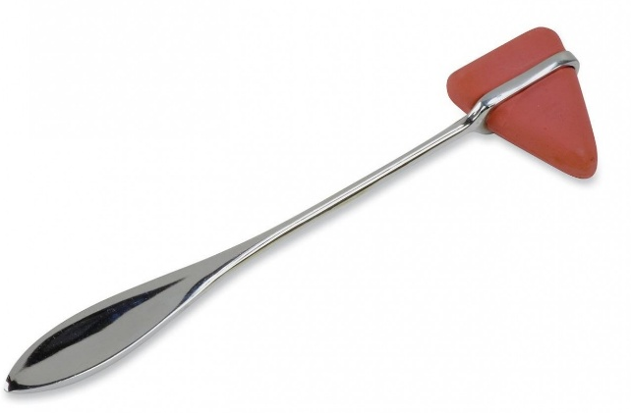
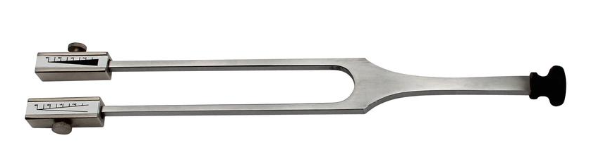
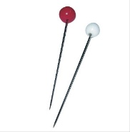
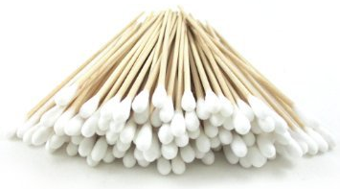

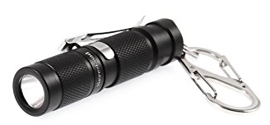
What do we need?
neurological hammer
flash light
tuning fork
sharp pin
cotton buds
measuring meter

Slide 5
neurological- psychological
(vs. psychiatric) examinations
(from Thieme Color Atlas of Neurology)

Slide 6
Anamnesis
family history of neurological diseases
all pathological changes, which cause the patients their problems
other personal medical history
work and social anamnesis (patient’s ability)

Slide 7
Present status
I. Mental, intellectual status (specific in children, standard in adult patients)
II. Cranial nerves
III. Motor function
  upper and lower extremity
  extrapyramidal, cerebellar signs
IV. Standing and gait
V. Somatosensory function

Slide 8
Mental status examination
Mini-Mental State Examination (MMSE)
  Long term memory (name, birthday, place of living, name of the president, this place)
  Short term memory (repetition of three short words)
  Phatic functions
    spontaneous speech, repetition of grammatical particles (no ifs, buts or ands)
    calculation (subtracting 7 from 100)
    practical skills (knot the tie, dressing, gestures)

Slide 9
Mental status examination
writing a sentence
(copy of a simple picture)
detailed neuropsychological and/ or psychiatric examination

Slide 10

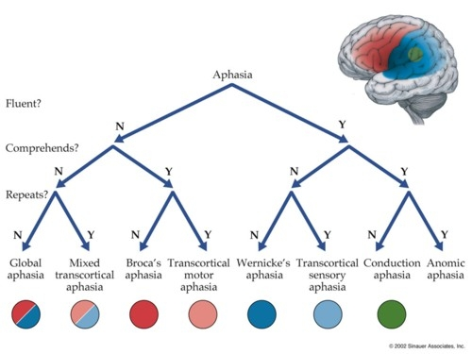
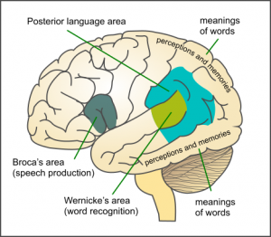
Aphasia

Slide 11
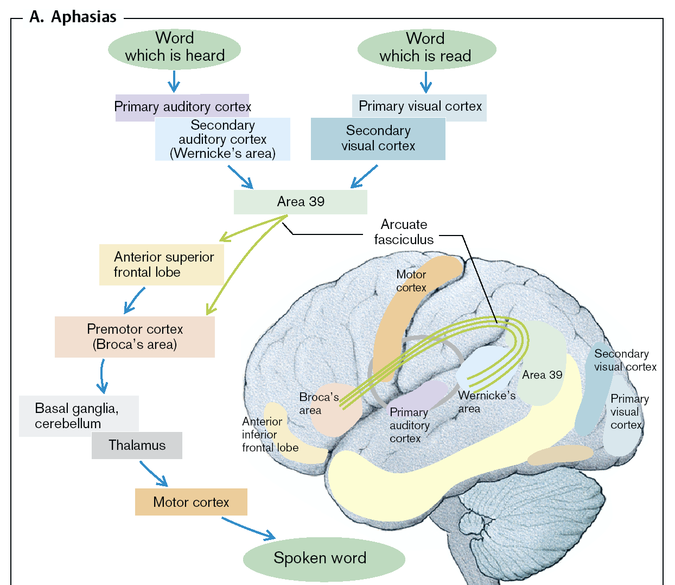

Slide 12
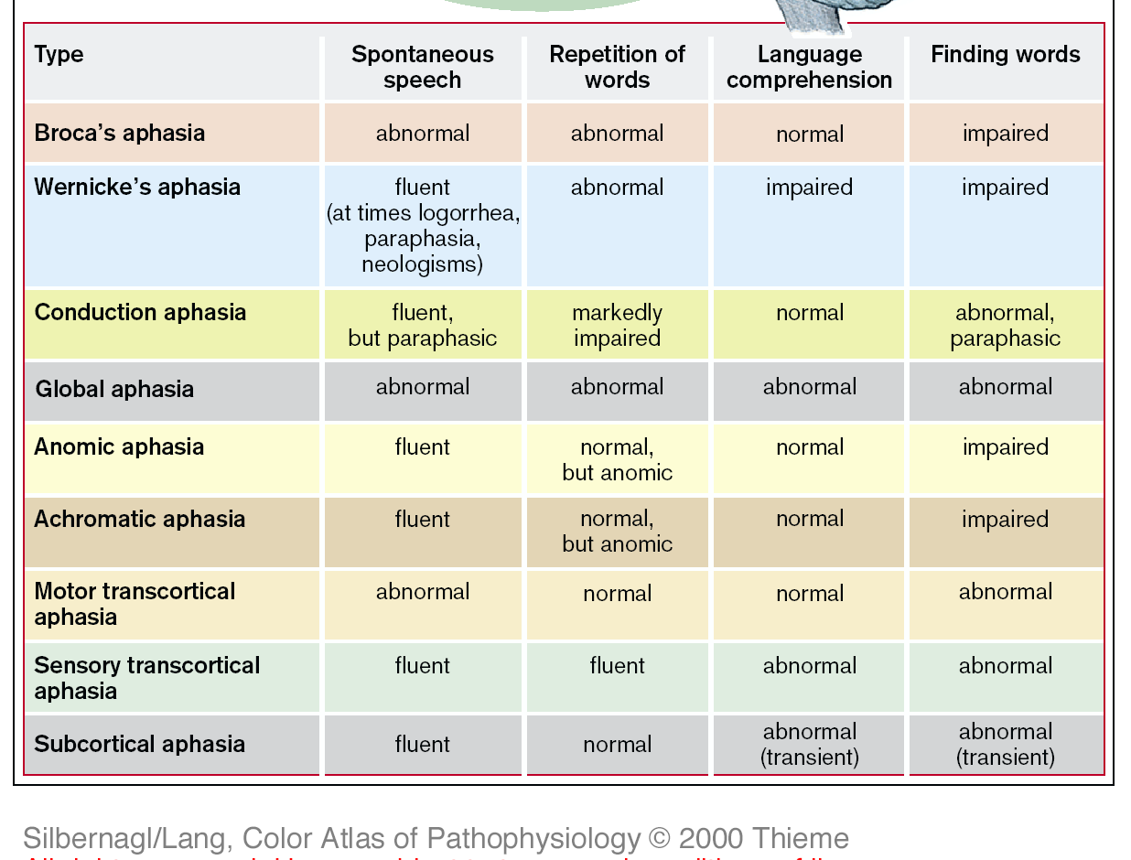

Slide 13
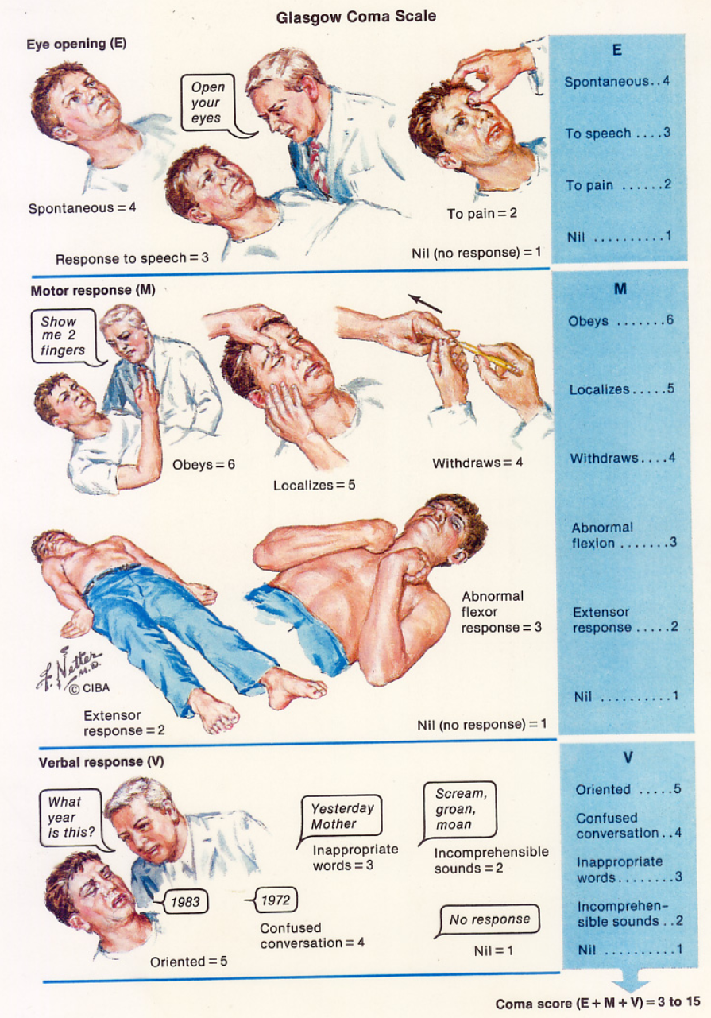
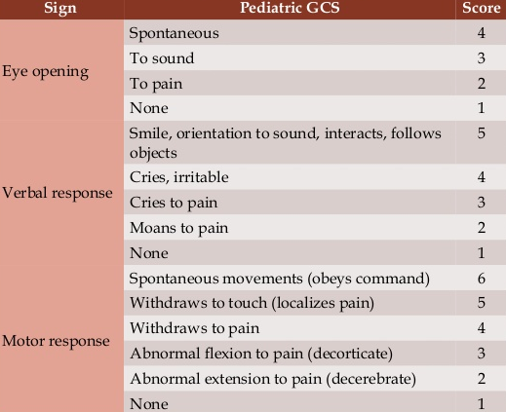
Glasgow coma scale
Glasgow coma scale (GCS)
  differences for adults and
  for small children
  lowest possible score: 3
  highest: 15 (fully conscious)

Slide 14
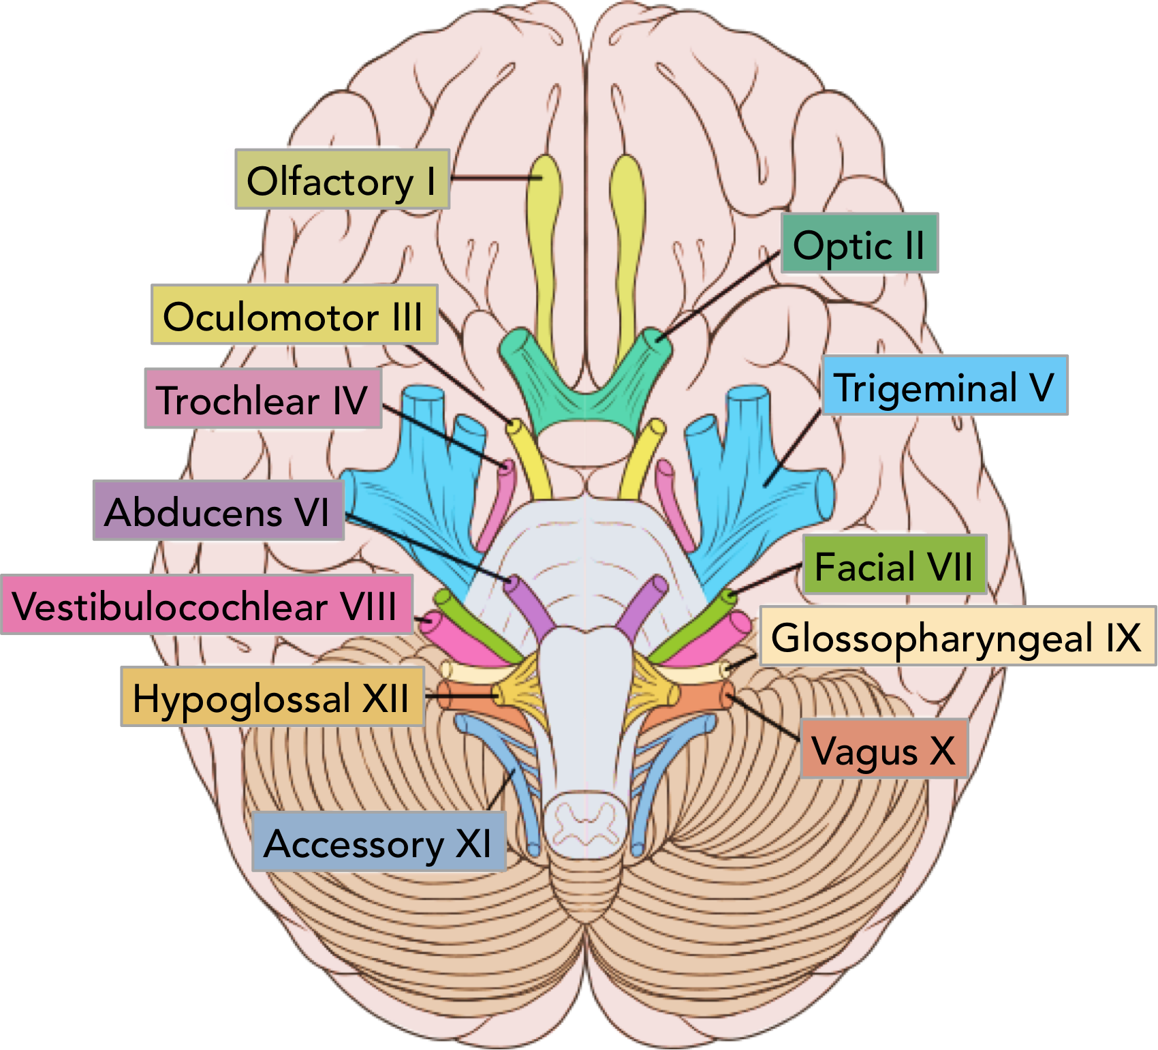
Examination of cranial nerves
I olfactory nerve
II optic nerve
III, IV, VI oculomotor nerves
Notes:
I olphactory nerve - smell sense
Anosmia = olphactory groove, anterior fossa!
Uncinate fits = olfactory pseudo hallucination - caused by medial temporal pole – tumours!
II optic nerve = visual field testing
Confrontation of patient´s and investigator´s visual fields
computer perimetry
III, IV, VI oculomotor nerves
lids - symmetry, ptosis ?
globes misalignment = strabismus
eye movements
primary, secondary and tertiary positions of the eyes are investigated
nystagmus (direction - horizontal, vertical or rotatory, intensity - I, II, III, amplitude - fine, coarse)
oculomotor palsy (note the direction, which muscle is weak ?) diplopia (double vision)
pupils
regular, round and symmetric ? = isocoria.
miosis x mydriasis x anisocoria
Photoreaction direct x indirect
Near reaction - convergence and pupilar constriction

Slide 15
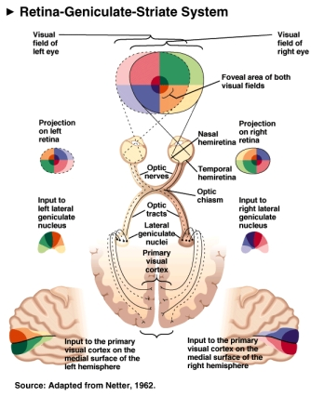
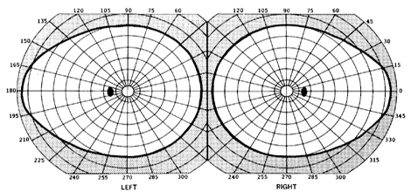
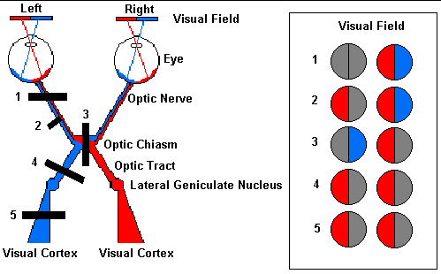
Visual field

Slide 16
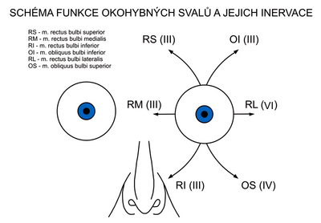
Oculo-motor nerves
Examination of cranial nerves

Slide 17
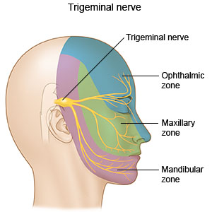
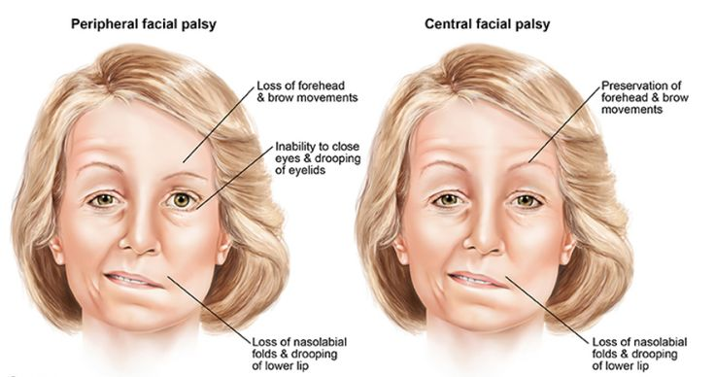
Examination of cranial nerves
V trigeminal nerve
VII facial nerve
Notes:
tactile and thermic sensations of the face and head
peripheral sensory deficit:
horizontal strips
central sensory deficit
vertical strips
motor function
masseter muscle tone (palpation with clenched teeth)
reflexes
masseter (trigemino-trigeminal)
corneal (trigemino-facial)
mimic muscles, parasympathetic fibres for parotid gland.
face symmetry:
forehead, eyelids, nasolabial sulcus, mouth and platysma muscle on the neck.
mimic movements
wrinkles, eye closure, mouth corners retraction
reflexes
axial = fronto-orbicular, labial and mentolabial
tetanic sign - Chvostek phenomenon

Slide 18
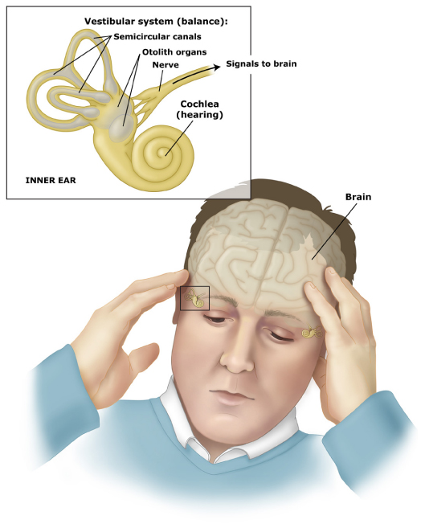
Examination of cranial nerves
VIII stato-acoustic nerve
Notes:
Senses of hearing and balance
Hearing
tuning fork test (Weber, Rinné)
tinnitus
Balance
vertigo, nystagmus description
vestibulospinal phenomena
stand I, II, III, gait I, II, Romberg test, tandem gait with eyes closed

Slide 19
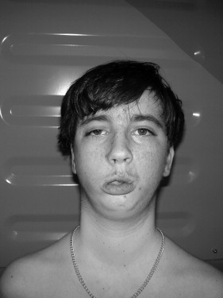
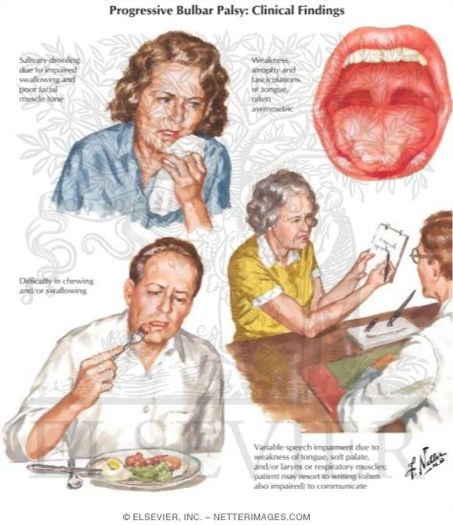
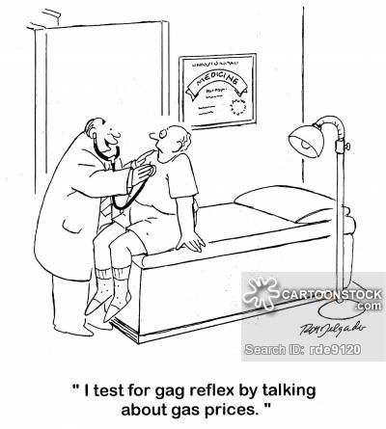
Examination of cranial nerves
location: cerebral‘bulbus’, bulbar paralysis/ bulbar palsy
IX glossopharyngeus
X vagus
XI accessorius
XII hypoglossus
Notes:
motor, sensitive and autonomic inervation
mouth, tongue, gastric tract, bronchi sternocleidomastoideus and trapezius muscles
tongue
atrophy, fasciculations, deviates to the paretic side
tactile sensations and taste on the posterior part of tongue, pharynx, soft palate.
soft palate
dysphagia and dysarthria
fluid aspiration, uvula retraction away from the paretic palate
Gag Reflex
missing in bulbar syndrome
enhanced in pseudobulbar syndrome

Slide 20
Examination of cranial nerves/ bulbar paralysis/ palsy
(bulbus = medulla oblongata)
Symptoms
dysphagia (difficulty in swallowing)
difficulty in chewing
nasal regurgitation
slurring of speech
difficulty in handling secretions
choking on liquids
dysphonia (defective use of the voice, inability to produce sound due to muscular /laryngeal/ weakness)
dysarthria (difficulty in articulating words due to a CNS problem)
IX glossopharyngeus
X vagus
XI accessorius
XII hypoglossus

Slide 21
Extremities
Range of movements
  active (paresis - neurology) X passive (skeletal, joint or ligaments - orthopaedics)
strength, muscle tone
paretic pyramidal signs (Mingazzini, Dufour)
irritative pyramidal signs (Babinski, Juster)
myotatic reflexes (spinal cord segment responses)
cerebellar syndromes
  taxis, diadochokinesis, muscle atonia, intention tremor
extrapyramidal syndrome
  elementary postural reflexes
  rigidity, bradykinesia, static tremor
Notes:
jeste je potreba zjednodusit…?

Slide 22
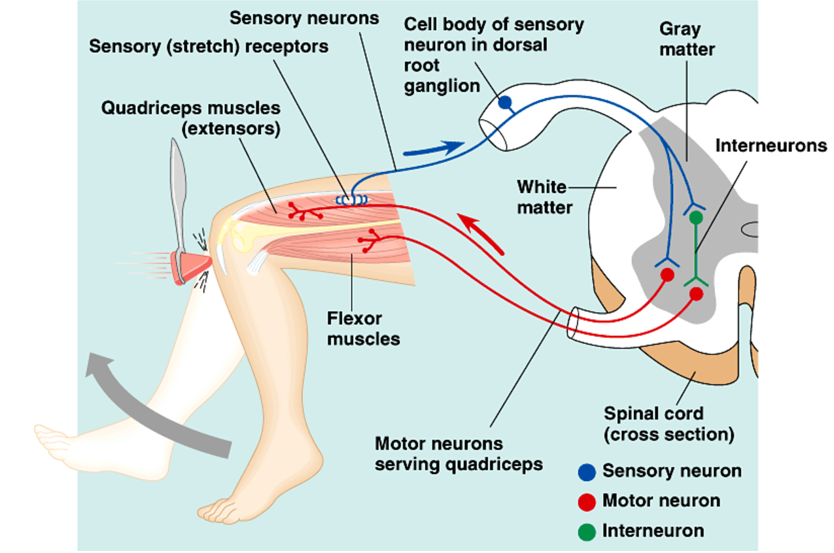
Spinal reflexes

Slide 23
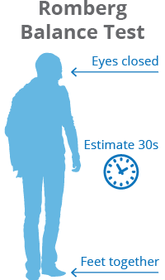
Standing and gait
Notes:
https://stanfordmedicine25.stanford.edu/the25/cerebellar.html video

Slide 24
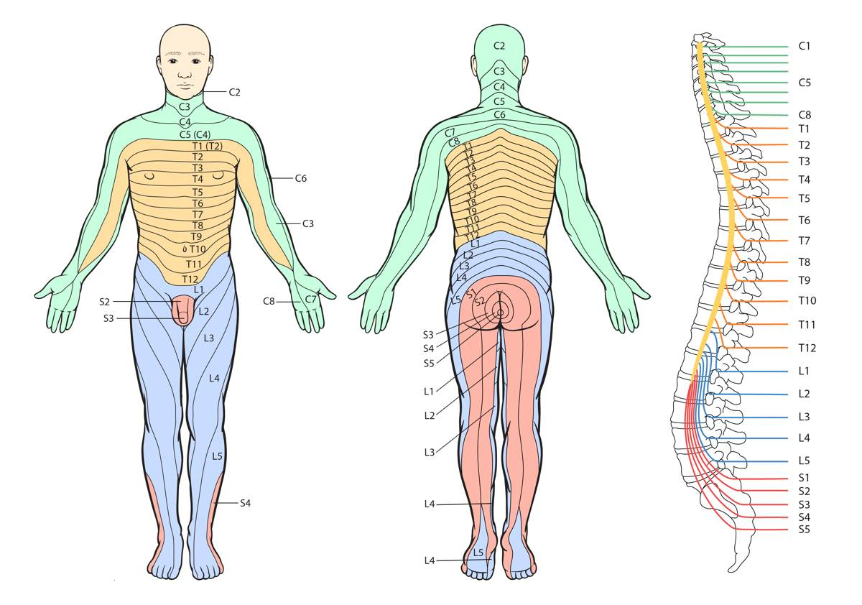
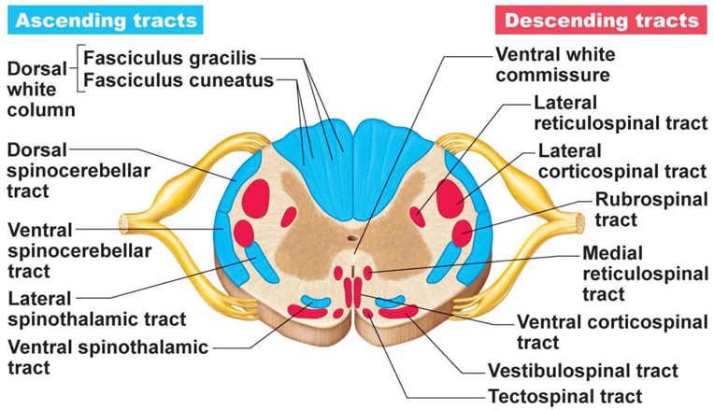
Somatosensory examination
touch and pressure
deep sensation, proprioception
  lemniscal, dorsal column
pain and thermic sensation
  spinothalamic tract
vibration sense by tuning fork
  dorsal column

Slide 25
Spinal tracts

Slide 26
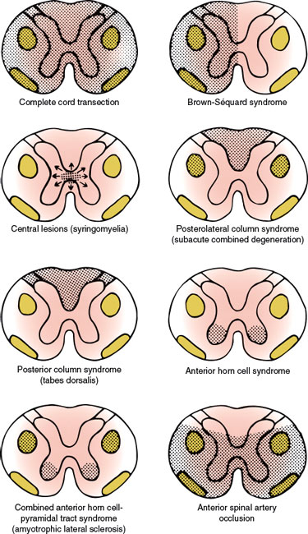
What should we know about spinal tracts?

Slide 27
Reciprocal action of sympathetic
and parasympathetic nerves

Slide 28
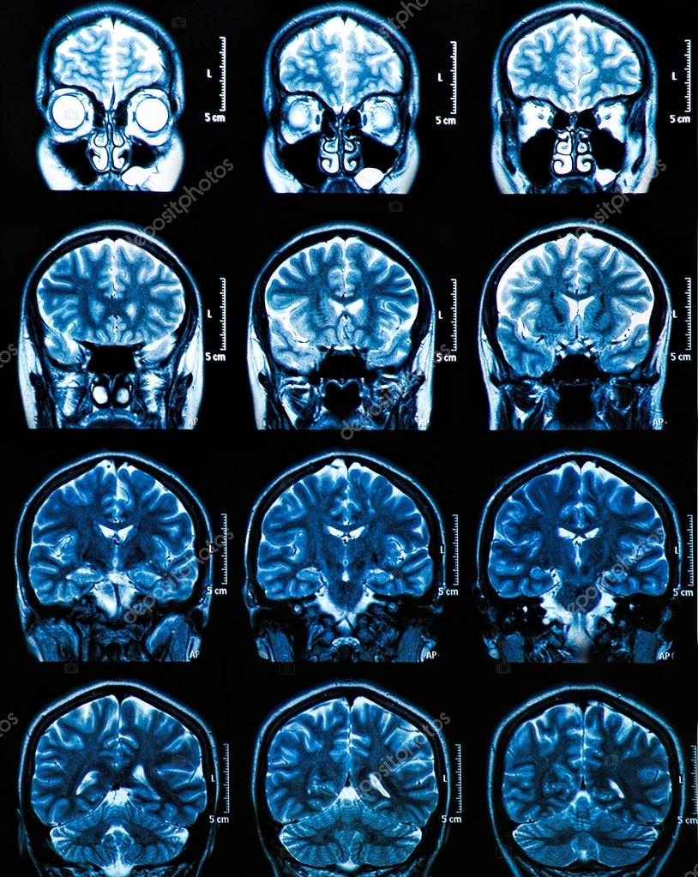
Other examinations
lumbar punction
radiodiagnostics
isotope methods
USG + Doppler
Angiography,
digital subtraction A.
EEG
sleep examination
evocated potencials
laboratory methods
meningeal signs
ventriculography
pneumoencephalography
…

Slide 29
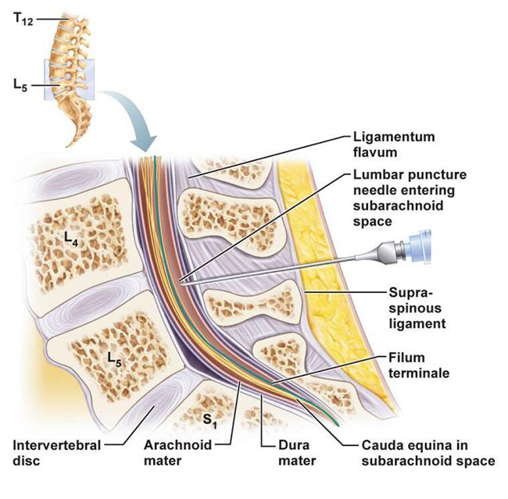
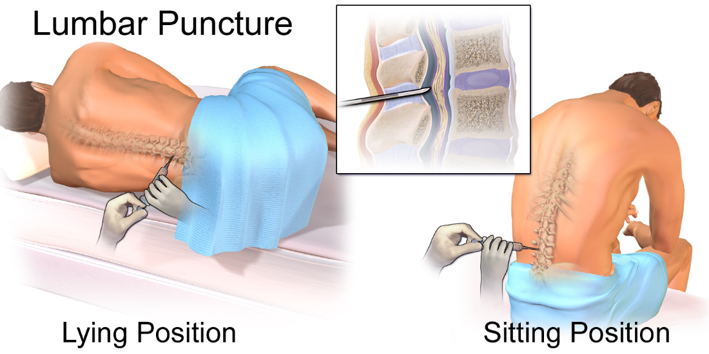
Lumbar punction
indications: diagnostics of neuroinfections, demyelinization diseases, tumours, ruling out intracranial hemorrhages
contraindications: high intracranial pressure, expansive intracranial processes, sepsis, local infection, hemorrhagic diateses, vertebral
deformities
postpunction syndrome

Slide 30
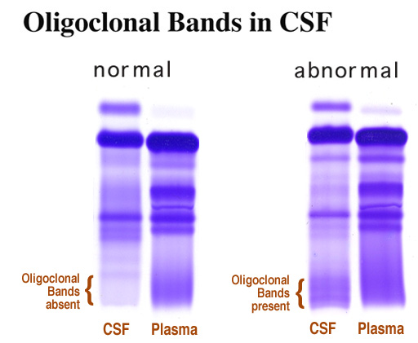
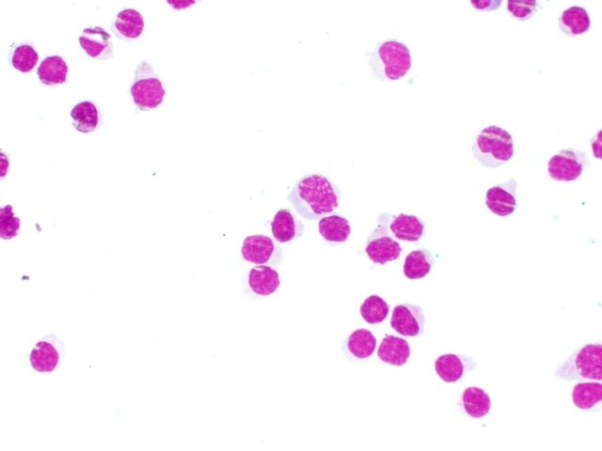
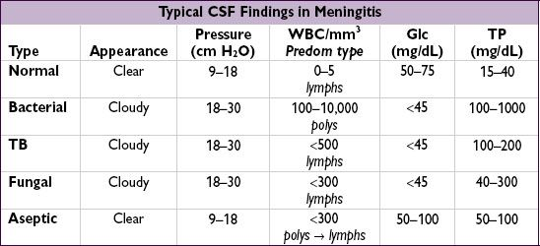
Findings in cerebrospinal fluid

Slide 31
Imaging Methods

Slide 32
Imaging Methods/ Radiodiagnostics
Morphological investigation methods (imaging)
  X ray
  Computational tomography
  Positron emission tomography (PET)
  (Nuclear) magnetic resonance
  Functional magnetic resonance
  brain angiography
  Ultrasonography (USG) and Doppler sonography

Slide 33
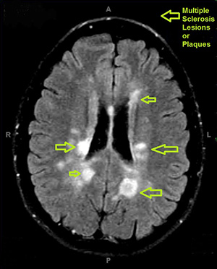
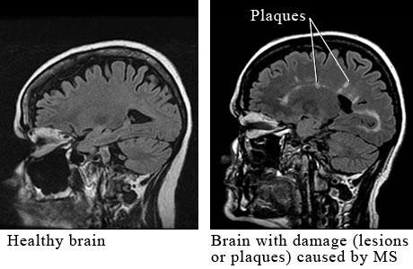
MRI (magnetic resonance imaging) example: multiple sclerosis
Notes:
(Nuclear) magnetic resonance
Principle: Detects atoms with an odd atomic weight and also their neighboring atoms in chemical compounds. Amongst natural isotopes, especially ¹ H, ¹⁴ N, ¹⁹ F, ²³ Na and ³¹P are useful, most of them ¹H.
Spatial resolution: 1 mm, time resolution: no theoretical limit,
in practice, only times in the range of 1 s are used
Application: Analogous, as in computer tomography. More sensitive for demyelinization processes.

Slide 34
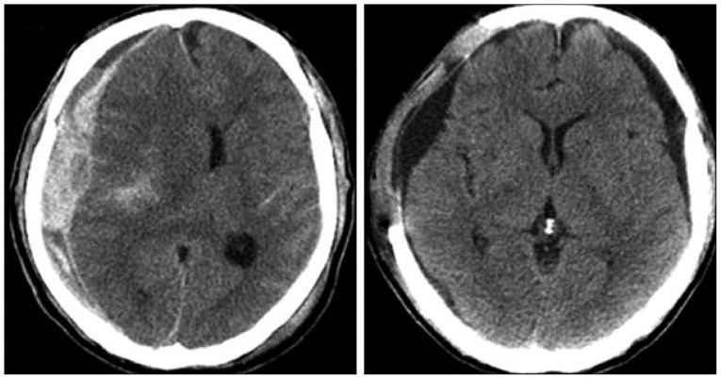
Computer Tomography example: acute subdural hematoma before and after evacuation
Notes:
https://www.researchgate.net/figure/263933962_fig4_CT-scans-of-Case-6-Acute-subdural-hematoma-was-evacuated-by-decompressive-craniectomy
Principle: One head with the X-ray source rotates on one side and another head with array of X-ray detector rotates on the other side of the skull. The radiodensity of individual pixels is recalculated from the summed densities as the two heads rotate and scan the skull from many angles. Numerical algorithms in computer are used to get the densities.
Spatial resolution: as sensitive as 1 mm. This method does not have time resolution.
Application: White and gray matter, blood and cerebrospinal fluid are distinguished. Pathologic processes inside skull or spinal canal are visualized.

Slide 35
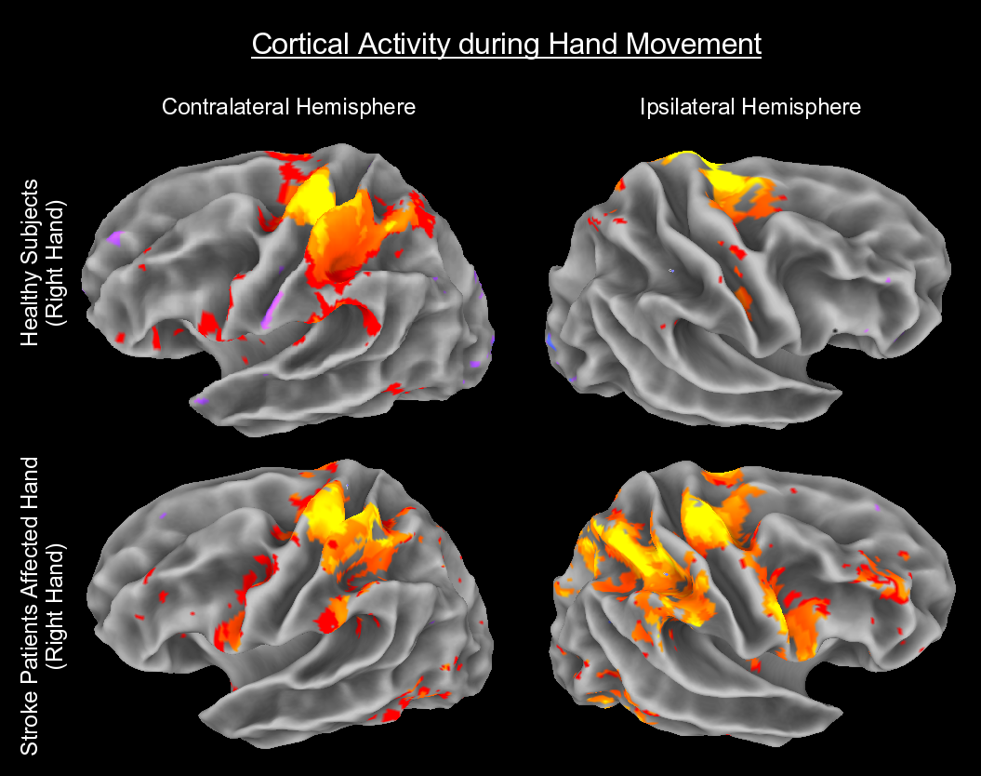
Functional magnetic resonance
(f MRI)
Principle: Detects BOLD (Blood Oxygen Level Dependent fMRI) signal.
Spatial resolution: 1 mm, time resolution: no theoretical limit, in practice, only times in the range of 1 s are used
Application: Analogous, as in computer tomography. Shows a succession of areas as they are activated.

Slide 36
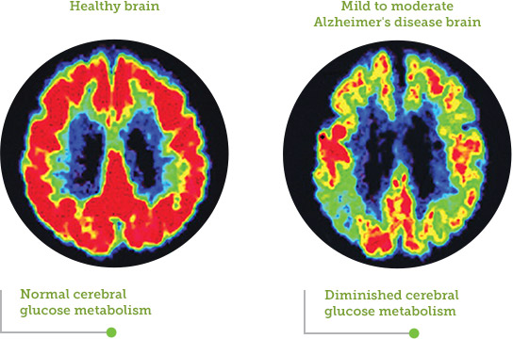
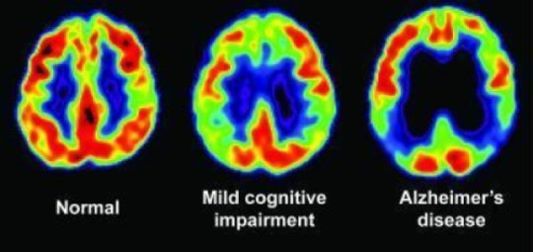
Positron emission tomography
Principle: Radioactive isotopes ¹¹ C, ¹³ N, ¹⁵ O and ¹⁸ F emit positrones. They collide with electrons and emit two quanta of gamma rays.
Spatial resolution: 8 mm, time resolution: no theoretical limit,
in practice, only times in the range of 1 s are used.
Application: Application of radioactive deoxy-glucose marks tissues with active metabolism.

Slide 37
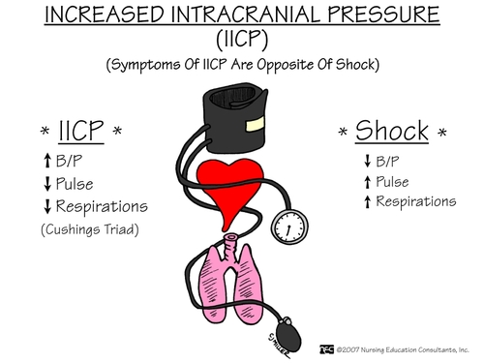
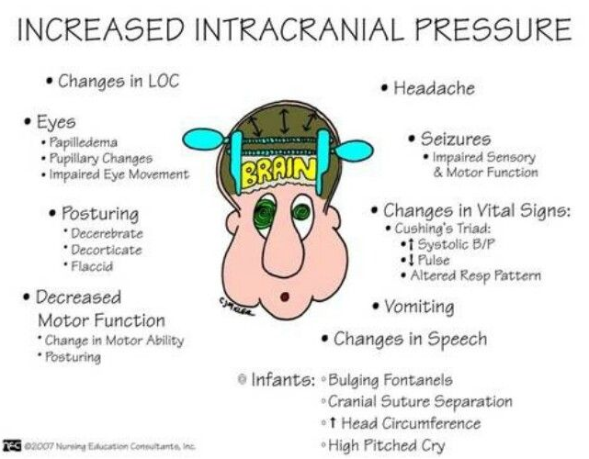
High intracranial pressure
causes:
  intracranial bleeding
  infections, abscesses
  tumours, metastases
  brain oedema
  hydrocephalus

Slide 38
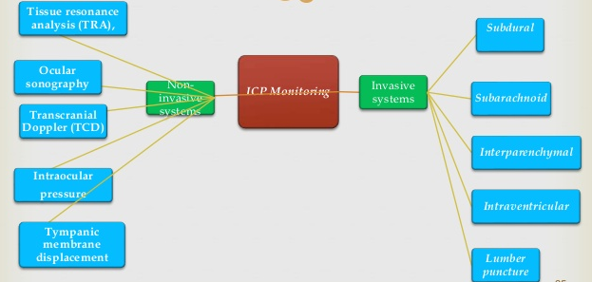
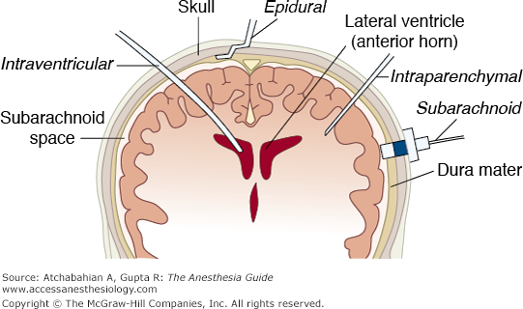
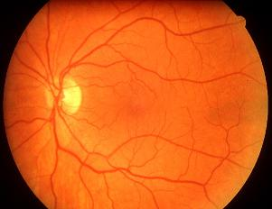
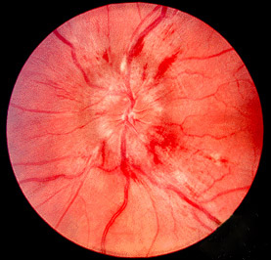
Intracranial pressure monitoring
Retinography:
normal papilla vs papillary oedema in high ICP

Slide 39
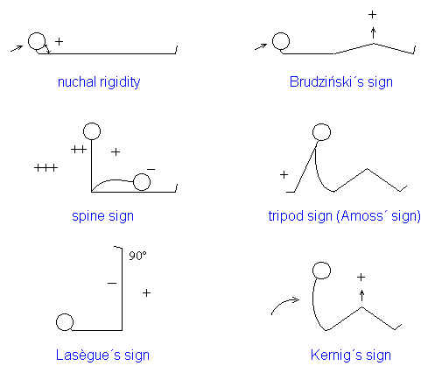
Meningeal signs
irritation of the meningae
  neuroinfection
  subarachnoid hemorrhage
  tumors on meningae
  lesions of nearby brain tissue

Slide 40
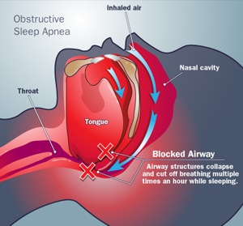
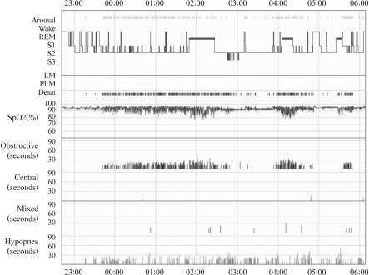
Sleep examination – sleep apnea
https://openi.nlm.nih.gov/detailedresult.php?img=PMC2848777_pi-7-75-g001&req=4
Notes:
https://openi.nlm.nih.gov/detailedresult.php?img=PMC2848777_pi-7-75-g001&req=4

Slide 41
Electro-
physio-
logic
Exami-
nations

Slide 42
Electrophysiologic examinations
Electroencephalography (EEG)
Evoked potentials (EP)
Electromyography (EMG)
Other methods (electro-oculography, retinography, etc.)

Slide 43
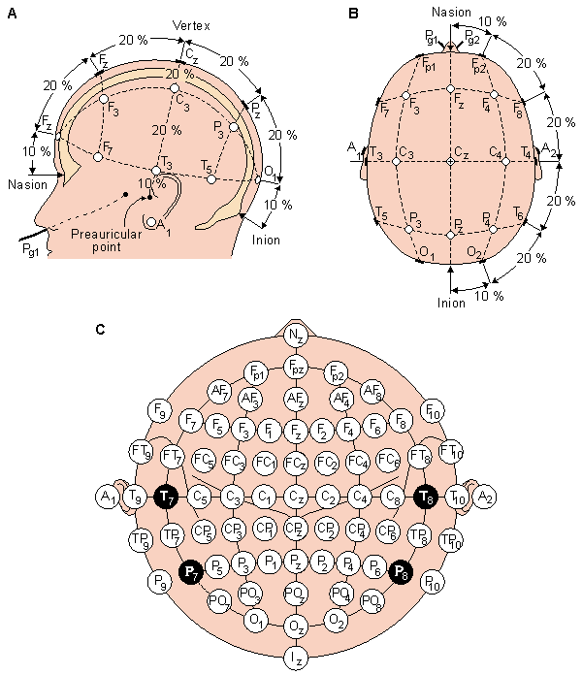
Electro-encephalo-graphy (EEG)
Principle: The EEG signal is result of net excitatory and inhibitory
post-synaptic activity in surface layers of cerebral cortex. On the
surface of the skull this is sometimes called macro-EEG, as compared to
micro-EEG recorded at the cortex surface during surgeries.
Spatial resolution: due to crosstalks coarser than 1 cm, time resolution: better than in imaging, in the range of 1 ms.
Application: Epilepsy, sleep disorders, also in investigation of sensory
systems.

Slide 44
EEG atlas A
Summation
and synchronization of post-synaptic potentials in surface layers of cerebral cortex.

Slide 45
EEG atlas B
Normal findings: EEG waves:
Alpha waves, 8-13 Hz, parieto-occipital region, marked in closed eyes
Beta waves, 14-30 Hz, frontal region
Gamma waves, 40-60 Hz, are not regularly used due to interference with electric power net.
Delta waves, < 4 Hz, e.g in synchronous phase of sleep.
Theta waves, 4-7 Hz, e.g in synchronous phase of sleep.

Slide 46

EEG Waves

Slide 47

How can EEG look during various activities/ pathologies?

Slide 48

Electromyography (EMG)
Principle: Recording from needles, shows recruitment of muscle fibers by motoneuron stimulation, myopathies and neuropathies can be distinguished.
Spatial resolution, time resolution: as in EEG
Application: Disorders of neuro-motor unit.

Slide 49


Evoked potentials
VEP – visual
AEP – auditory- Ear-Nose-Throat Dept.
SEP – somato-sensoric
SpEP – spinal

Slide 50

Diseases of the motor unit

Slide 51
Myotonias
Norm Pathology

Slide 52
Muscular dystrophies

Slide 53
Metabolosmus Kreatinu

Slide 54
No Copyright/ Disclaimer/ Warning
„seminar“
Petr Marsalek, and others
warning: the PDF version of this
presentation is not an official study material
First Medical Faculty, Institute of Pathological Physiology
Notes:
54

Slide 55

Transcranial Doppler USG
= ultra-sonography,shows cerebral blood flow

