Slide 1
Pathological Physiology of Nervous System: Neuro 1 - Pain
Department of pathological physiology
First Medical Faculty, CUNI

Slide 2
Outline
An Attempt To Describe Pain Objectively: Psychophysics
Biological and Pharmacological approach to pain

Slide 3
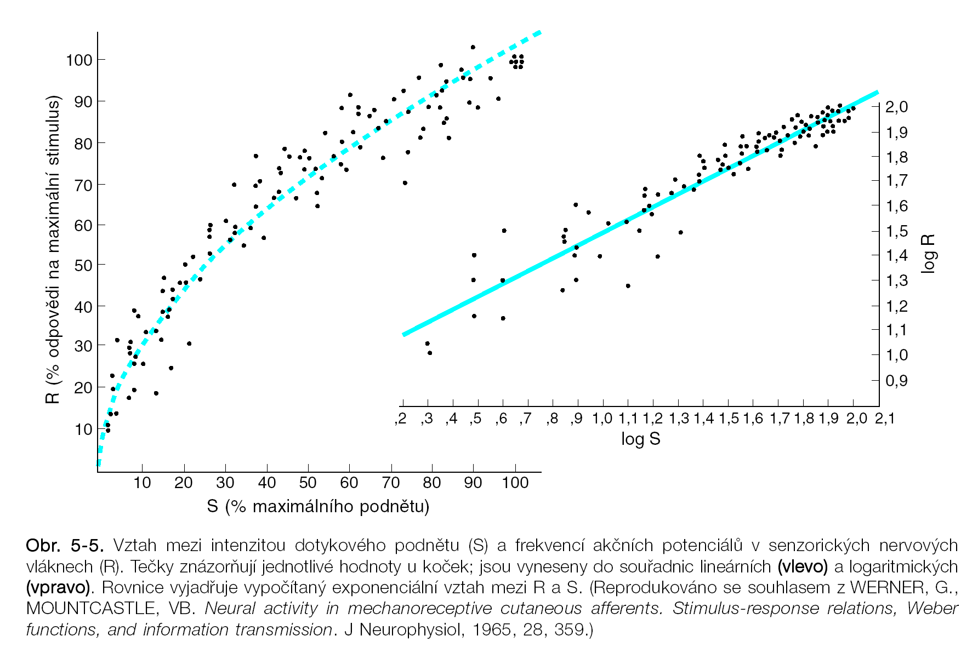
Response (R) is function of stimulus intensity (S), R=f(S),
sense of touch as an example

Slide 4
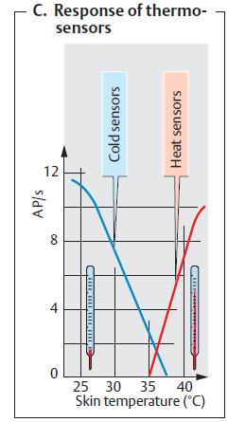
Thermoreceptors
Cold, < 36 st. C
Warm > 36 st. C
Hot temp. > 45 st. C
( = VR1, TRPV, vaniloid, capsaicin receptors)
Ion channels: TRP = transient potential.
Group 1 includes TRPC ( "C" for canonical), TRPV ("V" for vanilloid), capsaicin,
TRPM ("M" for melastatin),
TRPN ("N“= No mechanoreceptor potential C),
and TRPA ("A" = ankyrin, mechanoreception).
In group 2, there are TRPP ("P" for polycystic) and TRPML ("ML" for mucolipin),
TRPM8, menthol receptor, aka cold menthol receptor1, CMR1, Icilin ≡ superagonist, 1983,
Mediate touch versus painful energies...

Slide 5
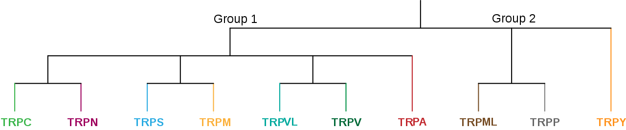

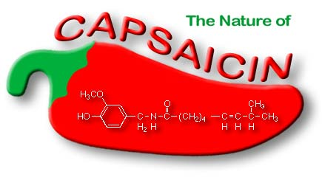
Phylogenetic family tree of receptors,
TRP = TRansient Potential,
Agonists: capsaicin and menthol
Menthol

Slide 6
Scoville: Design of Experiments to Measure Hotness, Construction of the Scoville Scale of Hot Chili Peppers…
The Nobel Prize in Physiology or Medicine 2021
”synesthetic substances”, menthol and capsaicin
David Julius, TRPM1, TRPV8, …
Ardem Patapoutian, PIEZO1, PIEZO2, …
Wilbur Lincoln Scoville,
American pharmacist (*1865 – +1942)

Slide 7
Scoville ratings of chemicals substance examples
(Scoville heat units)
16,000,000,000 Resiniferatoxin
5,300,000,000 Tinyatoxin
16,000,000 Capsaicin
15,000,000 Dihydrocapsaicin
9,200,000 Nonivamide
9,100,000 Nordihydrocapsaicin
8,600,000 Homocapsaicin
160,000 Shogaol (dehydr. ginger oil)
100,000 Piperine (black pepper alkaloid)
60,000 Gingerol (ginger oil)
16,000 Capsiate

Slide 8
Scoville ratings of hot peppers examples
3 000 000-6 000 000 Pepper spray
2 000 000 Trinidad Moruga Scorpion
1 850 000 Chocolate 7-Pot
1 600 000 Dorset Naga
1 450 000 Trinidad Scorpion Butch Taylor
1 200 000 Naga Viper, Trinidad 7 Pot Jonah
1 200 000 Satan's Strain Trinidad Scorpion Moruga
1 100 000 Naga Morich, Infinity Chili
1 050 000 Bhut Jolokia
850 000 Trinidad 7 Pot CARDI Strain
350 000 – 580 000 Red Savina Habanero
100 000 – 350 000 Habanero
50 000 – 100 000 Pepper Birds Eye, Piri Piri
30 000 – 50 000 Tabasco pepper
5 000 – 23 000 Serrano
5 000 – 10 000 Chipotle
2 500 – 8 000 Jalapeño, Tabasco sauce
1 000 – 2 000 Poblano
100 – 500 Pimento

Slide 9
Psychophysics = describes, how subjective
response depends on magnitude of physical,
or chemical stimulation
R - (response) subjective intensity
S - (stimulus) physical intensity
Examples:
Chili pepper hotness: S... active or dry substance concentration,
R... hotness
Pain: S… damage intensity (pain modality typology is
better corresponding to R),
R... pain
Various curves can be fitted to given datapoints
(linear dependence, logarithm, power function, etc.)

Slide 10
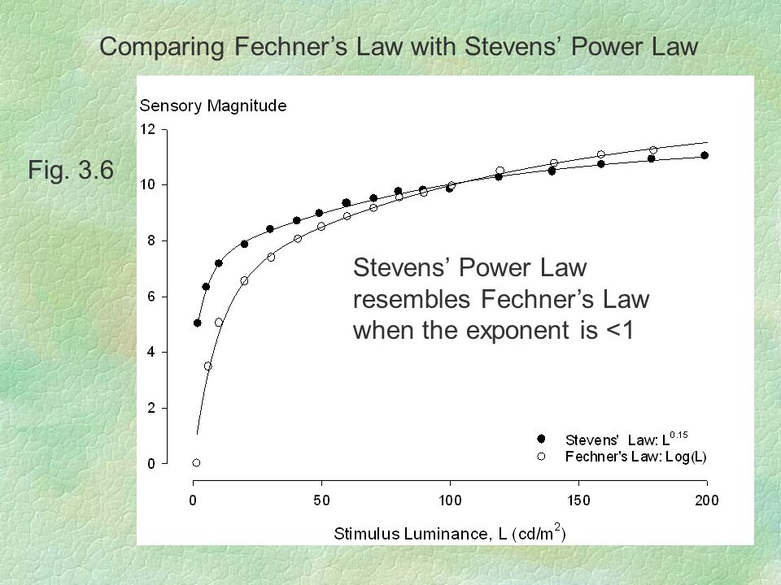

Slide 11
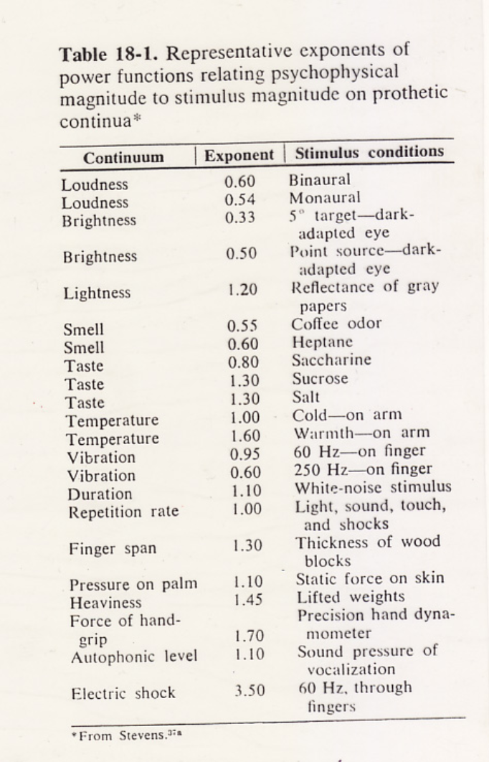
Exponents in the Stevens (power) law
Psychophysical laws
R - (response) subjective intensity
S - (stimulus) physical intensity
S₀ - threshold stimulus intensity
A - constant of proportion
N - exponent
Weber – Fechner
(logarithmic) law
Stevens
(power) law

Slide 12
... other ways of objective investigation of sensory perception, including somatosensation and pain...

Slide 13
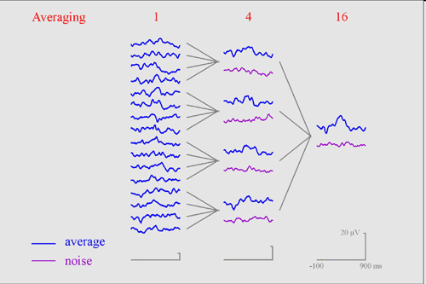
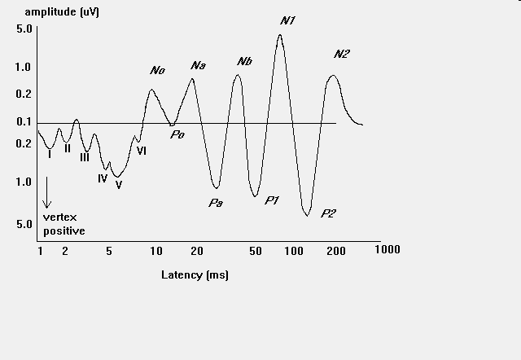
Evoked potentials
Measurement principle: repeated EEG response to stimulus is summed up (averaged)
The sensory response is a result
Example: evoked potentials of different parts of the auditory pathway

Slide 14
Evoked potentials – auditory as example
Objective Audiometry:
Brainstem or cortical evoked response audiometry BERA (CERA, CZ),
Auditory Brainstem Response (ABR)

Slide 15
Somatosensoric EP (SEP) – mechanical or electrical stimulation
stimulus duration 2 - 300 ms, repetition rate up to 3 Hz
recorded from various locations in correspondence to stimulations
typical sequence (positive and negative EEG waves)
P1 N1 P2 N2 P3 N3
16 ms 20 ms 28 ms 33 ms 43 ms 50 ms
typical use:
during spinal cord surgery – continuous checkup of CNS conditions
- prolonged latency in multiple sclerosis

Slide 16
Only experimental: is maping of pain using functional magnetic resonance imaging, fMRI; differentiation between painful and neutral stimulation in somatosensation
In practice only specialized centers dispose
with the avanced methods
How is diagnosis and fighting with pain in medical
practice?...

Slide 17
Biological and Pharmacological Approach to Pain

Slide 18
CGRP (Calcitonin-gene related peptide), SP (Peptide substance)

Slide 19
Tissue injury leads to painful sensation
Pain:
1 is a warning that something goes wrong
2 helpful to diagnostics and localization pathologies
3 can be pathologic, annoying beyond the purpose
Psychological pain components
The algothymic component is its emotional context
The algognostic component says where, what, and how much it gets wrong
Pains that lose the warning purpose are …neuralgic pains neurologic investigation shows no deviation from the norm.
Psychophysics: - no relation between stimulus intensity and percept intensity
- there is a continuous transition between various touch and pain sensations
tickling, sharp point touch, warm, cold vs.
itching, puncture, scalding (opaření), congelation (omrznutí)
what itches, we scrub (scrape) (?), [Fenistil – antihistaminic, anti pruriginous drug]

Slide 20
Pain is modified by…
previous experience, expectations
instruction, suggestion
emotions, especially fear and anxiety
concurrent activation of other sensory inputs
diversion/ redirection of attention

Slide 21
sympathetic n.s.
vasoconstriction, hypertension, tachycardia,
sweating, paleness, goose flesh, mydriasis
parasympathetic n.s.
hypotension, bradycardia, nausea/ vomiting
motor response
conscious response
Pain leads to activation of…

Slide 22
Types of pain, phenomenology
Acute pain
-cause can be identified
-short term
-disappears when the original cause is cured
-usually does not recur
Chronic pain
-the cause may not be identified
-intensity higher than expected to a known stimulus
-causes high physical and psychical stress
-annoying in daily life
Patho-genetic classification of pain
•receptive (nociceptive)
•peripheral neurogenous (neuropathy)
•central neurogenous
•originating in autonomous nervous
system (Sympathetic n.s.)
•visceral
•pain of psychical origin

Slide 23
I. Mechanoreceptors
Skin tactile sensibilities (epidermis and dermis)
Free nerve endings
Expanded tip endings
Merkel’s discs
Plus several other variants
Spray endings
Ruffini’s endings
Encapsulated endings
Meissner’s corpuscles
Krause’s corpuscles
Hair end-organs
(Deep tissue sensibilities, Free nerve endings, Expanded tip endings, Spray endings, Ruffini’s endings, Encapsulated endings)
Pacinian corpuscles
Plus a few other variants
Muscle endings
Muscle spindles
Golgi tendon receptors
Hearing
Sound receptors of cochlea
Equilibrium
Vestibular receptors
Arterial pressure
Baroreceptors of carotid sinuses and aorta
II. Thermoreceptors
Cold
Cold receptors
Warmth
Warm receptors
III. Nociceptors
Pain
Free nerve endings
Mechanoreception – receptor organs (long list ☹)

Slide 24
Four major touch modalities

Slide 25
Schematic crossings of spinal cord somatosensory pathways

Slide 26
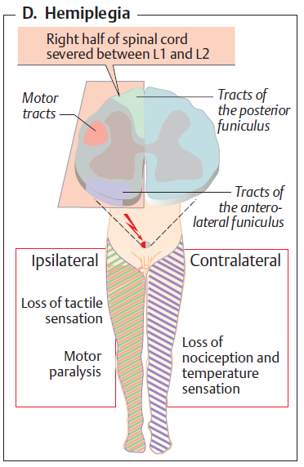
One set of the somatosensory pathways crosses in the appropriate spinal cord segment and the other set crosses as a whole in medulla oblongata
Dissociation of somatosensory modalities in the unilateral spinal cord lesion
This is a condition of Brown-Sequard syndrome

Slide 27
Fibres conducting nociceptive stimuli
C-fibres – without myelin sheets, action potentials are convected slowly, fibres convect deep, nonaccurate localized, diffuse pain
Aδ-fibres – with thin myelin sheet, fibres mediate fast conduction of sharp, accurate localized pain
Aα/Aβ-fibres – large myelinated. Fibres do not convect nociceptive stimuli, they mediate tactile stimuli
Afferent fibres enter dorsal spinal roots. In this region exist excitatory and inhibitory interneurons. Inhibitory interneurons gate the passage of information into thalamus and cortex.

Slide 28
Nociceptors, pain receptors = dedicated receptors, ion channels and free nerve endings
They are sensitive to the pH changes (pH in acute abscess, phlegmona reaches 5,8 = pain, pH in the chronic abscess is normal, without pain)
Nociceptors register the ratio K⁺:Ca²⁺ (threshold for pain is lower in the lower Ca²⁺ level in ECV)
evoking inflammation are (permeability of vessel wall, edema) histamine, bradykinin, serotonin
A direct influence of free-nerve endings: potassium, histamine, bradykinin serotonin
sensitisation of nociceptors: prostaglandins, esp. PgE₂, interleukin-1, interleukin-6, cyclooxygenases (COX-1, COX-2)
From activated free nerve endings, P-substance is released.
It influences the vessel wall (vasodilation, the permeability of the vessel wall, edema) and mast cells (release of histamine after degranulation).

Slide 29
Painful stimuli
-chemical
-endogenous inflammation mediators (bradykinin, prostaglandins, serotonin, histamin, K+, H+, Il-1)
-exogenous substances (capsaicin, formalin = formaldehyde)
-low/ high temperatures
-temperature above 42°C is damaging
-mechanical

Slide 30
During painful stimuli…
are activated tetrodotoxin resistant (TTX-R) channels
ATP is relased from damaged cells and acts as pain mediator. ATP receptors are purin receptors (P₂X)
vaniloid receptors (VR₁),are receptors for capsaicin, also activated above 42°C, pH < 6.5
activated acid sensing ion channels (ASIC), when pH < 6.5
Up-regulation of post-synaptic receptors of excitation neuro-transmitters - glutamate (NMDA) and substance P (NK₁)

Slide 31
Vaniloid Receptors and Pain
Birds versus mammals...
(Versus insects...)
Eating hot peppers can be beneficial to rise the individual pain threshold…

Slide 32
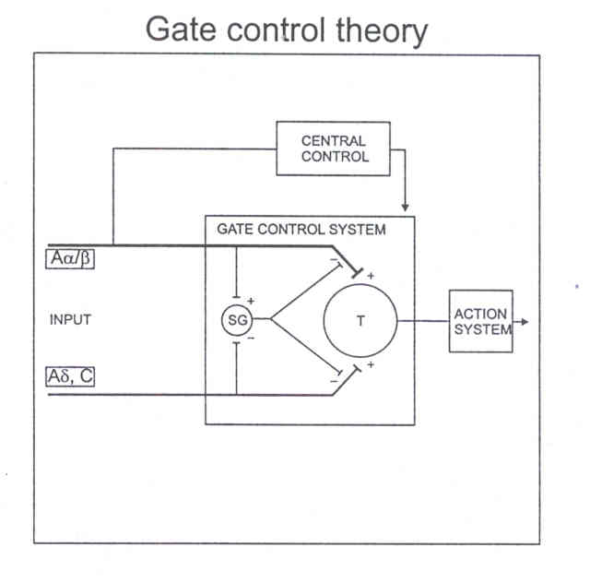
Pain gating control – spinal cord
fast fibers
pomalá
slow fibers
Substantia gelatinosa
II. and III. Rexed zone

Slide 33
Opioid system and others
nigro-striatal and meso-limbic, dopaminergic
motor systems and reward pathways
hypothalamo-hypophyseous
central hormone modulation
ascendent and descendent pathways
modulation
ascendent – spinal cord, talamus
descendent – peri-aquaeductal grey, nuclei raphe

Slide 34
Endogenous opioids
Endogenous cannabinoids
β-endorphine (31 AA) - μ
Endomorphine (4 AA) - μ
Leu-enkefalin (5 AA) - δ
Met-enkefalin (5 AA) - δ
Dynorphine(A:AA 1-8, B:AA1-17) - κ
nociceptin/ orphanin
nocistatin
amids and esthers of fatty acids
anandamid
palmitoyl-etanolamid (PEA)
receptors CB1 a CB2
CB1 in PAG and RVM,
sensory neuron
CB2 in structures of
immune system
FAAH – hydrolasis of FA amids
In the inner ear and auditory pathway as well
pre-synaptic receptors
Inhibiting neuro-transmitter release
⇓ Ca²⁺
post-synaptic receptors
⇑ K⁺ conductance – hyperpolarization

Slide 35
Head’s zones - Referred pain

Slide 36
Referred and pathologic pain
Other pathologic painful sensations: …, headache, n. trigeminus, Migraine,…

Slide 37
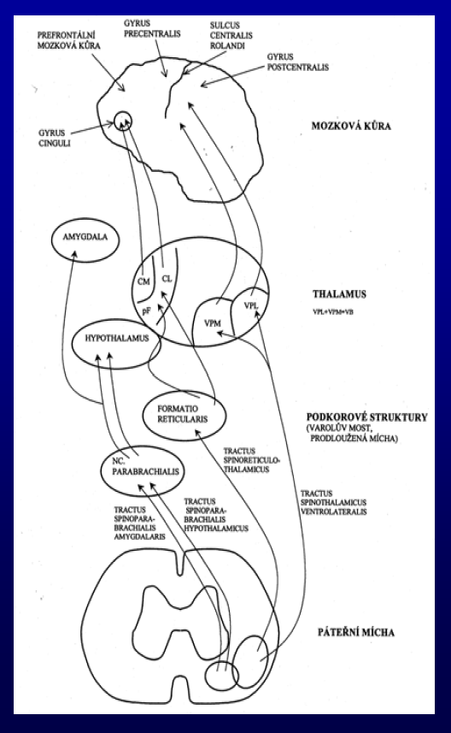
Localization of CNS pain pathways
CZ

Slide 38
Localization of sensory, affective and cognitive pain components
CZ

Slide 39
Pain Relief

Slide 40
END
OF THE LECTURE
Thanks for your attention
Warning: neither the PDF, nor the PPT, PPTX, etc.
versions of this presentation are official study materials.
For internal use only. Do not distribute.
Contact: Petr.Marsalek@LF1.CUNI.CZ
First Medical Faculty, Institute of Pathological Physiology

