Slide 1


1st part: Hearing disorders
Charles University of Prague, First Medical Faculty

Slide 2
Outline of part 1
- Intro: normal hearing, speech production and understanding
Basics of anatomy of the ear -> for understanding the function
Bone and air conduction
Hearing disorders
Functional classification of hearing performance

Slide 3
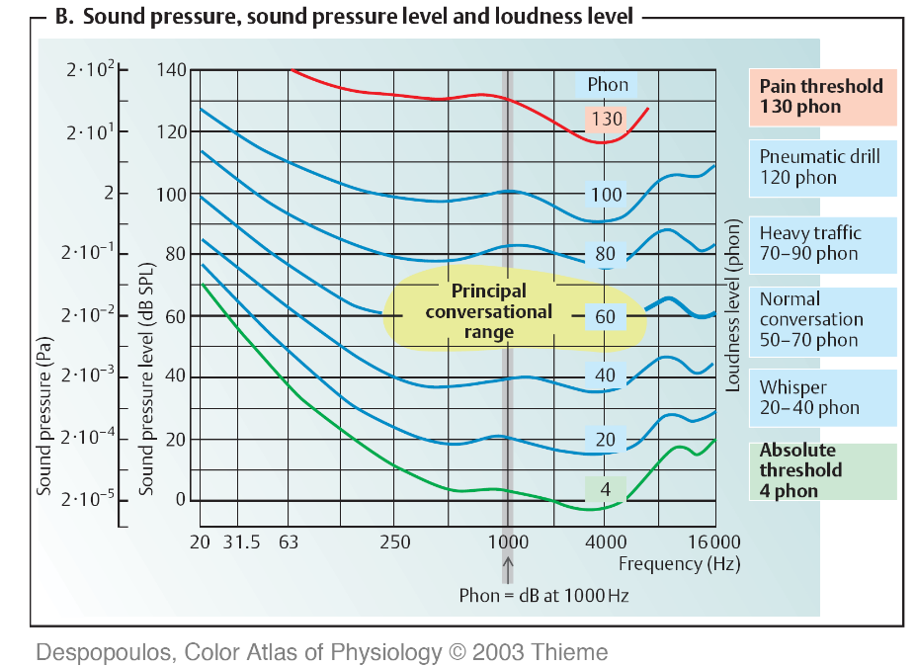
Nadpis
Hearing range: frequencies and intensities

Slide 4
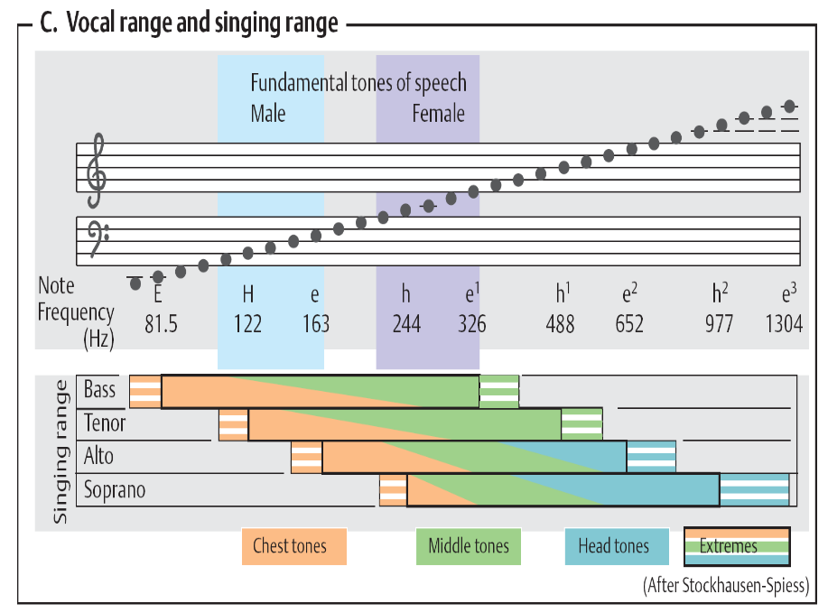
Vocal range and singing range

Slide 5
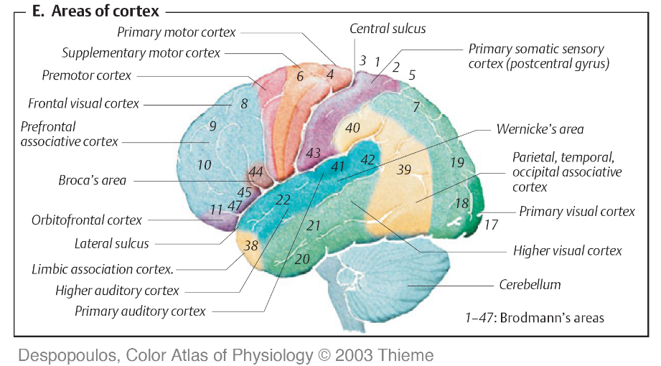
Two main speech centers within the Brodman areas

Slide 6
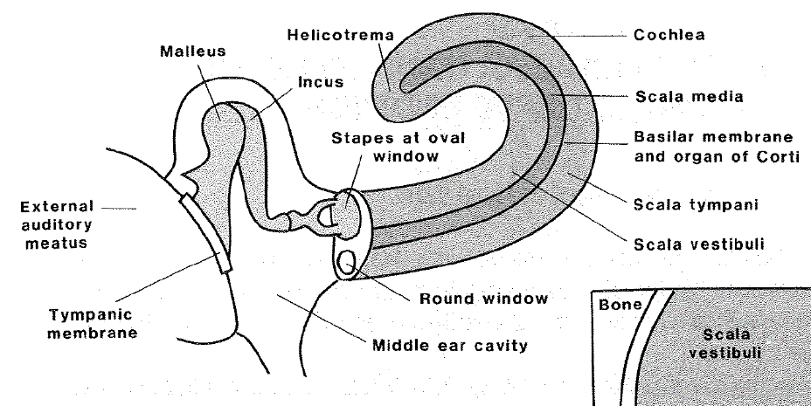
Outer, middle and inner ear

Slide 7
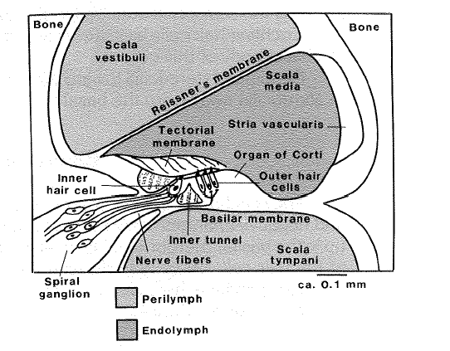
Organ of Corti

Slide 8
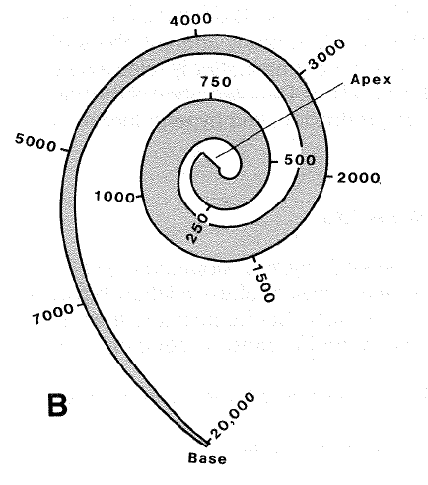
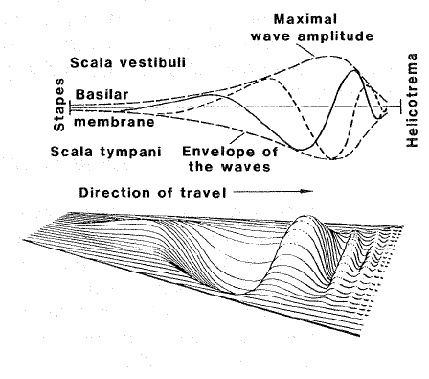
Basilar membrane – from above and unfolded into trapezoid plane
Width at the base
100 μm
Width at the apex
500 μm
Length
33 mm

Slide 9
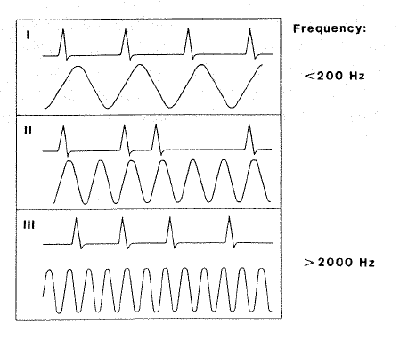
Encoding of sound loudness and frequency

Slide 10
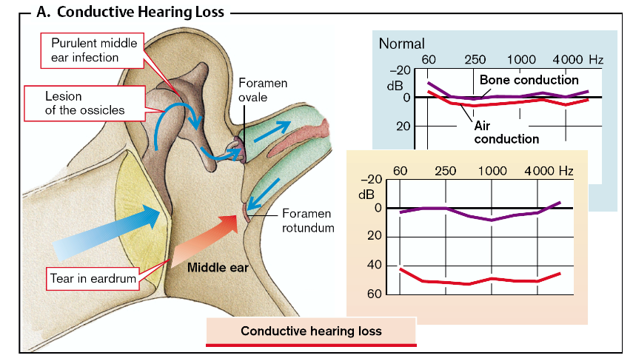
Conduction: through air and bone
Hearing loss: A. conductive, B. sensorineural

Slide 11
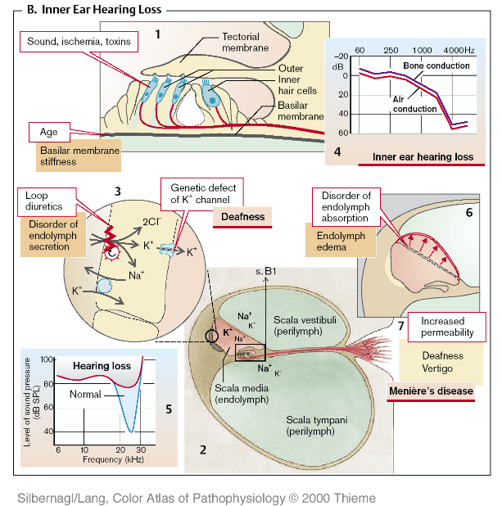
Hearing loss: A. conductive, B. sensorineural

Slide 12
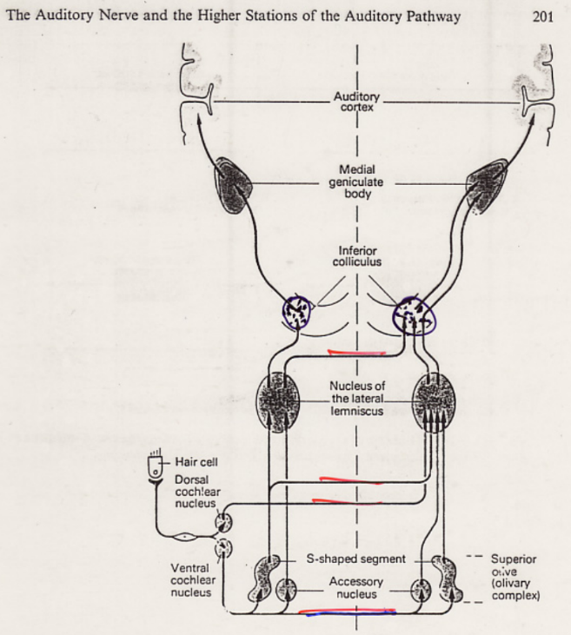

Slide 13
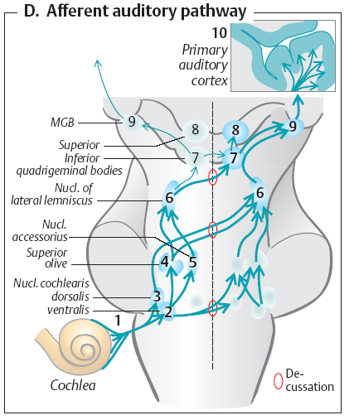
Auditory pathway
Three notes to lateral
symmetry of auditory pathway
>Compared to visual pathway, where left and right parts of visual scene only cross, the auditory pathway is from the third (first binaural) neuron on backed up by the crossings
>Speech centers are laterally
assymetric (due to probable functional purpose)
>Difference between the
left and the right ear is used in sound localization

Slide 14
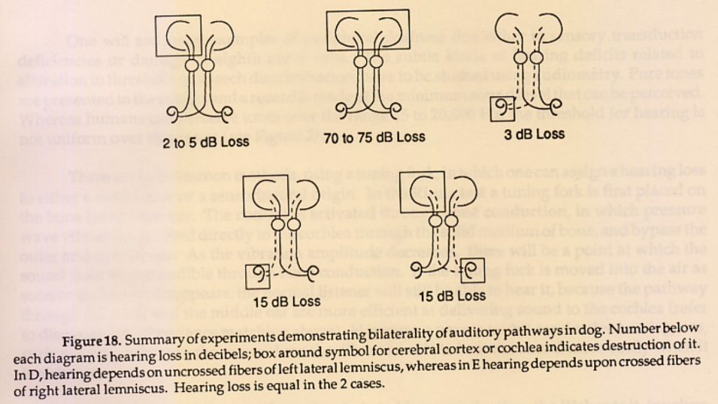

Slide 15
Functional classification of hearing loss
(measured without hearing aid)
1 normal hearing (threshold about 4 phon)
2 hardness of hearing
(hearing aid may be indicated:
at the band 500 Hz - 2 kHz bilaterally
threshold rise of 35 - 40 dB,
speech audiometry –threshold rise of more than 35 dB
low comprehension of loud speech at less than 4 m)
3 (practical) deafness
(does not hear loud voice at the ear, own voice,
threshold rise of 75 - 80 dB)
4 deaf-and-dumbness
(when the speech is not rehabilitated with inborn deafness)

Slide 16
Causes of hearing loss
- otosclerosis (in 0,5 - 1 % of elderly)
- conductive disorders
- hereditary and inborn disorders
- toxic damage
- meningoencefalitis
- profesional damage
- presbyakusia
- Menier’s disease

Slide 17
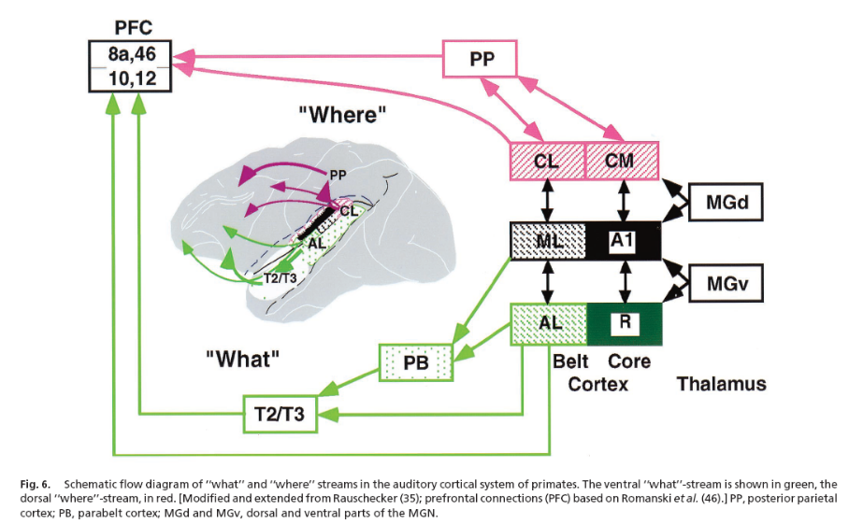
What and Where in auditory cortex

Slide 18
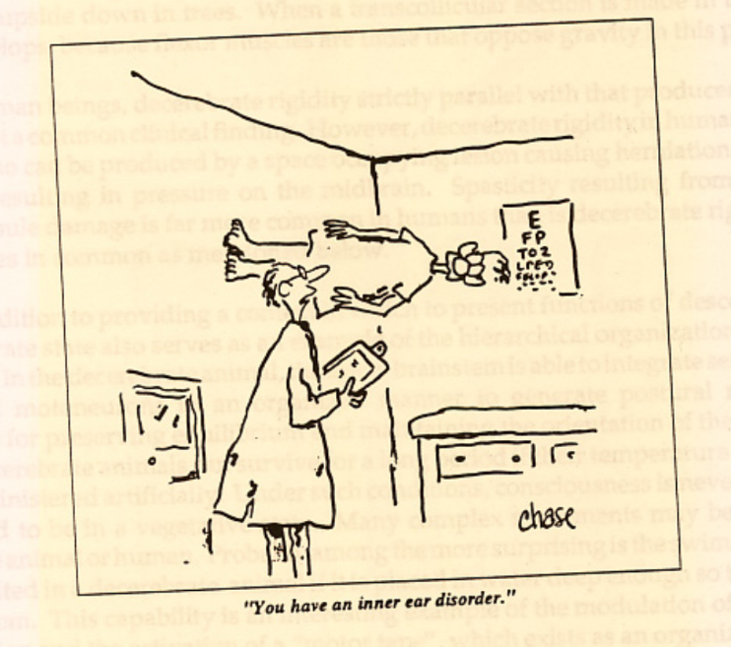

Slide 19
2nd part: Speech, development, perception and production. Hearing prosthetics, cochlear implants.
Charles University of Prague, First Medical Faculty
Outline of part 2
introduction: speech and development (ontogenesis) of speech
perception and production of speech
classical and revised view of speech ontogenesis, based on new experiments with infants
hearing impairment and speech, cochlear implants

Slide 20
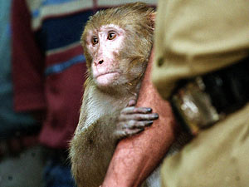
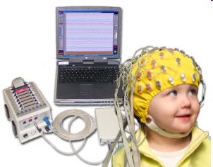
Electrophysiology:
non-invasive and invasive

Slide 21
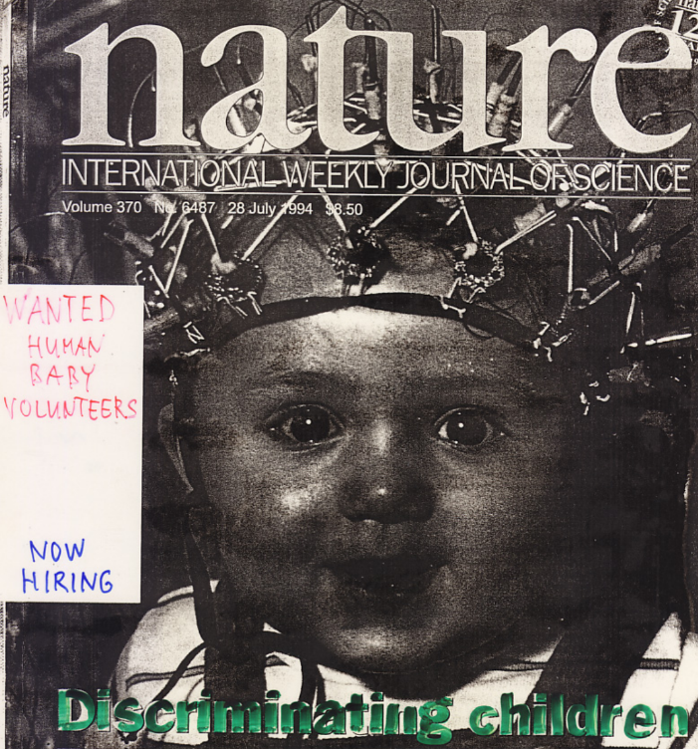
„Psycho-physical“
and electro- encephalo-graphic
responses
of infants and
small children

Slide 22
Stages of language acquisition
6 mo Beginning of distinct babbling.
1 y Beginning of language understanding, one word utterances.
1.5 y Dictionary of 30 to 50 words.
2 y Dictionary of 50 to several hunderd words. Two word (telegraphic/ short message) speaker.
2.5 y Three or more word sentences. Many grammatical errors and idiosyncratic expressions. Good understanding of language.
3 y Dictionary of 1000 words.
4 y Dictionary of 2000 words. Speech competence close to adults.
[Kandel, Schwartz, Jessel, Principles of Neural Science, 1991]
EN: babble, CZ: žvatlat, SK: džavotať, GE: plappern,
LAT: balbuties, et cetera…

Slide 23
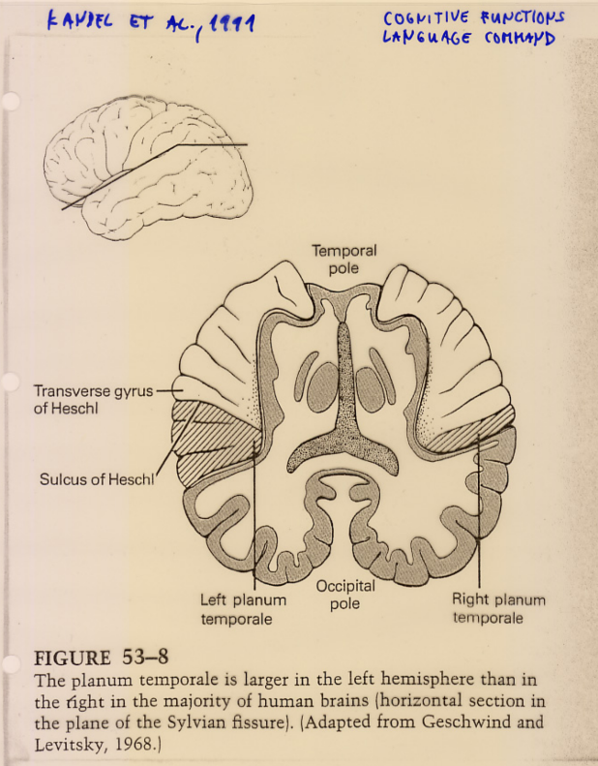

Slide 24
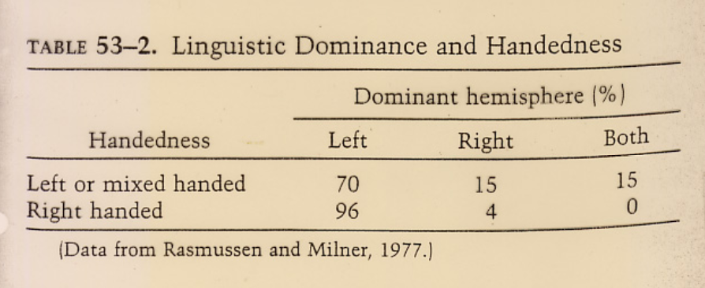

Slide 25
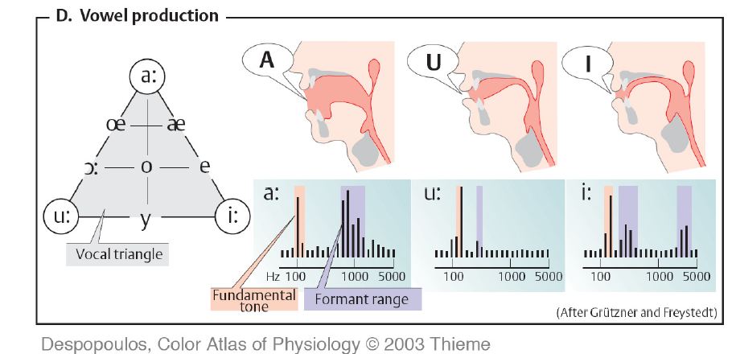
Formants of vowels in English

Slide 26
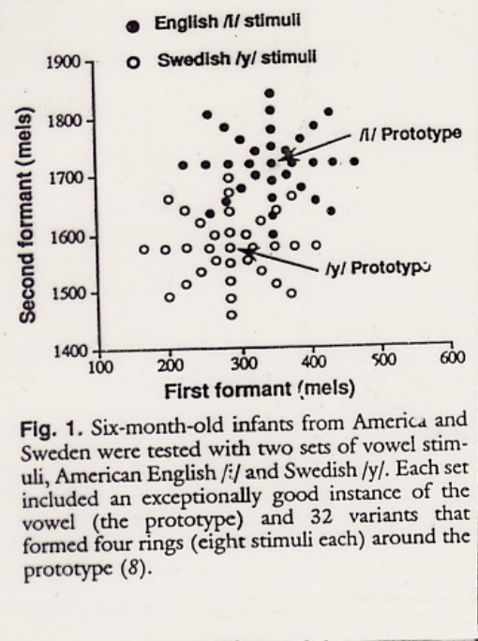
Prototypes of vowels
and synthetic vowels
in formant space
[P. Kuhl et al., 1992]

Slide 27
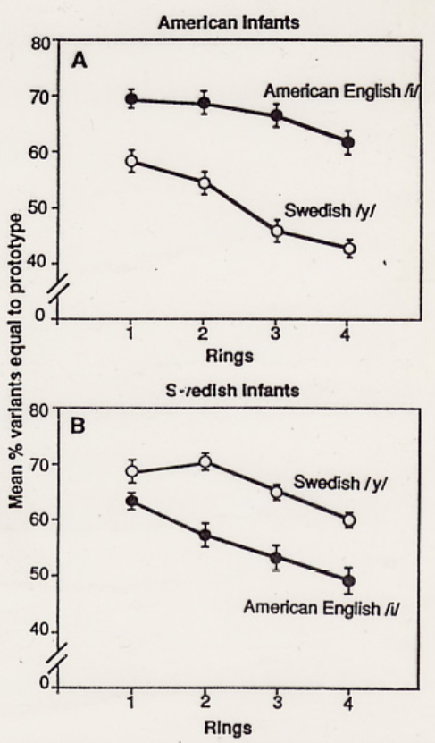
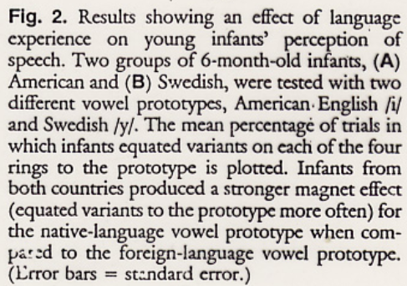
„Psycho-physical“
responses of 6 month old infants to vowels of native and foreign language
[P. Kuhl et al., 1992]

Slide 28
Speech processing in cerebral cortex

Slide 29
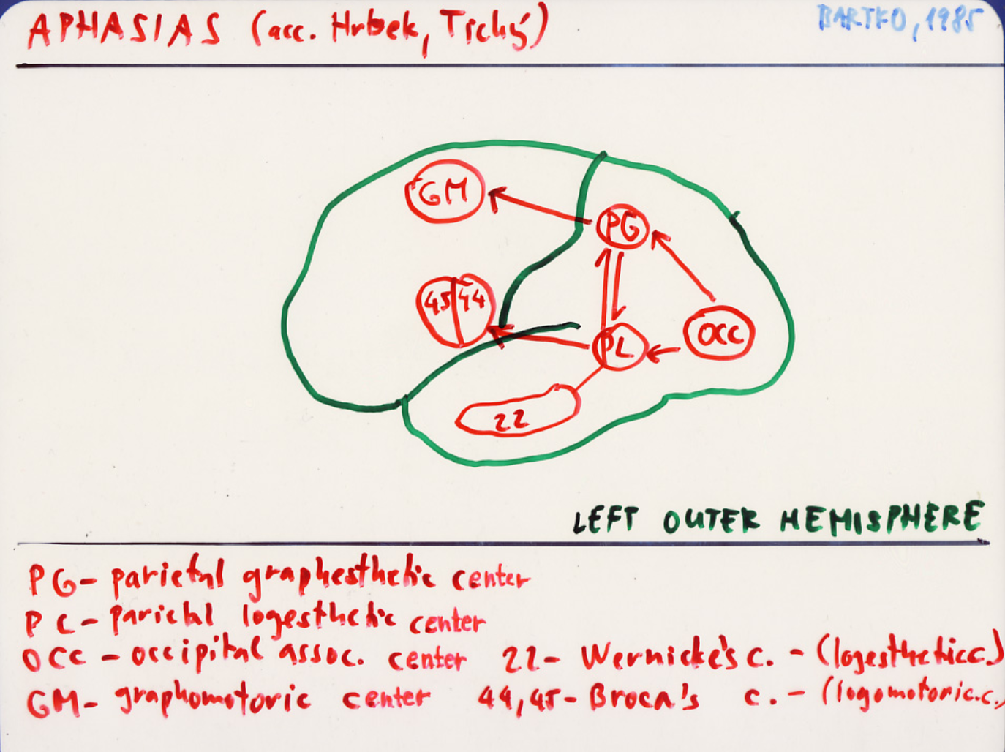

Slide 30
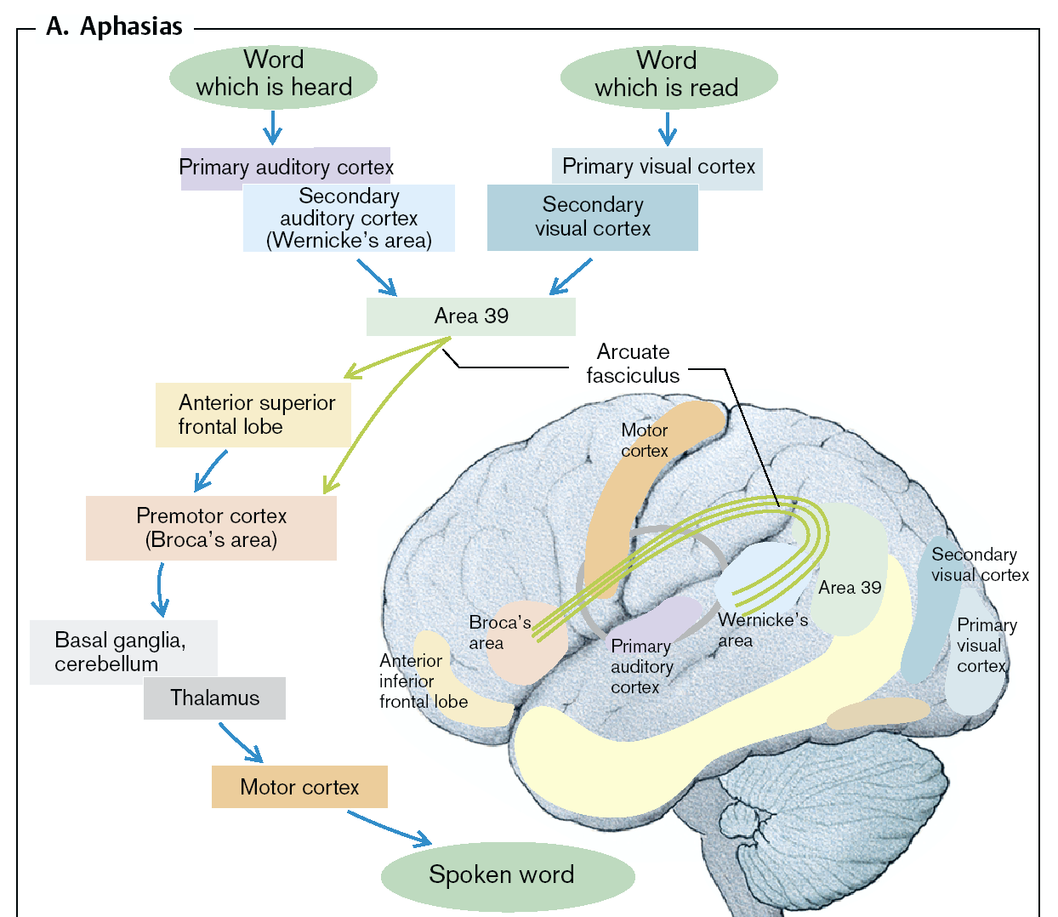

Slide 31
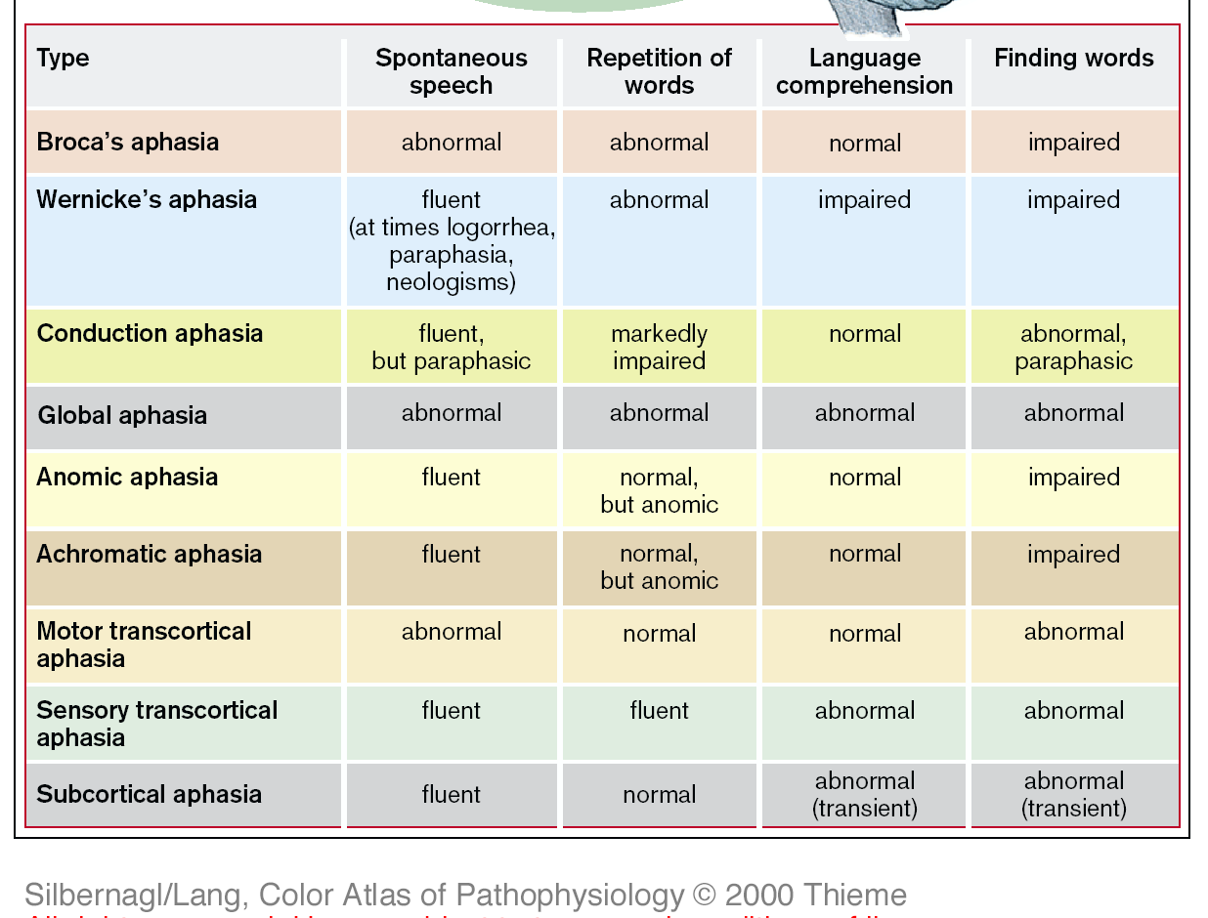

Slide 32
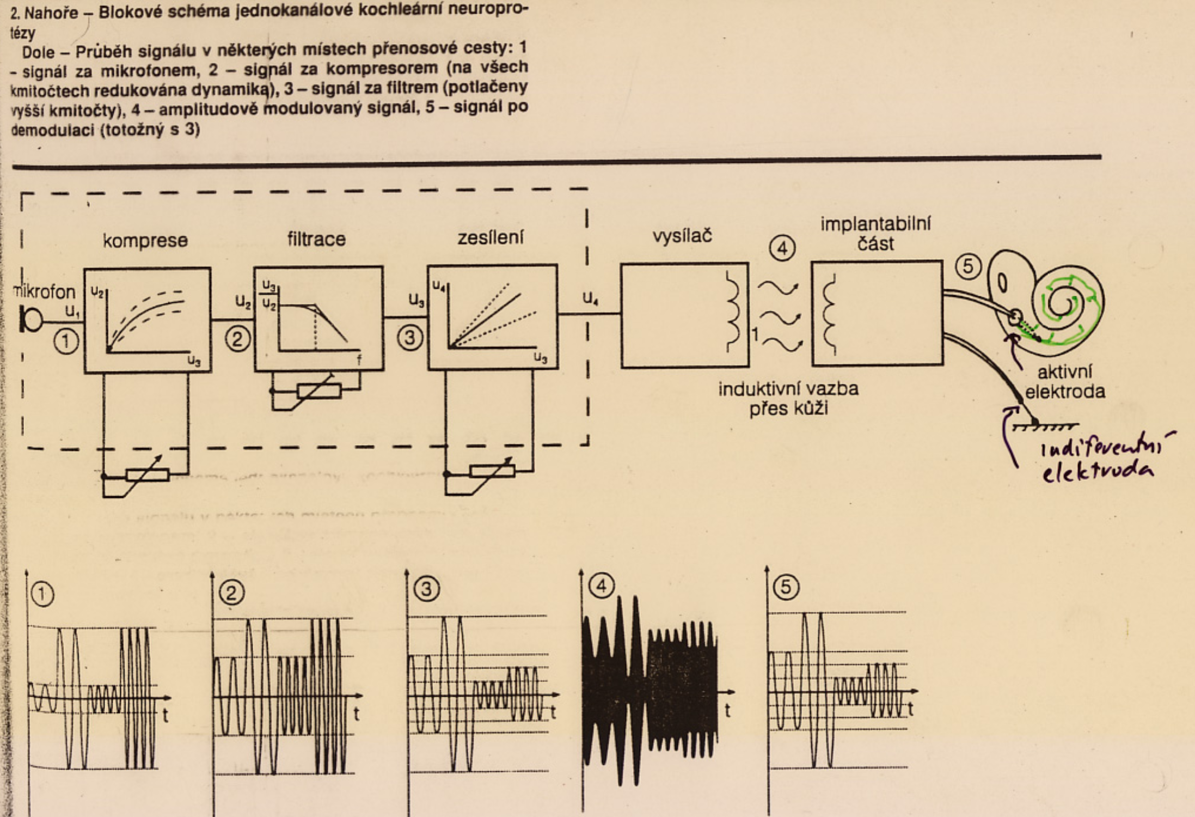
Cochlear implant – single channel

Slide 33
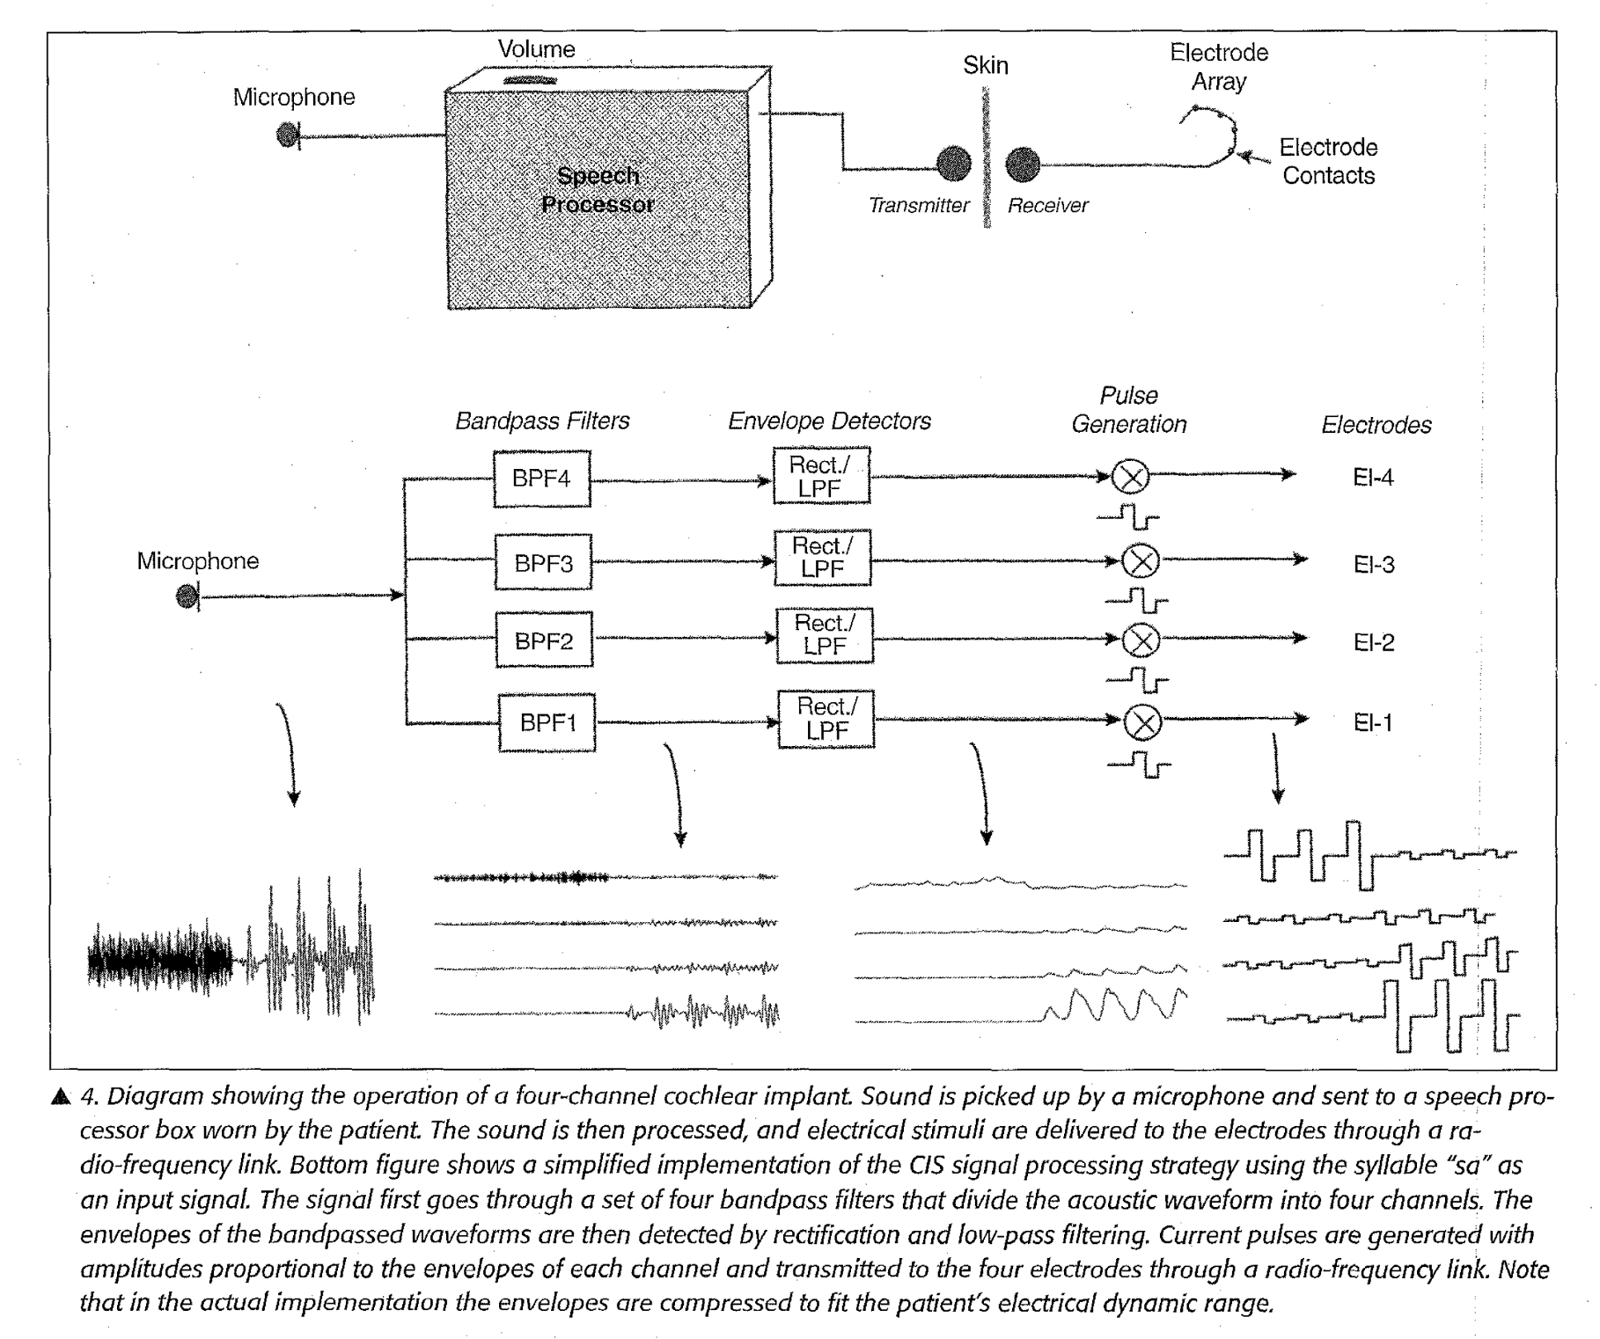
Cochlear implant – multi-channel

Slide 34
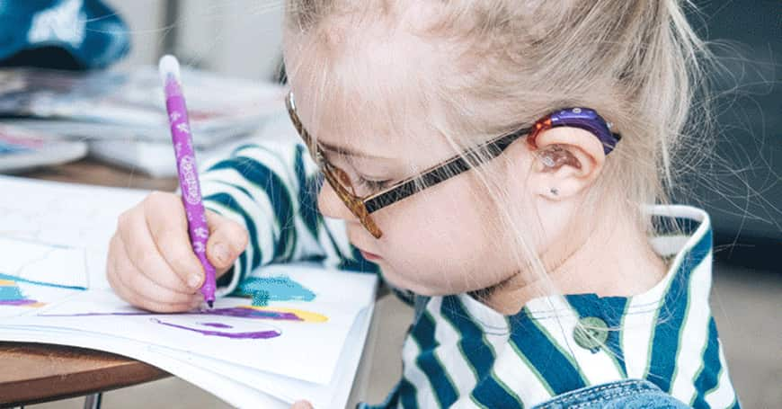
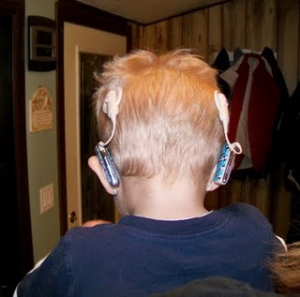
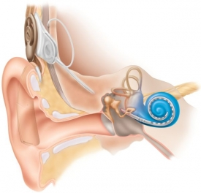
Cochlear implant vs. hearing aid

Slide 35
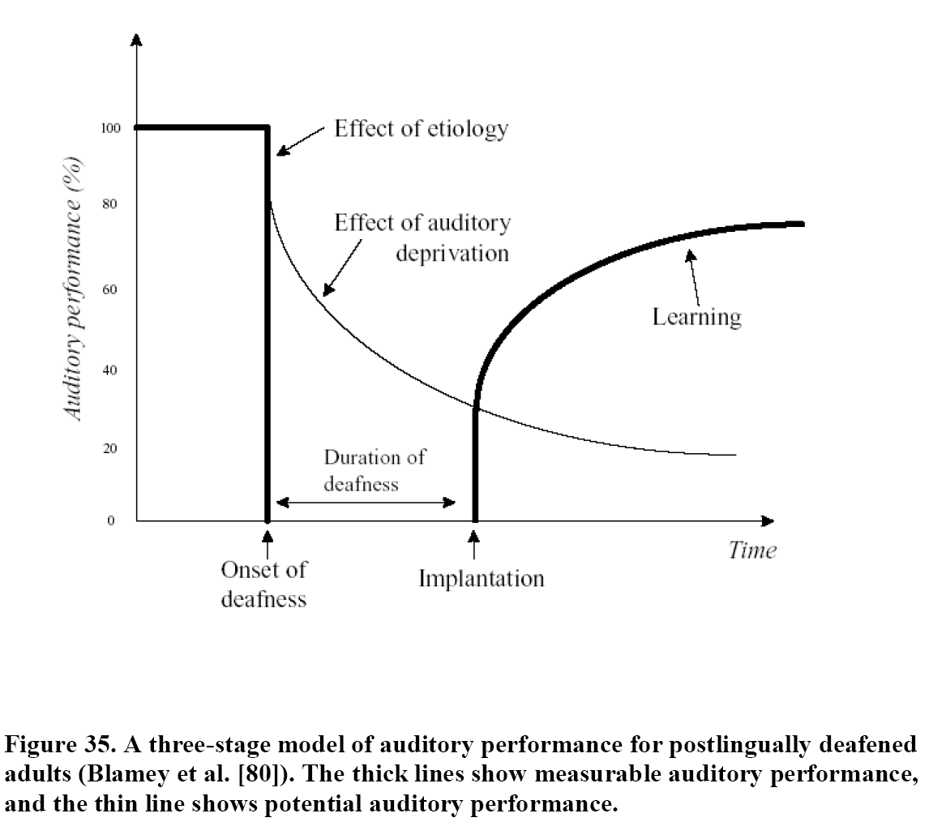
Cochlear implant – performance in time

Slide 36
END
OF THE LECTURE
Thanks for your attention
Warning: neither the PDF, nor the PPT, PPTX, etc.
versions of this presentation are official study materials.
For internal use only. Do not distribute.
Contact: Petr.Marsalek@LF1.CUNI.CZ
First Medical Faculty, Institute of Pathological Physiology

