Slide 1
Examinations of Respiratory System
seminar
Department of Pathological Physiology
First Medical Faculty CUNI
(version 25)

Slide 2
Functional lung tests/ Spirometry
Ventilation
Diffusion
Perfusion
Blood gases
Endoscopic examination
Imaging methods X-ray imaging
scintigraphy
angiography
ultrasonography
MRI
Laboratory tests

Slide 3
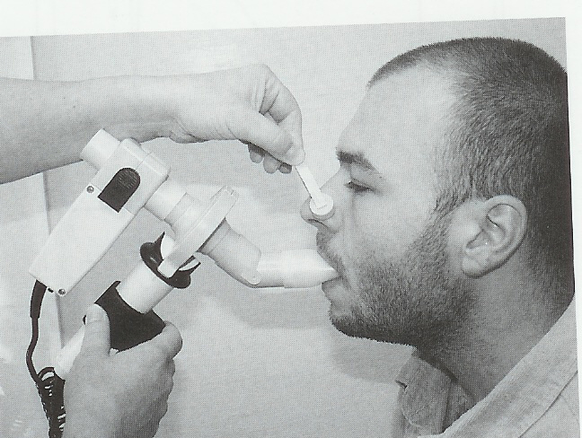
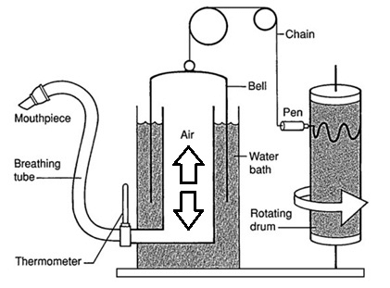
Flow spirometer (versus Groh’s s. with cylinder)

Slide 4
Ventilation
Spirometric volumes (and capacities)
- VT - tidal volume
- VC - vital capacity
- ERV, IRV - expiratory (inspiratory) reserve volume
- TLC = Total lung capacity
- FRC = Functional residual capacity
- RV = Residual volume

Slide 5
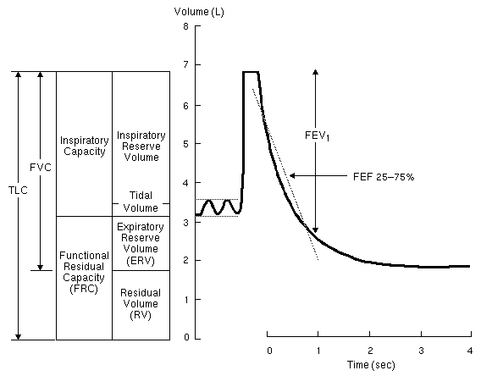
Normal spirogram
Notes:
Normal spirogram and lung volumes. ERV = FRC - RV; VC = TLC - RV; RV ~= 25% of TLC; FRC ~= 40% of TLC; FEV1 >= 75% of FVC.
Spirogram and lung volumes in obstructive disease. RV and FRC are increased.TLC is also increased but to a lesser degree, so that VC is decreased. Expiration is prolonged. FEV1 <= 75% of FVC. Note the emphysematous notch.

Slide 6
Dynamic ventilation parameters and tests
Breathing in rest: ventilatory rate (f/ min) (~ 12 breaths/ min)
Minute ventilaton (volume/ min) 6-8 L/ min
FVC - Forced vital capacity Total volume exhaled during the forced expiration
Normal VC values based on Regression equation in healthy set
female: [21.7 – (0.101 x age)] × (cm) = (mL)
male: [27.63 – (0.112 x age)] × (cm) = (mL) Values between 80 to 120 % of predicted are considered to be normal
MVV (Vmax) = Maximal voluntary ventilation maximal tidal volume (TV) and maximal ventilation rate
measured for 10 – 30 sec
> 40 L/min
- Ventilatory reserve: minute ventilation / MVV >1:7, > 1 : 5
= 1 : 2 means dyspnea at rest

Slide 7
FEV₁ - Volume of gas exhaled during the first second of forced expiration
- Evaluation of disease severity in patients with obstructive diseases
- Evaluation of therapy response
- Prognostic parameter: if FEV₁ < 1 L (5-year survival less then 50% of patients)
FEF 25-75% - Forced expiratory flow from 25 to 75 % of the vital capacity (Also: MMFR = Maximal Midexpiratory Flow Rate)
- often more sensitive measurement of early airflow obstruction then FEV1 (normal values: 2 – 4 L/sec)
False results may be obtained in patients with abnormally small lungs

Slide 8
Normal spirogram
Notes:
Normal spirogram and lung volumes. ERV = FRC - RV; VC = TLC - RV; RV ~= 25% of TLC; FRC ~= 40% of TLC; FEV1 >= 75% of FVC.
Spirogram and lung volumes in obstructive disease. RV and FRC are increased.TLC is also increased but to a lesser degree, so that VC is decreased. Expiration is prolonged. FEV1 <= 75% of FVC. Note the emphysematous notch.

Slide 9
PEFR = Peak expiratory flow rate
Wright’s peak flow meter:
repeated measurements of PEFR by patient to evaluate changes in dynamic pressure of the airways

Slide 10
Flow volume loops
measurement of flow dependend on volume
Inspiration
Exspiration

Slide 11
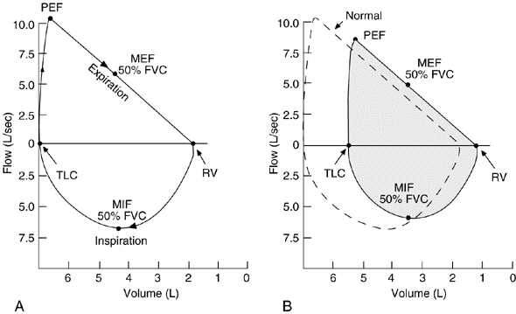
Normal flow volume curve
Notes:
Flow-volume loops.
(Fyziologická) Inspiratory limb of loop is symmetric and convex. Expiratory limb is linear. Flow rates at midpoint of VC are often measured. MIF 50%FVC is > MEF 50%FVC because of dynamic compression of the airways. Peak expiratory flow is sometimes used to estimate degree of airway obstruction but is very dependent on patient effort. Expiratory flow rates over lower 50% of FVC (ie, approaching RV) are sensitive indicators of small airways status.
(Restrikční vada) Restrictive disease (eg, sarcoidosis, kyphoscoliosis). Configuration of loop is narrowed because of diminished lung volumes, but shape is basically as in (Fyz). Flow rates are normal (actually greater than normal at comparable lung volumes because increased elastic recoil of lungs and/or chest wall holds airways open).

Slide 12
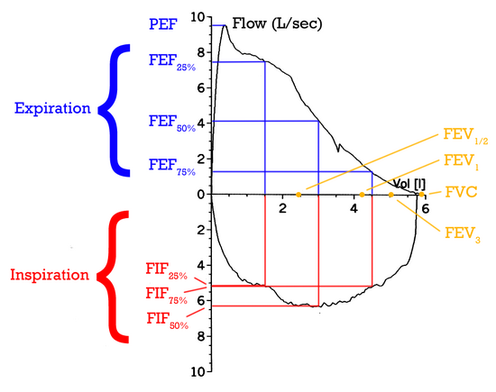
Inspiratory and Expiratory flows

Slide 13
Restrictive diseases
anatomical and/ or functional loss of surface for gas exchange
resection
atelectasis
lung edema
lung fibrosis
thoracic deformities / breathing movements
pneumonia
pneumothorax

Slide 14
Characteristics
- decreased vital capacity (VC)
- decreased function residual capacity (FRC)
- decreased compliance
- normal shape of flow volume loops
more negative intrapleural pressure during inspiration
increased in pulmonary vascular resistance
- hypoxemia

Slide 15
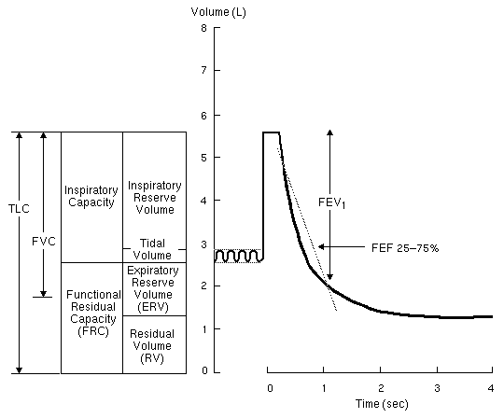
Spirogram - restrictive disease
Notes:
Spirogram and lung volumes in restrictive disease. Lung volumes are all diminished, the RV less so than the FRC, FVC, and TLC. FEV1 %FVC is normal or greater than normal. Tidal breathing is rapid and shallow.

Slide 16
Obstructive diseases
increased resistance of airways
intrathoracic
extrathoracic
Asthma bronchiale /COPD
- intrathoracic
- expiratory obstruction
- decreased FVC
- decreased FEV1
- decreased FEF_{25-75%}
decreased PEFR
flow volume curve

Slide 17
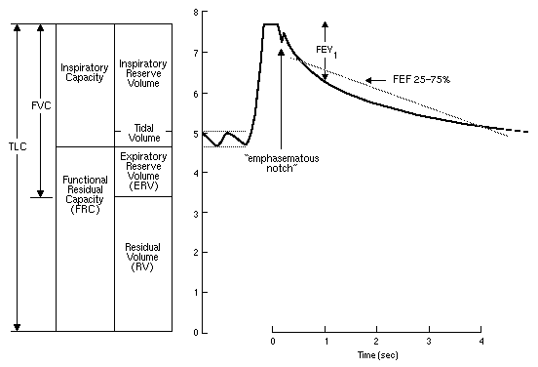
Spirogram - obstructive disease
Asthma, COPD

Slide 18
Evaluation of Flow Volume Curve
1. peak-flow-metry (PEF)
2. measurement of expired volume in different time intervals, mainly in 1 sec (FEV1)
3. relation of expired flow to volume
a) mean expiratory flow 25-75 % FVC (FEF₂₅₋₇₅, FMF)
b) mean expiratory flow in any point of FVC (MEF_{25,50,75})
Values from initial phases of expiration depend on maximal effort of pacient
changes of extrathoracic airways
Values from later phases of expiration depend on mechanical lung properties

Slide 19
Evaluation of shape of expiration curve
maximal flow is in approx. 80 % of FVC
100–75 %: part dependent on expiratory effort (velocity and muscular effort)
75–15 %: part independent on expiratory effort (relation between lung volume and maximal flow) – indicator of airway resistance and lung elasticity
15–0 %: part dependent on expiratory effort

Slide 20
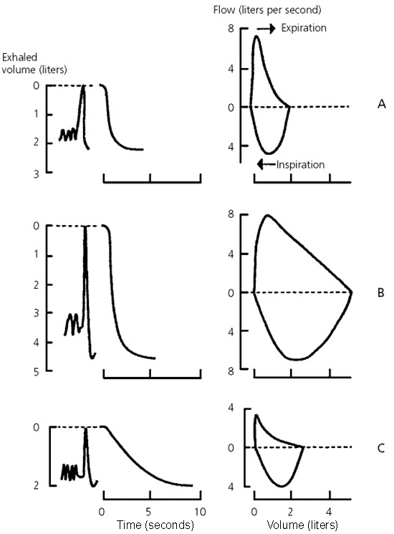

Slide 21
Flow volume curves in different conditions
Normal
Restrictive disease (parenchymal)
Notes:
Flow-volume loops.
(Fyziologická) Inspiratory limb of loop is symmetric and convex. Expiratory limb is linear. Flow rates at midpoint of VC are often measured. MIF 50%FVC is > MEF 50%FVC because of dynamic compression of the airways. Peak expiratory flow is sometimes used to estimate degree of airway obstruction but is very dependent on patient effort. Expiratory flow rates over lower 50% of FVC (ie, approaching RV) are sensitive indicators of small airways status.
(Restrikční vada) Restrictive disease (eg, sarcoidosis, kyphoscoliosis). Configuration of loop is narrowed because of diminished lung volumes, but shape is basically as in (Fyz). Flow rates are normal (actually greater than normal at comparable lung volumes because increased elastic recoil of lungs and/or chest wall holds airways open).

Slide 22
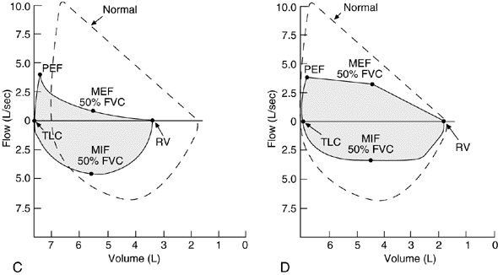
Obstructive diseases
Asthma, COPD
Fixed obstruction of
upper airway
Notes:
(Obstrukce: C) COPD, asthma. Though all flow rates are diminished, expiratory prolongation predominates, and MEF is < MIF.
(Obstrukce: D) Fixed obstruction of upper airway (eg, tracheal stenosis, bilateral vocal cord paralysis, goiter). Top and bottom of loop are flattened so that the configuration approaches that of a rectangle. The fixed obstruction limits flow equally during inspiration and expiration, and MEF = MIF.
(Obstrukce: E) Variable extrathoracic obstruction (eg, vocal cord paralysis). When a single vocal cord is paralyzed, it moves passively in accordance with pressure gradients across the glottis. During a forced inspiration, it is drawn inward, resulting in a plateau of decreased inspiratory flow. During a forced expiration, it is passively blown aside and expiratory flow is unimpaired, ie, MIF 50%FVC is < MEF 50%FVC.
(Obstrukce: F) Variable intrathoracic obstruction (eg, tracheomalacia). During a forced inspiration, negative pleural pressure holds the "floppy" trachea open. With forced expiration, the loss of structural support results in narrowing of the trachea and a plateau of diminished flow (a brief period of maintained flow is seen before airway compression occurs).

Slide 23
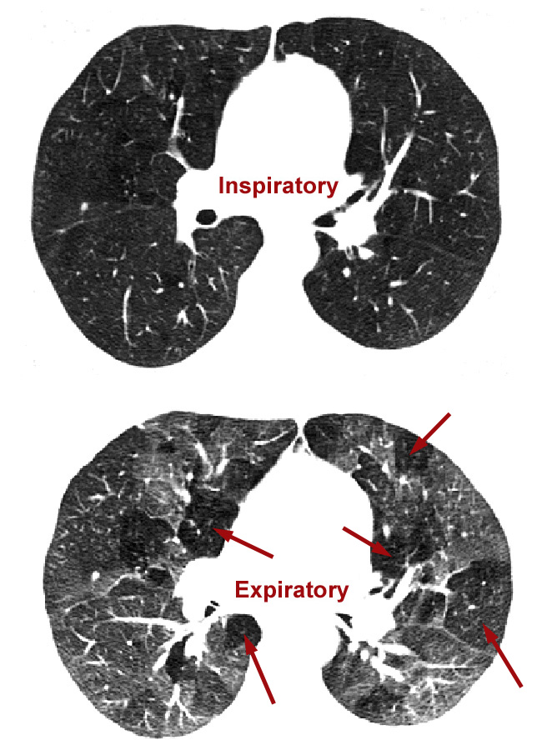
AIR TRAPPING
(Schematic picture)
Warning: this slice image/
pathologic-anatomic
section (? CT scan/
? CT angiography)
captures emphysematous
distension.
But it does not reflect
functional relations.
Functional properties are set
by resistance, pressure
gradients, and by measurable
spirometric parameters,
not visible macroscopically…

Slide 24
Alveolar-capilary diffusion and perfusion
a/ Blood gases (paO₂, paCO₂, pH)
b/ Partial gas pressure in alveoli (pAO2, pACO₂; P(A-a)O₂)
c/ mean pressure in a. pulmonalis: PAP < 20 mmHg [2.67kPa]; PAP =15-30/5-13 mmHg)
- Flow directed pulmonary arterial (Swan-Ganz) catheter
- Diseases causing hypoxemia are potentially capable of increasing pulmonary vascular resistance (COPD, interstitial lung disease, chest wall disease, recurrent pulmonary emboli...)
d/ Ventilation / perfusion scan

Slide 25
e/ Diffusion capacity of lungs for CO (0.3 %) or O2 (DLCO; DLO2 = 1.23 × DLCO)
(single breath, 10 secm hold, then exhale) decrease is caused by:
a) Thickening of alveolocapilary membrane (fibrosis...)
b) Destruction of alveolocapilary membrane (emphysema..)
c) Anaemia
Limiting factors | Gases
 | O₂ | CO₂ | CO | N₂O
Alveolo-capillary membrane | + | - | + | -
Blood volume and HB | + | + | + | -
Circulation | + | + | - | +

Slide 26
Ventilation to perfusion ratio

Slide 27
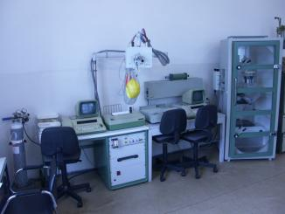
The box on the
right is not
Wine cupboard
But
pletysmograph
Plethysmo-
graphy
= body test
measuring:
spirometry
flow curves
other volumes:
RV – residual volume
ITV – introthoracic volume
FRC – functional residual capacity
- resistance

Slide 28
OXYGEN - hypoxia
Oxygen consumption
= Hemoglobin × blood flow (CO) × (AV difference)
AV difference
activity of the tissue (oxygen extraction), paO₂, pvO₂
Hypoxia
* Transport (anemic) hypoxia
* Ischemic hypoxia
* Histototoxic hypoxia (decrease in AV difference)
* Hypoxic hypoxia
Factors influencing paO₂
- p_{A}O₂
- p_{ATM}O₂
- ventilation
- ventilation/perfusion
- difusion
- right-left shunt

Slide 29
CARBON DIOXIDE (CO₂)
- Hypocapnia = lower CO₂
- Hypercapnia = higher CO₂
depends mainly on alveolar ventilation
acid base balance !!

Slide 30
Blood gasses – HB saturation by O2

Slide 31
HB - O2 dissociation curve

Slide 32
other HBs dissociation curves

Slide 33
Endoscopic examination of the lungs
1. Bronchoscopic examination
Fibroscopy (Flexible fiberoptic bronchoscope)
- Visualization of tracheobroncial tree
- Biopsy of suggestive or obvious lesions
- Lavage, brushing or biopsy of lung regions for culture, cytological and microbiologic examination
* bronchiolo-alveolar lavage (BAL): saline 150-500mL
* transbronchial lung biopsy
2. Mediastinoscopy – insertion of lighted mirror lens system through a insertion on the base of the neck anteriorly
3. Thoracoscopy

Slide 34
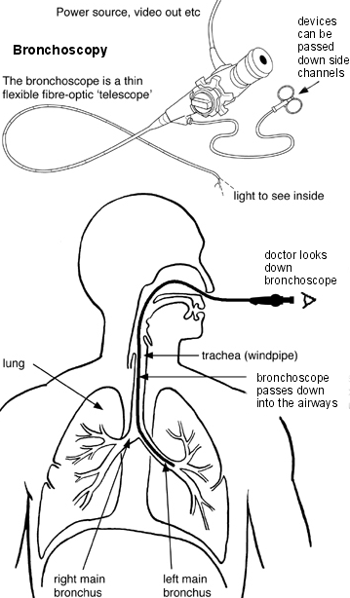
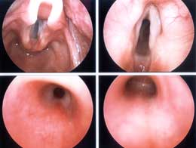

Slide 35
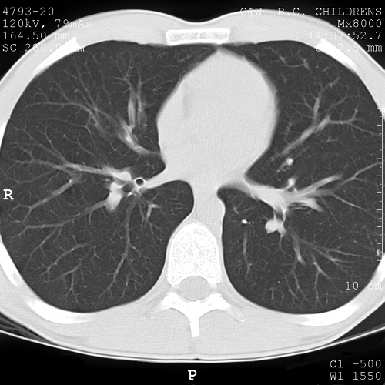
Imaging methods
1. Radiographic procedures (Skiagram, Abreogram, Tomogram, ComputerTomogram)
- pneumonia, atelectasia, pneumothorax, pneumo-mediastinum, emphysema, cystic fibrosis, tumors
CT zdravých plic

Slide 36
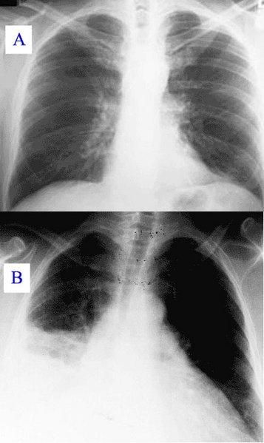
X-ray normal lung
X-ray pneumonia

Slide 37
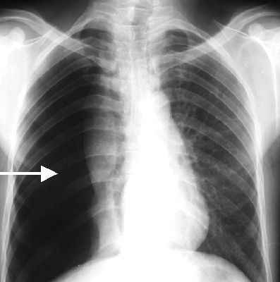
Pneumothorax

Slide 38
2. Pulmonary scintigraphy
a) Ventilation - perfusion scan
- diagnosis of pulmonary embolism and parenchymal lung disease
should be performed in all clinically stable patients with the suspicion of pulmonary embolism
- Ventilation scan - 133Xe gas
- Perfusion scan – microspheres of albumin (50-100 mm labeled with gamma emitting isotope 99mTc
“Mismatch” in ventilation and perfusion is characteristic for pylmonary thrombo-embolism

Slide 39
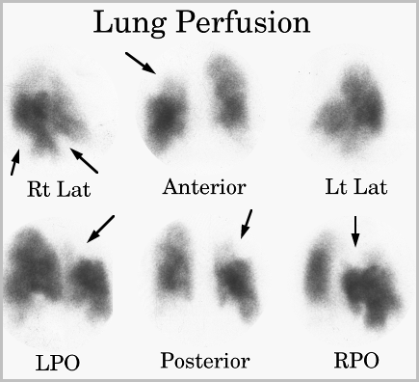

Slide 40
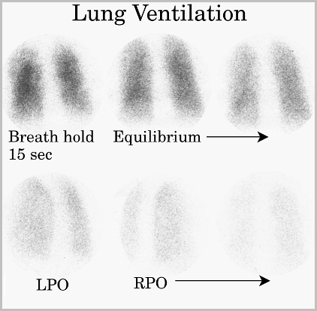

Slide 41
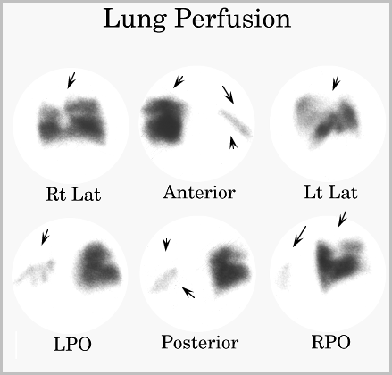

Slide 42
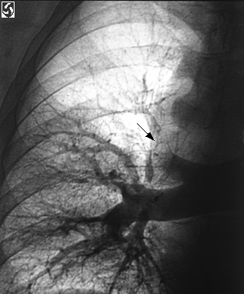
b) Gallium scan – 67Gallium – accumulation in intrathoracic inflammatory and neoplastic tissues
lungs and mediastinal lymph nodes
3. Pulmonary angiography
Pulmonary thromboembolism, massive hemoptysis
Injection of radio-opaque material into pulmonary artery or its branches

Slide 43
4. Ultrasonography
- evaluation of pleural processes
percutaneous lung biopsy
5. Nuclear Magnetic Resonance (MRI)
- more sensitive then CT for distinguishing nonvascular tissues in the complex hilar region and central portions of lungs.
same effectiveness as CT in lung cancer staging

Slide 44
Laboratory tests
- alpha-1-antitrypsin (deficiency: young non-smokers with emphysema)
- Test of sweat for chlorides (Cystic fibrosis Cl⁻ > 60 mmol/L)
- Microbiology: cultivation of sputum or BAL (broncho-alveolar lavage), molecular test (PCR…): Pseudomonas aeruginosa (CF), Staphylococcus aureus, Hemophilus influenzae, Burkholderia cepacia
Cytological examination of sputum or BAL
Biopsy

Slide 45
suicide
with the
help of
apnoe?

Slide 46
Pulse oxymetry
Pulse oxymetry – measures saturation of O2 in Hb using photo-electric methods
Lower sensitivity for pO₂ > 8 kPa, in worse skin perfusion and in presence of carboxy-hemoglobin and methemoglobin

Slide 47
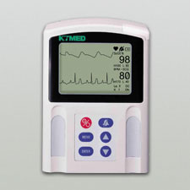
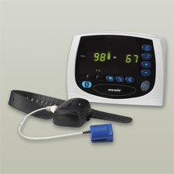
Pulse oxymeter

Slide 48
No Copyright/ Disclaimer/ Warning
„seminar“
Petr Marsalek, and others
warning: the PDF version of this
presentation is not an official study material
First Medical Faculty, Institute of Pathological Physiology
Notes:
48

