Slide 1
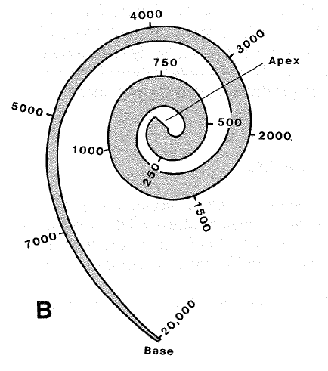
FAV, Talk no. 3,
Auditory pathway https://dec52.lf1.cuni.cz/~pmar/ftp/REST/PPT-FEL/
Petr Maršálek
- presentation update -
Notes:
1

Slide 2
Outline – Review of the auditory pathway anatomy is here
Auditory nerve encodes sound in digital format – using trains of action potentials (spike trains) composed from binary (all-or-none) pulses.
Auditory pathway branches into two anatomically and functionally distinct neural pathways: 1 ascending mono-aural pathway and 2 binaural pathway.
Between cochlea and auditory cortex, signal is relayed through circa 10 neuronal relays. Some have fewer and some have more neurons inbetween. We highlight 7 here. Not all of them have known functions.
This (3rd) talk deals with sub-cortical processing, while next (4th) deals with thalamo- cortical (in short cortical) processing and binaural/ =spatial hearing.
Distinct mono aural nuclei are: 1 spiral ganglion = auditory nerve center, 2 cochlear nuclei, 3 superior olivary complex. These are medial and lateral superior olives (MSO and LSO) and 4 lamina quadri-gemina nuclei, one of whose is inferior colliculus.
Then as numbers 5, 5A, 5B, 5C/ and variable number inbetween/ the pathway intertwines through the bundle of lemniscus lateralis to 6 medial geniculate nucleus, which is in fact thalamic nucleus.
Last stage is 7: auditory part of cerebral cortex. It consists od several auditory areas, one called primary and the rest is dubbed secondary.
Binaural pathway starts with the 3rd neuron of medial or lateral superior olive.
While it is easy to dissect these pathways into anatomical parts, we want to know, what are neuronal functions, and they are mostly unknown to date.
Majority of this talk deals with spikes, so let us start over with the spikes = action potentials.

Slide 3
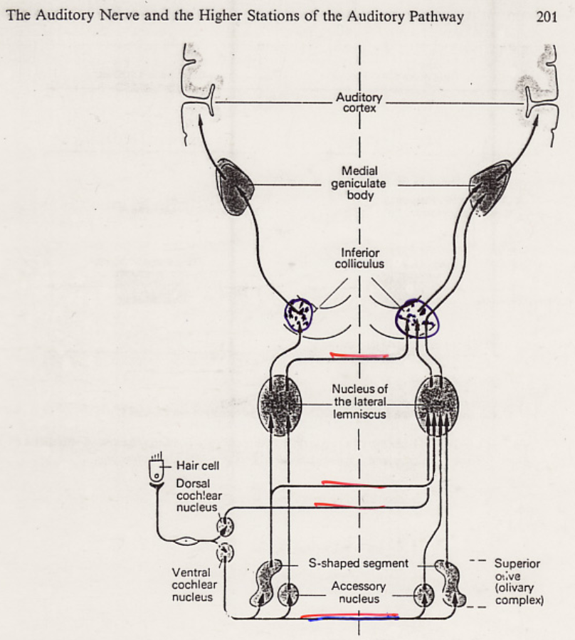
Auditory pathway
Mono-aural (1)
pathway
overview

Slide 4
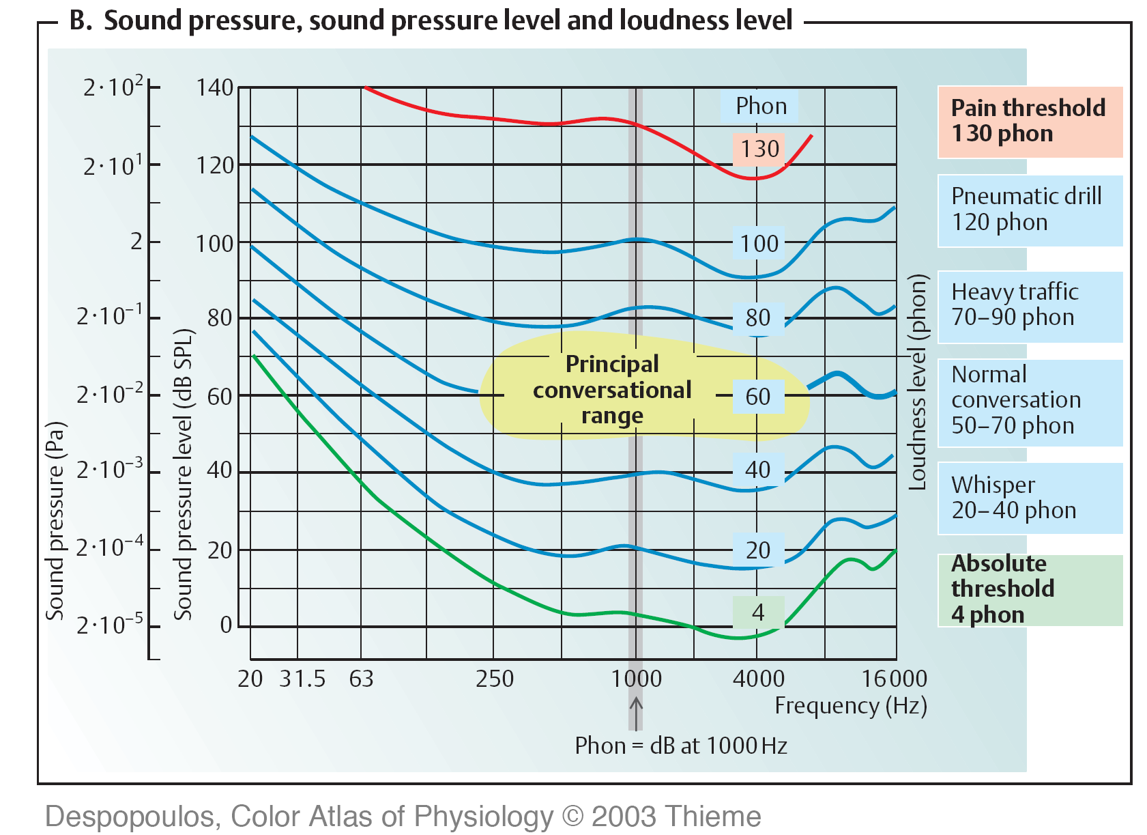
Normal audiogram
Before starting with spikes, recall Normal audiogram: x-axis, sound frequency (Hz), y-axis, sound pressure (Pa). Red top curve is pain threshold. Hearing threshold is Green bottom curve. Blue are curves of subjectively equivalent loudness level. dB SPL is objective unit, phone is subjective unit. Yellow blob is speech region.
Gray line is reference frequency 1000 Hz.
[loudness
depending on pitch,
in a textbook: Silbernagl, Despopoulos, Thieme, 2000]

Slide 5
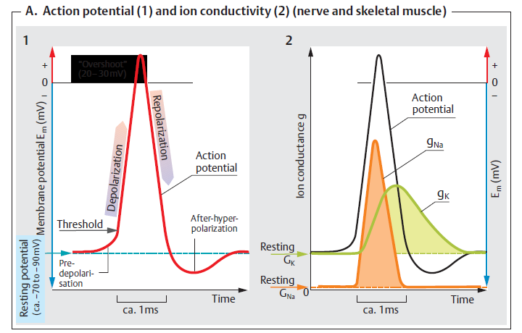
Spike, or Action Potential, AP,
Is an Unitary Impulse.
5

Slide 6
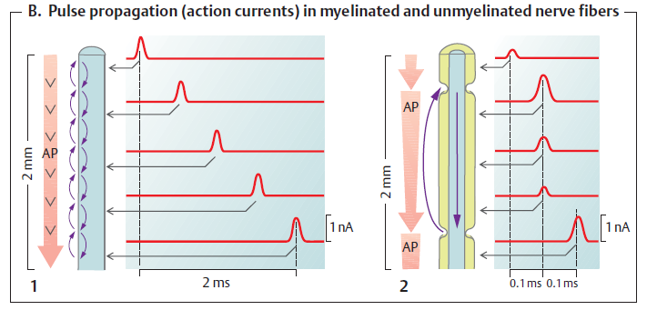
AP Conduction in Neural Fiber
6

Slide 7
RECALLING PSYCHO-PHYSICS:
Objective /to Subjective Barrier;
Physical /to Perceptual Energy
amplitude
frequency
spectrum
duration
azimuth
A modulation, etc
loudness
pitch
timbre
length
direction
roughness, etc
But: how is this represented/ encoded?

Slide 8
Action Potential (AP) Propagation, and Conduction on a Synapse
8

Slide 9
Excitatory and Inhibitory Post-Synaptic Potentials, EPSPs and IPSPs. (Plus neuromuscular plate, just for completeness…)

Slide 10
This is only a methaphor! Pulse-code modulation (PCM)
Sound file extensions:
…, .WAV, .PCM
Synchronous with sampling
frequency,
Auditory pathway:
Low freq. (20-500 Hz)
Synchronous with sound,
High frequency f. (0.5-16 kHz)
Asynchronous, triggered
[Vejražka, 1991,Signals and systems]

Slide 11
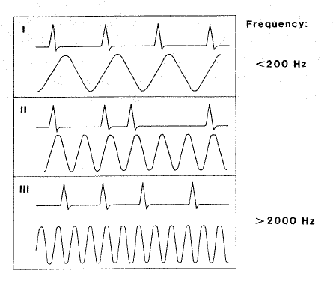
Encoding of Sound Loudness and Frequency by APs (= Spike Trains)

Slide 12
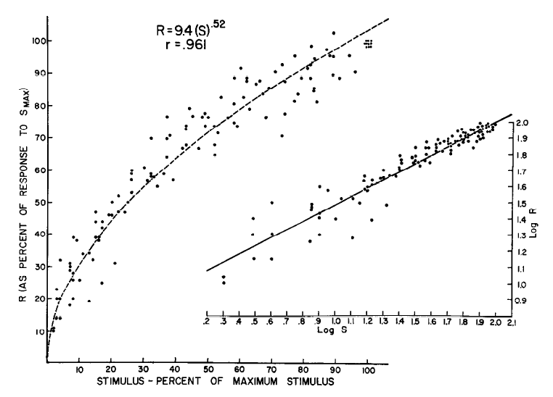
Objective /to Internal /to Subjective; This transform is described as: Psychophysical Law, is also called Psychometric Function, R=f(S)
Touch, vibration
stimulus: skin indenta-tion stimuli, internal
response: spike trains in mechano- receptive fibers,
Subjective: touch percept
[Werner, Mountcastle, 1965]

Slide 13
High, Middle and Low S.R.
High, Middle and Low Spontaneous Rate Auditory Nerve Fibres
dB SPL,
decibels of sound pressure level
(objective units)
spike rate (internal units)
x-axis: stimulus intensity, dB SPL,
y-axis: neuronal spike rate per s
[WINTER I.M., PALMER A.R. Intensity coding in low-frequency auditory-nerve fibres of the guinea pig.
J Acoust Soc Am 1991, 90, pp. 1958–1967]
[Winter and Palmer, 1991]

Slide 14
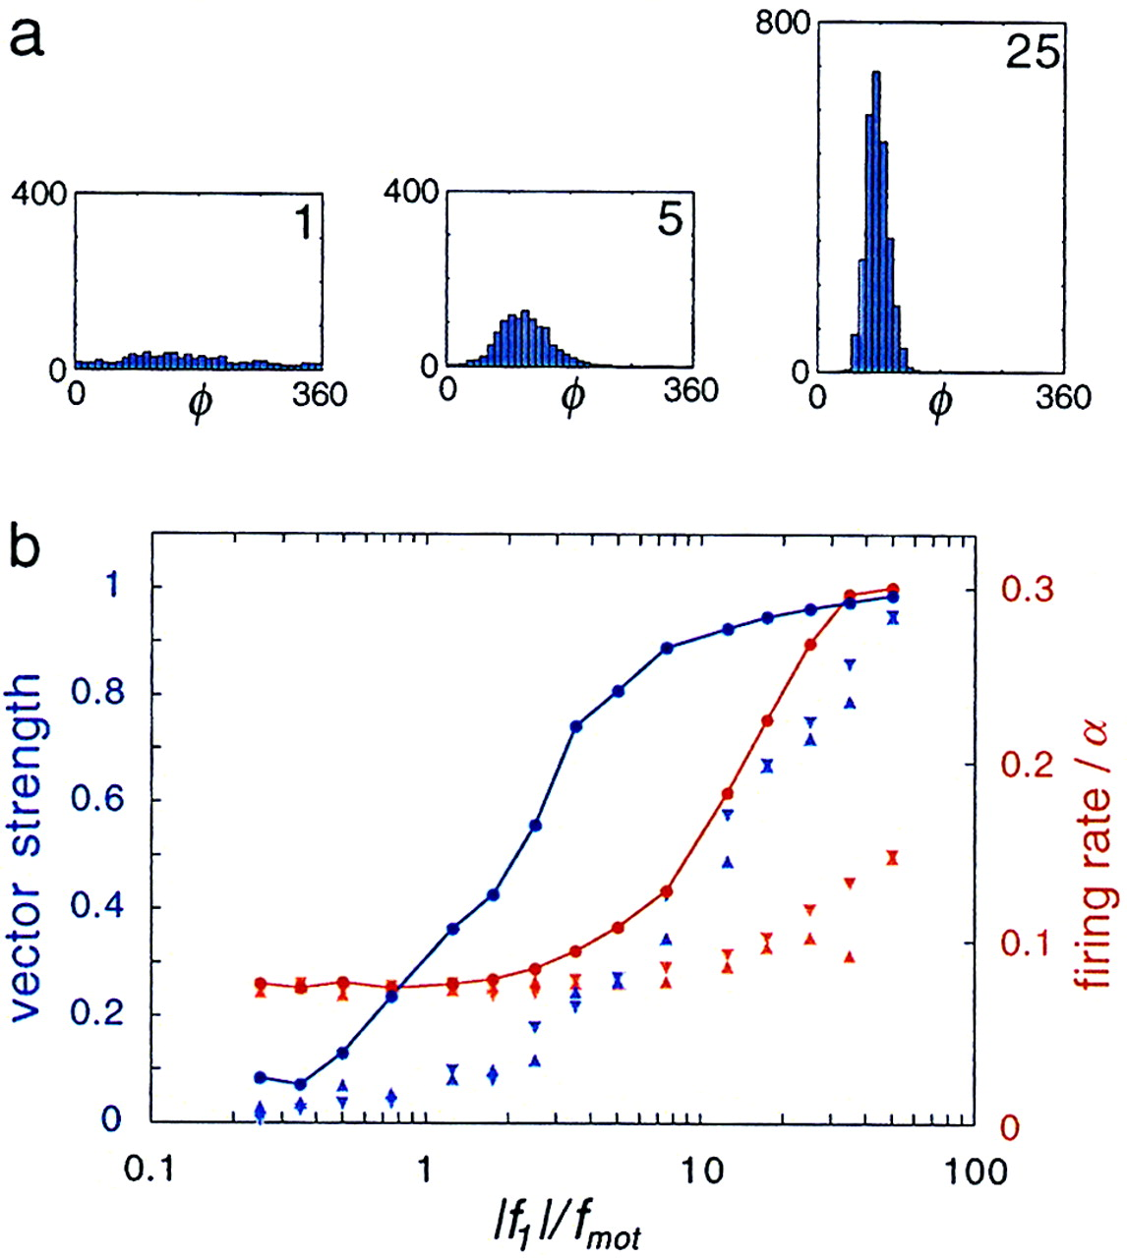
Physical /to Internal Representation of
Percept; Modality of Percept;
Internal Representation by Spike Trains
[Camalet, Duke, Julicher, Prost, Proc Natl Acad Sci USA, 2000]
[Winter and Palmer, 1991]

Slide 15
Vector strength,
has values from 0 to 1.
Is similar to correlation coefficient
(which has values
from –1 to 1).
[Joris et al, 2006]
[Goldberg and Brown, 1969]

Slide 16
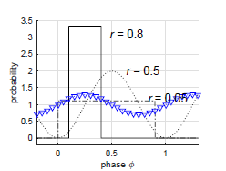
Vector strength r
Examples with
values r = 0.5, 0.8, 0.05
(Narrow) rectangular pulse, r = 0.8
sine with DC component, r = 0.05
[Toth, Marsalek, Pokora, Biol Cybern, 2018]

Slide 17
Circular statistics
Circular statistics is used in description of repetitive
events (time domain).
It can cover time repetition on different time scales.
(Examples: sound period, time gap in sound.)
Can be used in description of horizontal sound
localization (for different quantities: time or space).
[Toth, Marsalek, Pokora, Biol Cybern, 2018]

Slide 18
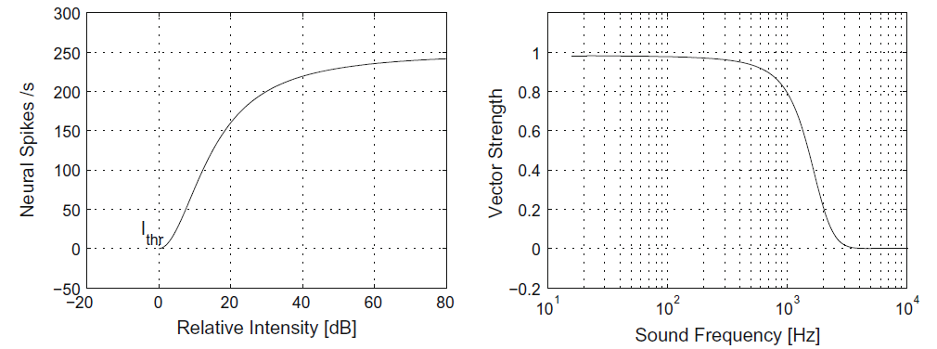
“Canonical” spiking auditory model
[Toth, Marsalek, Pokora, Biol Cybern, 2018]

Slide 19
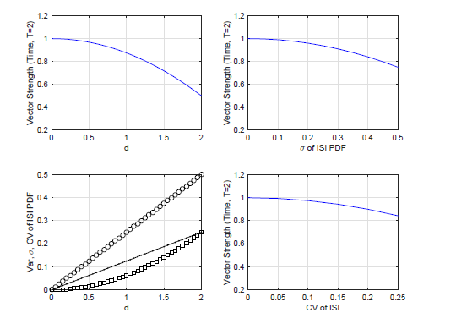
Vector strength, spike timing jitter and other variability measures
[Toth, Marsalek, Pokora, Biol Cybern, 2018]

Slide 20
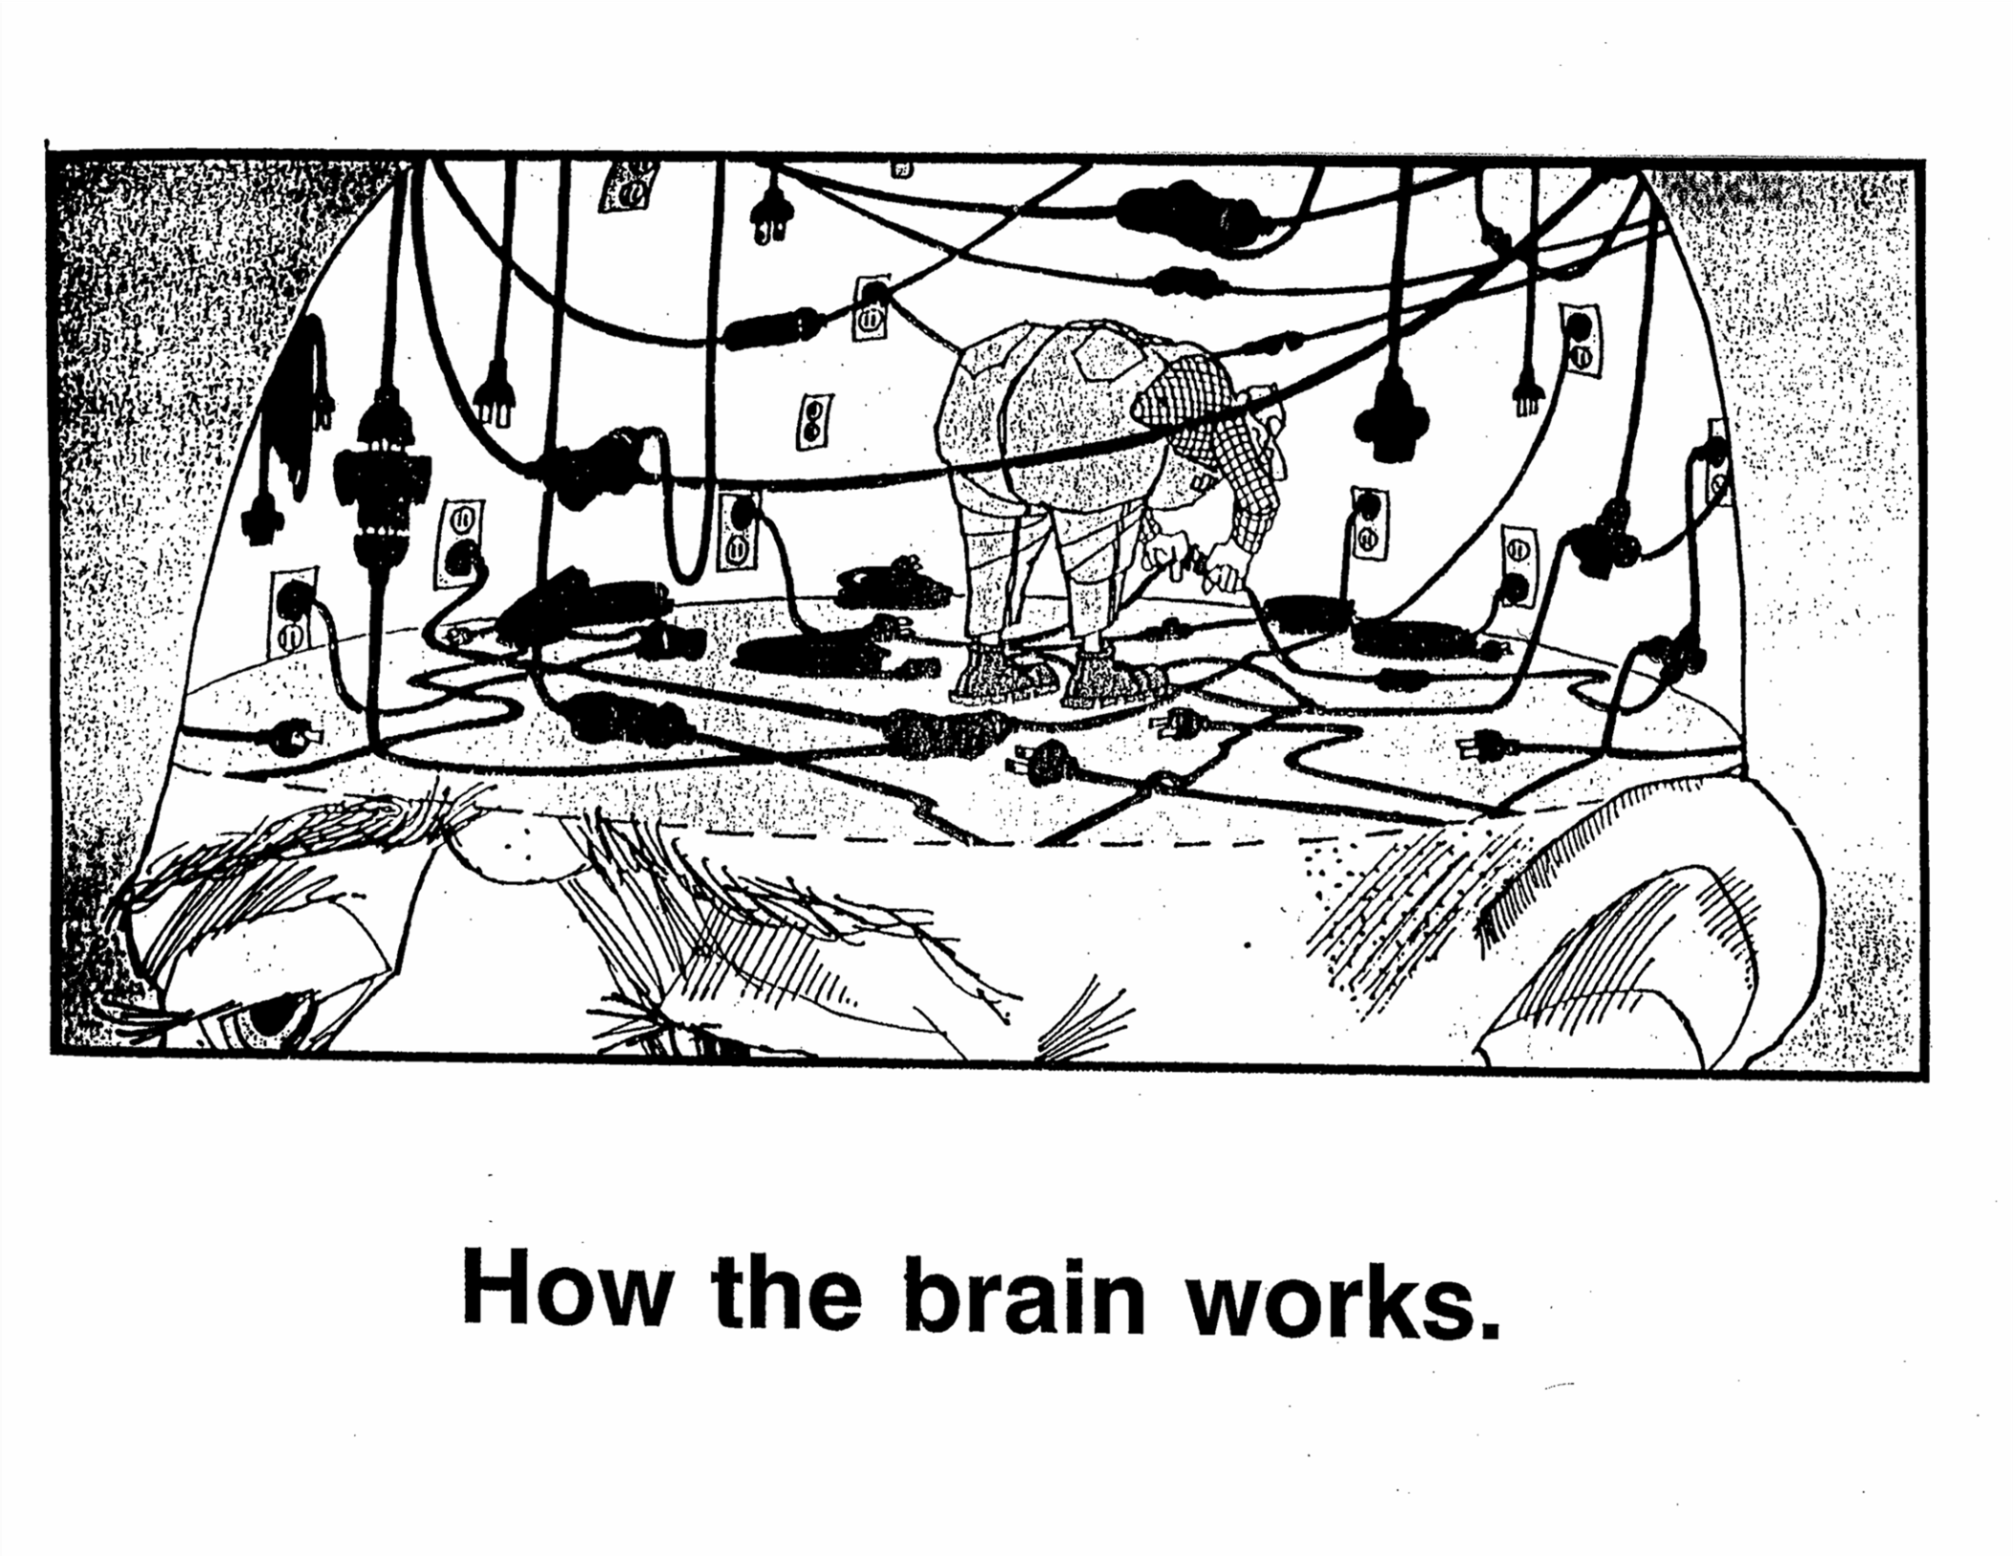
Auditory pathway, parts (1) and (2)
20

Slide 21
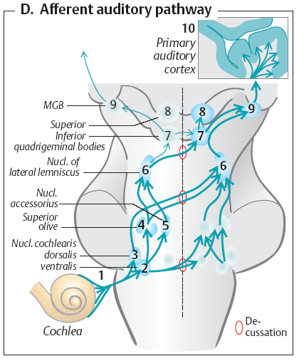
Auditory pathway
Binaural part (2)
Three notes to lateral
symmetry of auditory pathway
>Compared to visual pathway, where left and right parts of visual scene only cross, the auditory pathway is from the third (first binaural) neuron on backed up by the crossings
>Speech centers are laterally
assymetric (due to probable functional purpose)
>Difference between the
left and the right ear is used in sound localization

Slide 22
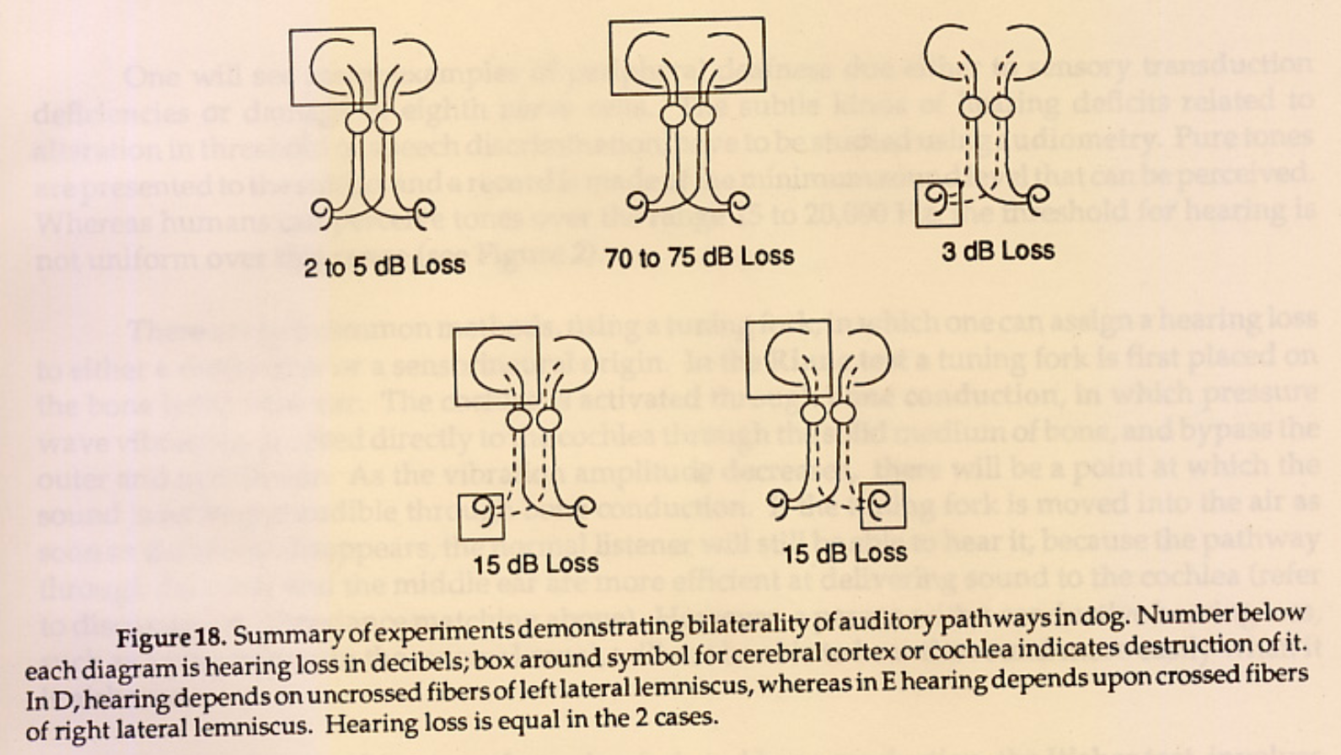

Slide 23
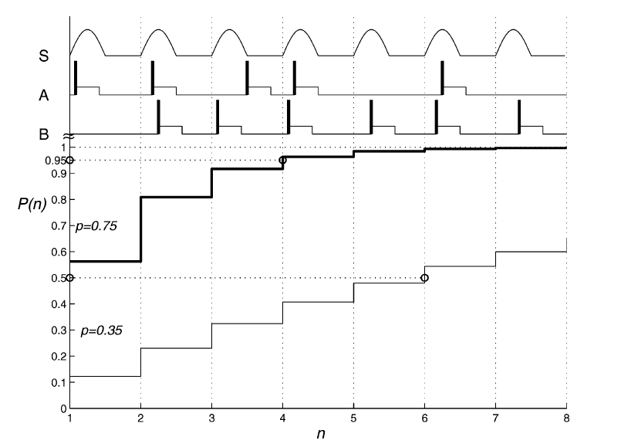
(Coincidence) Detection Probability of Two Spikes Converging on Medial Superior Olive Neuron
[Marsalek, Lansky, Biol Cybern, 2005]

Slide 24
Reaction times
[Toth, Marsalek, Pokora, Biol Cybern, 2018]

Slide 25
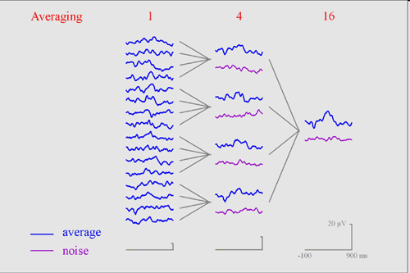
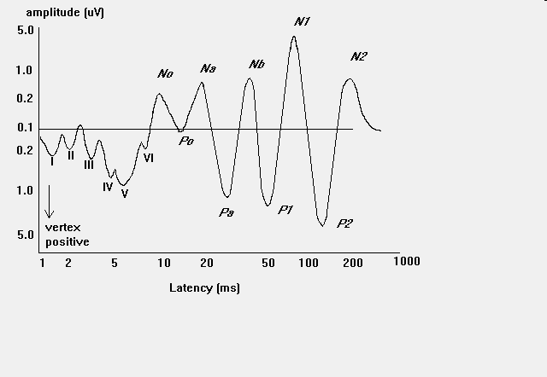
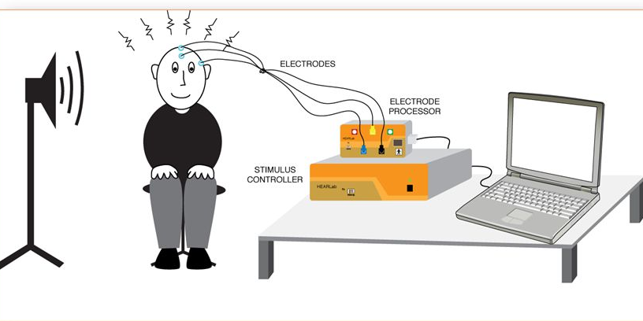
Objective Signal From Lower Auditory Etages Is Recorded As: Evoked Potentials
AEP – auditory EP VEP – visual EP
Repetition rate in
brainstem ER audiometry
Can be of low freq. sound
(40 Hz).
[R. Hari et al, Exp Brain Res, 1980]

Slide 26
Literary references
[Werner, Mountcastle,
J Physiology, 1965],
[Goldberg and Brown,
J Physiology 1969],
[R. Hari et al, Exp Brain Res, 1980]
[C. Koeppl, J Neuroscience, 1997],
[Camalet, Duke, Julicher, Prost, Proc Natl Acad Sci USA, 2000],
[Joris, et al, Hear Res, 2006],
[Koeppl C, Biol Cybern, 1997]
(on vector. strength in barn owl)
etc
our group
[Marsalek, Lansky,
Biol Cybern, 2005],
[Toth, Marsalek, Pokora,
Biol Cybern, 2017]
[Bouse, Vencovsky, Rund, Marsalek, JASA, 2019]
etc

Slide 27
Conclusions
1 Auditory pathway consists of mono-aural and binaural part.
2 Neurons encode signals by trains of action potentials, spike trains.
3 Several sound processing stages are attributed to different nuclei in the auditory pathway.
4 Binaural hearing uses two cues, Interaural Time Difference (ITD) and Interaural Level Difference. ILD (Level) difference is more important.
5 Ultimate processing stage is sound representation in Auditory Cortex.

Slide 28
Summary
Auditory nerve encodes sound in digital format – using trains of action potentials (spike trains) composed from binary (all-or-none) pulses.
Auditory pathway branches into two anatomically and functionally distinct neural pathways: 1 ascending mono-aural pathway and 2 binaural pathway.
Between cochlea and auditory cortex, signal is relayed through circa 10 neuronal relays (we highlight 7 here). Not all of them have known functions.
This (3rd) talk deals with sub-cortical processing, while next (4th) deals with thalamo- cortical, in short cortical processing.
Distinct mono aural nuclei are: 1 spiral ganglion (auditory nerve center), 2_cochlear nuclei, 3 superior olivary complex (MSO, LSO) and 4 lamina quadri-gemina nuclei, one of whose is inferior colliculus.
Then as numbers 5, 5A, 5B, 5C the pathway intertwins through the bundle of lemniscus lateralis to 6 medial geniculate nucleus, which is in fact thalamic nucleus.
Last stage is 7 auditory part of cerebral cortex consisting od several auditory areas, one called primary and the rest is dubbed secondary.
Binaural pathway starts with the 3rd neuron of medial or lateral superior olive.
While it is easy to dissect these pathways into anatomical parts, it is relevant what are functions of these, and they are mostly unknown to date.
Majority of this talk deals with spikes, spikes = action potentials.

Slide 29
END
OF THE LECTURE
Thanks for your attention
Warning: neither the PDF, nor the PPT, PPTX, etc.
versions of this presentation are official study materials.
For internal use only. Do not distribute.
Contacts: (Petr.Marsalek@CVUT.CZ)
Petr.Marsalek@LF1.CUNI.CZ
This Is Proprietary Material of the Czech Technical University

Slide 30
České vysoké učení technické v Praze, Fakulta elektrotechnická Právní doložka (licence) k tomuto Dílu (elektronický materiál) České vysoké učení technické v Praze (dále jen ČVUT) je ve smyslu autorského zákona vykonavatelem majetkových práv k Dílu či držitelem licence k užití Díla. Užívat Dílo smí pouze student nebo zaměstnanec ČVUT (dále jen Uživatel), a to za podmínek dále uvedených.
ČVUT poskytuje podle autorského zákona, v platném znění, oprávnění k užití tohoto Díla pouze Uživateli a pouze ke studijním nebo pedagogickým účelům na ČVUT. Toto Dílo ani jeho část nesmí být dále šířena (elektronicky, tiskově, vizuálně, audiem a jiným způsobem), rozmnožována (elektronicky, tiskově, vizuálně, audiem a jiným způsobem), využívána na školení, a to ani jako doplňkový materiál. Dílo nebo jeho část nesmí být bez souhlasu ČVUT využívána ke komerčním účelům. Uživateli je povoleno ponechat si Dílo i po skončení studia či pedagogické činnosti na ČVUT, výhradně pro vlastní osobní potřebu. Tím není dotčeno právo zákazu výše zmíněného užití Díla bez souhlasu ČVUT. Současně není dovoleno jakýmkoliv způsobem manipulovat s obsahem materiálu, zejména měnit jeho obsah včetně elektronických popisných dat, odstraňovat nebo měnit zabezpečení včetně vodoznaku a odstraňovat nebo měnit tyto licenční podmínky.
V případě, že Uživatel nebo jiná osoba, která drží toto Dílo (Držitel díla), nesouhlasí s touto licencí, nebo je touto licencí vyloučena z užití Díla, je jeho povinností zdržet se užívání Díla a je povinen toto Dílo trvale odstranit včetně veškerých kopií (elektronické, tiskové, vizuální, audio a zhotovených jiným způsobem) z elektronického zařízení a všech záznamových zařízení, na které jej Držitel díla umístil.

Slide 31
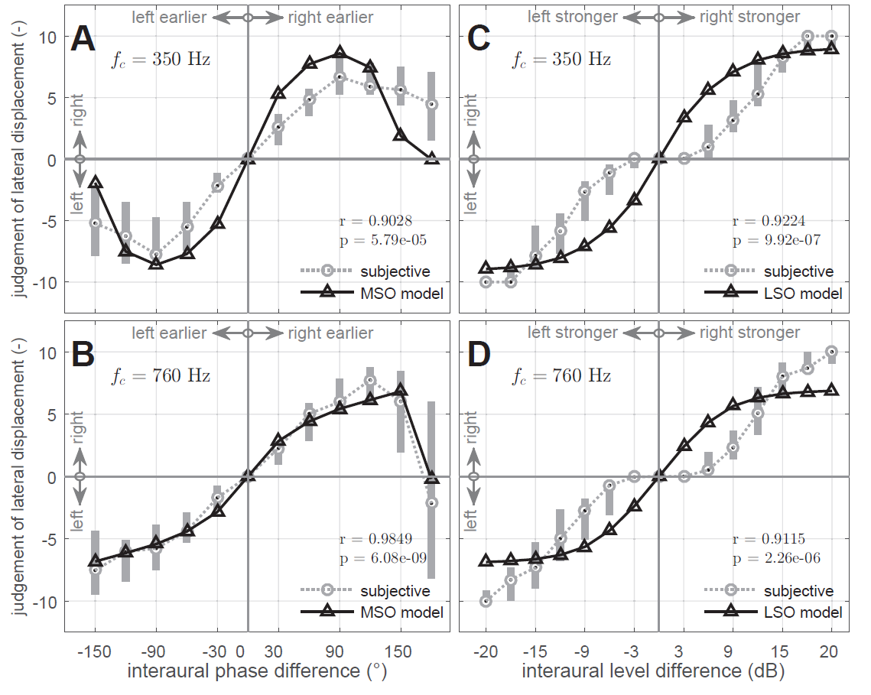
sound azimuth, model and subjective response
[Bouse, Vencovsky, Rund, Marsalek, JASA, 2019]

Slide 32
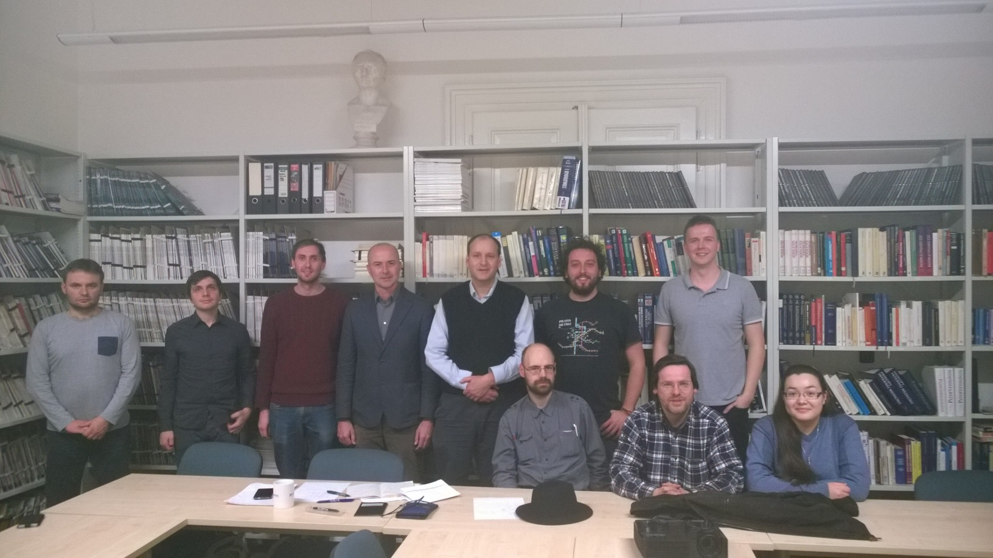
Group: Audiology, Acoustics and Computational
Neuroscience, CTU and 1stMF CUni (year 2015)

